Slide 1
SPEC 2017 results

Slide 2
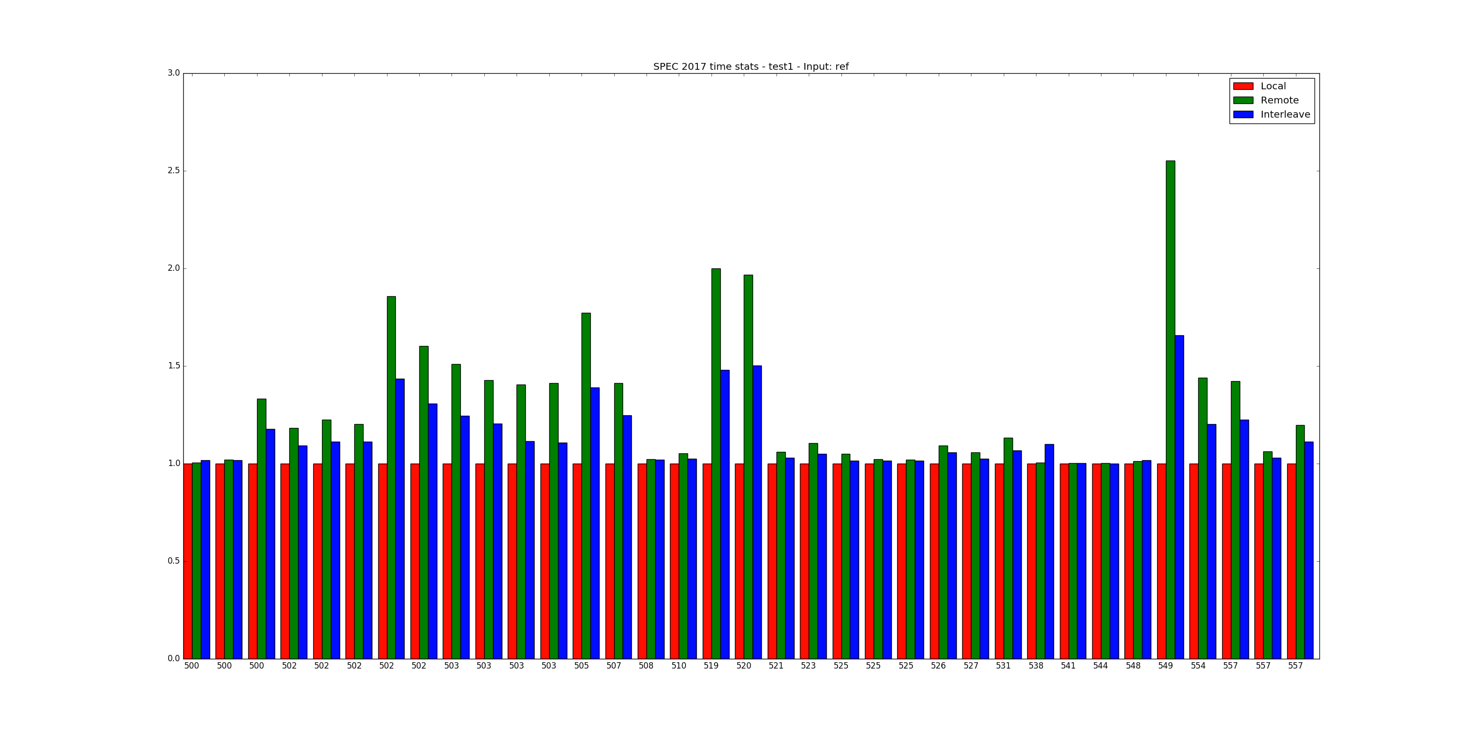
Basecase scanario (Test 1)
500 series

Slide 3
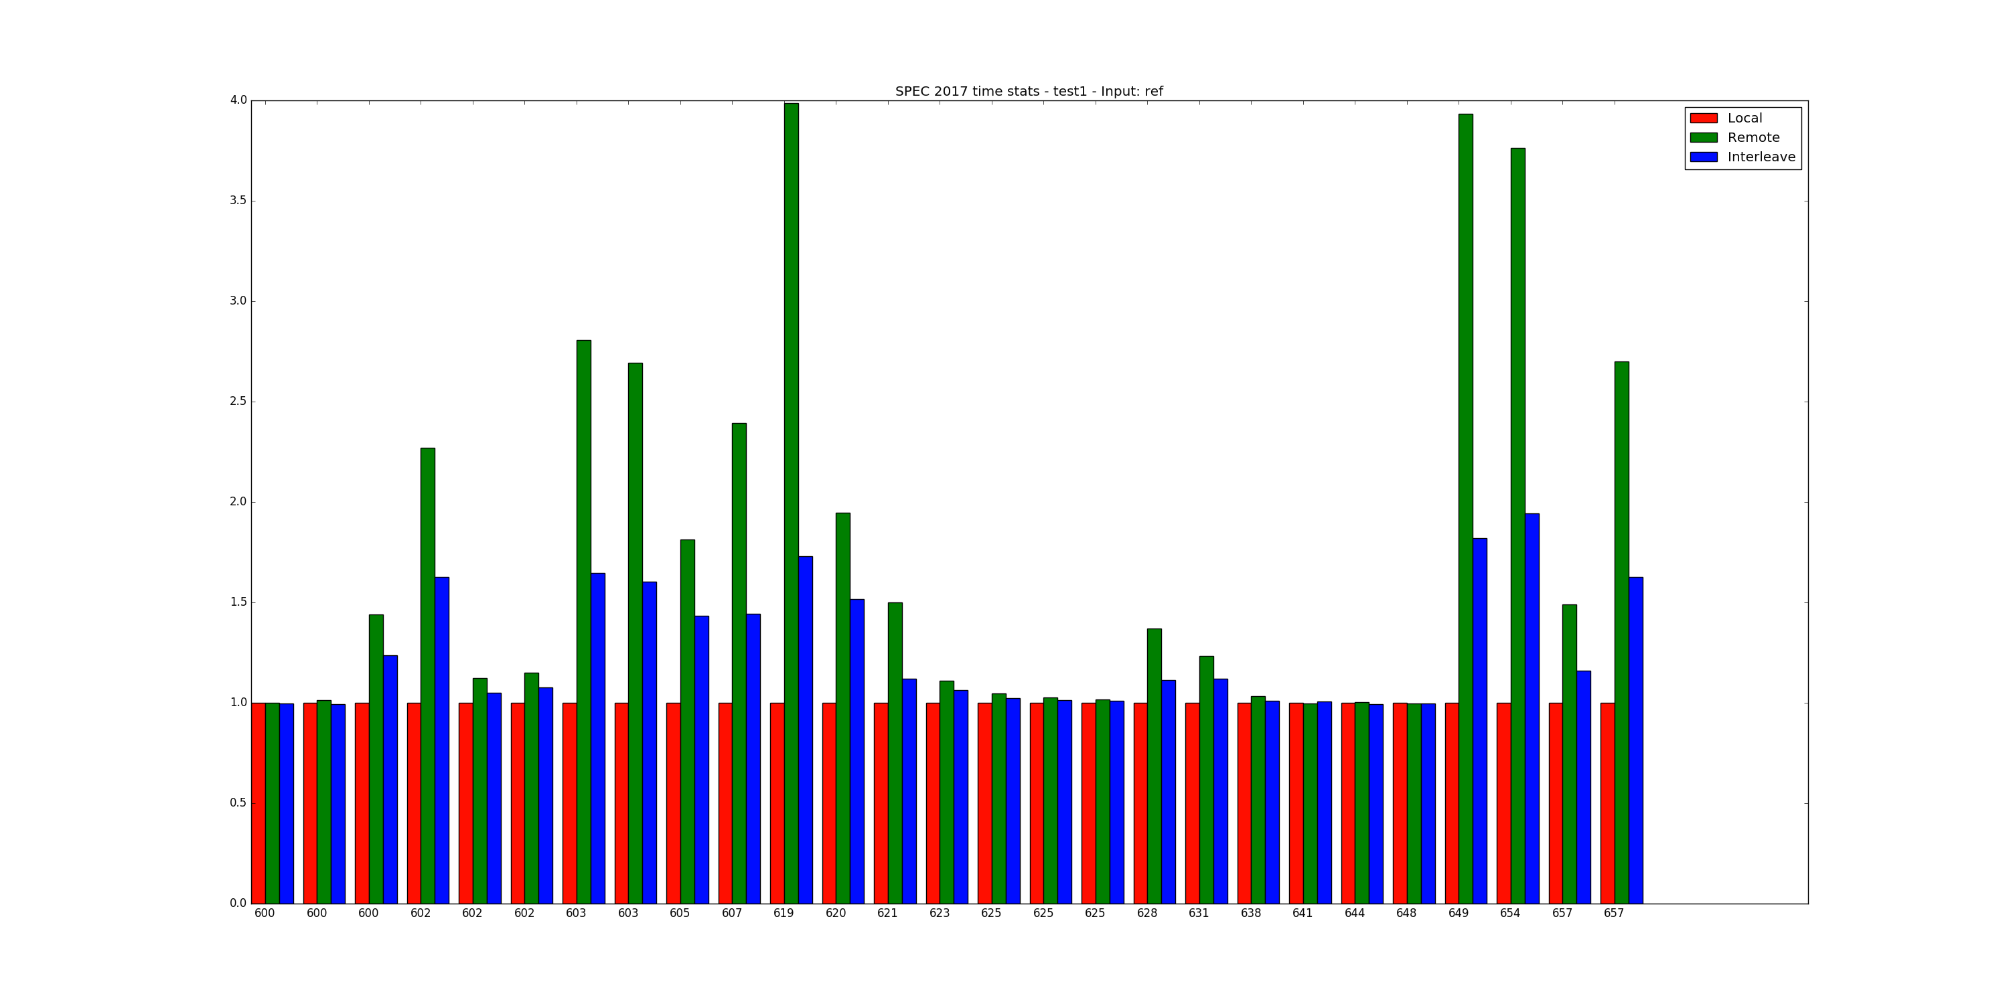
600 series

Slide 4
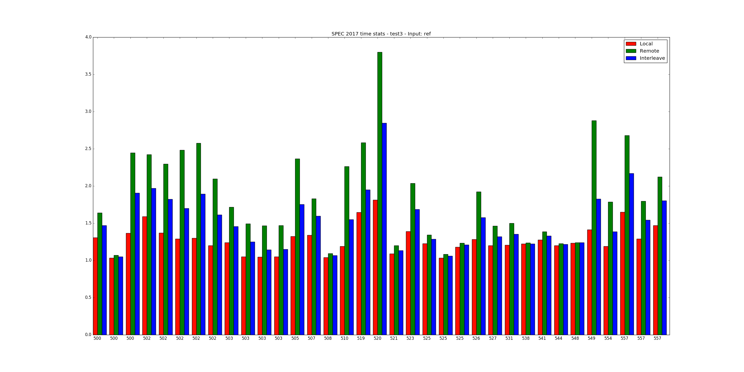
1 Stress in -N 0 -M 0 mode (Test 3)
Results in relation to test 1 500s

Slide 5
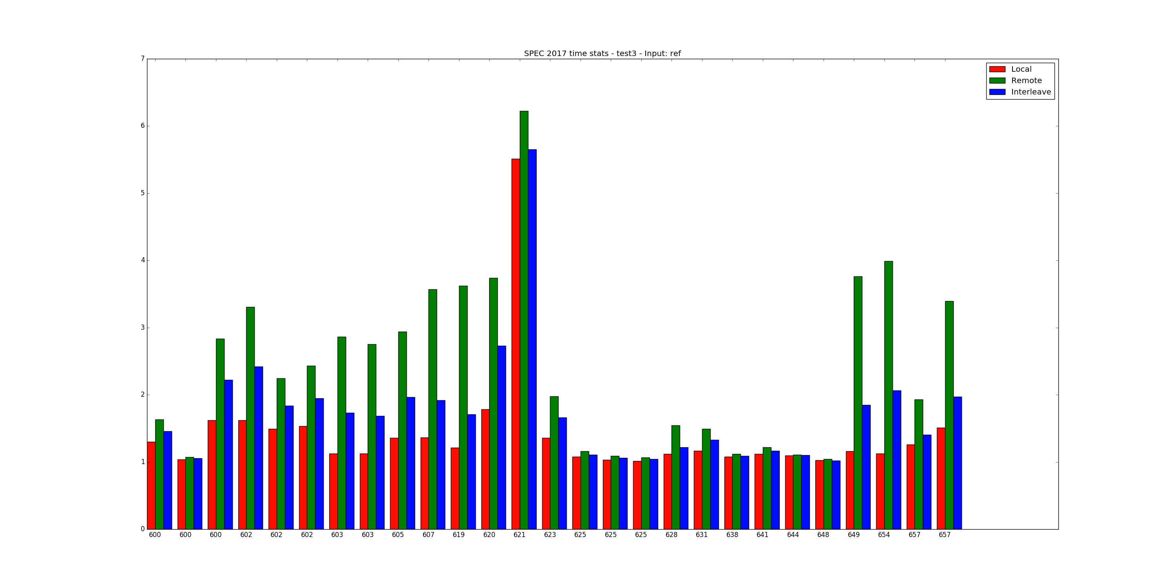
600s

Slide 6
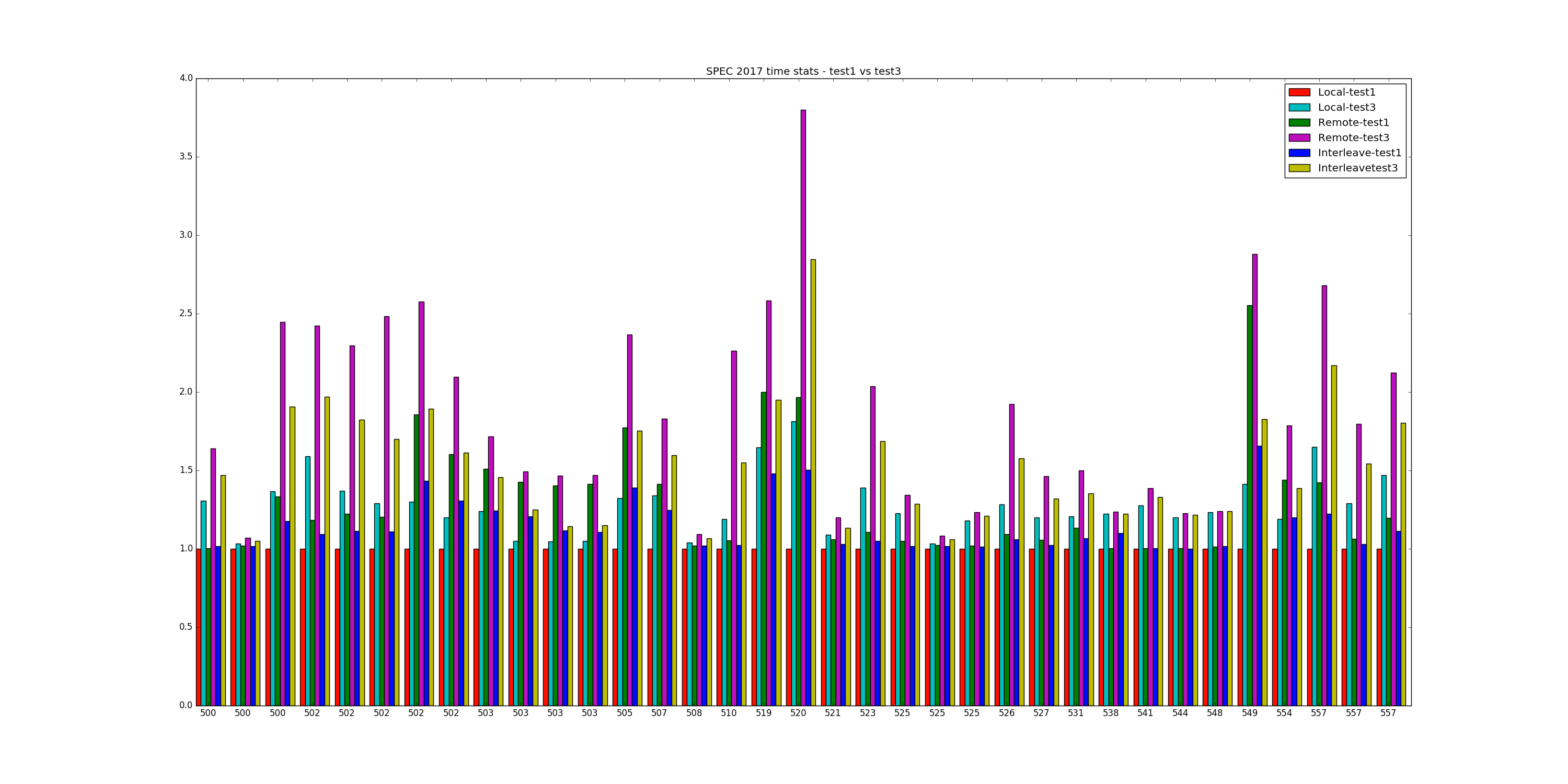
Test 3 vs Test 1 performance
500s

Slide 7
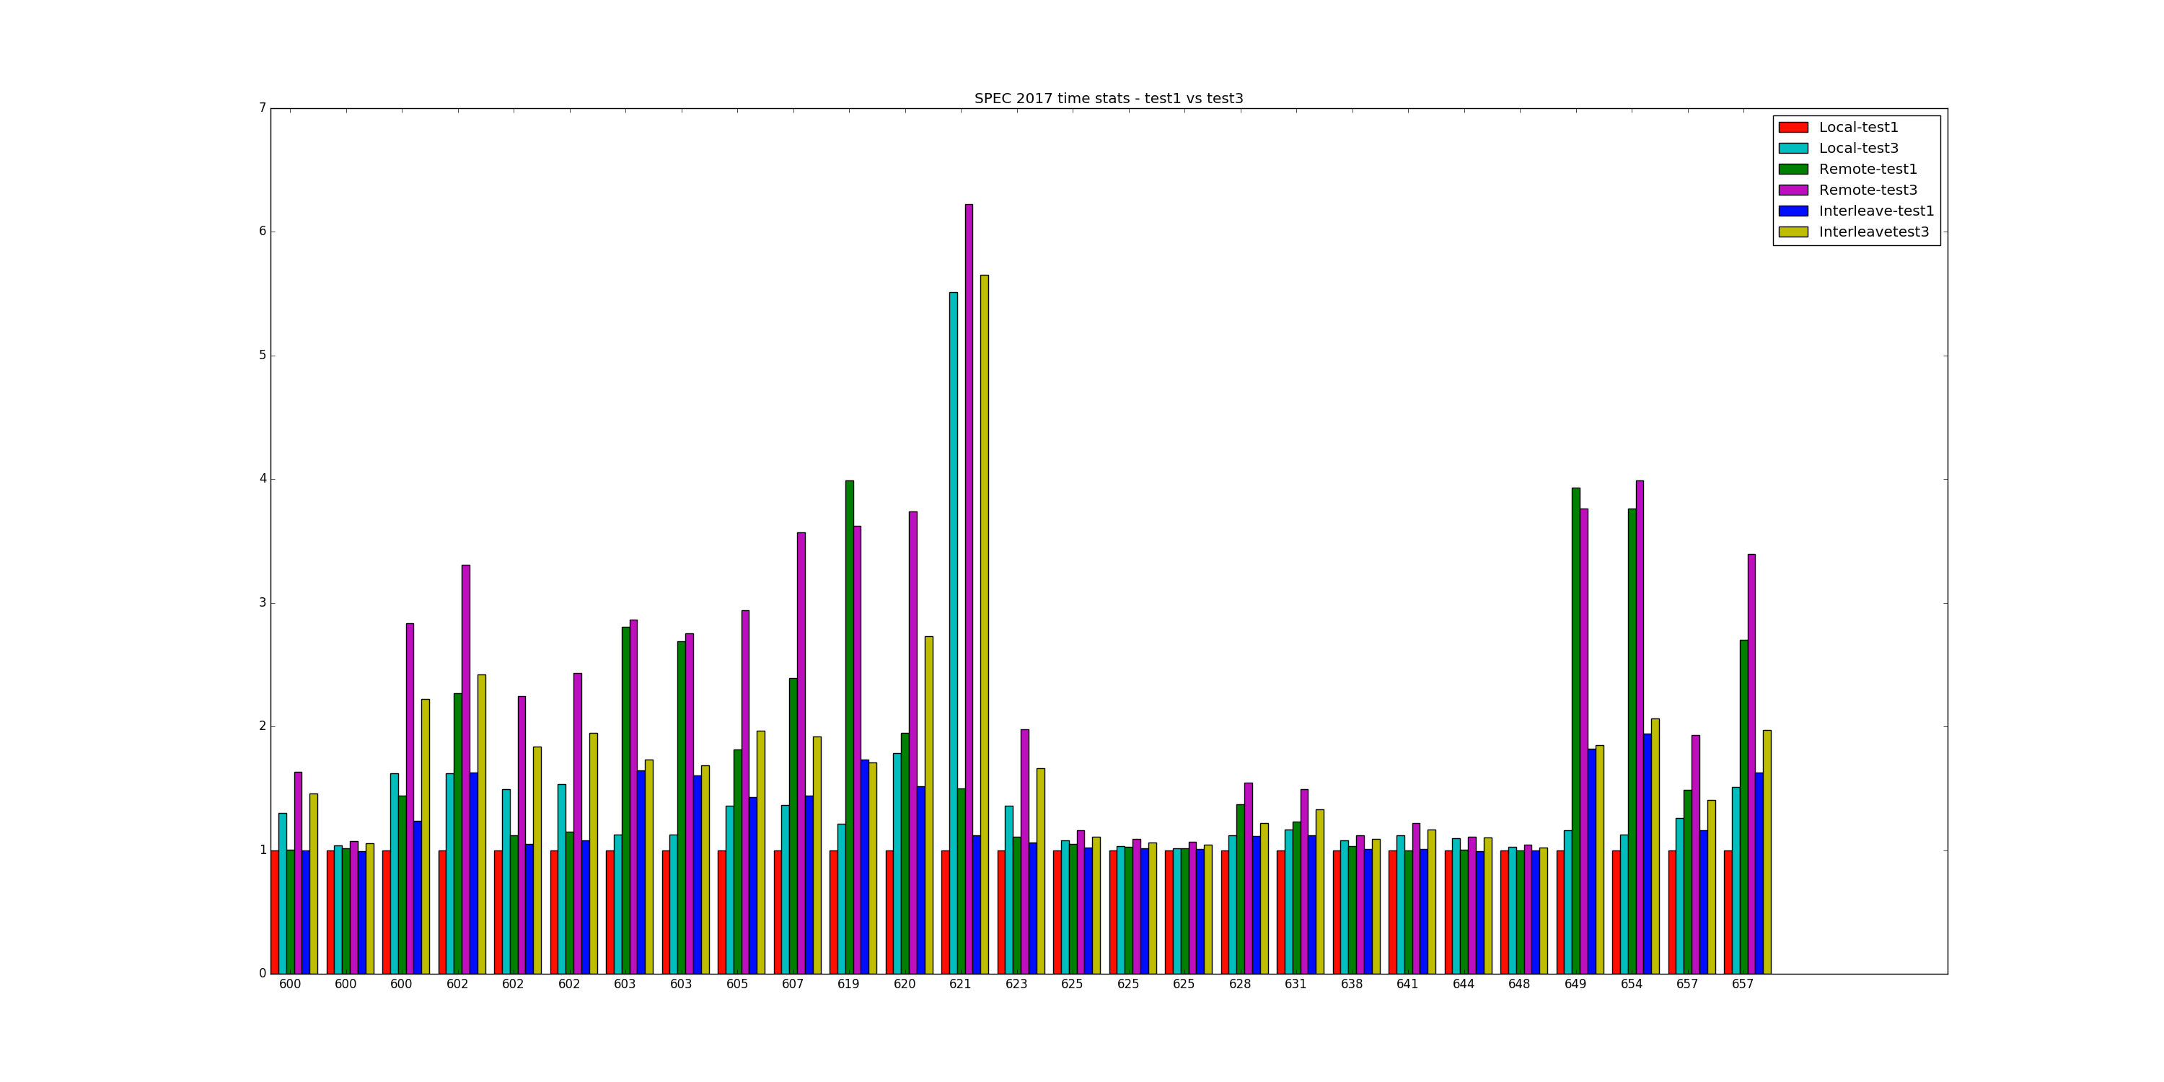
600s

Slide 8
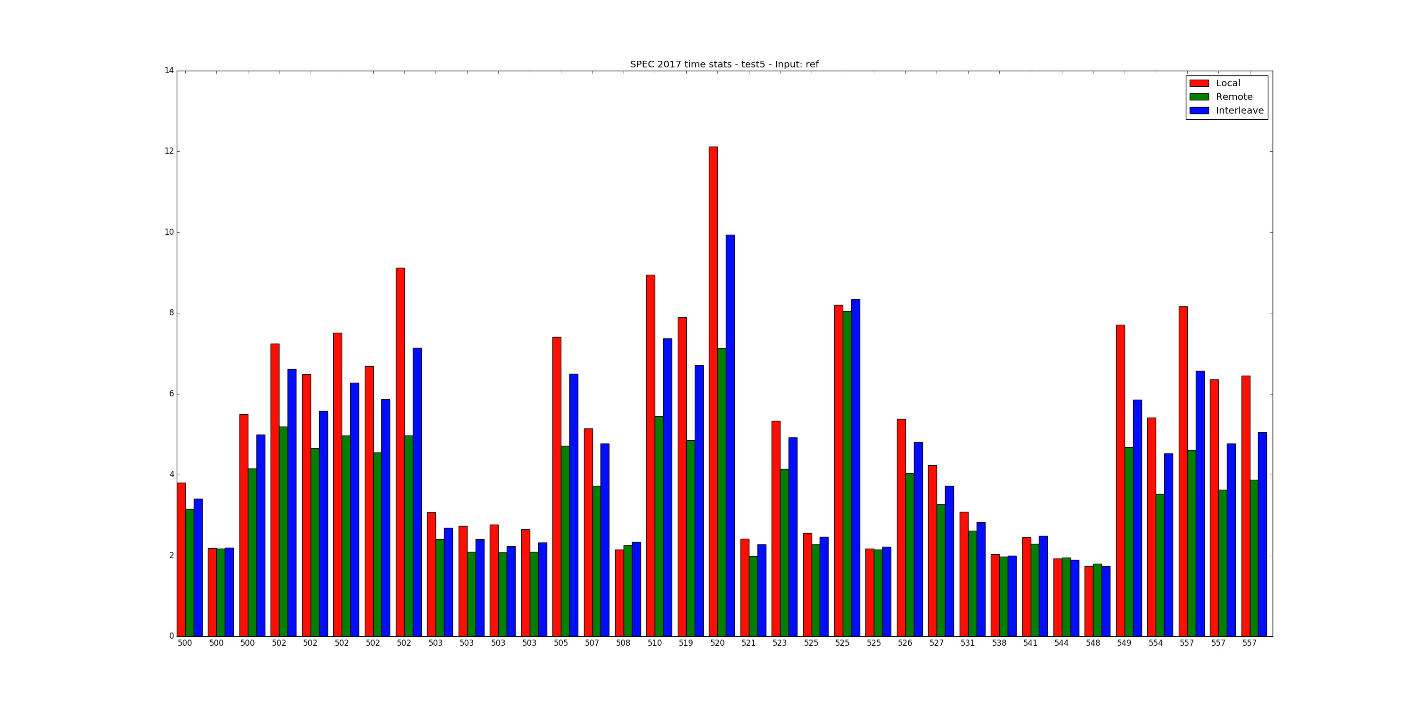
10 Stress in -N 0 -M 0 mode (Test 5)
Results in relation to Test 1 500s

Slide 9
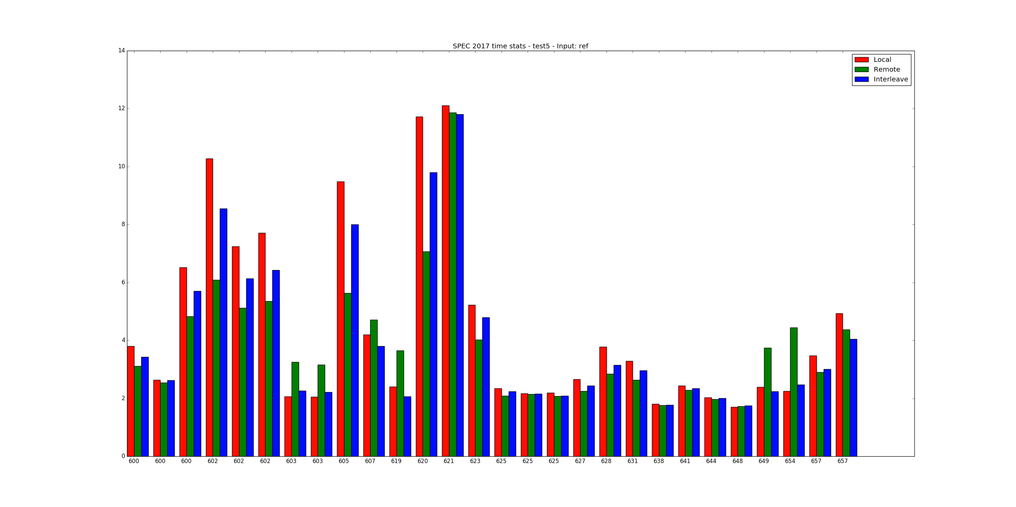
600s

Slide 10
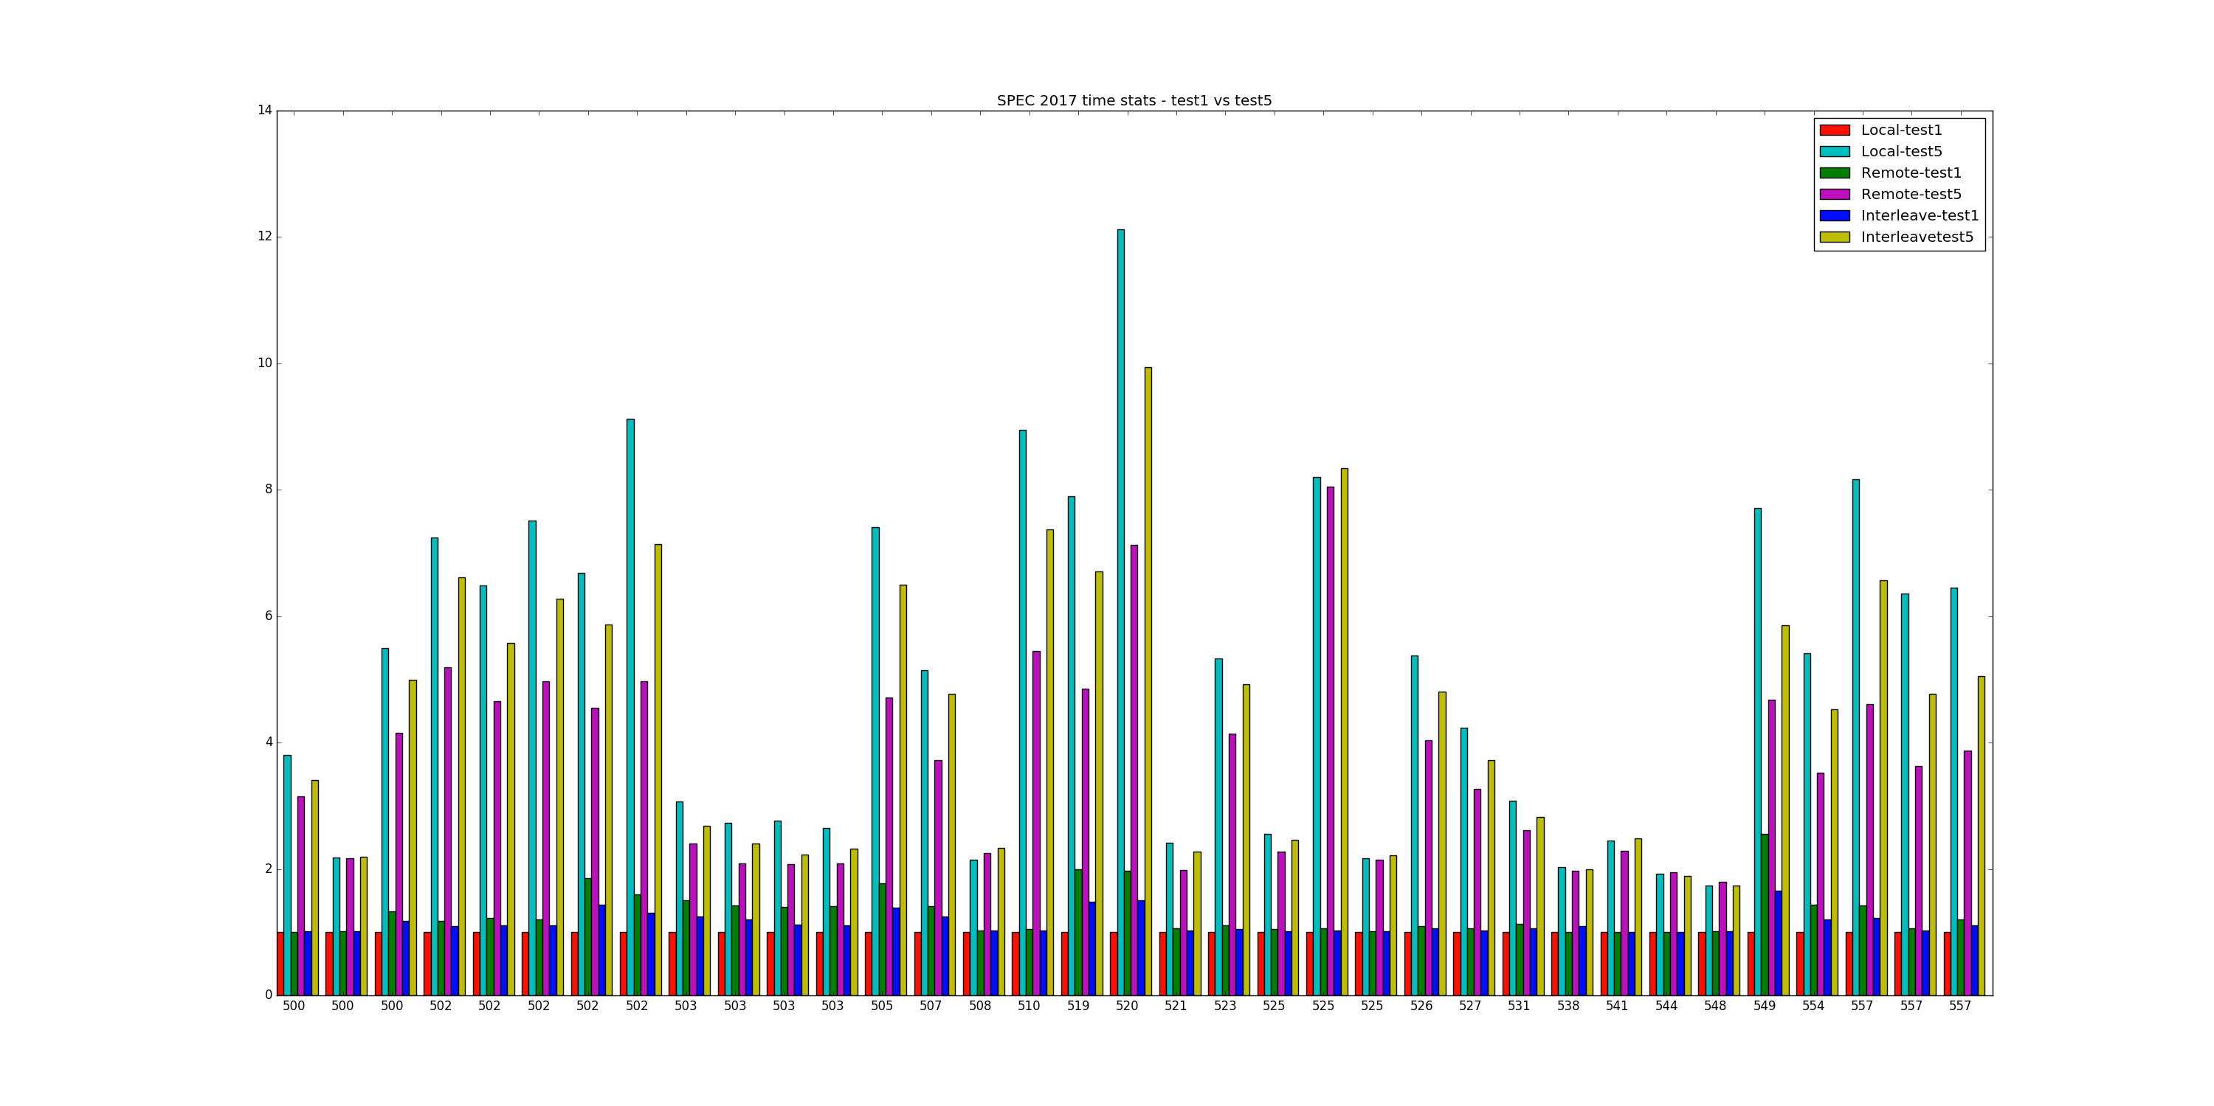
Test 5 vs Test 1 performance
500s

Slide 11
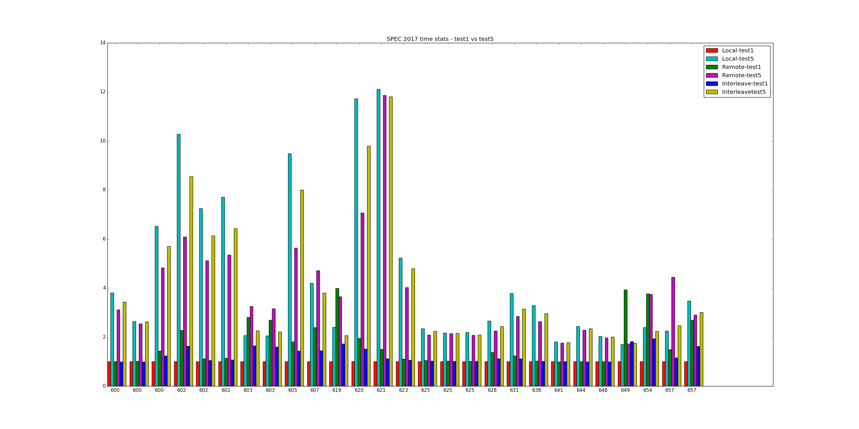
600s

Slide 12
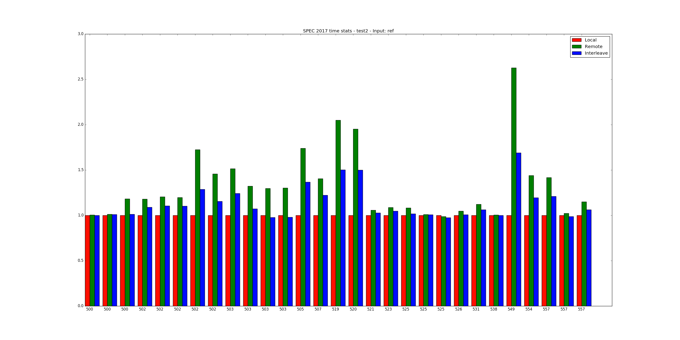
1 Stress in -N 1 -M 1 mode (Test 2)
Results in relation to Test 1 500s

Slide 13
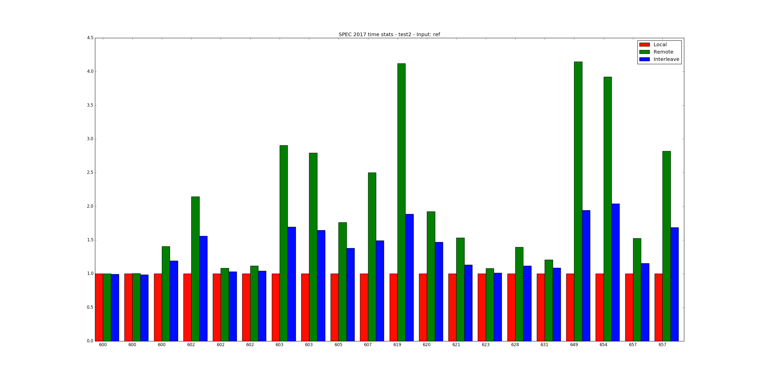
600s

Slide 14
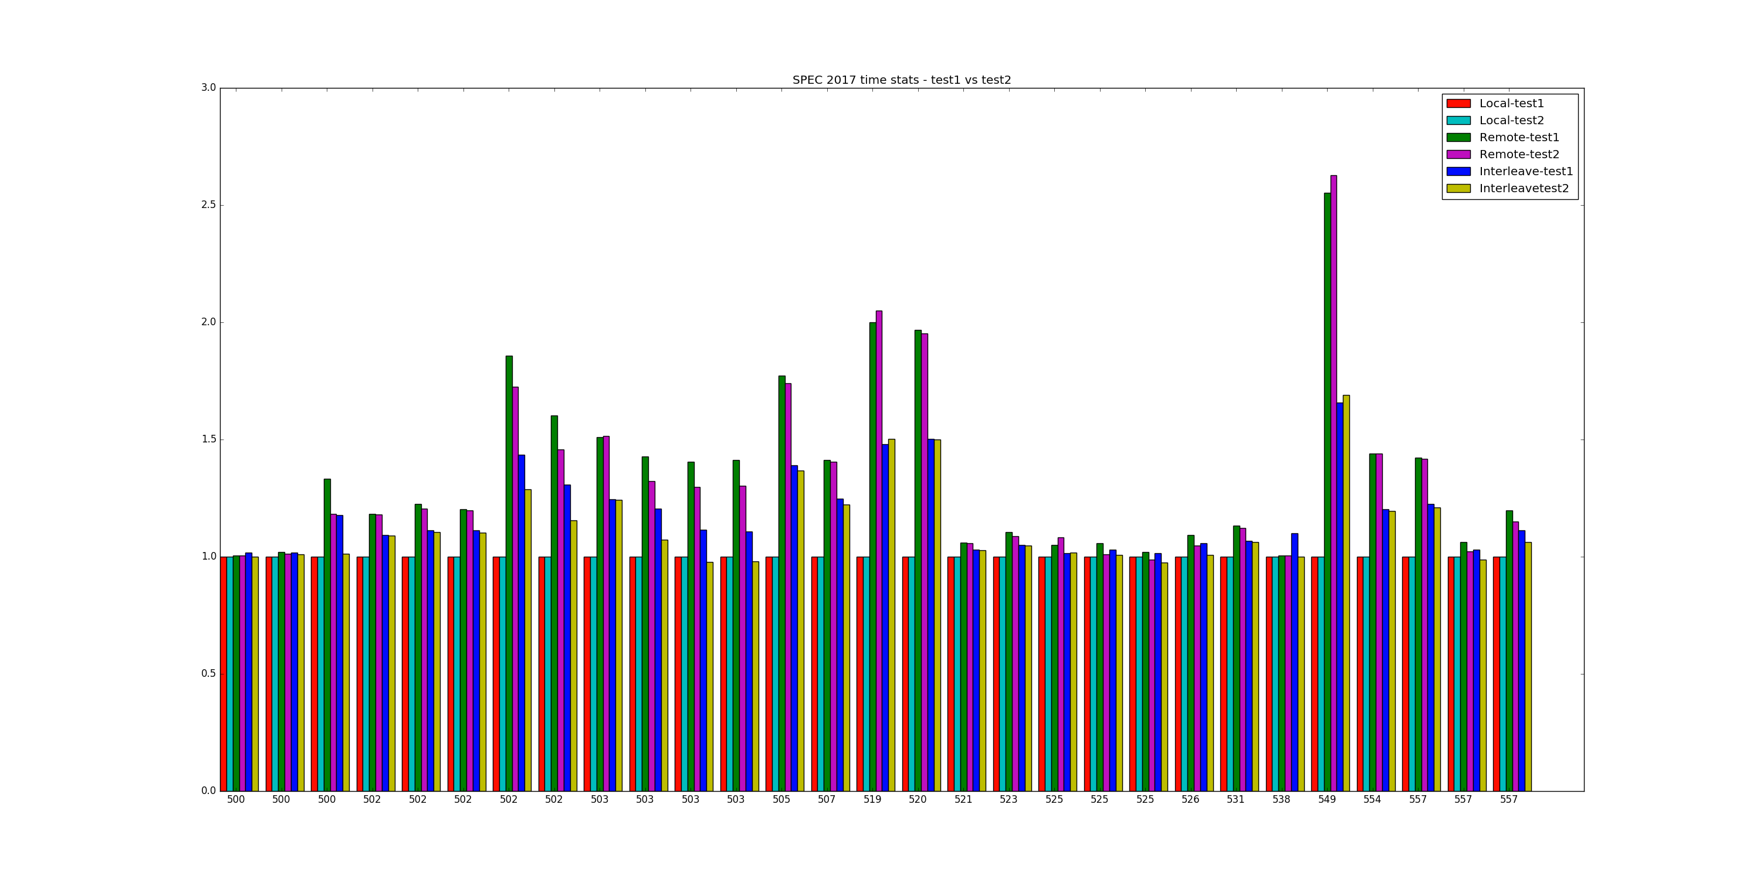
Test 2 vs Test 1 performance 500s

Slide 15
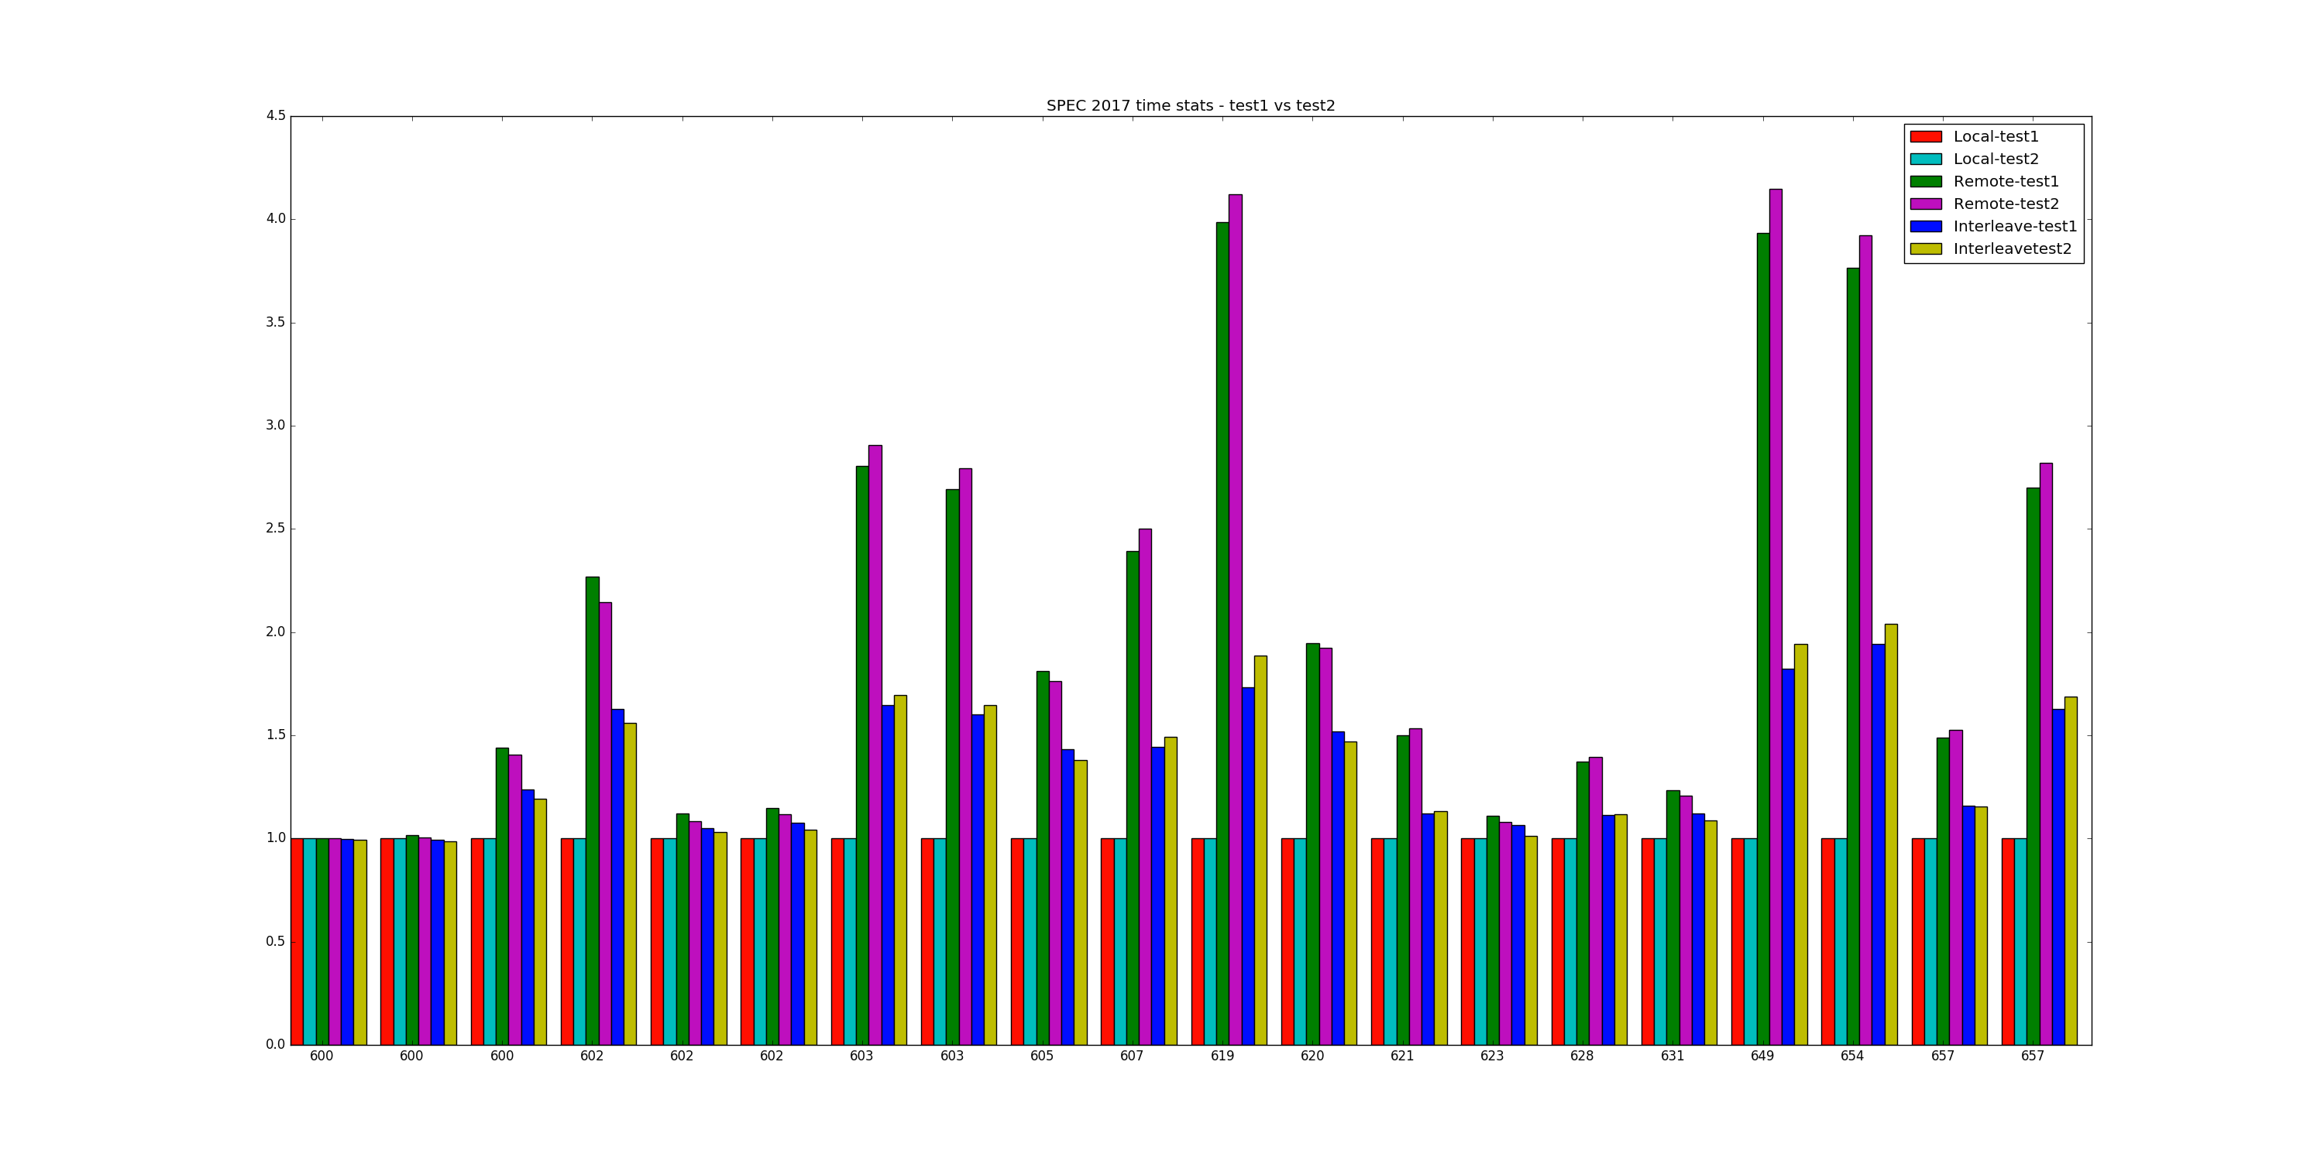
600s

Slide 16
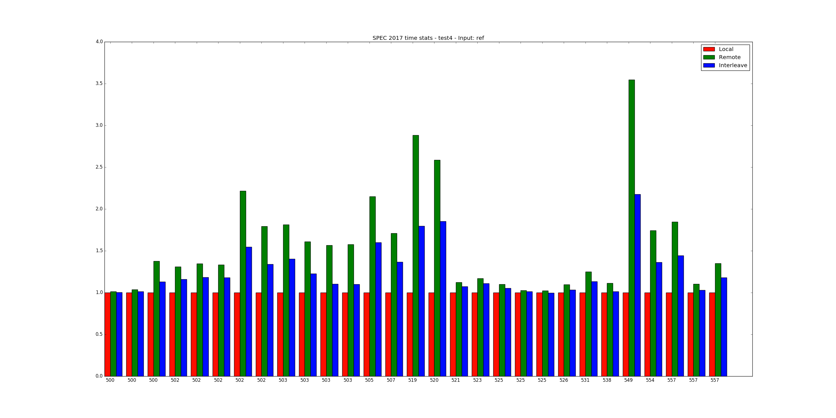
10 Stress in -N 1 -M 1 mode (Test 4)
Results in relation to Test 1 500s

Slide 17
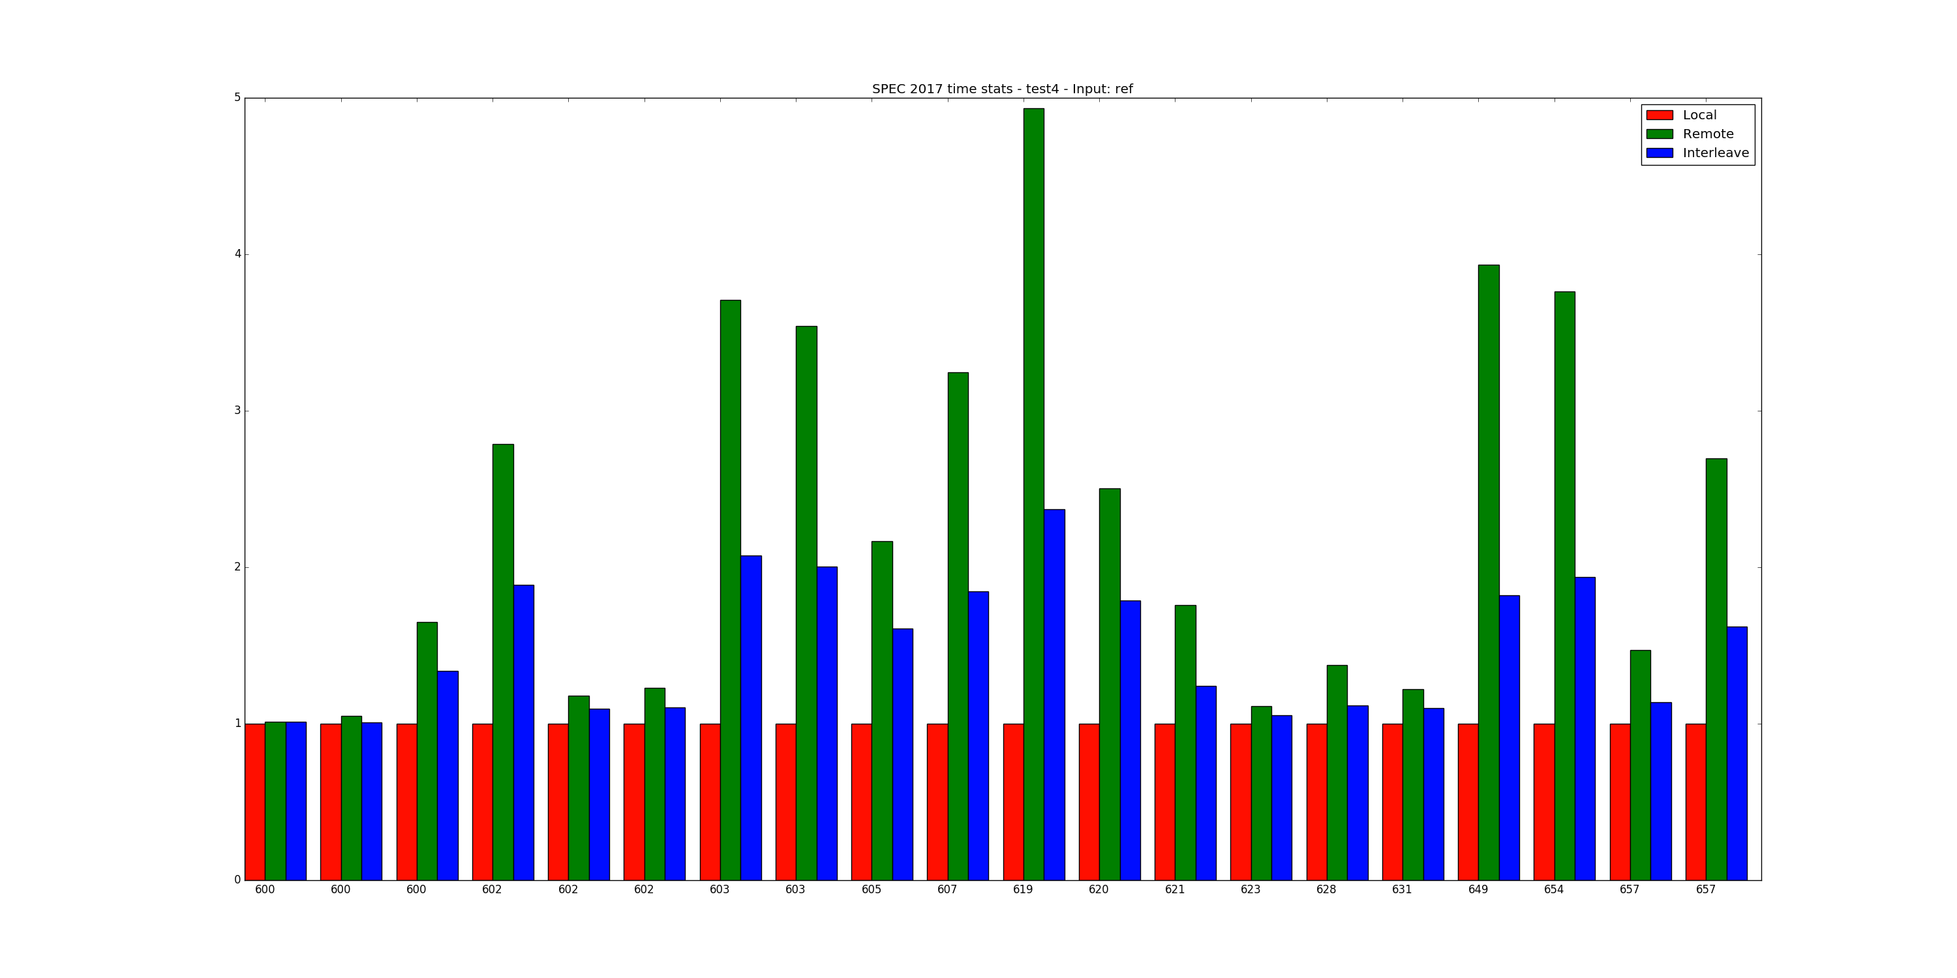
600s

Slide 18
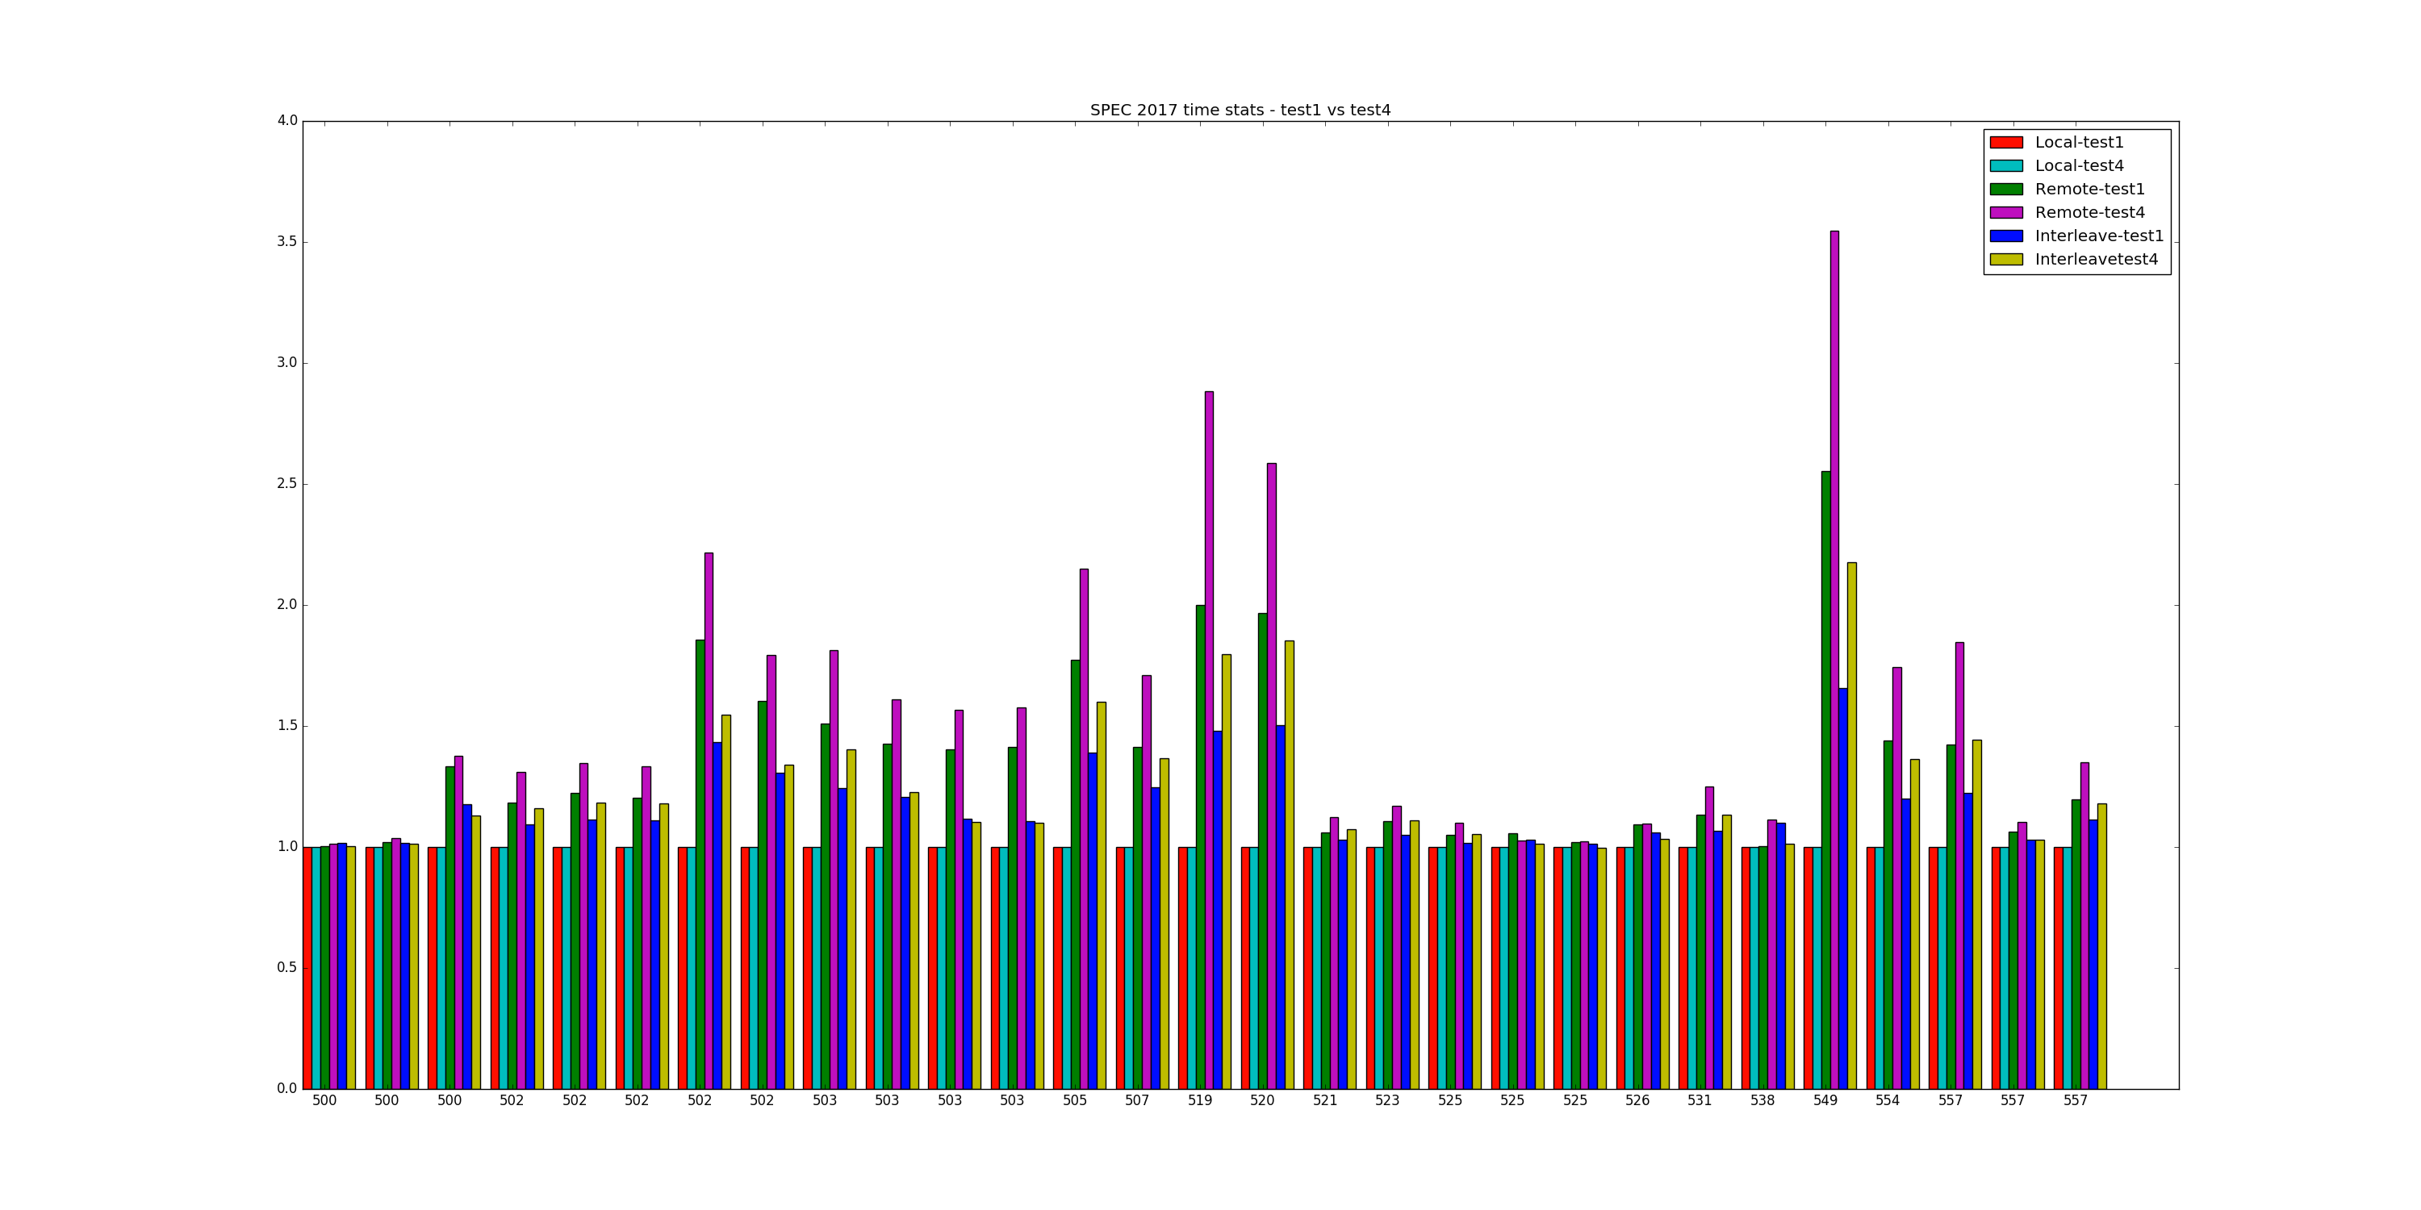
Test 4 vs Test 1 performance 500s

Slide 19
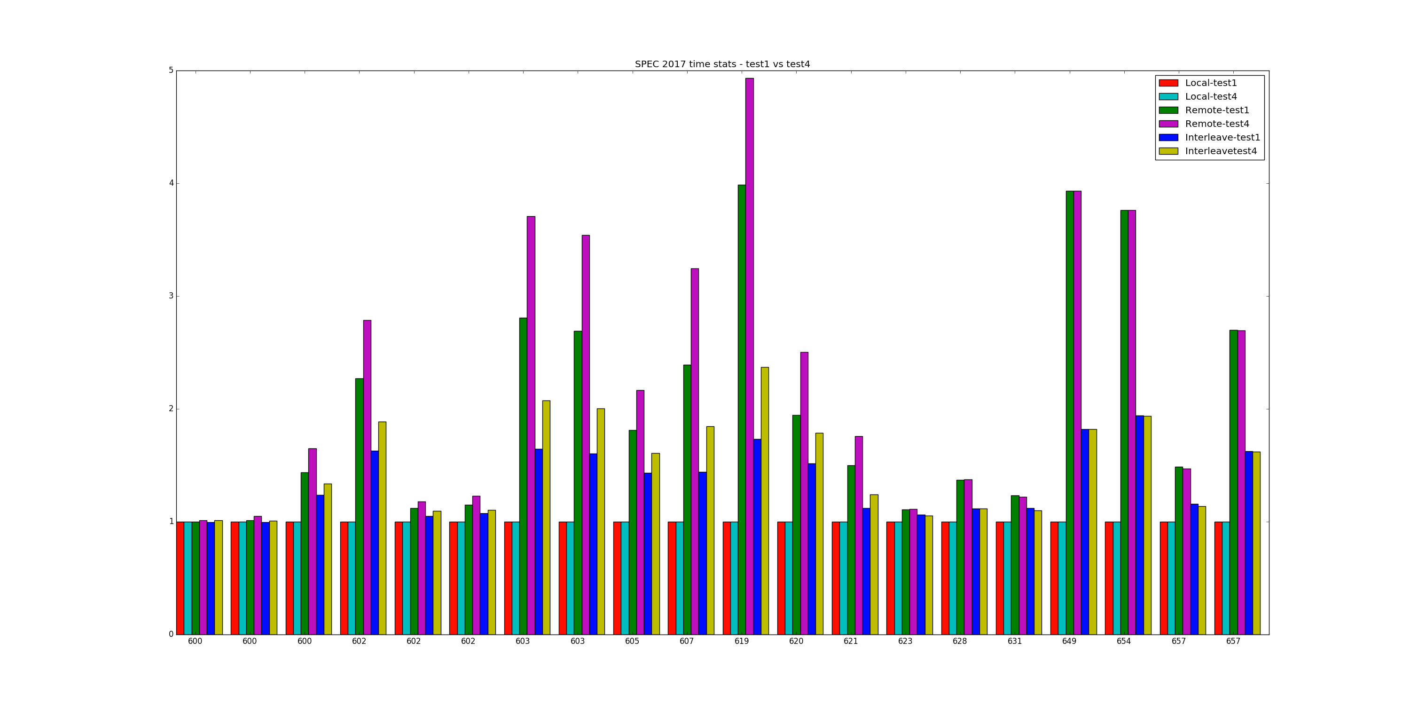
600s

