Slide 1




MORNING REGISTRATION ACTIVITIES
Team Challenges
VOLUME ONE
Five challenges for teams of four or five. Describe and Draw is done in pairs.
Get into teams
Do the challenge
Talk about it
Four or five to a team, sitting together, with the chairs turned in.
Each challenge runs from its own slides. Follow them in order.
Every challenge ends with a question for the whole form to talk about.
The Pastoral Guide
1 / 35

Slide 2





TEAM CHALLENGES · VOLUME ONE
The five challenges
ONE
TWO
THREE
FOUR
FIVE
Lost
at Sea
Paper
Tower
Split
Clues
Describe
and Draw
Silent
Line-Up
Every one of them ends by asking what the best team,
or the best pair, actually did.
The Pastoral Guide
2 / 35

Slide 3
CHALLENGE 1 OF 5
Lost at Sea
Rank ten things by how much they would help you survive at sea, first on your own and then as a team.
The Pastoral Guide
3 / 35

Slide 4
LOST AT SEA · THE STORY
Your sailing boat has sunk. Everyone is in the life raft, which has no roof, no engine and no oars. It is cold, land is days away, and nobody knows where you are.
The raft holds the ten things below. Number them from 1, the most useful for getting home safely, to 10, the least useful.
A
A large plastic sheet
F
A map of the ocean
B
A pack of cards
G
Three distress flares
C
Dry, warm clothes for everyone
H
A torch
D
A bar of chocolate each
I
A fishing line and hooks
E
A small mirror
J
Ten litres of drinking water
The Pastoral Guide
4 / 35

Slide 5
LOST AT SEA · STEP ONE
ON YOUR OWN
Your own answer first
Rank all ten
1
1 is the most useful and 10 the least. Use every number once.
Write them in the Me column
2
Write your numbers on your sheet, beside each letter.
No talking yet
3
This is your answer, before you hear anybody else’s.
The Pastoral Guide
5 / 35

Slide 6
LOST AT SEA · STEP TWO
AS A TEAM
Now agree one order
Talk it through
1
Keep going until the whole team can live with the order.
Write it in the Team column
2
Leave your own column as it is.
No voting
3
Try to get there by talking, not by counting hands.
The Pastoral Guide
6 / 35

Slide 7
LOST AT SEA · THE ANSWER
The answer, 1 to 5
1
Dry, warm clothes for everyone (C)
Cold is the biggest danger at sea, so keeping warm comes first.
2
Three distress flares (G)
Fire one straight away. Keep the other two for when you can see a boat or a plane.
3
A small mirror (E)
On a sunny day its flash can be seen from miles away, and it never runs out.
4
Ten litres of drinking water (J)
People can last weeks without food, but only a few days without water.
5
A large plastic sheet (A)
It catches rainwater to drink, and keeps off the spray and the wind.
The Pastoral Guide
7 / 35

Slide 8
LOST AT SEA · THE ANSWER
The answer, 6 to 10
6
A torch (H)
For signalling at night. Save the battery until you can see or hear something.
7
A bar of chocolate each (D)
Food keeps spirits up, but only eat when there is water to drink, because digesting food uses water.
8
A fishing line and hooks (I)
Fish is food, but digesting it takes a lot of water, so it only helps once water is sorted.
9
A pack of cards (B)
Keeping busy and keeping everyone’s spirits up really does help people survive.
10
A map of the ocean (F)
With no engine or oars you cannot go anywhere, so knowing where you are helps very little.
The Pastoral Guide
8 / 35

Slide 9
LOST AT SEA · SCORE IT
Work out your scores
Copy the answer, then find the gap
1
Copy each answer into The Answer column. Your gap is the difference: a 3 against a 7 is a gap of 4.
Add up both gap columns
2
Add up My Gap, then Team Gap. The lower the score, the better.
Compare
3
Hands up if the team scored lower than you did on your own.
The Pastoral Guide
9 / 35

Slide 10
LOST AT SEA · TALK ABOUT IT
What did the team that did best
actually do?
THEN ASK
Did the team’s score beat most of the scores people got on their own?
Who changed the team’s mind about something, and how did they do it?
Did anybody have it right at first, but then give way to the team?
The Pastoral Guide
10 / 35

Slide 11
CHALLENGE 2 OF 5
Paper Tower
Build the tallest tower you can from ten sheets of paper, with nothing to stick it together.
The Pastoral Guide
11 / 35

Slide 12
PAPER TOWER · THE RULES
Tallest tower wins
Ten sheets per team
1
Every team gets ten sheets of paper. No tape, no glue and no scissors.
Fold, roll or tear
2
You can do anything to the paper, but you cannot fix it to the table or the wall.
Ten seconds
3
At the end it has to stand on its own for ten seconds. The tallest one wins.
The Pastoral Guide
12 / 35

Slide 13
PAPER TOWER
PLAN
Two minutes to plan
Talk about how you will build it. Nobody touches the paper yet.
The Pastoral Guide
13 / 35

Slide 14
PAPER TOWER
BUILD
Eight minutes to build
When the time is up, your tower has to stand on its own for ten seconds.
The Pastoral Guide
14 / 35

Slide 15
PAPER TOWER
MEASURE
Hands off
Everybody steps back. Count to ten out loud together, then the towers still standing get measured.
The Pastoral Guide
15 / 35

Slide 16
PAPER TOWER · TALK ABOUT IT
What did the team that did best
actually do?
THEN ASK
Why did the tallest tower stay up when others fell?
Did your team use the planning time, or start building as soon as it could?
Whose idea did the team end up using, and did the team listen to it the first time?
The Pastoral Guide
16 / 35

Slide 17
CHALLENGE 3 OF 5
Split Clues
Solve a puzzle together when the clues are shared out and nobody can see anyone else’s.
The Pastoral Guide
17 / 35

Slide 18
SPLIT CLUES · THE RULES
Everyone holds a clue
Share out the cards
1
Deal out the eight clue cards so that everybody has one or two.
Say it, never show it
2
You can read your clue out as often as you like, but nobody else can see it.
Solve it together
3
Work out who lost what, and on which day. Use the grid on your sheet to keep track.
The Pastoral Guide
18 / 35

Slide 19
SPLIT CLUES · THE PUZZLE
The lost property box
Last week, four students each lost one thing, on a different day from Monday to Thursday. The students were Amira, Ben, Chloe and Dev. The four things were a scarf, a water bottle, a PE bag and a pencil case.
Who lost what, and on which day?
Every one of the eight clues is needed. When your team thinks it has the answer, put your hands up and your teacher will check it.
The Pastoral Guide
19 / 35

Slide 20
SPLIT CLUES · THE ANSWER
Who lost what
MONDAY
Amira lost the PE bag.
TUESDAY
Dev lost the scarf.
WEDNESDAY
Chloe lost the water bottle.
THURSDAY
Ben lost the pencil case.
The Pastoral Guide
20 / 35

Slide 21
SPLIT CLUES · TALK ABOUT IT
What did the team that did best
actually do?
THEN ASK
Did every clue get heard, or was somebody’s clue missed at first?
Who wrote things down, and did it help the rest of the team?
If you had a new set of clues tomorrow, what would you do first?
The Pastoral Guide
21 / 35

Slide 22
CHALLENGE 4 OF 5
Describe and Draw
One of you describes a picture and the other draws it without seeing it.
The Pastoral Guide
22 / 35

Slide 23
DESCRIBE AND DRAW · SET UP
Get into pairs
Facing the board
1
The describer faces the board and describes the picture on it.
Back to the board
2
The drawer sits with their back to the board, with a pen and a sheet of paper.
Drawers: turn your chair round now, before the picture goes up. If there are three of you, two draw and one describes.
The Pastoral Guide
23 / 35

Slide 24
DESCRIBE AND DRAW · ROUND ONE
Round one: no questions
Describer
1
Say what you see. No pointing, and no drawing shapes in the air.
Drawer
2
Draw what you hear, without asking questions or talking.
When the picture goes up, you have three minutes.
The Pastoral Guide
24 / 35

Slide 25
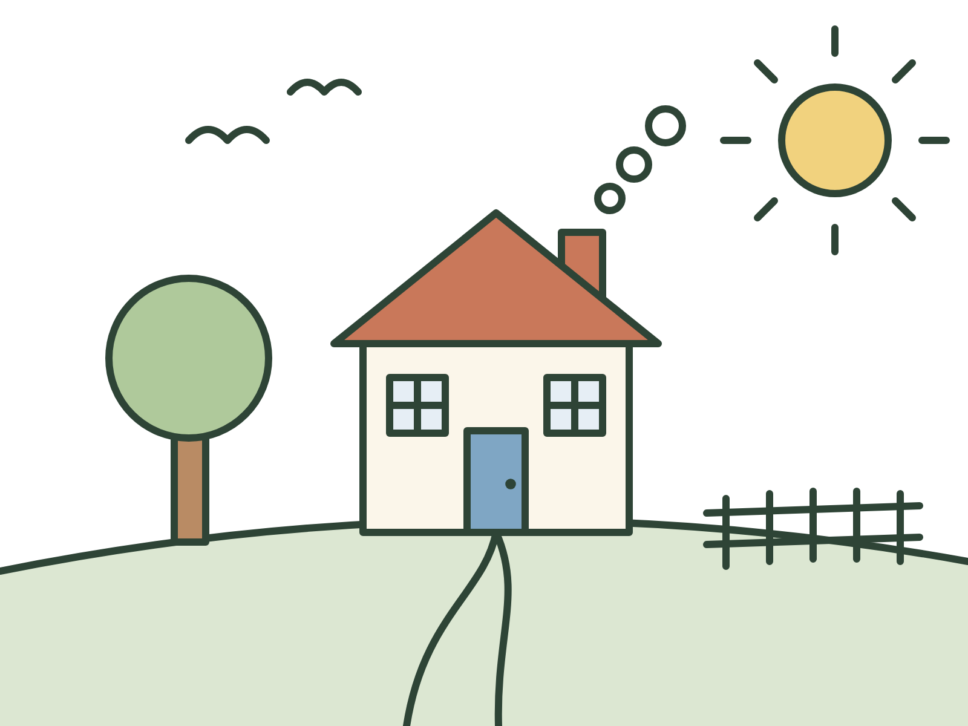
ROUND ONE · DESCRIBERS ONLY
The Pastoral Guide
25 / 35

Slide 26
DESCRIBE AND DRAW · ROUND TWO
Round two: ask away
Swap jobs
1
Last round’s drawer now faces the board and describes. Last round’s describer turns round and draws.
This time
2
The drawer can ask as many questions as they like, and there is still no pointing. You have three minutes again.
Keep your round one drawing. You will need it at the end.
The Pastoral Guide
26 / 35

Slide 27

ROUND TWO · DESCRIBERS ONLY
The Pastoral Guide
27 / 35

Slide 28
EVERYBODY LOOK
Round one
Round two
Put your two drawings side by side. Which one is closer to its picture?
The Pastoral Guide
28 / 35

Slide 29
DESCRIBE AND DRAW · TALK ABOUT IT
What did the pair with the closest
drawing actually do?
THEN ASK
What did the describer say that made the drawing easier?
What made a description hard to follow?
In round two, which question helped the most?
The Pastoral Guide
29 / 35

Slide 30
CHALLENGE 5 OF 5
Silent Line-Up
Get your whole team into birthday order without saying a word.
The Pastoral Guide
30 / 35

Slide 31
SILENT LINE-UP · THE RULES
Not a word
The order
1
Line up by birthday, from 1 January at one end to 31 December at the other.
No words
2
Nobody speaks, mouths words or writes anything down. Using your hands is fine.
Done
3
When your team is in order, everyone folds their arms. The first team in the right order wins.
The Pastoral Guide
31 / 35

Slide 32
SILENT LINE-UP
CHECK
Check it out loud
Starting at the January end, each person says their birthday out loud. Is anybody in the wrong place?
The Pastoral Guide
32 / 35

Slide 33
SILENT LINE-UP
AGAIN
Round two
Now do it again, in alphabetical order of your first names. The same rules apply.
The Pastoral Guide
33 / 35

Slide 34
SILENT LINE-UP · TALK ABOUT IT
What did the team that did best
actually do?
THEN ASK
How did your team get birthdays across without any words?
Did somebody take charge? Did the team decide that, or did it just happen?
What would have made it faster?
The Pastoral Guide
34 / 35

Slide 35
TEAM CHALLENGES · VOLUME ONE
The end of Volume One
Which challenge has your form done best at so far, and which would you like to do again? Volume Two is on the way.
More free form time activities at thepastoralguide.com.
The Pastoral Guide
35 / 35

