Slide 1

Sweet Notes
A Valentine’s Event
A hot chocolate and a handwritten note, delivered to someone who is not expecting one.
The Pastoral Guide
1 / 11

Slide 2

TO START WITH
When did someone last tell you something good about you?
Have a think. Not a compliment about your shoes. Something about you.
The Pastoral Guide
2 / 11

Slide 3



THE THING ABOUT KINDNESS
It is worth more than it costs
It costs almost nothing
It lasts far longer than you think
It comes back to you
A few words and a minute of your time.
People remember a kind thing said to them long after the person who said it has forgotten.
Being the one who said it feels almost as good as being the one who heard it.
The Pastoral Guide
3 / 11

Slide 4
The people who need it most
are the ones least likely to ask.
You cannot always tell who is having a hard week. Most people are quite good at hiding it.
The Pastoral Guide
4 / 11

Slide 5

SO, THIS VALENTINE’S DAY
Sweet Notes
Send someone a hot chocolate and a note. They will not know it came from you.
Run by students, for students
Come to the stall, write your note, and we do the rest. The money raised goes to [ CHARITY ].
The Pastoral Guide
5 / 11

Slide 6
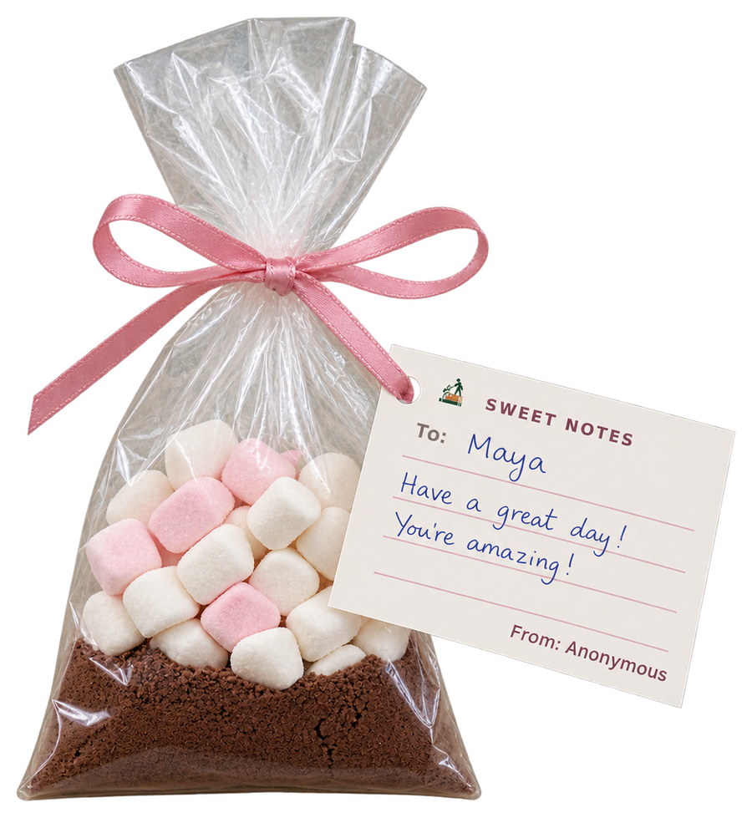

WHAT THEY GET
One small bag, three small parts
1
Hot chocolate and marshmallows
Enough for one proper mug, tied up in a little bag.
2
A note you write yourself
Your own words, in your own handwriting. That is the part they keep.
3
Handed to them on the day
Sorted by form the night before and delivered before registration.
The Pastoral Guide
6 / 11

Slide 7

ONE RULE
You do not sign it
Every note is signed the same way:
From: Anonymous
So the person reading it thinks about what it says, not who sent it. An adult reads every note before it goes out.
From: Anonymous
the note on every bag
The Pastoral Guide
7 / 11

Slide 8
BEFORE YOU DECIDE
Who will you send one to?
Your best friend already knows. Have a think about someone who does not.
Someone who joined this year and is still finding their feet.
Someone who has had a harder term than they have let on.
1
2
Someone who is kind to everyone and never gets told.
Someone you have sat near all year and never spoken to.
3
4
The Pastoral Guide
8 / 11

Slide 9



HOW TO SEND ONE
Come to the stall
Replace anything in [ brackets ] with your own dates, place and price before you show this.
Find us
Write it there
We do the rest
The Sweet Notes stall is in [ PLACE ], at [ TIME ], from [ DATE ] to [ DATE ].
Bring [ PRICE ]. You write your note at the stall, fold it, and hand it back.
We tie it to a bag and deliver it on the morning of [ 14 FEBRUARY ].
The Pastoral Guide
9 / 11

Slide 10
DO NOT LEAVE IT TOO LATE
Three dates to remember
The stall opens
[ DATE ]
Last chance to send one
[ DATE ]
Delivered to your form, first thing
[ 14 FEBRUARY ]
The Pastoral Guide
10 / 11

Slide 11
One bag. One note. One morning.
Someone in this room is going to have a much better day because of a minute of your time.
A Valentine’s Event
The Pastoral Guide
11 / 11

