Slide 1
Introduction

Slide 2
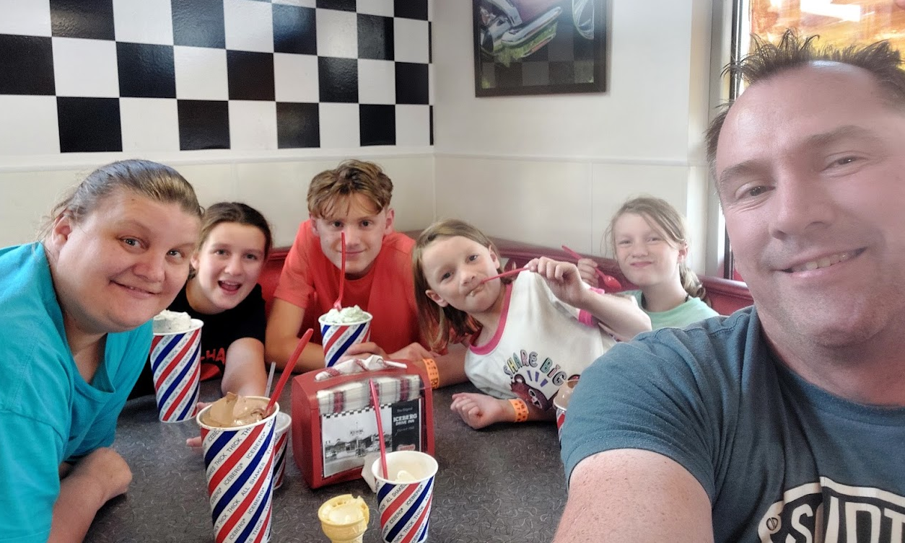
$ whoami
Leon Trappett (thepcn3rd)
Love my Family of 4 growing children…
My son is loves Basketball and French
Daughters love gymnastics, horses, soccer, swimming, …
We all love Iceberg!

Slide 3
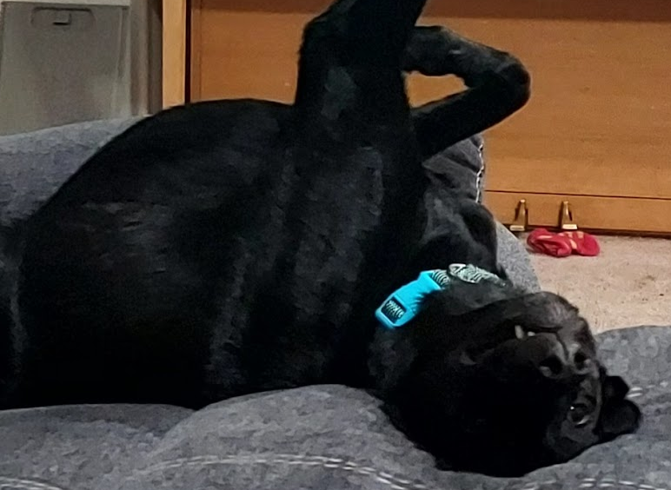
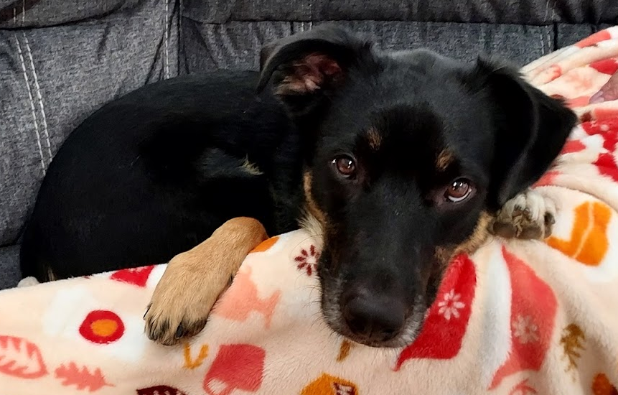
$ ls -a
Github: github.com/thepcn3rd
Twitter: @lokut
Blogspot: thepcn3rd.blogspot.com
LinkedIn: https://www.linkedin.com/in/infosecpassion

Slide 4
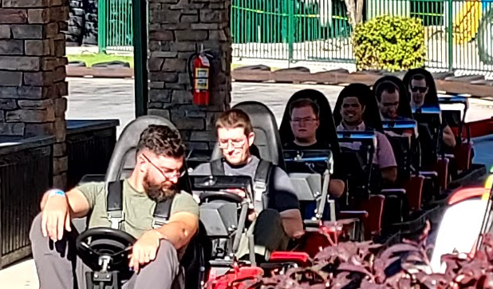
$ ps -aux
VP, Monitoring, Detection and Response - Merrick Bank and Cardworks Servicing (3+ years)
Adjunct Professor for Ensign College in SLC (6+ years)
First Programming Language was Turbo Pascal in 1987 (Was 8 years old on a Kaypro IIe)
First Forensic Recovery of Information 2004
First Incident Response was 2005
First Real Information Security Position was 2007

