Slide 1
Spearphishing with ODT Files
Tactic: Initial Access - T1566.002

Slide 2
Summary of Actions
Build Open Office ODT file with Macro
Setup Macro to Execute on Document Open
Send Phishing Email
Utilize Reverse Shell
Create Hidden Local User Account for Persistence
Add Local Account to Local Administrators Group

Slide 3
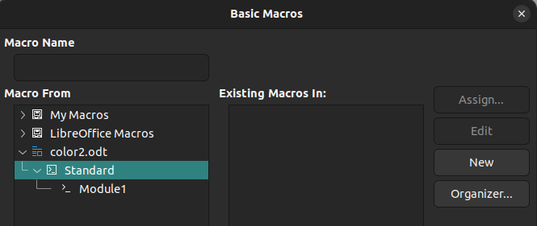
LibreOffice Add a Macro
Create a Macro in LibreOffice by clicking Tools → Macros → Organize Macros
Click Standard and then Click New
By default it can be named Module1

Slide 4
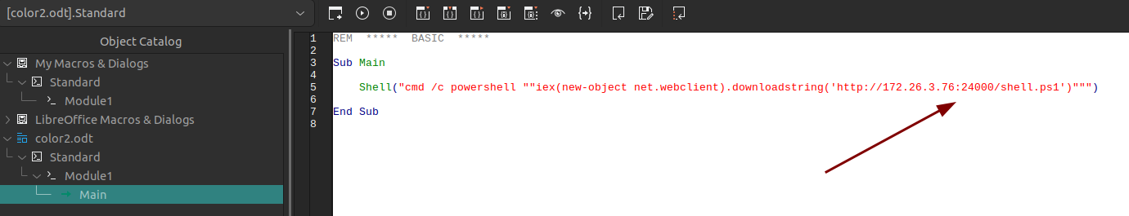
Build Macro
Verify the Main is under Module1; Verify that Module1 is under the name of your document
Create the command that you would like executed with the IP of PurpleLin and the port of the front of the SSH reverse tunnel (Your port may be different)
If you named the payload something other than shell.ps1 in your http.server you will need to adjust

Slide 5
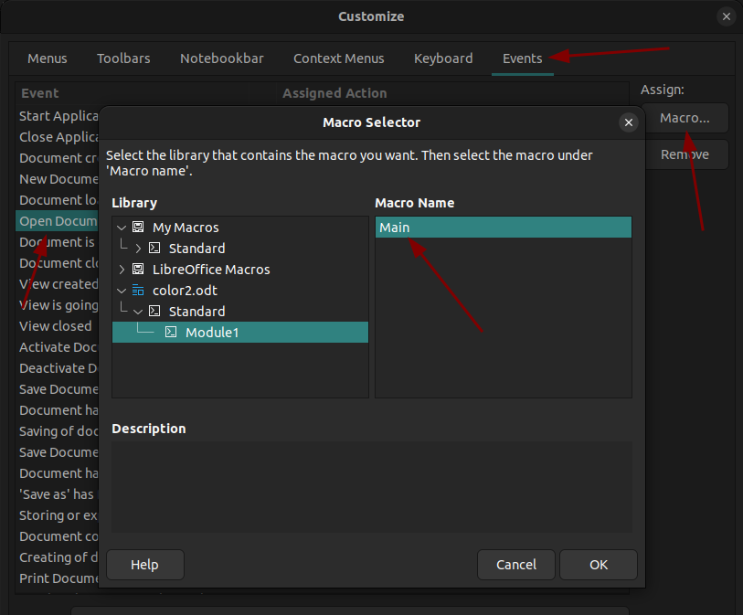
Setup Macro to Execute on Doc Open
Click Tools → Customize → Click on the Tab Events
Then select “Open Document”
On the right side select “Macro”
Find your macro under the name of the document
Then click OK and then OK

Slide 6
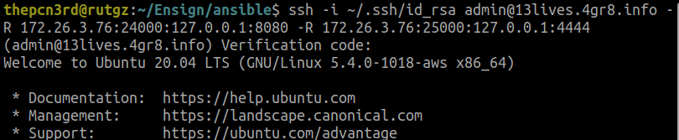
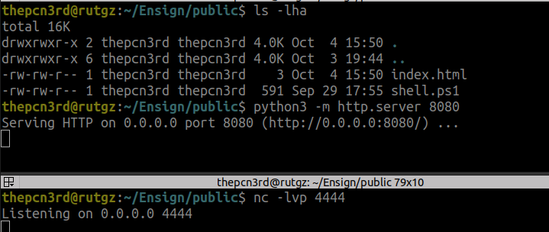
Prepare the SSH Reverse Tunnels
Setup SSH Reverse Tunnels (if you have not already) for the http.server and the nc listener
← Examples of the http.server running and the netcat listener

Slide 7
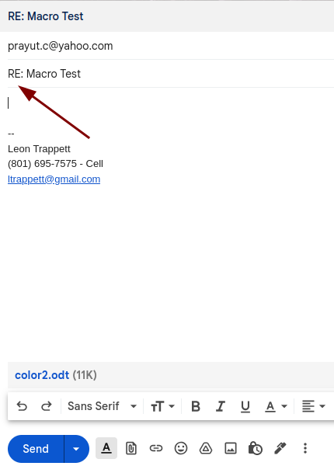
Send Phishing Email
Send the phishing email to the email address you setup in the configuration phase of the workshop (prayut.c@yahoo.com is used for the lab)
At the moment I can use gmail to send the attachment with the macro
Verify the subject is what you setup in the configuration phase

Slide 8
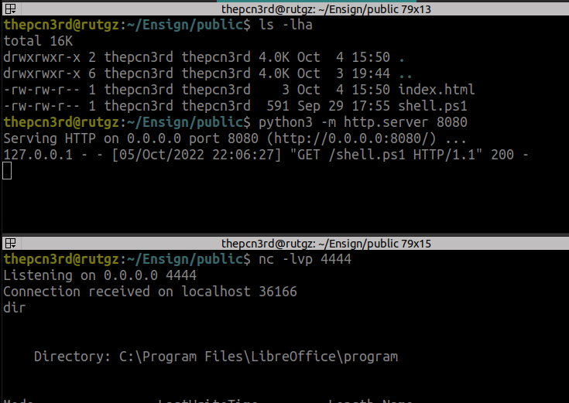
Utilize the Reverse Shell
Observe that the payload was pulled by the macro, the http.server shows the successful GET
Then we have code execution through the reverse shell.

Slide 9
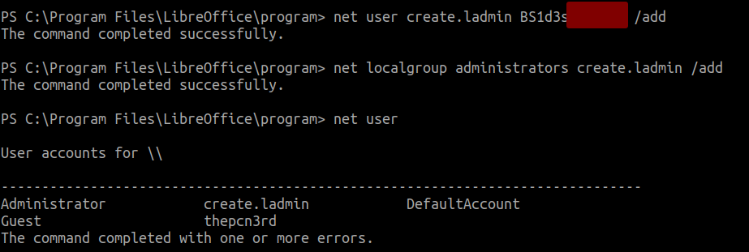
Create a Hidden User (Hidden from net user)
Create a local admin with a $ as the last character, in the output of net user it will not show up…
RDP into the box with the local admin that was created (You could try other ways to get in…)

