Slide 1
Establish Accounts: Social Media Accounts
Resource Development - T1585.001

Slide 2
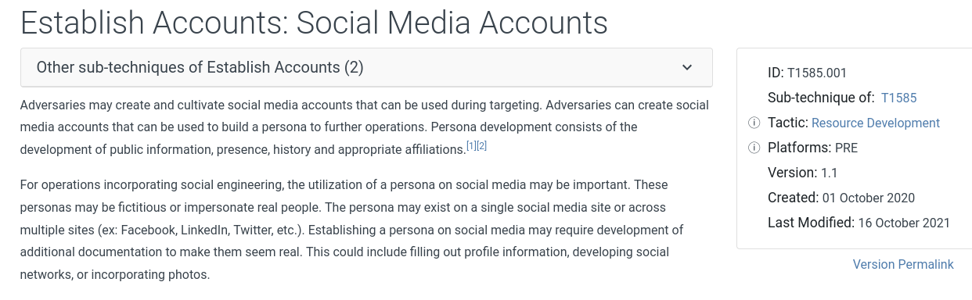
MITRE ATT&CK

Slide 3
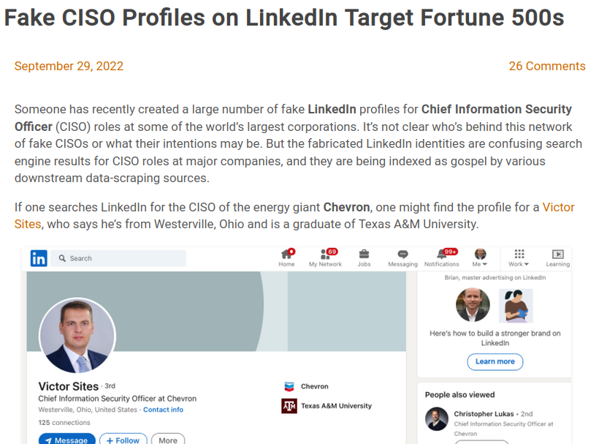
Fake LinkedIN Accounts
Recently on Krebs on Security this was observed
https://krebsonsecurity.com/2022/09/fake-ciso-profiles-on-linkedin-target-fortune-500s/

Slide 4
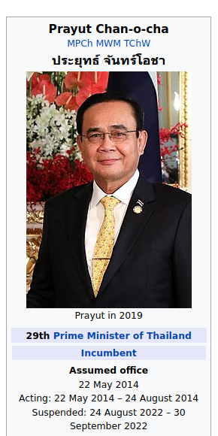
13lives - Video
“Thirteen Lives” - Amazon Prime Original Movie
In the true story of Thirteen Lives, twelve boys and the coach of a Thai soccer team explore the Tham Luang cave when an unexpected rainstorm traps them in a chamber inside the mountain. Entombed behind a maze of flooded cave tunnels, they face impossible odds. A team of world-class divers navigate through miles of dangerous cave networks to discover that finding the boys is only the beginning.
Prayut Chan-o-cha was the Prime Minister of Thailand during this time frame.

Slide 5
Fake Scenario - Based on Events of 13 Lives
Disclaimer: The scenario today is based on this true story. The scenario today is not meant to disrespect anyone or anything based on the events of the true story or the movie. The accounts created are based on the people in the movie.
Executives and Government dignitaries are targets of attacks constantly. You were asked by the Prime Minister to conduct a red team engagement to identify weaknesses in People, Processes and Technology.
This scenario starts with identifying a system administrator that manages the CMS site http://13lives.4gr8.info. After conducting some research you identify through social media articles an executive assistant uses the email of prayut.c@yahoo.com and one of the athletes Chanin Wibunrungrueang mentions in his LinkedIn profile that he is the administrator of the CMS site.

Slide 6
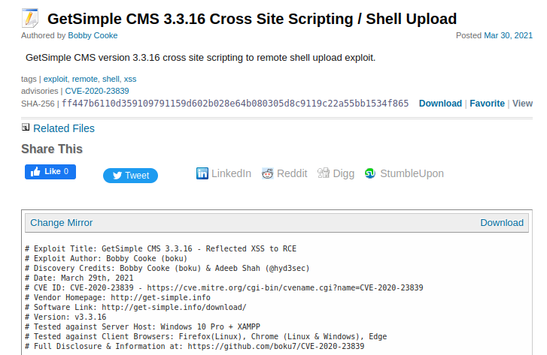
Research Exploits for Site

