Slide 1
Spearphishing
Tactic: Initial Access - T1566.002

Slide 2
Summary of Actions
Actions to Take
Build Link for Web Site Admin to Click
Send Phishing Email
Wait for the Admin to Click and Authenticate
During the Authentication Process Persistent XSS using Javascript is Executed
Use Webshell to Execute Commands
Hide Persistence
Gather Information

Slide 3
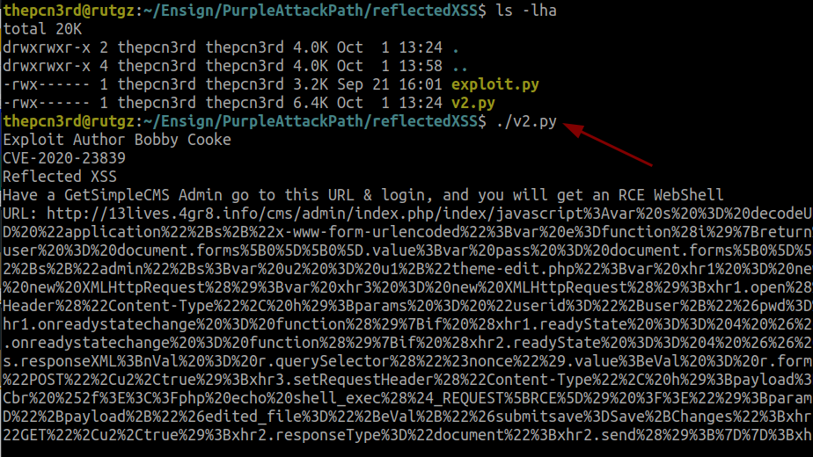
Build Phishing Link
Under PurpleAttackPath and reflectedXSS execute the v2.py
Script builds a phishing link that can be sent to the administrator
Trigger the stored XSS as you login as if you are the administrator

Slide 4
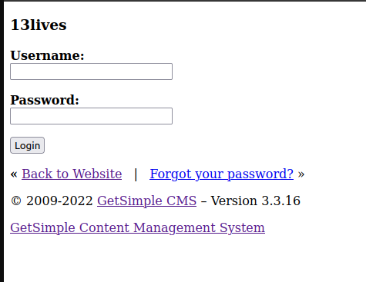
Authenticate as Administrator
The page does not render properly due to how the javascript is injected into the page
Prior to authenticating let’s view the source of the page

Slide 5
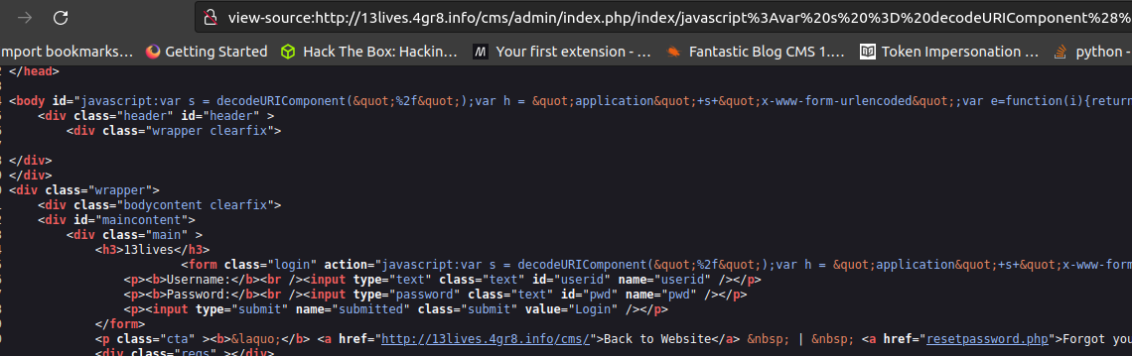
View Source on Page
Observe that what is in the URL is injected into the body HTML tag and the form HTML tag action parameter
This also explains why the POST of the authentication appears to be broken

Slide 6
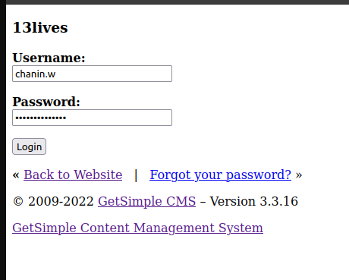
Authenticate as Administrator
Login button does not work due to the injection into the form tag and action parameter
Refresh the page because it appears broken

Slide 7
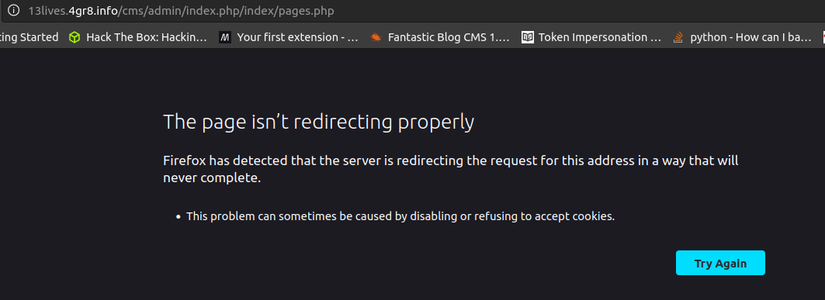
Page cannot be displayed
Notice the URL is broken, if you remove index/pages.php the admin login will complete (Hopefully the administrator notices this and reports the phishing link that they clicked on)

Slide 8
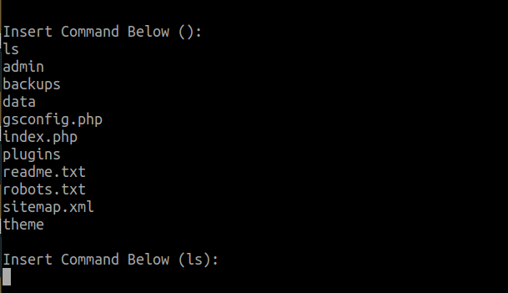
Use Webshell to Interact
Use the exploit executed to interact with the webshell
Execute commands
In python code was added to hide the persistence that we added, type h as the command
You will notice if you type r it will restore the template file that we overwrote and leave our webshell

Slide 9
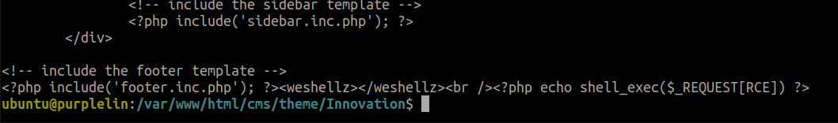
Evaluate the Webshell
Observe under /var/www/html/cms/theme/Innovation is the template.php file that was manipulated by the reflected XSS with the javascript code (more to come on that)
When you cat the file after restoring the template.php file, the webshell is positioned at the bottom

Slide 10
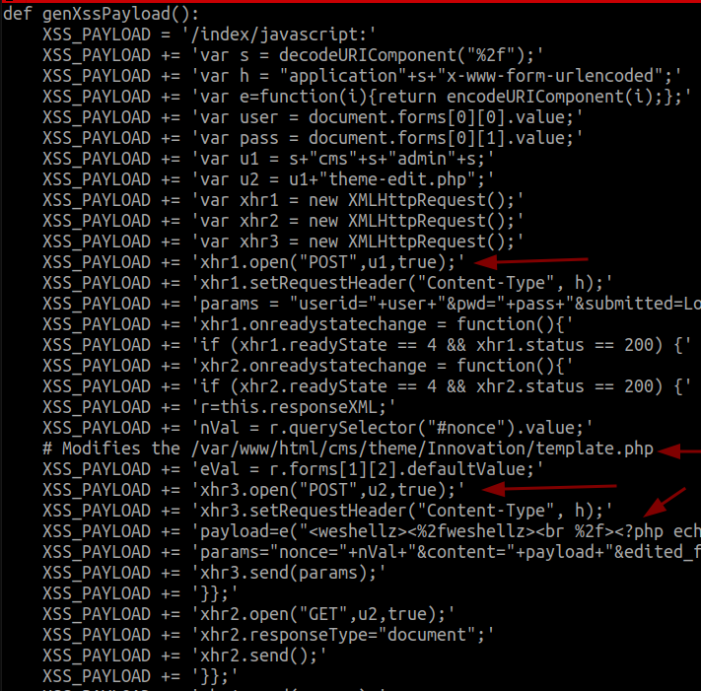
Evaluate the Exploit
XSSPayload after authentication sends a POST to theme-edit.php
Then it sends another POST to update the template.php file with the PHP webshell
GET parameters or the number of characters that can go on a URL is limited

Slide 11
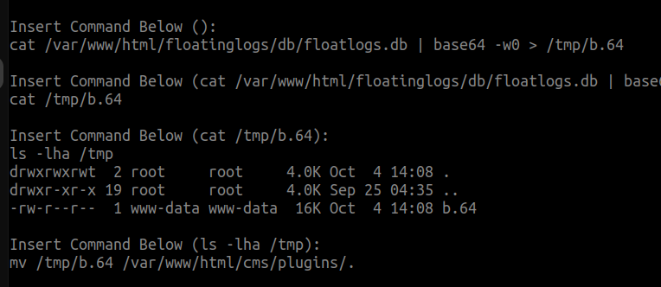
Gather Information
Identified other websites located on the server
As you explore you will also observe the other users in /etc/passwd
Evaluate the sshd_config file and how it has changed from a default state

