Slide 1
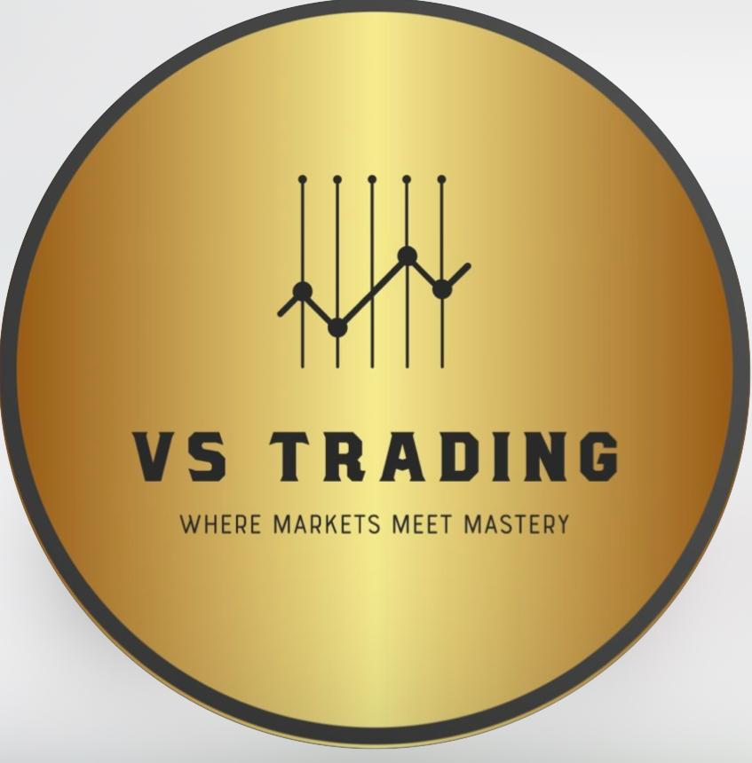
VS TRADING
WHERE MARKETS MEET MASTERY
Investor Pitch Deck — 2025
Disciplined Trading. Consistent Returns. Proven Strategy.
Confidential | For Accredited Investors Only

Slide 2
THE OPPORTUNITY
₹240T+
48M+
3–5%
5–8x
Indian Capital
Market Size
Active Demat
Accounts in India
Monthly Returns
We Target
More Than
Bank FD Returns
India's capital markets are booming. With 48M+ active investors and the market growing at record pace, professional trading firms are uniquely placed to generate returns that leave conventional savings instruments far behind.
VS Trading — turning market opportunity into investor wealth since 2023

Slide 3
MEET THE FOUNDER
[ Add
Photo ]
Vinayak P. Kamble
Founder & Lead Trader | VS Trading
🎓 B.E. / B.Tech Engineer [Add Your Branch & College]
📊 [X] Years of Active Trading Experience
🏦 Specializes in Equity, Swing & Derivatives Trading
🏆 Managed ₹2Cr+ in investor capital
📍 [Add Your City, Maharashtra]
"My engineering mindset drives everything I do in the markets — data, systems, and discipline. No emotion. Just results."
VS Trading | Where Markets Meet Mastery

Slide 4
OUR TRACK RECORD — 14 MONTHS VERIFIED
14
50+
₹2Cr+
0
Consecutive
Profitable Months
Active
Investors
Capital
Managed
Months of
Negative Returns
Month
Month
Return
Return
Month
Month
Return
Return
Month
Month
Return
Return
Month
Month
Return
Month
Return
Nov '23
3.1%
Dec '23
3.4%
Jan '24
3.2%
Feb '24
3.8%
Mar '24
4.0%
Apr '24
3.5%
May '24
4.2%
Jun '24
3.9%
Jul '24
4.5%
Aug '24
4.1%
Sep '24
5.0%
Oct '24
4.8%
Nov '24
5.1%
Dec '24
4.9%
Average Monthly Return
4.1%
VS Trading | Where Markets Meet Mastery
* Performance data based on managed accounts. Past returns indicative only.

Slide 5
MISSION & VISION
🎯
🔭
OUR MISSION
OUR VISION
To democratize professional-grade trading returns — offering transparent, structured plans that consistently outperform conventional savings, empowering every investor to build lasting wealth.
To become India's most trusted trading investment firm — known for unwavering commitment to investor returns, transparency, and market mastery. Where intelligent trading is the cornerstone of every portfolio.
VS Trading | Where Markets Meet Mastery

Slide 6
WHY INVESTORS CHOOSE VS TRADING
📈
Managed Monthly Return Strategies
💰
High-Yield Annual Investment Solutions
Our proprietary system generates consistent monthly income — not luck, but disciplined, rule-based execution.
3–5% monthly compounding delivers 36–60% annually — light years ahead of mutual funds and FDs.
🎯
Personalized Wealth & Portfolio Management
🔍
Expert Equity & Swing Market Insights
Custom plans built around YOUR capital, timeline, and goals. One size never fits all.
Deep expertise in equity markets and short-term swing trades to capture returns in any market condition.
🛡️
Disciplined Capital Allocation & Fund Mgmt
🌱
Long-Term Compounding & Wealth Building
Every rupee deployed within strict risk controls. Position sizing, stop-losses, and diversification built in.
Our long-term plan lets your wealth compound over 3–10 years for truly life-changing financial results.
VS Trading | Where Markets Meet Mastery

Slide 7
FOUR PATHS TO WEALTH — CHOOSE YOURS
⭐ MOST POPULAR
🌿 LONG TERM
PLAN 1
PLAN 3
PLAN 2
PLAN 4
Balanced Growth
Apex Growth
Fast Growth
Legacy Growth
3%
5%
4%
Custom
Monthly Return
Monthly Return
Monthly Return
Monthly Return
Total Profit:
36%
Total Profit:
60%
Total Profit:
48%
Total Profit:
Custom
Investment:
₹50K–₹2L
Investment:
Above ₹5L
Investment:
₹2L–₹5L
Investment:
Custom
Closing Fee:
8%
Closing Fee:
15%
Closing Fee:
10%
Closing Fee:
Negotiable
VS Trading | Where Markets Meet Mastery

Slide 8
PLAN 4 LEGACY GROWTH — LONG-TERM WEALTH
🌿
Built for investors who think in decades, not months.
Investment Horizon
3 – 10 Years (Fully Customizable)
Capital Required
Tailored to investor capacity & goals
Return Structure
As per agreed terms — capital & tenure based
Performance Updates
Quarterly detailed portfolio reports
Closing Fee
Mutually negotiated at plan setup
Exit Policy
Planned exit windows at agreed milestones
VS Trading | Where Markets Meet Mastery

Slide 9
ROI PROJECTIONS — SEE EXACTLY WHAT YOU EARN
Plan
Investment
Monthly
Return
12M Gross
Profit
Closing
Fee
NET
PROFIT
Total
Received
Plan 1
₹50,000
₹1,500
₹18,000
₹1,440
₹16,560
₹66,560
Plan 1
₹1,00,000
₹3,000
₹36,000
₹2,880
₹33,120
₹1,33,120
Plan 1
₹2,00,000
₹6,000
₹72,000
₹5,760
₹66,240
₹2,66,240
Plan 2
₹2,00,000
₹8,000
₹96,000
₹9,600
₹86,400
₹2,86,400
Plan 2
₹3,00,000
₹12,000
₹1,44,000
₹14,400
₹1,29,600
₹4,29,600
Plan 2
₹5,00,000
₹20,000
₹2,40,000
₹24,000
₹2,16,000
₹7,16,000
Plan 3
₹5,00,000
₹25,000
₹3,00,000
₹45,000
₹2,55,000
₹7,55,000
Plan 3
₹10,00,000
₹50,000
₹6,00,000
₹90,000
₹5,10,000
₹15,10,000
All figures calculated on 12-month plan | Net Profit = Gross Profit minus Closing Fee | Principal fully returned on maturity
VS Trading | Where Markets Meet Mastery

Slide 10
EARLY EXIT SCENARIOS & RISK MANAGEMENT
📤 Early Exit — What You Receive
🛡️ How We Protect Your Capital
Plan
Exit At
Returns
Earned
Closing
Fee
Net
Profit
Total
Received
🔒
Stop-Loss on
Every Trade
Plan 2 — ₹3L
3 months
₹36,000
₹3,600
₹32,400
₹3,32,400
Max 1-2% loss per
trade — auto triggered
Plan 2 — ₹3L
6 months
₹72,000
₹7,200
₹64,800
₹3,64,800
📊
Position Sizing
Plan 2 — ₹3L
9 months
₹1,08,000
₹10,800
₹97,200
₹3,97,200
Never >5% capital
in a single position
Plan 3 — ₹5L
6 months
₹1,50,000
₹22,500
₹1,27,500
₹6,27,500
🔀
Diversification
Early exit permitted at any time | Closing fee applies on profits earned to date
Multiple instruments,
sectors & strategies
💵
Liquidity Buffer
20% capital held
in liquid assets
VS Trading | Where Markets Meet Mastery

Slide 11
RETURN COMPARISON
VS Trading vs Traditional Investment Options (Annual Returns %)
VS Trading | Where Markets Meet Mastery

Slide 12
HOW IT WORKS — 4 SIMPLE STEPS
01
📋 Choose Your Plan
02
✍️ Sign & Onboard
Select from Plans 1–4 based on your capital, risk appetite, and return goals. Our team walks you through every option.
Complete a simple investment agreement with clear terms. Full documentation provided. No hidden clauses. Ever.
03
💳 Transfer Funds
04
🚀 Earn & Grow
Securely transfer your investment. Receive instant confirmation, a signed receipt, and your investment timeline.
Monthly returns credited to your account. Quarterly reports for long-term plans. Watch your wealth compound.
VS Trading | Where Markets Meet Mastery

Slide 13
FREQUENTLY ASKED QUESTIONS
Q
What if markets crash or go down?
Q
Can I exit my investment early?
Our systematic stop-loss strategy limits losses to 1-2% per trade. We hold liquidity buffers and diversify across instruments — so a market dip doesn't wipe out your returns.
Yes. Early exit is permitted at any time. You receive all returns earned up to that date, minus the closing fee on those profits. Your principal is fully returned.
Q
How and when are returns paid?
Q
Is my principal safe?
Monthly returns are credited directly to your registered bank account by the 5th of every month. For long-term plans, quarterly statements are provided.
Capital protection is our first priority. Principal is never risked beyond the agreed framework. Strict position sizing ensures your core investment is insulated from trading losses.
Q
What documents do I need to start?
Q
What if I want a custom plan?
KYC basics: PAN card + Aadhaar + bank account details + signed investment agreement. That's it. We keep it simple so you can start fast.
Plan 4 (Legacy Growth) is built for this. Tell us your capital, timeline, and expectations — we design a tailored structure just for you.
VS Trading | Where Markets Meet Mastery

Slide 14
LEGAL & COMPLIANCE
📜
Registered Business Entity
VS Trading operates as a legally registered business entity. Investment agreements are formally documented and signed by both parties for every transaction.
🔐
Investment Agreement
Every investor receives a signed investment agreement detailing capital amount, return structure, tenure, exit terms, and closing fee — fully transparent before any funds are transferred.
🏦
Fund Segregation
Investor capital is tracked and managed separately from operational funds. You always know the status of your principal.
📊
Regulatory Compliance
VS Trading is committed to operating within applicable Indian financial regulations. Investors are advised to consult a financial advisor. All investments carry inherent risk.
🤝
Investor Rights
All investors have the right to regular statements, early exit (with conditions), and direct access to the founding team for any queries or concerns.
VS Trading | Where Markets Meet Mastery

Slide 15
READY TO START YOUR WEALTH JOURNEY?
Join 50+ investors already earning consistent returns with VS Trading.
Vinayak P. Kamble
Founder & Lead Trader | VS Trading
📞 +91 9765465493
✉️ vstrading2712@gmail.com
📱 WhatsApp for quick response
VS Trading — Where Markets Meet Mastery | Confidential Investor Document

