Slide 1
Report 3 : do it with MUMPS Cardiovascular monitoring with MEMS accelerometers
By Vanouche Benjamin & Alex Pip

Slide 2
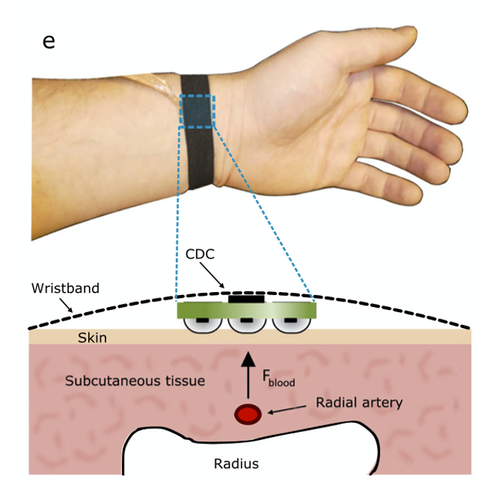
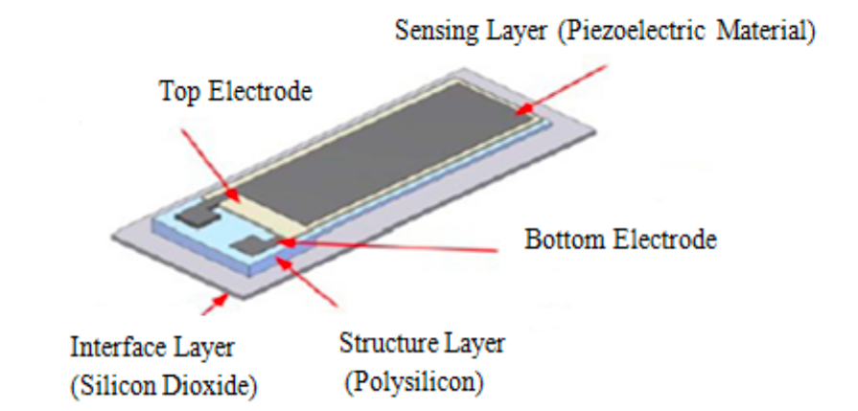
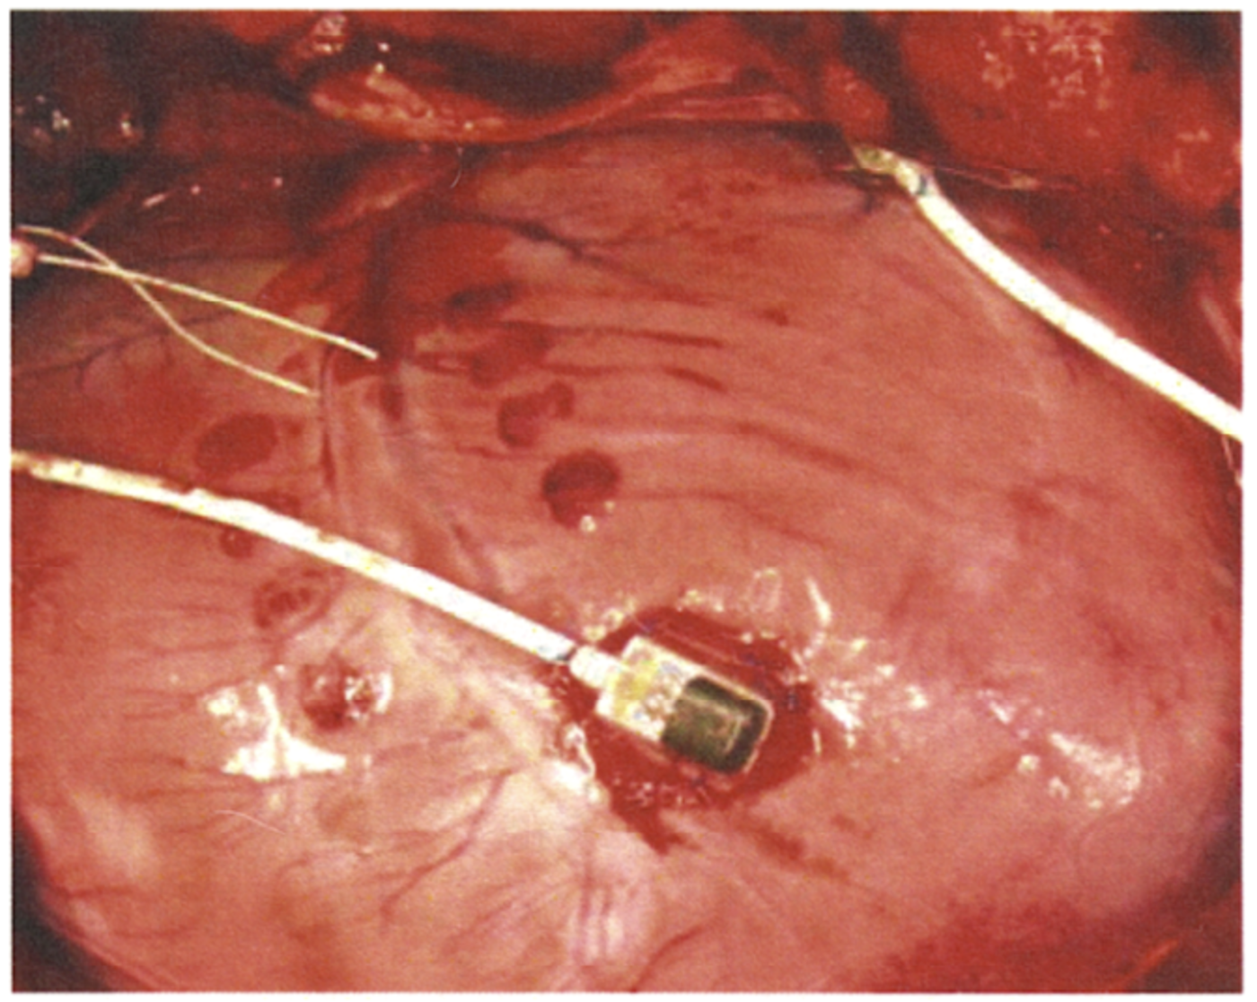
Application : monitor cardiac activity
Through blood pressure measures -> topology 1
Through myocardial muscle movements -> topology 2
Kala, S. et al. (2017). Design of MEMS Piezoelectric Blood Pressure Sensor.
Kaisti, M.,et al (2019) Npj Digital Medicine, 2(1), 1–10.
Lowrie, C. et al. (2009). DTIP of MEMS and MOEMS - Symposium on Design, Test, Integration and Packaging of MEMS/MOEMS, 229–234.

Slide 3
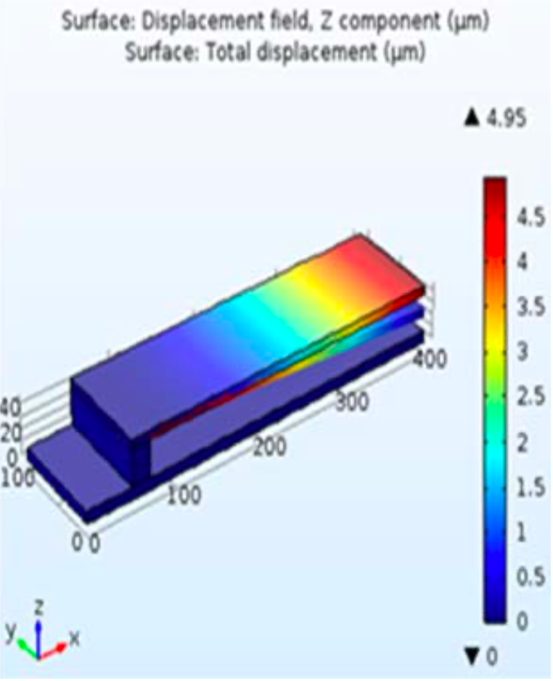
Topology 1 : Blood pressure measurements
Design proposed by Kala, S. et al. (2017) OR the one by
Based on piezoelectric measurements of a PZT-on-Si cantilever

Slide 4
Topology 1 : fabrication with piezoMUMPS
Deposition + etching OK piezoMUMPS
Al electrodes
PZT layer
Thickness not defined
Possible only with poly-Si deposition
Si frame
SiO₂ substrate

Slide 5
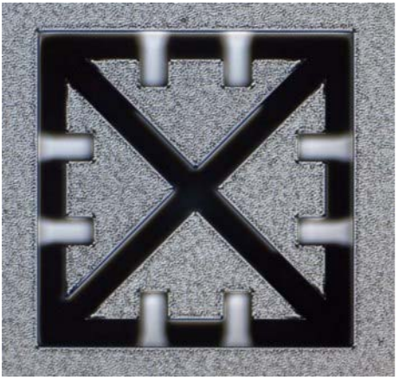
Topology 2
Principle : 3-axis accelerometer stitched to the surface of the heart to measure the motion of the heart wall
Structure : The transducer is a bulk micromachined seismic mass supported by cantilever beams. SOI wafers are employed.
4um thick silicon beam
Inductively Coupled Plasma (ICP) etch
380um thick silicon seismic mass

Slide 6
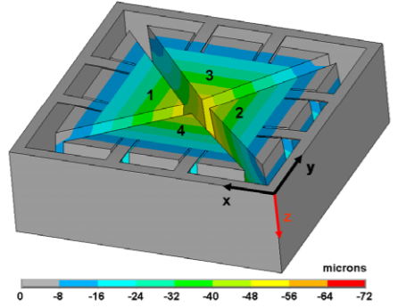
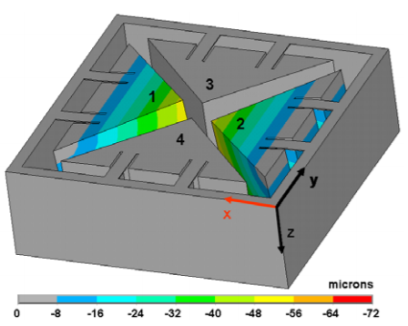
Topology 2
Working principle : 16 longitudinal and transversal piezoresistors connected in Wheatstone bridge configuration

Slide 7
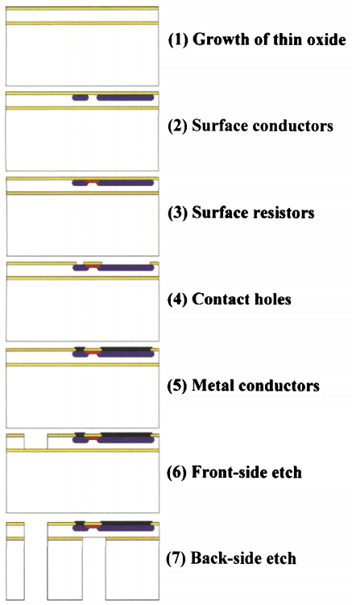
Topology 2 : Fabication with SOI MUMPS
Photolithography
Etching
Alluminimum sputtering then photolithography followed by etching
Etching
Lithography

Slide 8
Topology 2 : Fabication with SOI MUMPS
SiO2 deposition / growth
Selective p-doping
Fabrication Techniques
Al deposition & etching
Si front-side etching (DRIE)
Si back-side etching (DRIE)

