Slide 1
MOBILE KNOWLEDGE GAME

Slide 2
Contents of this presentation
WHY CHARTS’ | We will show which problem the project provides a solution to
GANT CHART | Gantt charts help teams to plan work around deadlines and properly allocate resources.
USE CASE DIAGRAM | Use-case diagrams illustrate and define the context and requirements of either an entire system or the important parts of the system.
UML DIAGRAM | You can use class diagrams to model the objects that make up the system, to display the relationships between the objects, and to describe what those objects do and the services that they provide.
SEQUANCE DIAGRAM | A sequence diagram shows the sequence of messages passed between objects.
ACTIVITY DIAGRAM | An activity diagram visually presents a series of actions or flow of control in a system similar to a flowchart or a data flow diagram.
STATE MACHINE DIAGRAM | State machine diagram typically are used to describe state-dependent behavior for an object. An object responds differently to the same event depending on what state it is in.
COMPONENT DIAGRAM | A component diagram is used to break down a large object-oriented system into the smaller components, so as to make them more manageable. It models the physical view of a system such as executables, files, libraries, etc. that resides within the node.

Slide 3
Why Charts’ ?
Charts’ are used for the visualize information about Project.

Slide 4
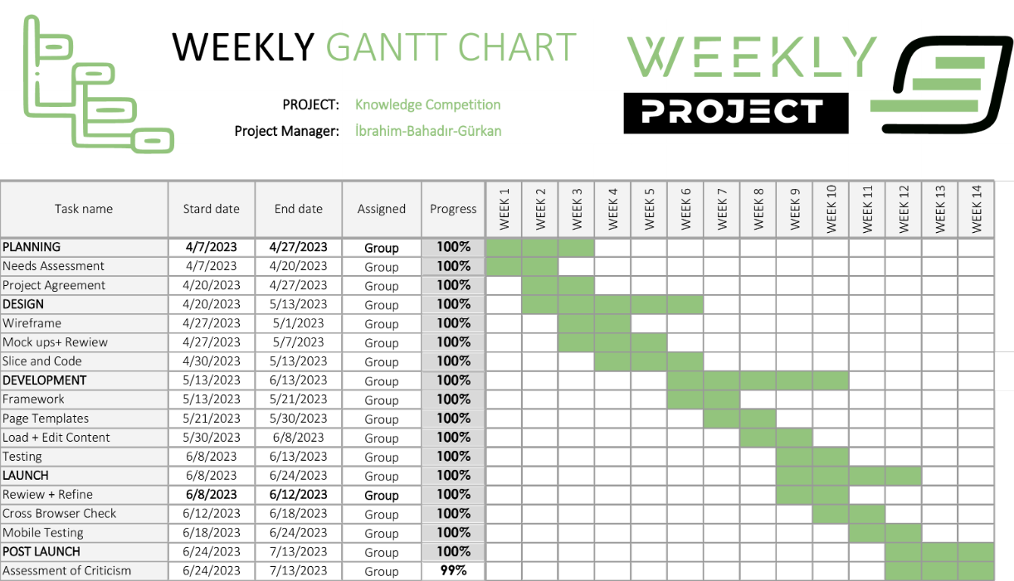
GANTT CHART

Slide 5
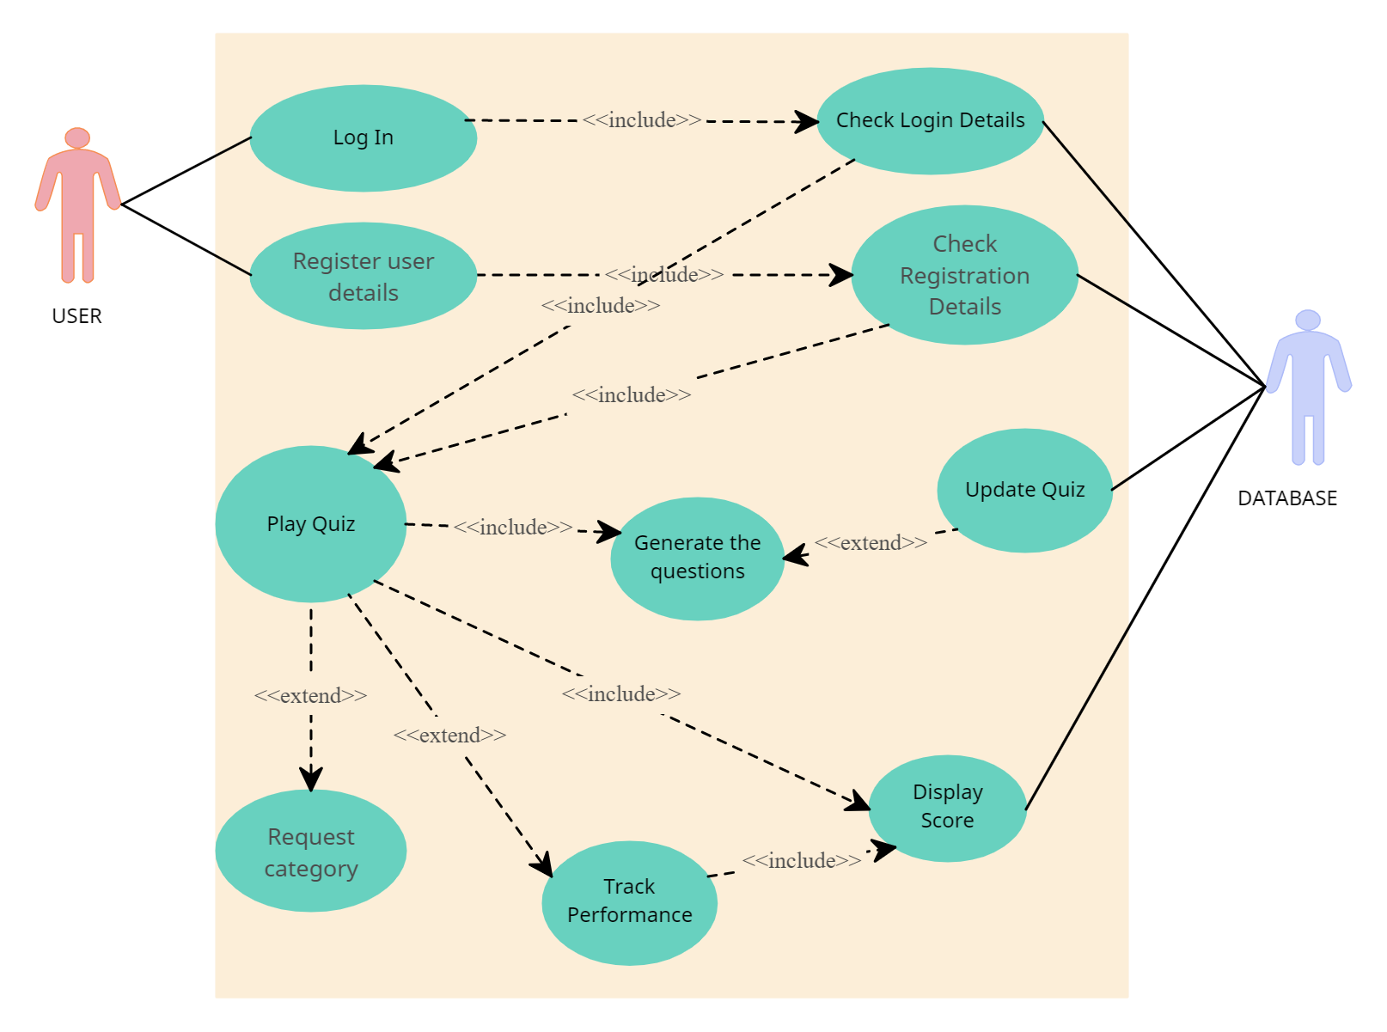
USE CASE DIAGRAM

Slide 6
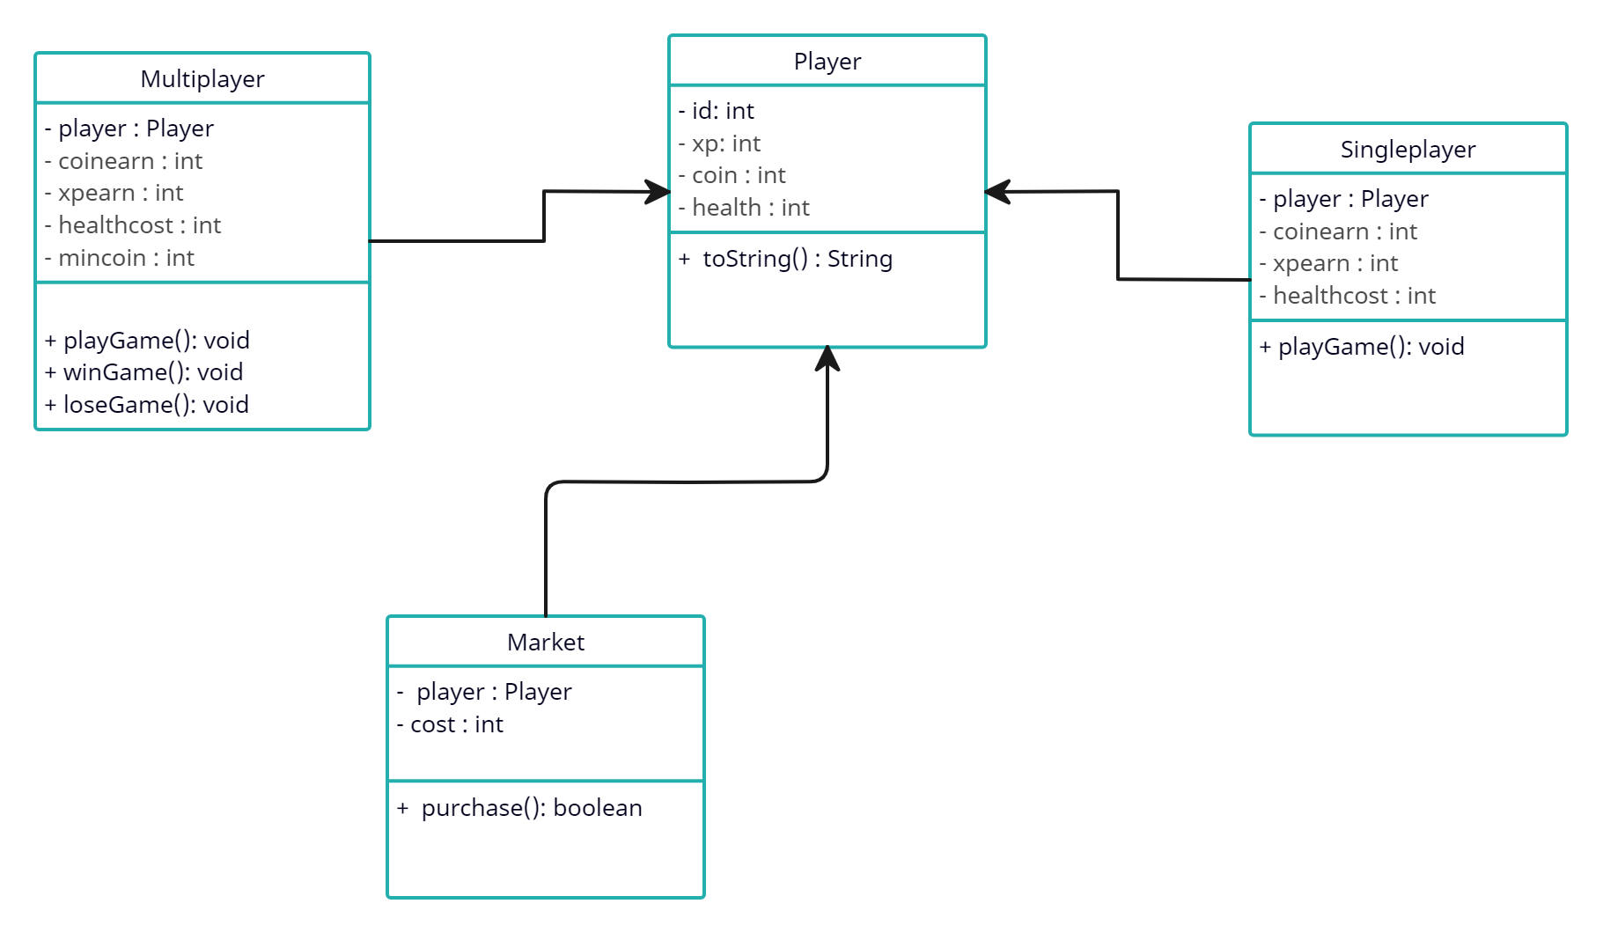
UML DIAGRAM

Slide 7
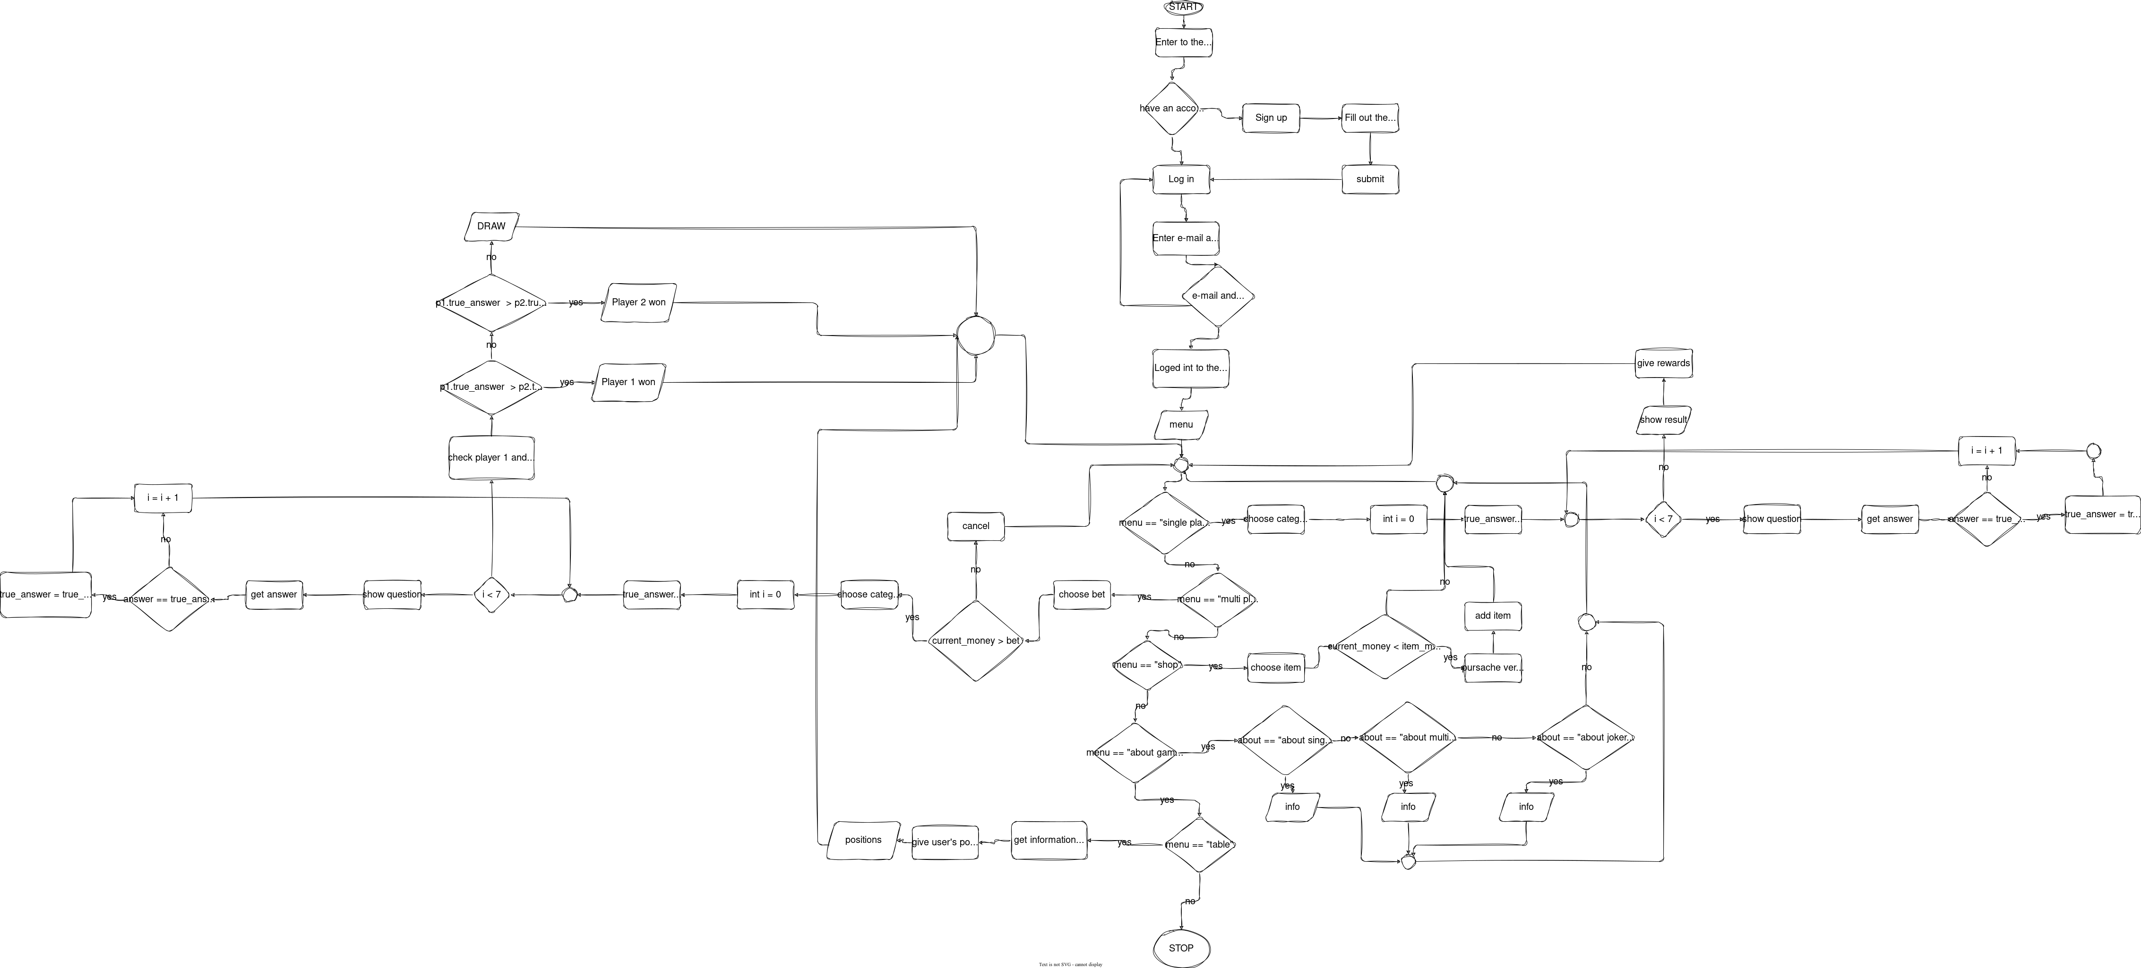
ACTIVITY DIAGRAM

Slide 8
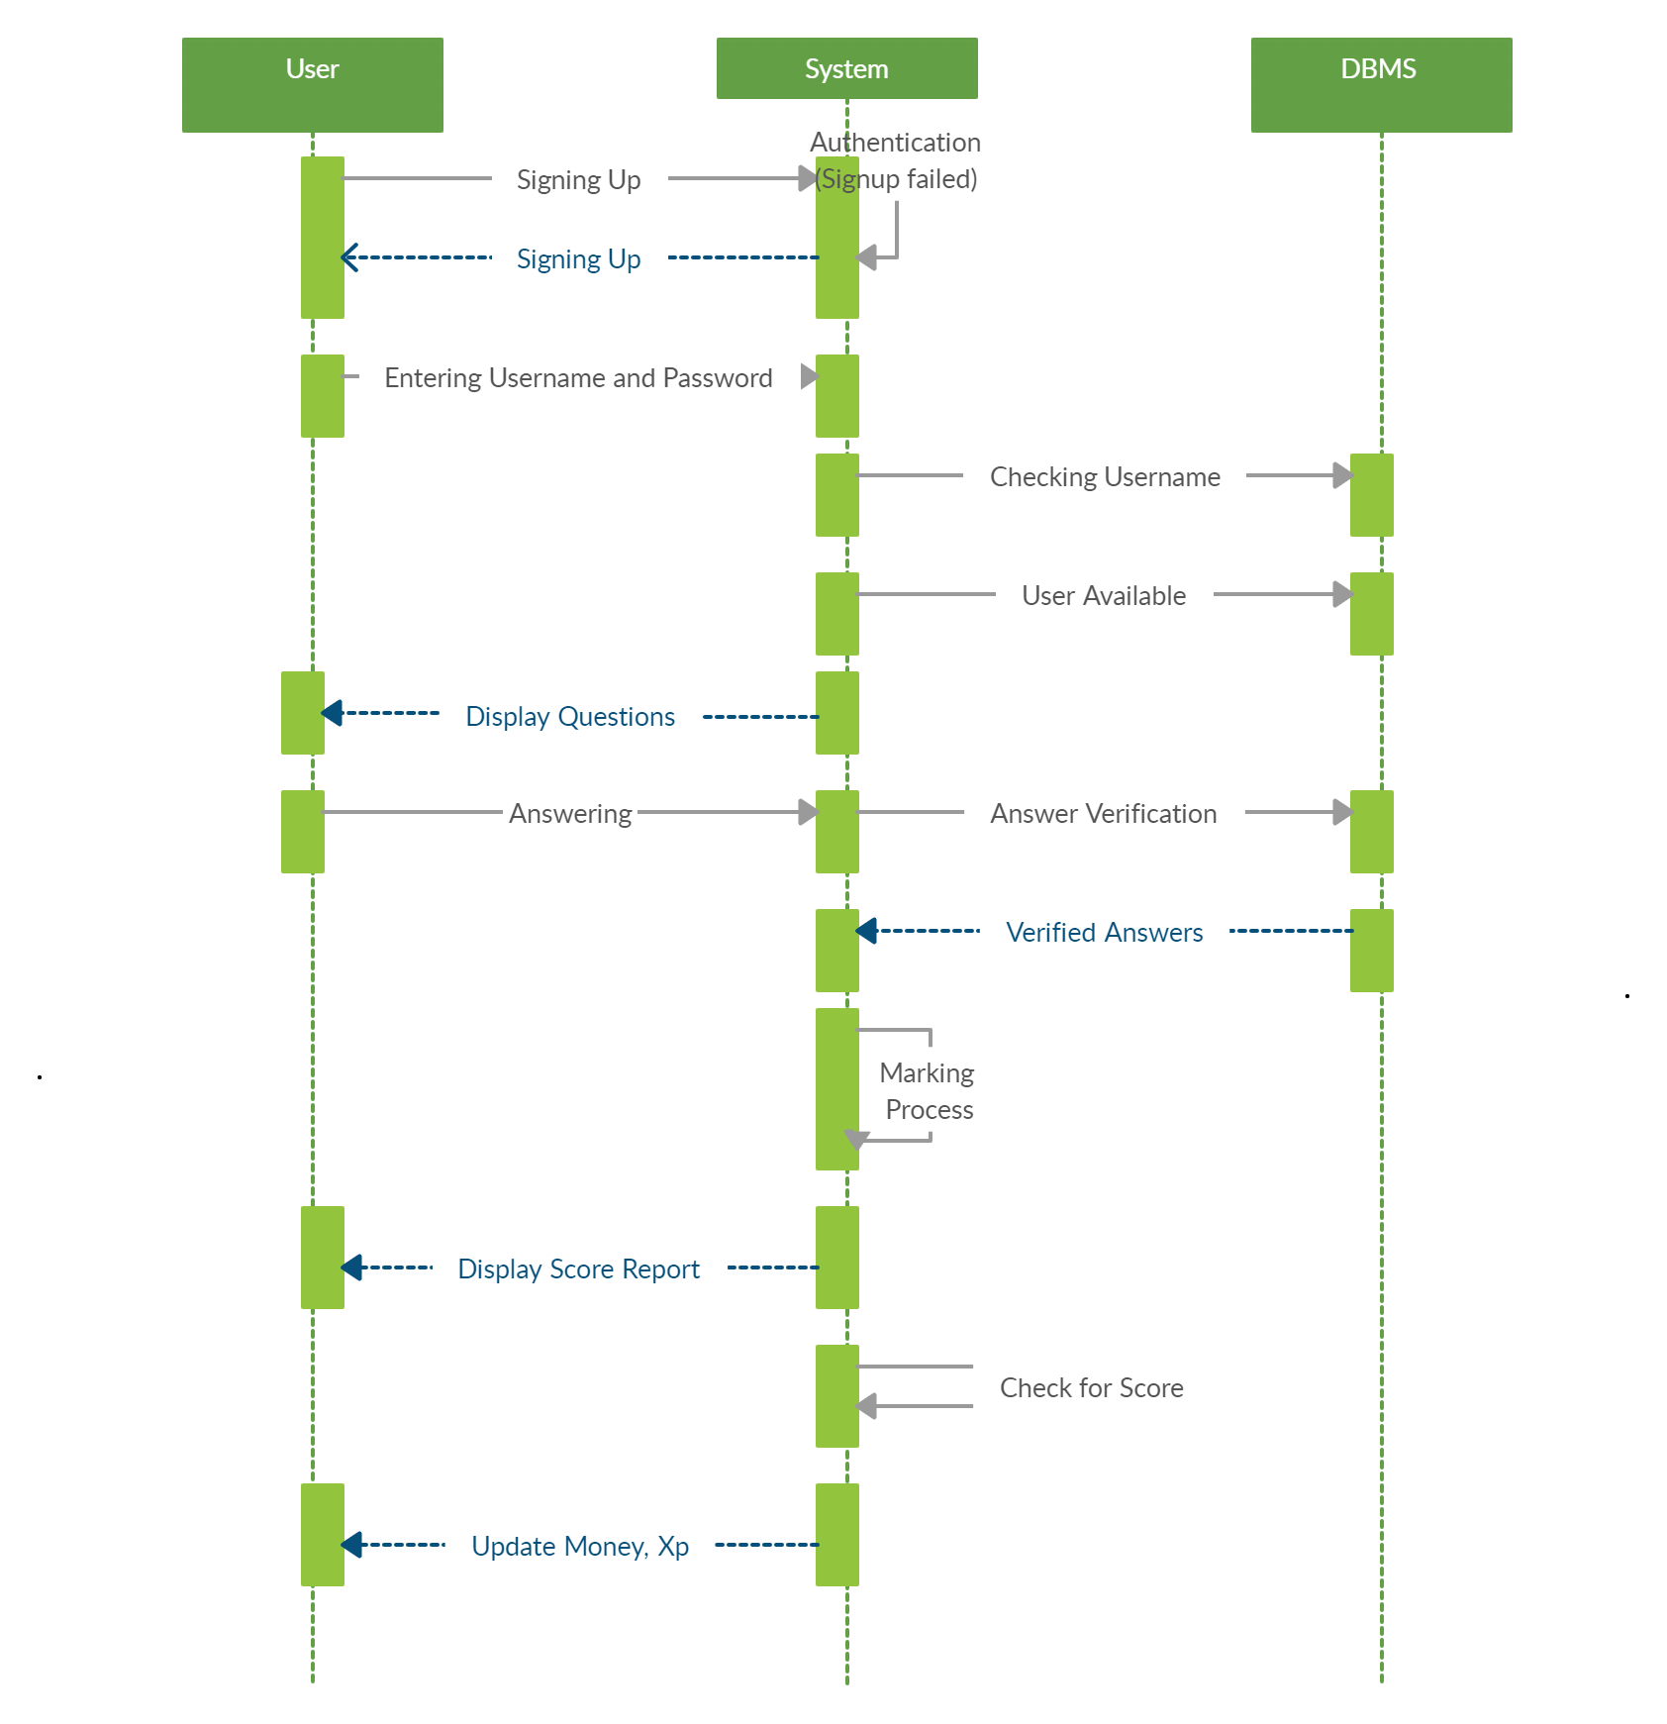
SEQUENCE DIAGRAM

Slide 9
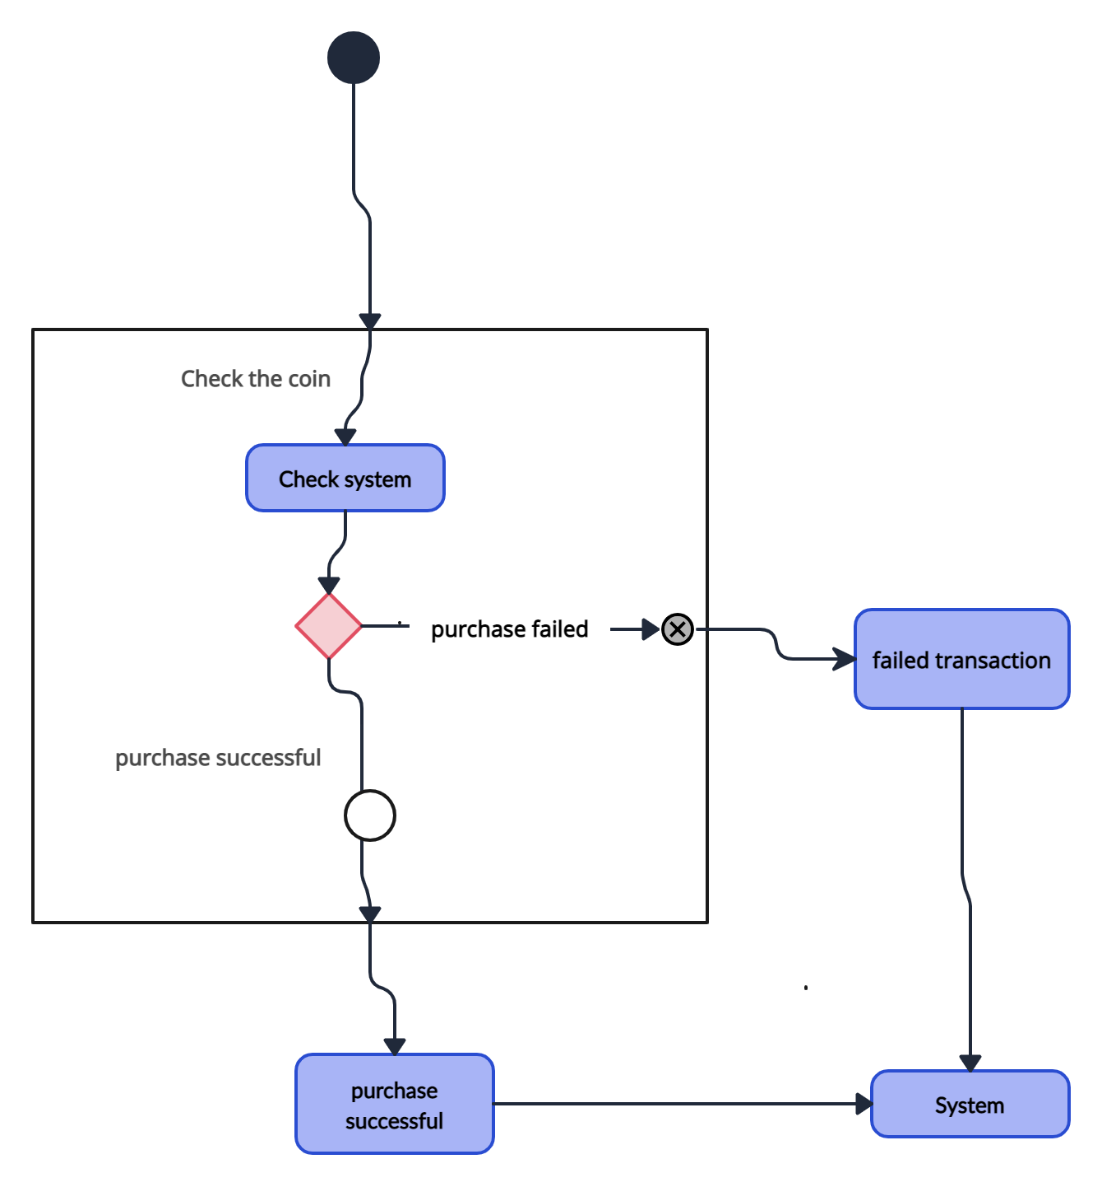
STATE MACHINE DIAGRAM

Slide 10
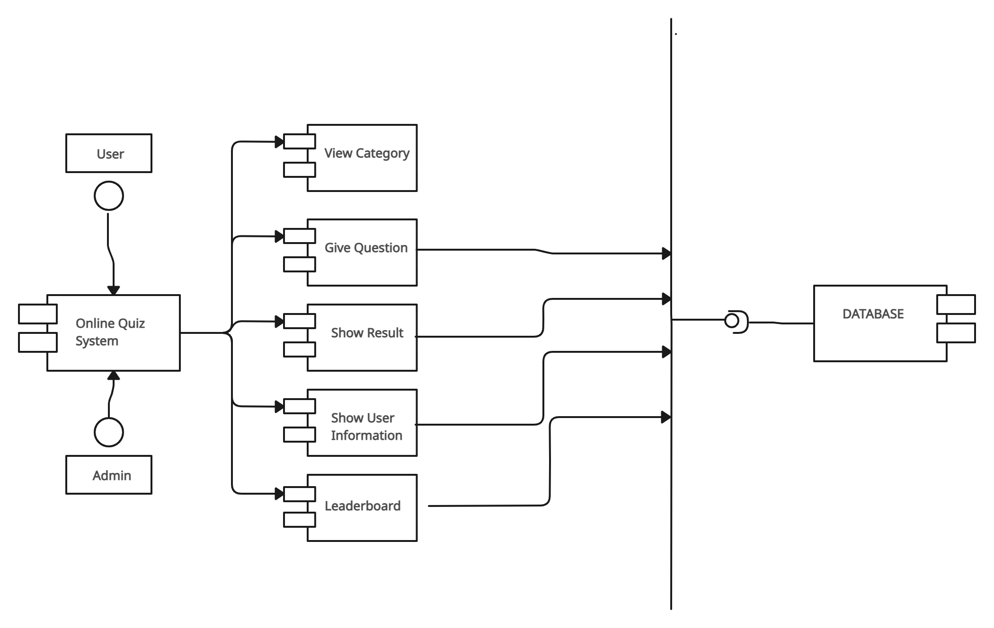

COMPONENT DIAGRAM

Slide 11
Project Responsibles’
İbrahim Cinan (Client)
Gürkan Eyrice (Stakeholder)
Umut Bahadır Kılıç (Developer)

Slide 12

Thanks for listening!
Please keep this slide as attribution

