Slide 1




Onlıne lıbrary
web project
Presenter: Berke Kadir Yıldırım – 200513233
Advisor: Dr. Hameed Mutlag Farhan Farhan

Slide 2

purpose of thıs project
A website for managing books and users. where users can search, borrow, and read books online.

Slide 3

our pages ın project
Welcome page
Sign up page
Login page
Main page
Books page
Profile page
Buy page

Slide 4
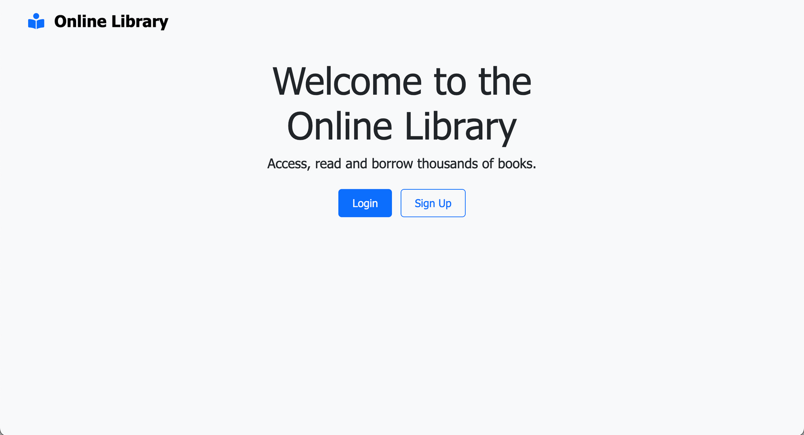
welcome page

Slide 5
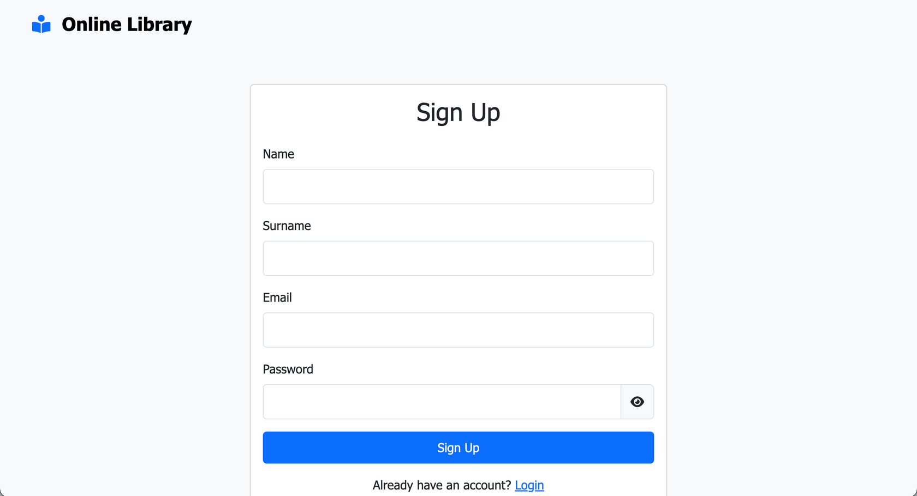
Sıgn up page

Slide 6
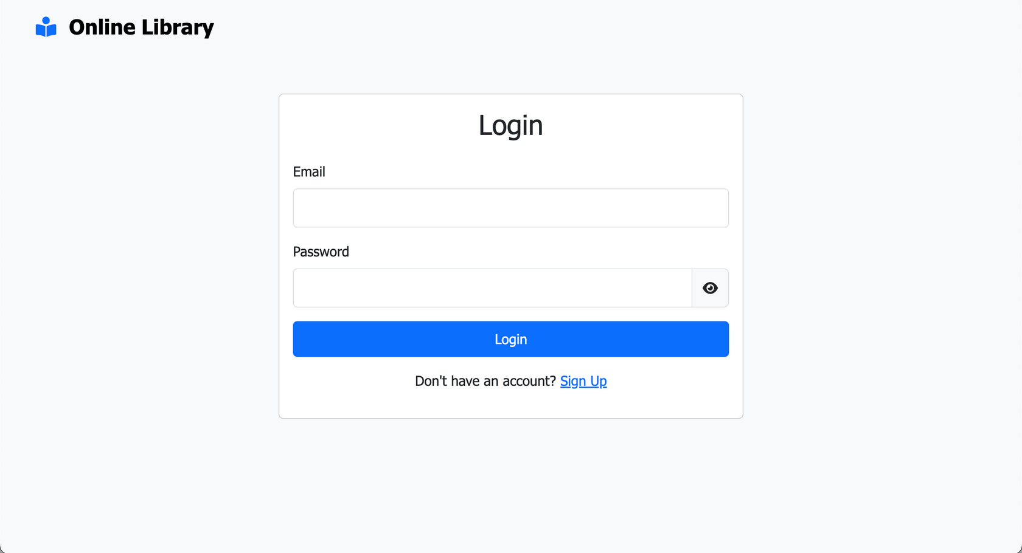
Logın page

Slide 7
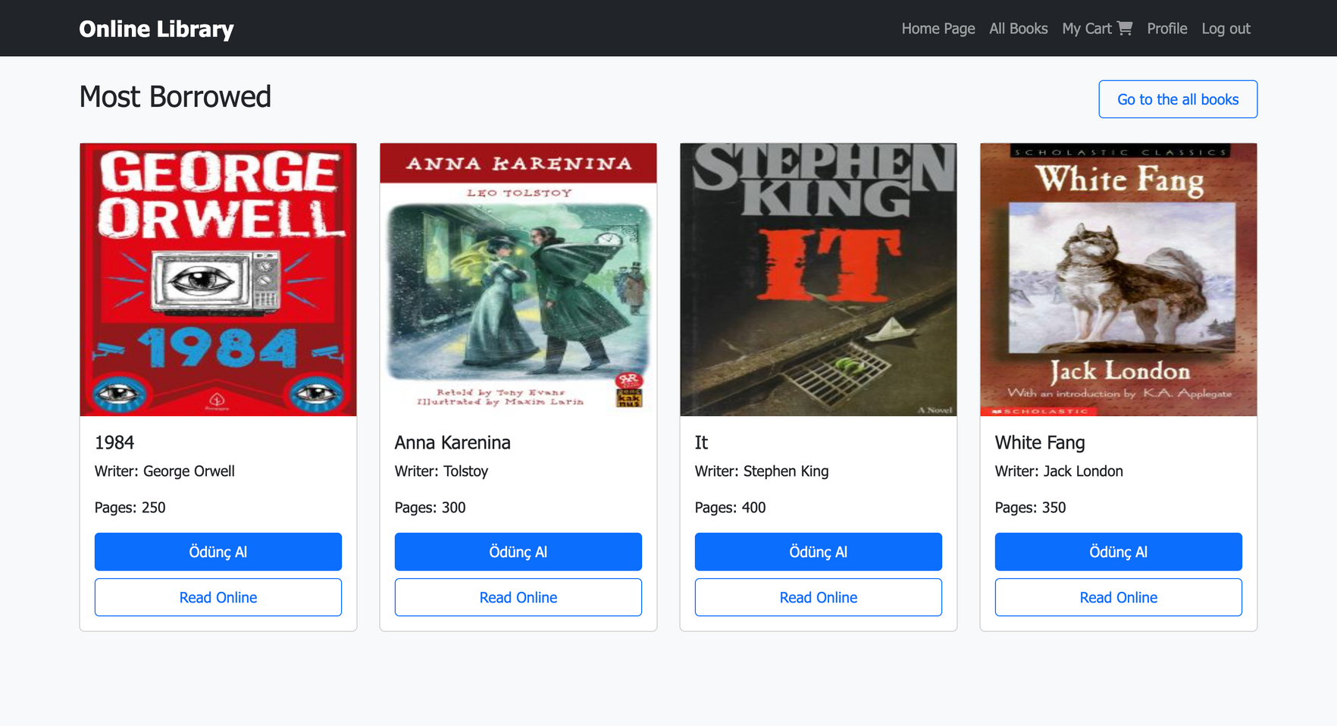
maın page

Slide 8

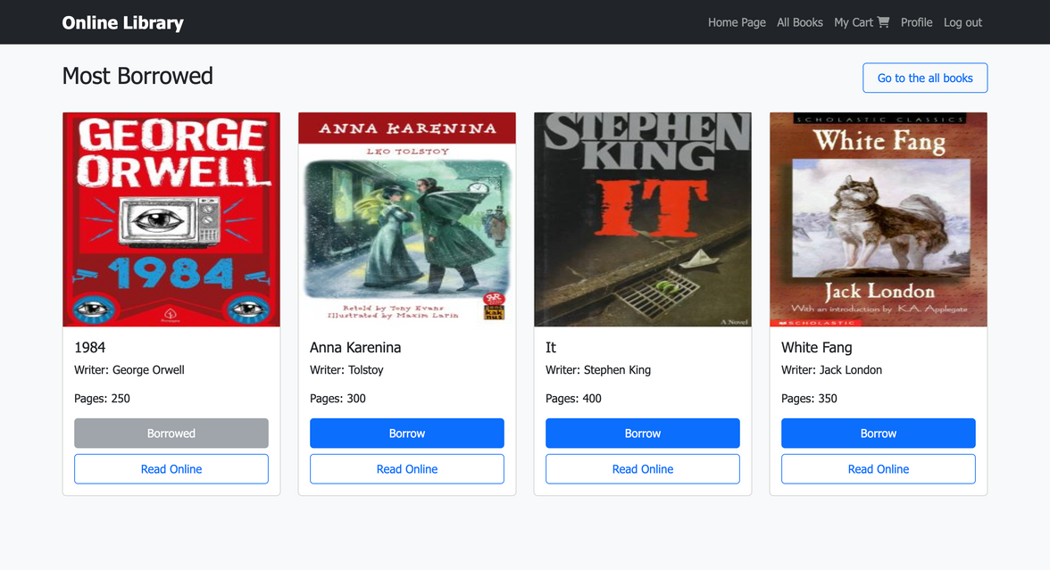
books page
When you click borrow,
borrow button change, because book added to your cart

Slide 9

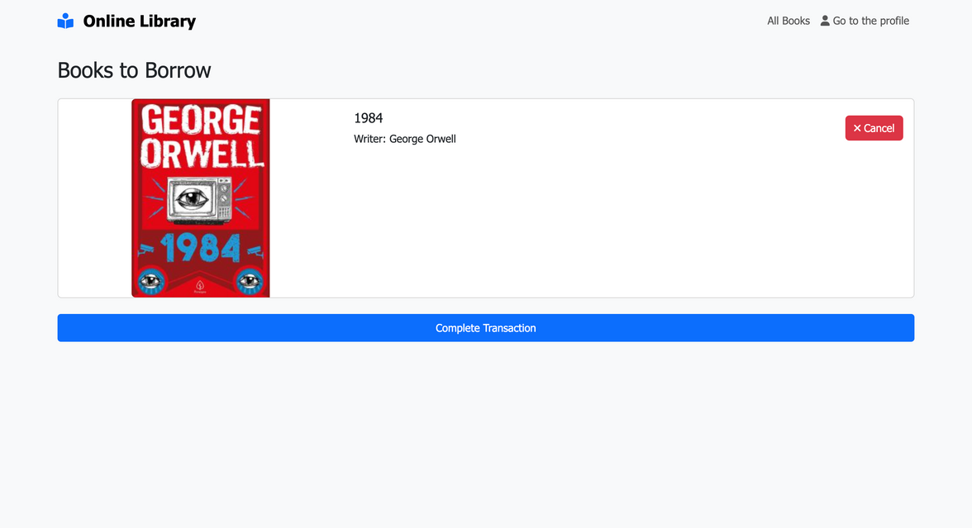
buy page
You can see what you want to borrow,
than you can complete transaction and you can borrow book

Slide 10
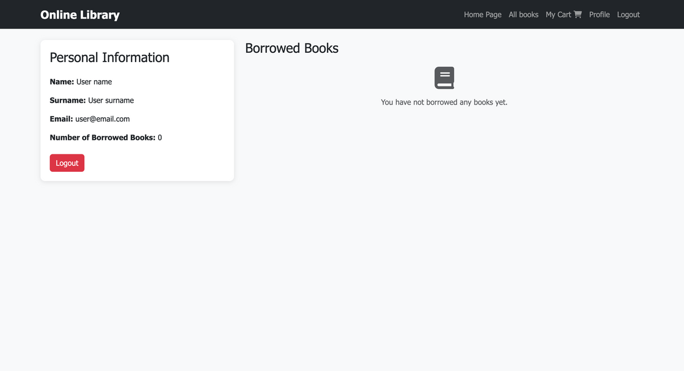
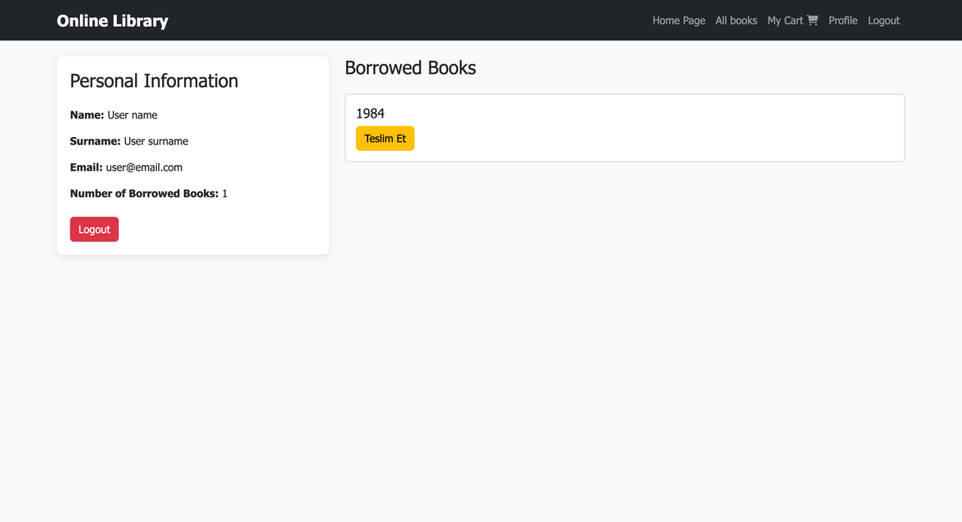
profıle page
When you borrow book,
you can return the book to the library.

Slide 11
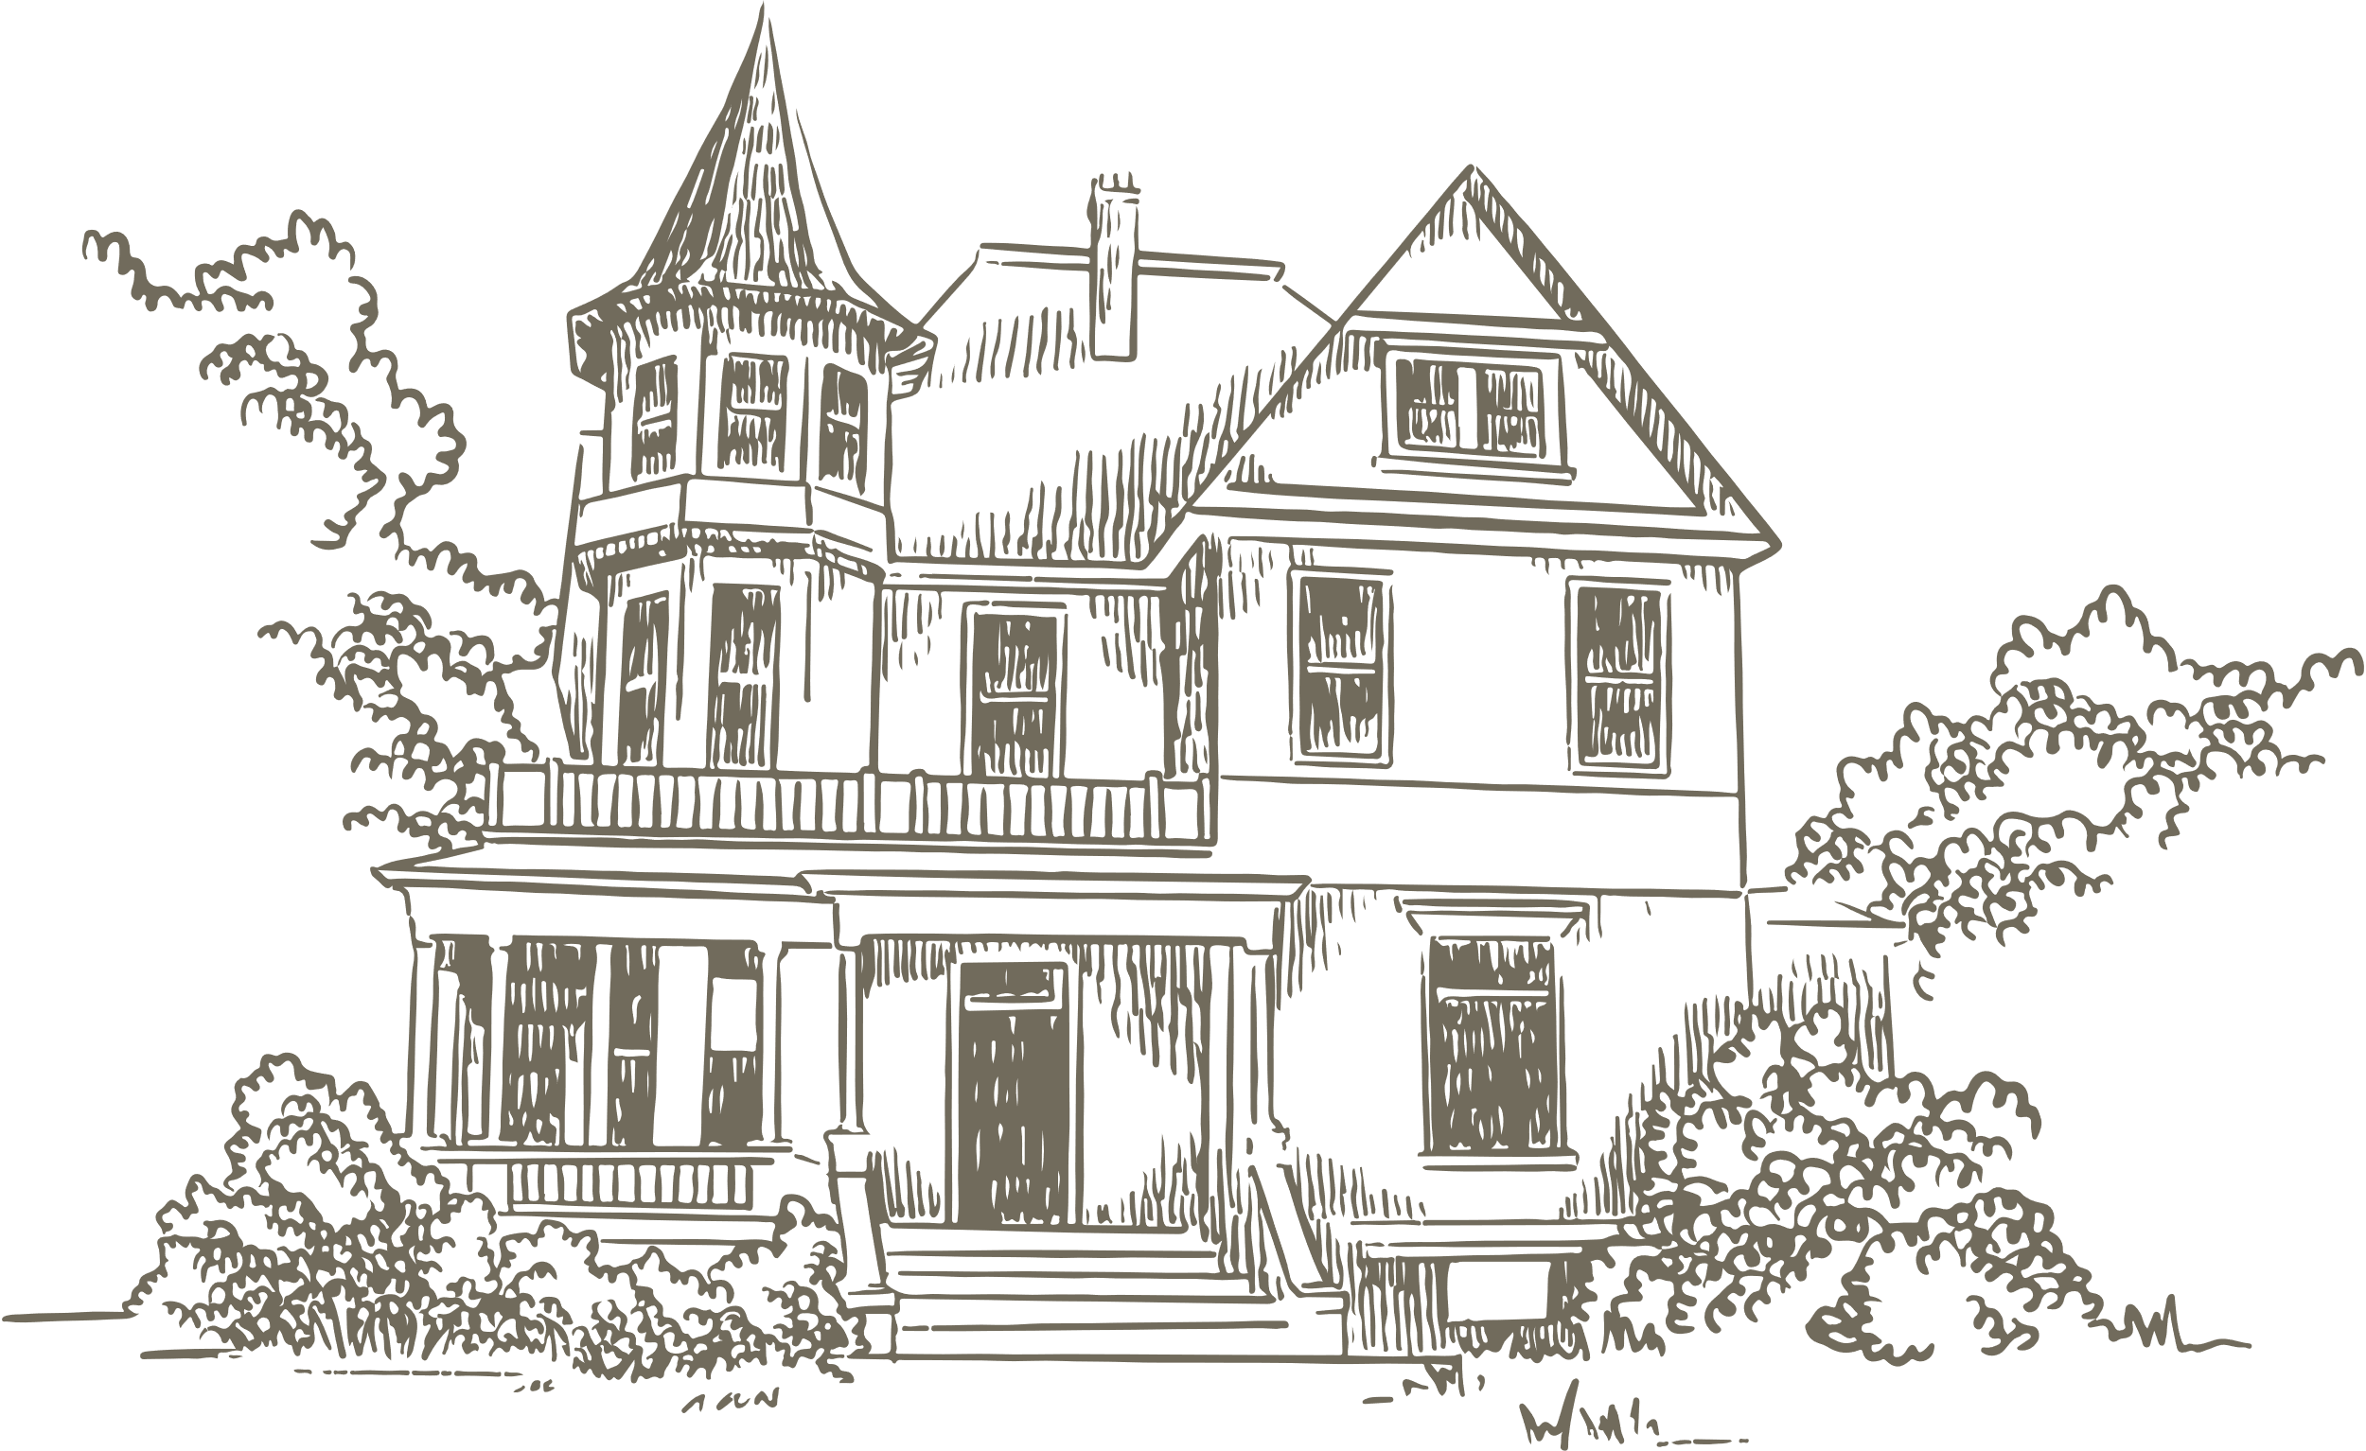
What features do we plan to develop in the future?
We can add how many days left when the user has to return the book after borrowing it
We can create a form where users can submit the books they want to see in our online library.
We can add user comments to books by adding comment and rating features
We can limit the number of books a user can borrow at a time

Slide 12

Technologies that we Used
HTML5
Css3
JavaScript (ES6+)
Bootstrap 5.3.0
Local Storage (for testing)
C# .net
PostgreSql

Slide 13
Thank You

