Slide 1

Using Using With With some SQL clauses you may not have tried
Todd Hepler – LIMS
August 2015

Slide 2
Before SQL
Notes:
I don’t expect you to read all this
This is an actual query I wrote
So what did it return?? <joke> just kidding
It produced some data that was useful in some way
Just notice the indenting and the subqueries – now lets deconstruct it

Slide 3
Before SQL (subqueries)
Notes:
Subquery – “correlated subquery” – a subquery in the select clause where a column name might be

Slide 4
Before SQL (subqueries)
Notes:
Embedded in another subquery, this one in a ‘from’ clause

Slide 5
Before SQL (subqueries)
Notes:
Embedded in another subquery, in another from clause

Slide 6
Before SQL (subqueries)
Notes:
Embedded in another subquery so that we make sure that the ‘order by’ happens after the ‘group by’
And so that we can order by some columns derived in the select clause
Maybe I could have used a ‘having’ clause after the ‘group by’, but I didn’t so…
Now we move on to some labels…

Slide 7
Before SQL (subqueries)
Notes:
Label called ‘x’ – that’s a good name

Slide 8
Before SQL (subqueries)
Notes:
A label called iiri – maybe a bit better name
II = index_illumina – to get into the domain a bit
That’s the main table that we’re querying here

Slide 9
Before SQL (subqueries)
Notes:
And a label called ‘y’ – to go along with ‘x’ – great name
Label – so when I come back to this to try to modify it I think
I’m a bad programmer – this looks bad – ugly – identifiers?!! X! Y! not good names….
So… can we do better
I got another request after that report, for an tweak
A good idea, but now I have to change this query
UGH!
So I was wanting to try using “with” clauses, and I decided to try them here – let’s look at the basic structure of ‘with’

Slide 10
SQL ‘with’ clause basics
with
foo as (…),
bar as (…),
baz as (…)
select …
from foo join bar … join baz … join other …
where …
group by …
order by …
Notes:
Here’s the basic structure of with clauses
With clause comes before the select – and then you can use the aliases in the from/join clauses like they were tables
We might think of it as
‘subquery factoring’
“inline view”
Here are the references…

Slide 11
SQL ‘with’ clause basics
with
foo as (…),
bar as (…),
baz as (…)
select …
from foo join bar … join baz … join other …
where …
group by …
order by …
Notes:
So… how nice is this compared to in-line subqueries???
“all’s fair if you predeclare” – sorta good, you declare them all up front before the select
I’m going to break down the “before” query that we started with into some ‘with’ clauses
Each ‘with’ clause will be trying to do one thing
I’m going to dive into bits of the new query. Let’s look at some “with” thingers

Slide 12
with iirl
Notes:
The main table we’re querying is index_illumina. Index_illumina typically has 2 read_illumina, and each of those has a length.
So we’re summing the lengths from the two rows for the read_length column, and then just renaming the seq_id
And I know I want a group by
So this query alone yields 1 row per row in index_illumina, with 2 columns: read_length and seq_id
That will be the theme of all these subqueries. All will be joined by seq_id, because that’s what I’m reporting on
IIRL = index illumina read length – not awesome name, but…

Slide 13
with iib
Notes:
IIB stands for index illumina BASES – as in base pairs
We’re doing an extension. Adding a column to the index illumina table

Slide 14
with iib
Notes:
Note that we’re referring to the previous subquery we just defined :: IIRL
So you may have to order your with clauses, by dependencies

Slide 15
with iid
Notes:
IID is for the DATE to be added to the index illumina
We need to join to another table for this. This one is one to one with index illumina (more or less)
But…

Slide 16
with iid
Notes:
But it has a 3 column foreign key
And one of the columns is a little more complicated

Slide 17
with iid
Notes:
And we have a filter – a restriction
A null DATE_COMPLETED means it’s not competed yet so we’re not interested in it
So when we join to this subquery, we’ll be filtering those out
This is the first filter I think we’ve seen here today

Slide 18
with iim
Notes:
IIM is for the MONTH

Slide 19
with iim
Notes:
It refers to IID that we’ve already seen
It’s so simple we could have just put it in IID
But I was being a purist and doing each step separately with it’s own subquery

Slide 20
with iia
Notes:
IIA – tells me if the index illumina has been ARCHIVED
Archived to tape. We don’t want to remove data if it hasn’t been put on tape
There’s probably a simpler way to do this. Convert to Boolean?

Slide 21
Whole with clause
Notes:
Ok, so here’s all 5 with clauses

Slide 22
Whole with clause
Notes:
There are some references
Now we’re done with ‘with’ – let’s move on to ‘using’ – because the title is using using with with

Slide 23
SQL ‘using’ basics
select *
from a join b on a.id = b.id
select *
from a join b using (id)
Notes:
Here is my understanding of ‘using’
Its seems a bit like a “natural join” to me – which is when you join on all columns that have the same name
But here you specify the columns – so a bit safer maybe than “natural join” in the face of a schema change

Slide 24
From clause
Notes:
I’m skipping the ‘select’ clause for now because it’s less interesting
So on to the ‘from’ clause, where we can use ‘using’ ☺

Slide 25
From clause
Notes:
Here are the ‘using’ key words
It just so happened that for all my joins, all the column names to join on were the same – maybe just lucky?

Slide 26
From clause
Notes:
Here are the identifiers that I defined in the ‘with’ clause – we join those using the seq_id
And then we join to 3 other tables that didn’t need to be involved in ‘with’ clauses

Slide 27
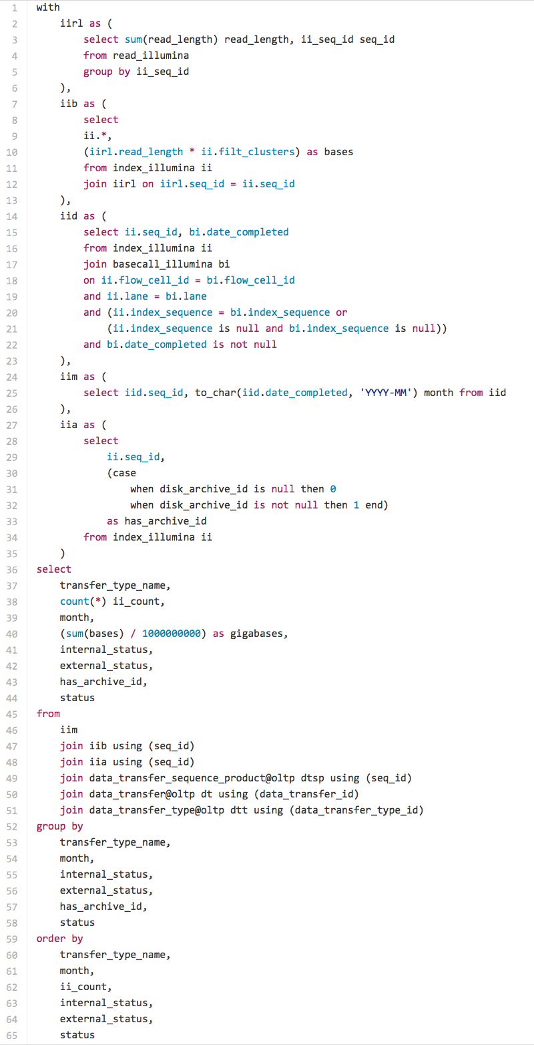
After (complete)

Slide 28
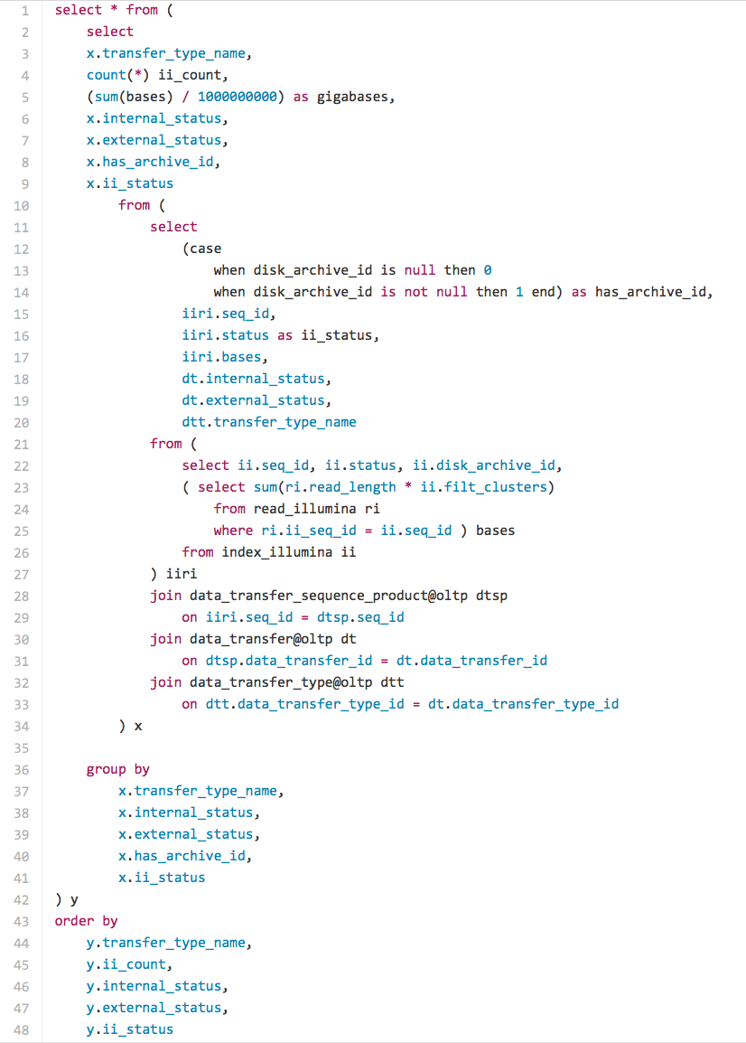
Side by Side
Notes:
These are actually not exactly the same query – so not apples to apples – but pretty close

Slide 29
Code size
Notes:
Lines, words, characters

Slide 30
Observations

Slide 31
Observations
with+using version is longer

Slide 32
Observations
with+using version is longer
but more decomposed

Slide 33
Observations
with+using version is longer
but more decomposed
There are no dots (.) outside the ‘with’ clauses
Notes:
The “with” clauses let you rename the columns so they line up nicely for the “using”
Then the joins, group by, order by and select clauses become simpler

Slide 34
Observations
with+using version is longer
but more decomposed
There are no dots (.) outside the ‘with’ clauses
strive for no dots?
Notes:
Dotless SQL? Should that be a thing?

Slide 35
Observations
with+using version is longer
but more decomposed
There are no dots (.) outside the ‘with’ clauses
strive for no dots?
with+using version seems easier to modify
Notes:
I took it forward and tweaked a few things from there
And because all the ugly was in the with clauses, it was mostly just tweaking group by, select, and order by

Slide 36
Acknowledgements
gist.github.com
Oracle SQL docs online
Thank you
Questions?
Notes:
gist for syntax highlighting

