Slide 1
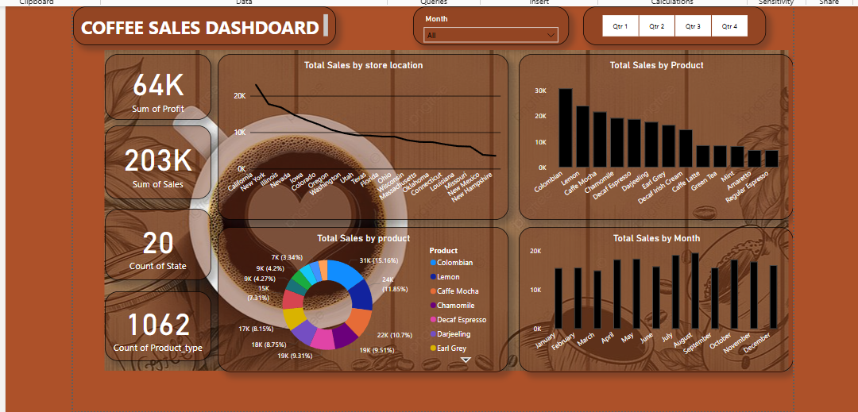
Coffee Sales Dashboard Summary
Sales Trends | Insights | Recommendations

Slide 2
Executive Summary
• Total Profit: 64K
• Total Sales: 203K
• Total States Analyzed: 20
• Product Types Sold: 1062

Slide 3
Top KPIs
• 📊 Profit Margin is healthy at 64K
• 💵 Revenue standing at 203K
• 📍 Coverage across 20 states
• 🛒 1062 unique product variants sold

Slide 4
Best Performing Products
• 🥇 Colombian - Top seller with 31K in sales
• 🍋 Lemon and ☕ Caffe Mocha follow closely
• 🛑 Hazelnut Espresso was least sold

Slide 5
Sales Trends by Month
• 📈 Peaks in May and October
• 📉 Dip noticed in July (seasonal impact)
• Suggests strong seasonal buying behavior

Slide 6
Quarterly Analysis Filters
• 🗓️ Interactive filters for Q1 to Q4
• 🔍 Enables targeted and seasonal analysis
• 📊 Enhances campaign performance tracking

Slide 7
Strategic Insights
• 📌 Double down on Colombian & Lemon variants
• 🎯 Promote offers during slow periods like July
• 📦 Monitor inventory in low-performing states
• 📍 Invest in high-demand regions

Slide 8
Thank You!
• For queries or custom dashboards, reach out.
• ☕ Keep brewing success!

