Slide 1



MACHINE DOWNTIME
This project focuses on addressing the critical issue of unplanned machine downtime in the manufacturing process of vehicle fuel pumps, which are essential for high-velocity fuel output and vehicle performance. The primary business objective is to reduce unplanned downtime by at least 10%, thereby enhancing productivity and achieving significant cost savings. The project aims to balance the reduction of downtime with the constraint of minimizing maintenance costs, targeting an economic success criterion of saving at least $1 million. Through strategic analysis and implementation, this initiative seeks to optimize machine performance and reliability, ensuring sustained operational efficiency for one of the leading vehicle fuel pump manufacturers.

Slide 2
Contents
Business Objective
Business Constraints
Project Architecture - Data Flow Diagram
Data Collection
Exploratory Data Analysis
Data Visualization
Notes:
Change

Slide 3
Business Problem
The core business problem revolves around frequent and unplanned machine downtime in the production of vehicle fuel pumps. This downtime disrupts the manufacturing process, leading to significant productivity losses. Unplanned stoppages not only delay production schedules but also increase operational costs due to urgent repairs and maintenance. Addressing this issue is crucial for maintaining consistent production flow, meeting customer demands, and achieving the company's financial and operational goals. The challenge lies in identifying the root causes of these unplanned downtimes and implementing effective solutions to mitigate them without escalating maintenance expenses.

Slide 4
Project Overview and Scope
This project aims to systematically reduce unplanned machine downtime in the manufacturing of vehicle fuel pumps. The scope includes analyzing the current manufacturing processes, identifying the primary causes of machine failures, and implementing targeted interventions to enhance machine reliability and performance. The project will focus on optimizing maintenance schedules, improving machine monitoring systems, and training staff to handle potential issues proactively. The scope is limited to the manufacturing facilities of the client and does not extend to the supply chain or distribution networks. Success will be measured by a 10% reduction in unplanned downtime and achieving cost savings of at least $1 million, all while keeping maintenance costs within the defined constraints.

Slide 5
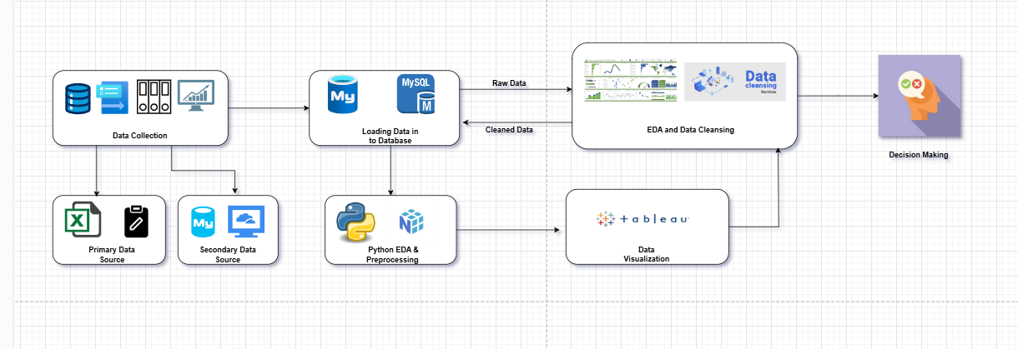
Data Dictionary

Slide 6
Exploratory Data Analysis [EDA]
Statistical Insights
Business Insights
To effectively address unplanned machine downtime, a comprehensive statistical analysis is essential. This involves collecting and analyzing data on the frequency, duration, and causes of machine failures. Key metrics include Mean Time Between Failures (MTBF), Mean Time to Repair (MTTR), and overall equipment effectiveness (OEE). By identifying patterns and trends in the data, we can pinpoint the most common causes of downtime, such as mechanical wear, operator error, or software issues. This statistical insight will guide the development of targeted strategies to reduce downtime, improve machine reliability, and optimize maintenance schedules. The analysis will also help in forecasting potential failures and implementing preventive measures to minimize disruptions in the manufacturing process.
Unplanned machine downtime has a profound impact on the business operations of vehicle fuel pump manufacturing. It leads to delayed production schedules, increased operational costs, and potential loss of customer trust due to missed deadlines. Financially, downtime results in lost revenue and higher expenses for emergency repairs and overtime labor. Operationally, it disrupts workflow efficiency and can lead to bottlenecks in the production line. By addressing downtime, the business can enhance its competitive edge, improve customer satisfaction, and achieve significant cost savings. The insights gained from analyzing downtime patterns will inform strategic decisions to optimize production processes, reduce costs, and improve overall business performance.
Notes:
EDA is used for seeing what the data can tell us before the modeling task.
Change

Slide 7
Data Preprocessing
Data preprocessing is a critical step in ensuring the accuracy and reliability of our analysis. In this project, I performed several key preprocessing tasks:
1:Type Casting: I converted data into appropriate formats to ensure consistency and compatibility across datasets. This included changing data types such as converting strings to numerical values where necessary.
2:Removing Duplicates: I identified and removed duplicate records to prevent skewed analysis and ensure that each data point is unique and representative.
3:Removing Outliers: I detected and addressed outliers that could distort our analysis. Outliers were either corrected or removed based on their impact on the overall dataset.
These preprocessing steps are essential for cleaning the data, reducing noise, and preparing a robust dataset for accurate analysis. By ensuring data quality, I can derive more reliable insights and make informed decisions to minimize machine downtime effectively
Notes:
Keep observations

Slide 8
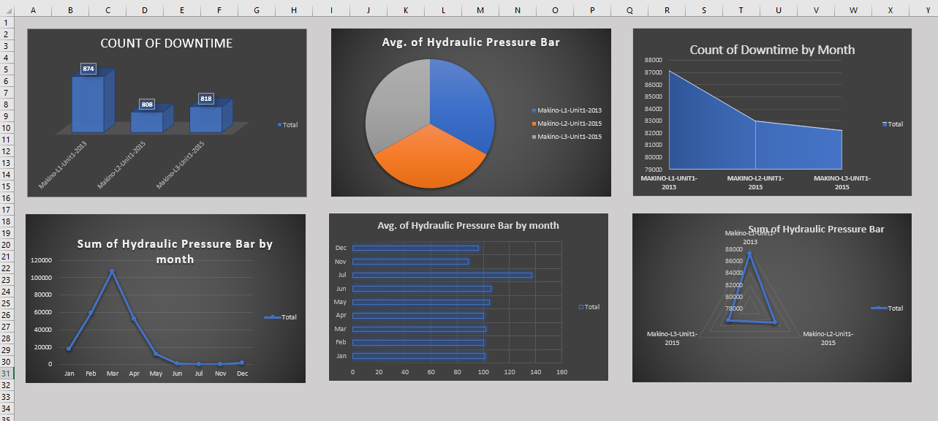
Data Visualization
Notes:
Add graphical

Slide 9


