Slide 1
MASTANI 2014
DAY 2 – exercise 3
scf and band structure calculations for Cu (metal)
Madhura Marathe
No input files available, but should be generated for practice.
Next two slides explain where changes need to be done for scf calculations.
Follow the similar procedure to find dos and band structure for Cu.
Refer to http://www.quantum-espresso.org/wp-content/uploads/Doc/INPUT_PW.html for more details

Slide 2
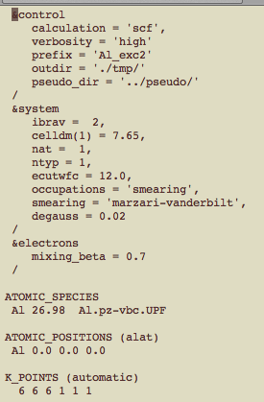
- Not system dependent!
- “prefix” should be changed preferably to avoid overwriting of wavefunctions and charge density.

Slide 3
1. What is the crystal structure for Cu?
2. Cu experimental lattice constant as a starting point?
3. Number of atoms in the unit cell?
4. How many different types of elements?
Need to specify which element,
which pseudopotential, and
atomic positions correct?
Convergence tests required for the new pseudopotential!!
NOTE – Cu pseudopotential available in day2/pseudo directory

