Slide 1
Hands on session:
PHONONS with Quantum ESPRESSO
Sharmila Shirodkar
Jawaharlal Nehru Centre for Advanced Scientific Research
Bangalore

Slide 2
Exercises
To calculate phonon frequencies at the Brillouin Zone centre (Γ-point) for silicon.
To calculate the phonon dispersion along high symmetry directions in the BZ for silicon.
To calculate the phonon frequencies in a polar material (AlAs), accounting for the presence of macroscopic electric fields and LO-TO splitting.
To calculate phonon dispersion of a metal (Al).

Slide 3
Exercise 1: phonon frequencies at Γ-point for silicon
Executables: pw.x and ph.x
Post processing: dynmat.x
To run the script: nohup sh run.sh &
Look in run.sh for
the sequence
Step1: run a scf calculation on the equilibrium structure
&electrons
mixing_mode = 'plain'
mixing_beta = 0.5
conv_thr = 1.0d-10
/
Smaller for scf calculations

Slide 4
Exercise 1: phonon frequencies at Γ-point for silicon
Step2: run a phonon calculation with ph.x
/usr/local/apps/espresso-5.1/bin/ph.x < si_ph_G.in > si_ph_G.out
&inputph
outdir='./tmp/',
prefix='si',
fildyn='si.dynmat_G',
tr2_ph=1.0d-14,
amass(1)=28.086
/
0.0 0.0 0.0
Path to temporary folder of scf
Prefix used in scf calculation
Name of file for saving dynamical matrix
Minimum threshold for convergence or smaller
Atomic mass of each atomic type:
If not specified it is read from the data file
q point at which frequencies are calculated (in 2pi/a format)

Slide 5
Exercise 1: phonon frequencies at Γ-point for silicon
In the output of ph.x: si_ph_G.out
omega( 1) = 0.437450 [THz] = 14.591747 [cm-1]
omega( 2) = 0.437450 [THz] = 14.591747 [cm-1]
omega( 3) = 0.437450 [THz] = 14.591747 [cm-1]
omega( 4) = 14.994107 [THz] = 500.149581 [cm-1]
omega( 5) = 14.994107 [THz] = 500.149581 [cm-1]
omega( 6) = 14.994107 [THz] = 500.149581 [cm-1]
Acoustic
modes
Optical
modes
The frequencies of acoustic modes at BZ centre are supposed
to be zero due to translational invariance

Slide 6
Exercise 1: phonon frequencies at Γ-point for silicon
In the si.dynmat_G file
q = ( 0.000000000 0.000000000 0.000000000 )
**************************************************************************
omega( 1) = 0.437450 [THz] = 14.591747 [cm-1]
( 0.294694 0.000000 -0.319422 0.000000 -0.557786 0.000000 )
( 0.294694 0.000000 -0.319422 0.000000 -0.557786 0.000000 )
omega( 2) = 0.437450 [THz] = 14.591747 [cm-1]
( -0.445392 0.000000 -0.543899 0.000000 0.076157 0.000000 )
( -0.445392 0.000000 -0.543899 0.000000 0.076157 0.000000 )
omega( 3) = 0.437450 [THz] = 14.591747 [cm-1]
( 0.463445 0.000000 -0.319599 0.000000 0.427873 0.000000 )
( 0.463445 0.000000 -0.319599 0.000000 0.427873 0.000000 )
omega( 4) = 14.994107 [THz] = 500.149581 [cm-1]
( -0.053967 0.000000 -0.110628 0.000000 0.696311 0.000000 )
( 0.053967 0.000000 0.110628 0.000000 -0.696311 0.000000 )
omega( 5) = 14.994107 [THz] = 500.149581 [cm-1]
( 0.635522 0.000000 -0.310019 0.000000 0.000000 0.000000 )
( -0.635522 0.000000 0.310019 0.000000 0.000000 0.000000 )
omega( 6) = 14.994107 [THz] = 500.149581 [cm-1]
( 0.305286 0.000000 0.625819 0.000000 0.123090 0.000000 )
( -0.305286 0.000000 -0.625819 0.000000 -0.123090 0.000000 )
**************************************************************************
eigenvectors

Slide 7
Exercise 1: phonon frequencies at Γ-point for silicon
The acoustic sum rule (ASR):
Due to translational invariance, the zone centre dynamical matrix
should allow a rigid translation of the solid as an eigenvector with
zero eigenfrequency. This leads to the sum rule:
Σ_{K} C_{Kα,K'β} = 0
K is atom index
α, β= x, y, z
Numercal inaccuracies lead to violation of accoustic sum rules for
force constant and effective charges.
Reasons:
●Insufficient k-point sampling.
●Large convergence thresholds.
●Small charge density cutoff (ecutrho) for ultrasoft PPs.

Slide 8
Exercise 1: phonon frequencies at Γ-point for silicon
Step 3: run dynmat.x with input file dynmat_Si_G.in
We apply ASR rule in this step
(skip step 3 for non-Γ q-point)
&input
fildyn='si.dynmat_G',
asr='simple',
filout='dynmat.out',
filxsf='dynmat.axsf',
/
Dynamical matrix file
Type of ASR rule
File that stores eigenvalues
and eigenvectors
XSF file: open in Xcrysden
to visualize the modes of vibration
/usr/local/apps/espresso-5.1/bin/dynmat.x < dynmat_Si_G.in > dynmat_Si_G.out

Slide 9
Exercise 1: phonon frequencies at Γ-point for silicon
Types of ASR in Quantum ESPRESSO
! asr character indicates the type of Acoustic Sum Rule imposed
! - 'no': no Acoustic Sum Rules imposed (default)
! - 'simple': previous implementation of the asr used
! (3 translational asr imposed by correction of
! the diagonal elements of the dynamical matrix)
! - 'crystal': 3 translational asr imposed by optimized
! correction of the dyn. matrix (projection).
! - 'one-dim': 3 translational asr + 1 rotational asr
! imposed by optimized correction of the dyn. mat. (the
! rotation axis is the direction of periodicity; it
! will work only if this axis considered is one of
! the cartesian axis).
! - 'zero-dim': 3 translational asr + 3 rotational asr
! imposed by optimized correction of the dyn. mat.
! Note that in certain cases, not all the rotational asr
! can be applied (e.g. if there are only 2 atoms in a
! molecule or if all the atoms are aligned, etc.).
! In these cases the supplementary asr are cancelled
! during the orthonormalization procedure (see below).
! Finally, in all cases except 'no' a simple correction
! on the effective charges is performed (same as in the
! previous implementation).

Slide 10
Exercise 1: phonon frequencies at Γ-point for silicon
dynmat.out file: Changes in eigenvalues and eigenvectors
diagonalizing the dynamical matrix ...
q = 0.0000 0.0000 0.0000
*****************************************************************
omega( 1) = 0.000000 [THz] = 0.000000 [cm-1]
( 0.000000 0.000000 -0.707107 0.000000 0.000000 0.000000 )
( 0.000000 0.000000 -0.707107 0.000000 0.000000 0.000000 )
omega( 2) = 0.000000 [THz] = 0.000000 [cm-1]
( -0.707107 0.000000 0.000000 0.000000 0.000000 0.000000 )
( -0.707107 0.000000 0.000000 0.000000 0.000000 0.000000 )
omega( 3) = 0.000000 [THz] = 0.000000 [cm-1]
( 0.000000 0.000000 0.000000 0.000000 -0.707107 0.000000 )
( 0.000000 0.000000 0.000000 0.000000 -0.707107 0.000000 )
omega( 4) = 14.987725 [THz] = 499.936680 [cm-1]
( 0.000000 0.000000 0.707107 0.000000 0.000000 0.000000 )
( 0.000000 0.000000 -0.707107 0.000000 0.000000 0.000000 )
omega( 5) = 14.987725 [THz] = 499.936680 [cm-1]
( 0.000000 0.000000 0.000000 0.000000 -0.707107 0.000000 )
( 0.000000 0.000000 0.000000 0.000000 0.707107 0.000000 )
omega( 6) = 14.987725 [THz] = 499.936680 [cm-1]
( -0.707107 0.000000 0.000000 0.000000 0.000000 0.000000 )
( 0.707107 0.000000 0.000000 0.000000 0.000000 0.000000 )
*****************************************************************

Slide 11
Exercise 2: phonon dispersion for silicon
Executables: pw.x and ph.x
Post processing: q2r.x, matdyn.x, plotband.x
To run the script: nohup sh run.sh &
Step1: run a scf calculation on the equilibrium structure
Same as step 1 in Exercise 1

Slide 12
Exercise 2: phonon dispersion for silicon
Step 2: run ph.x on a grid of q points
Look in si_ph.in file
&inputph
outdir='./tmp/',
prefix='si',
ldisp=.true.
nq1=4,nq2=4,nq3=4
fildyn='si.dynmat',
tr2_ph=1.0d-14,
amass(1)=28.086
/
Specifies that phonon calculations
are on a grid of q-points
4x4x4 grid of q-points
Run: nohup /usr/local/apps/espresso-5.1/bin/ph.x < si_ph.in > si_ph.out &

Slide 13
Exercise 2: phonon dispersion for silicon
ph.x generates si.dynmat0 to si.dynmat8 files
si.dynmat0 consists of the q-point grid
si.dynmat1 to si.dynmat8 consist of dynamical matrices for 4x4x4 grid of q-points
Step 3:
This step fourier transforms dynamical matrices from q-space (i.e. si.dynmat0 to si.dynmat8) to real space (R-space) force constant matrix (si444.fc). The q2r.in file
&input
fildyn='si.dynmat'
zasr='simple'
flfrc='si444.fc'
/
/usr/local/apps/espresso-5.1/bin/pw.xq2r.x < q2r.in > q2r.out

Slide 14
Exercise 2: phonon dispersion for silicon
Step 4:
This step involves generating the dynamical matrix (eigenvectors and eigenvalues) for an arbitrary q-point from the force constant matrix using Fourier interpolation.
Look in matdyn_Si_disp.in file
&input
asr='simple',
amass(1)=28.0855,
flfrc='si444.fc',
flfrq='si.freq',
q_in_band_form=.true.
/
5
0.0000000 0.0000000 0.0000000 10
0.0000000 0.0000000 1.0000000 10
0.5000000 0.0000000 1.0000000 10
0.5000000 0.5000000 0.5000000 10
0.0000000 0.0000000 0.0000000 1
Force constant matrix file
Output file
For band calculations
List of high symmetry points in 2pi/a followed by number of points between two high symmetry q-points

Slide 15
Exercise 2: phonon dispersion for silicon
Step 5: Run plotband.x to generate a file which can be plotted
We will run plotband.x interactively
prompt> /usr/local/apps/espresso-5.1/bin/plotband.x
We plot the band structure using a plotting software

Slide 16
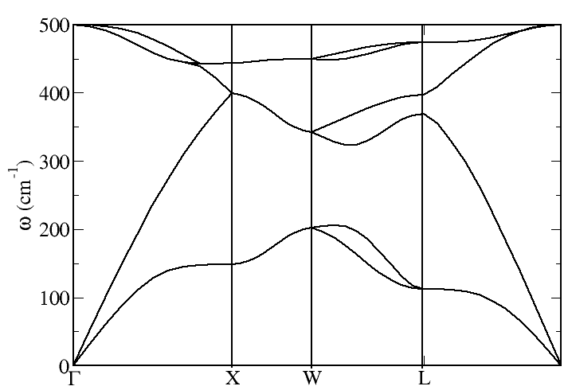
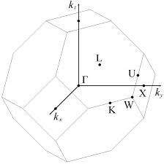
Exercise 2: phonon dispersion for silicon
BZ of FCC lattice

Slide 17
Exercise 2: phonon dispersion for silicon
Phonon density of states (DOS) using matdyn.x
The matdyn.x executable can also be used to calculate the phonon
density of states
Look in matdyn_Si_dos.in file
&input
asr='simple',
amass(1)=28.0855,
flfrc='si444.fc', flfrq='si.freq.dos'
dos=.true.,
fldos='si.dos'
deltaE=1.d0,
nk1=4, nk2=4, nk3=4,
/
Tag for calculating DOS
File with phonon DOS
Energy interval

Slide 18
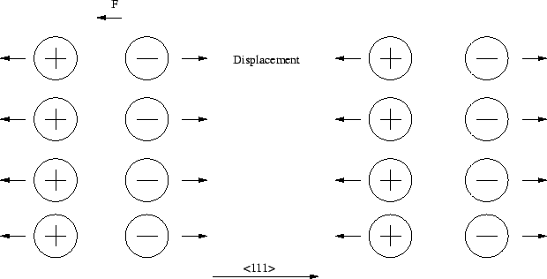
Exercise 3: LO-TO splitting for AlAs
In polar crystals, long range macroscopic electric fields arise that
are associated with long wave longitudinal optical (LO) phonons.
The long range electric fields associated with long-wavelength
LO phonons are responsible for removal of degeneracy between the LO and TO (Transverse Optical) phonons at the Brillouin zone centre (q= 0), and is known as LO-TO splitting.

Slide 19
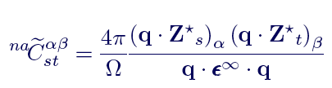
Exercise 3: LO-TO splitting for AlAs
A macroscopic electric field is incompatible with periodic boundary conditions (PBC).
Force constants need to be modified in the case of PBC to account for the
LO-TO splitting.
A non-analytic term involving the effective charges (polarization induced
by lattice distortion) and the dielectric tensor (polarization induced by electric field) is added to the force constants at gamma point.

Slide 20
Exercise 3: LO-TO splitting for AlAs
Executables: pw.x and ph.x
Post processing: dynmat.x
To run the script: nohup sh run.sh &
Step1: run a scf calculation on the equilibrium structure
&system
ibrav= 2, nat= 2, ntyp= 2,celldm(1)=10.58997,
ecutwfc =45, ecutrho=180
occupations='fixed', nbnd=8
/
&electrons
mixing_mode = 'plain'
mixing_beta = 0.5
conv_thr = 1.0d-10
/
Do a calculation with fixed
occupations
Keep small
covergence threshold

Slide 21
Exercise 3: LO-TO splitting for AlAs
Step2: run ph.x with alas_ph_G.in input file
&inputph
outdir='./tmp/',
prefix='alas',
fildyn='alas.dynmat_G',
epsil=.true.,
tr2_ph=1.0d-14,
amass(1)= 26.98,
amass(2)= 74.92,
/
0.0 0.0 0.0
To calculate born effective
charges and dielectric constant

Slide 22
Exercise 3: LO-TO splitting for AlAs
Output in alas_G_ph.out
Dielectric constant in cartesian axis
( 9.224845161 0.000000000 0.000000000 )
( 0.000000000 9.224845161 0.000000000 )
( 0.000000000 0.000000000 9.224845161 )
Effective charges (d Force / dE) in cartesian axis
atom 1 Al
Ex ( 2.15581 0.00000 0.00000 )
Ey ( 0.00000 2.15581 0.00000 )
Ez ( 0.00000 0.00000 2.15581 )
atom 2 As
Ex ( -2.17069 0.00000 0.00000 )
Ey ( 0.00000 -2.17069 0.00000 )
Ez ( 0.00000 0.00000 -2.17069 )
Diagonalizing the dynamical matrix
q = ( 0.000000000 0.000000000 0.000000000 )
**************************************************************************
omega( 1) = 0.153627 [THz] = 5.124437 [cm-1]
omega( 2) = 0.153627 [THz] = 5.124437 [cm-1]
omega( 3) = 0.153627 [THz] = 5.124437 [cm-1]
omega( 4) = 10.714684 [THz] = 357.403379 [cm-1]
omega( 5) = 10.714684 [THz] = 357.403379 [cm-1]
omega( 6) = 10.714684 [THz] = 357.403379 [cm-1]
**************************************************************************
ASR not satisfied
No LO-TO splitting

Slide 23
Exercise 3: LO-TO splitting for AlAs
Step3: run dynmat.x with dynmat_alas_G.in
&input
fildyn='alas.dynmat_G',
asr='simple',
amass(1)= 26.98,
amass(2)= 74.92,
q(1)=1.0, q(2)=0.0, q(3)=0.00,
filout='dynmat.out',
filxsf='dynmat.axsf',
/
Direction for approaching
Gamma point (q= 0)
Check output in dynmat_alas_G.out
# mode [cm-1] [THz] IR
1 0.00 0.0000 0.0000
2 0.00 0.0000 0.0000
3 0.00 0.0000 0.0000
4 357.40 10.7144 5.4432
5 357.40 10.7144 5.4432
6 395.39 11.8536 5.4432
LO-TO splitting
2 TO modes and 1 LO mode

Slide 24
Exercise 4: phonon dispersion of a metal (Al)
Repeat exercise 2
Notice the ecutwfc, ecutrho, conv_thr, kmesh
Do you think they are converged?
Check how phonons converge with the above parameters.

