Slide 1
Hands on session:
POLARIZATION via Berry phase with Quantum ESPRESSO
Sharmila Shirodkar
Jawaharlal Nehru Centre for Advanced Scientific Research
Bangalore

Slide 2
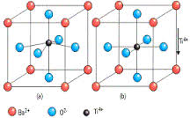
Exercises
To calculate polarization via Berry phase for symmetric tetragonal BaTiO₃
To optimize the structure of tetragonal BaTiO₃ with displaced Ti atom, and calculate the polarization via Berry phase
To determine the Born effective charges from Polarization for Cubic BaTiO₃
Asymmetric
Symmetric

Slide 3
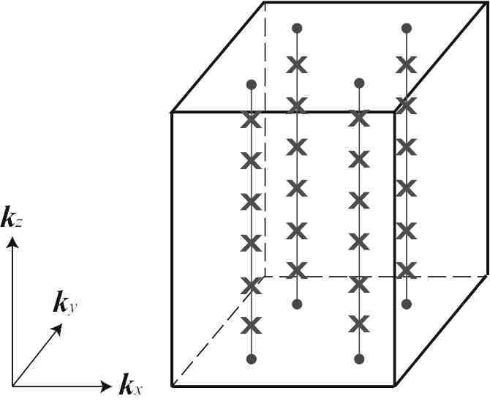
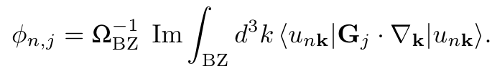
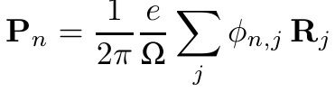
Steps that are followed
Do a total energy calculation that calculates the charge density (scf) with well converged kmesh and ecutwfc
Make sure that the system is insulating at every kpoint.
Berry phase is ill-defined for metals!
Run berry phase calculations (nscf) to
evaluate the Berry phase along k-point strings
Total polarization = Ionic part + electronic part
Spontaneous polarization= P(asymmetric cell) – P(symmetric cell)

Slide 4
Exercise 1: polarization of symmetric tetragonal BaTiO₃
Executable: pw.x
To run the script: nohup sh job_sy.sh &
Step1: run a scf calculation on the equilibrium structure
Look at sy.scf.in

Slide 5
Exercise 1: polarization of symmetric tetragonal BaTiO₃
Step2: run a nscf calculation with sy.bscf.in
/usr/local/apps/espresso-5.1/bin/pw.x < sy.bscf.in > sy.bscf.out
&control
calculation = 'nscf'
restart_mode='from_scratch',
prefix='symm',
pseudo_dir = '../../pseudo',
outdir='tmp-sy'
lberry=.true.
gdir = 3
nppstr = 10
/
K_POINTS {automatic}
10 10 20 0 0 0
nscf calculation
For doing Berry phase calculations
direction of the k-point strings in reciprocal space. Allowed values: 1, 2, 3 where 1= first, 2= second, 3=third reciprocal lattice vector
Number of kpoints in the string along gdir
nppstr = nk3

Slide 6
Exercise 1: polarization of symmetric tetragonal BaTiO₃
In sy.bscf.out
K-POINTS STRINGS USED IN CALCULATIONS
~~~~~~~~~~~~~~~~~~~~~~~~~~~~~~~~~~~~~
G-vector along string (2 pi/a): 0.00000 0.00000 0.97699
Modulus of the vector (1/bohr): 0.82171
Number of k-points per string: 10
Number of different strings : 6
IONIC POLARIZATION
~~~~~~~~~~~~~~~~~~ ============================
Ion Species Charge Position Phase
----------------------------------------------------------------------------
1 Ba 10.000 0.0000 0.0000 0.0000 0.00000 (mod 2)
2 Ti 12.000 0.5000 0.5000 0.5118 0.00000 (mod 2)
3 O 6.000 0.5000 0.5000 0.0000 0.00000 (mod 2)
4 O 6.000 0.5000 0.0000 0.5118 -1.00000 (mod 2)
5 O 6.000 0.0000 0.5000 0.5118 -1.00000 (mod 2)
----------------------------------------------------------------------------
IONIC PHASE: 0.00000 (mod 2)
nppstr
Depends on nk1 and nk2
No contribution
from ions!

Slide 7
Exercise 1: polarization of symmetric tetragonal BaTiO₃
In sy.bscf.out
ELECTRONIC POLARIZATION ~~~~~~~~~~~~~~~~~~~~~~~
Note: (mod 1) means that the phases (angles ranging from
-pi to pi) have been mapped to the interval [-1/2,+1/2) by
dividing by 2*pi; (mod 2) refers to the interval [-1,+1)
=============================================
Spin String Weight First k-point in string Phase
----------------------------------------------------------------------------
up 1 0.040000 0.0000 0.0000 0.0000 0.00000 (mod 1)
up 2 0.160000 0.0000 0.2000 0.0000 0.00000 (mod 1)
...
Up 5 0.320000 0.2000 0.4000 0.0000 0.00000 (mod 1)
Up 6 0.160000 0.4000 0.4000 0.0000 0.00000 (mod 1)
----------------------------------------------------------------------------
down 1 0.040000 0.0000 0.0000 0.0000 0.00000 (mod 1)
down 2 0.160000 0.0000 0.2000 0.0000 0.00000 (mod 1)
...
Down 5 0.320000 0.2000 0.4000 0.0000 0.00000 (mod 1)
Down 6 0.160000 0.4000 0.4000 0.0000 0.00000 (mod 1)
----------------------------------------------------------------------------
nk1
and nk2
The total phase and polarization in symmetric structure = 0
No contribution from electrons!

Slide 8
Exercise 2: polarization of asymmetric tetragonal BaTiO₃
Executable: pw.x
Step1: Displace Ti atom in +z direction and relax the structure. Look in relax.in file
&control
calculation = 'relax'
restart_mode='from_scratch',
prefix='asymm-relax',
tstress = .true.
tprnfor = .true.
pseudo_dir = '../../pseudo',
outdir='tmp'
/
ATOMIC_POSITIONS {crystal}
Ba 0.0000 0.0000 0.0000
Ti 0.5000 0.5000 0.5200
O 0.5000 0.5000 0.0000
O 0.5000 0.0000 0.5000
O 0.0000 0.5000 0.5000
Structural relaxation calculation
Ti atom is displaced along z
/usr/local/apps/espresso-5.1/bin/pw.x < relax.in > relax.out

Slide 9
Exercise 2: polarization of asymmetric tetragonal BaTiO₃
Look at the final relaxed co-ordinates in relax.out file
ATOMIC_POSITIONS (crystal)
Ba 0.000000000 0.000000000 0.020604613
Ti 0.500000000 0.500000000 0.530311403
O 0.500000000 0.500000000 -0.015428482
O 0.500000000 0.000000000 0.492256232
O 0.000000000 0.500000000 0.492256232
Use the above co-ordinates in asy.scf.in and asy.bscfx.in,
asy.bscfy.in and asy.bscfz.in files

Slide 10
Exercise 2: polarization of asymmetric tetragonal BaTiO₃
Step2: Repeat Steps 2 and 3 from exercise 1
In asy.bscf.out
IONIC POLARIZATION
~~~~~~~~~~~~~~~~~~ ============================
Ion Species Charge Position Phase
----------------------------------------------------------------------------
1 Ba 10.000 0.0000 0.0000 0.0211 0.20605 (mod 2)
2 Ti 12.000 0.5000 0.5000 0.5428 0.36374 (mod 2)
3 O 6.000 0.5000 0.5000 -0.0158 -0.09257 (mod 2)
4 O 6.000 0.5000 0.0000 0.5038 0.95354 (mod 2)
5 O 6.000 0.0000 0.5000 0.5038 0.95354 (mod 2)
----------------------------------------------------------------------------
IONIC PHASE: 0.38429 (mod 2)
Finite contribution
from ions!

Slide 11
Exercise 2: polarization of asymmetric tetragonal BaTiO₃
In asy.bscfz.out
ELECTRONIC POLARIZATION ~~~~~~~~~~~~~~~~~~~~~~~
Note: (mod 1) means that the phases (angles ranging from
-pi to pi) have been mapped to the interval [-1/2,+1/2) by
dividing by 2*pi; (mod 2) refers to the interval [-1,+1)
=============================================
Spin String Weight First k-point in string Phase
----------------------------------------------------------------------------
up 1 0.040000 0.0000 0.0000 0.0000 0.06891 (mod 1)
up 2 0.160000 0.0000 0.2000 0.0000 0.03158 (mod 1)
...
up 5 0.320000 0.2000 0.4000 0.0000 -0.02818 (mod 1)
up 6 0.160000 0.4000 0.4000 0.0000 -0.05090 (mod 1)
----------------------------------------------------------------------------
down 1 0.040000 0.0000 0.0000 0.0000 0.06891 (mod 1)
down 2 0.160000 0.0000 0.2000 0.0000 0.03158 (mod 1)
...
down 5 0.320000 0.2000 0.4000 0.0000 -0.02818 (mod 1)
down 6 0.160000 0.4000 0.4000 0.0000 -0.05090 (mod 1)
----------------------------------------------------------------------------
ELECTRONIC PHASE: -0.01845 (mod 2)
Finite contribution from electrons!
Total polarization is non-zero along z!

Slide 12
Exercise 2: polarization of asymmetric tetragonal BaTiO₃
In asy.bscf.out
SUMMARY OF PHASES
~~~~~~~~~~~~~~~~~
Ionic Phase: 0.38429 (mod 2)
Electronic Phase: -0.01845 (mod 2)
TOTAL PHASE: 0.36584 (mod 2)
VALUES OF POLARIZATION
~~~~~~~~~~~~~~~~~~~~~
The calculation of phases done along the direction of vector 3
of the reciprocal lattice gives the following contribution to
the polarization vector (in different units, and being Omega
the volume of the unit cell):
P = 2.7973956 (mod 15.2930243) (e/Omega).bohr
P = 0.0065551 (mod 0.0358362) e/bohr^2
P = 0.3747686 (mod 2.0488144) C/m^2
The polarization direction is: ( 0.00000 , 0.00000 , 1.00000 )
Sum of electronic
and ionic phases
Sum of electronic
and ionic phases
P= -ie/(2π³)*berry phase
Polarization
quantum
Polarization in
different units

Slide 13
Exercise 2: polarization of asymmetric tetragonal BaTiO₃
Polarization of tetragonal BaTiO₃
P(asymmetric phase)- P(symmetric phase)
= 37 μC/cm² - 0 μC/cm²
= 37 μC/cm²
Why is the polarization not same as in experiments (26 μC/cm² )?
Check the convergence of P with nppstr and nk1, nk2

Slide 14
Exercise 3: Born Effective charges for cubic BaTiO₃
Step1: Look at scf.in
The Ti atom is displaced by +z direction by 0.01a
Step2: Look at bscf.in
Now run a berry phase calculation along gdir=3
Step3: Calculate the Born Effective charge
dP
Z* = Omega ----
dr

