Slide 1
Response approach to the effective Hamiltonian multi-reference coupled cluster theory
Sourav Pal
Physical Chemistry Division
National Chemical Laboratory
Pune, India

Slide 2
Model Theoretical Chemistry
Unified model to describe ground and excited states of different symmetry and of general applicability
Efficient summing up of dynamical correlation, which is important around equilibrium.

Slide 3
In near-degenerate cases, a few equally important determinants contribute. Theory must include this non-dynamical electron correlation correctly
Balanced treatment of electron correlation in different states of interest
Correct scaling of energies and properties
Correct separation limit results

Slide 4
Electron Correlation
Instantaneous repulsion between electrons, which can not be accounted by spherical averaging
In the actual interacting problem, electrons tend to avoid each other, but in Hartree-Fock theory electrons with only parallel spins avoid each other
Correlation of electrons with anti-parallel spins

Slide 5
Electron correlation methods include configuration interaction, perturbation theory, various coupled pair theories , coupled cluster theory etc.
Perturbation theory is based on perturbation expansion of the energy and wave function in terms of the residue perturbation operator, which is the difference of actual two particle interaction and the its spherically averaged part.

Slide 6
Configuration Interaction Method
ψ₀ = c ₀Φ ₀ + Σ_{i,a} c _{i}ª Φ _{i}ª + Σ_{i≤j} _{a ≤b} c _{ij}, ^{ab}Φ_{ij} ^{ab}
Linear combination of determinants generated by ordered excitation of electrons from occupied spin orbitals to the virtual orbitals. The coefficients are obtained by a variational principle.
Matrix linear eigen-value problem

Slide 7
H C = C E
H is a matrix of the Hamiltonian over the determinants and C is the matrix of the coefficients and E is diagonal matrix containing the energies of the states as diagonal elements.
Approximate CI is size-inextensive and does not separate correctly into its fragments.

Slide 8
Coupled cluster method
Coupled cluster is a well established method. Unlike CI it is nonlinear in structure. Use of exponential excitation operator instead of linear operator is the genesis of the coupled cluster method.
⎥ Ψ ⟩ =exp (T) ⎮Φ_{HF}⟩
T : hole particle excitations on ⎮Φ_{HF}⟩ , it can be decomposed as
T = T₁ + T₂ + T₃ + ……T_{n}

Slide 9
T₁ = ∑_{i,a} t_{i}ª {a⁺i } , T ₂ = ∑_{i j, ab}(1/ 2!)² t _{ij} ^{ab} { a⁺ b⁺ j i }
i,j,k, etc are occupied spin orbitals and a,b,c, are the
unoccupied orbitals.
With ⎪Φ _{HF} > as hole-particle vacuum, a⁺,b⁺ are the particle creation operators and i,j, are the hole creation operators.
⎮ψ_{ccsd} ⟩ = exp (T₁ + T₂ ) ⎪Φ _{HF}⟩
J. Cizek JCP 45, 4256 (1966); Bartlett and co-workers

Slide 10
Standard Coupled-cluster equations are obtained by method of projecting the Schrodinger’ s equation to the Hartree-Fock and excited determinants
H exp (T) ⎮Φ_{HF}⟩ = E_{o} exp (T) ⎮Φ_{HF}⟩
Pre-multiplying by exp ( -T) and projecting to the Hartree-Fock and excited determinants,
⟨Φ_{HF}⎮exp (-T) H exp (T) ⎮Φ_{HF}⟩ = E_{o}
⟨Φ*⎮exp (-T) H exp (T) ⎮Φ_{HF}⟩ = 0

Slide 11
Φ* are excited state determinants
exp (-T) H exp (T) has Campbell Backer Hausdorff multi-commutator expansion
exp (-T) H exp (T) = H + [ H, T] + ½ ! [[ H, T], T] +
Diagrammatically, this leads to a fully connected operator , where the first T is connected to H and every T is connected to the piece of connected H,T. However, since T can not connect to itself ( because of the special structure of T’s defined by the same vacuum ), every T must be connected to H.

Slide 12
General non-linear equation, quartic for CCSD
A + BT + CT T + DT T T + E T T T T =0
Important consequences:
· Size extensive theory ( proper scaling)
· CBH expansion formally truncates

Slide 13
Multi-Reference coupled cluster theories
    Fock space coupled cluster method
Valence universal cluster operator to correlate systems with different number of valence electrons
Single vacuum

Slide 14
Advantages::
Energy difference calculations , IP,EA,and EE
Disadvantages::
Potential energy surfaces difficult to calculate due to intruder State problem

Slide 15
Hilbert space coupled cluster method
As many cluster operators as the number of states with a given fixed number of valence electrons
Advantages::
Potential energy surfaces are easy to get
Disadvantages::
Difference energies are difficult to get

Slide 16
MRCC effective Hamiltonian approach
Define quasi degenerate model space P
P_{o} = ∑⏐Φ_{μ}⟩ ⟨Φ_{μ}⎟
ψ = ∑_{i} C_{iμ} |Φ_{μ} >
Transform Hamiltonian by Ω to obtain an effective Hamiltonian such that it has same eigen values as the real Hamiltonian

Slide 17
P_{o} H_{eff} P_{o} = P_{o} H Ω P_{o}
( H_{eff})_{ij} C _{jμ} = E _{μ} C _{μI}
Obtain energies of all interacting states in model
space by diagonalizing the effective Hamiltonian
Over the small model space P.

Slide 18
Simple formulation of effective Hamiltonian
theory
H exp (T ) ∑_{i} C_{μi} |Φ_{i} > = E_{μ} exp (T ) ∑_{i} C_{μi} | Φ_{i} >
(H_{eff}) _{ji} = < Φ _{j}| exp (-T) H exp (T) | Φ_{i} >
Due to different structure of T’s, special effort
need be made to prove linked cluster
expansion of the operator.

Slide 19
More efficient formulation of solution of effective Hamiltonian is due to Bloch, Des Cloizeaux and Kubo
( Mukherjee, Lindgren, Kutzelnigg)
Effective Hamiltonian defined over the smaller dimension
Eigen values of H_{eff} are the exact energies of the system
Multiple states at a time at a particular geometry

Slide 20
Multi- reference coupled cluster thus is more general and powerful electronic structure theory
To make the theory applicable to energy derivatives like properties or gradients, Hessians etc., it is important to develop linear response to the MRCC theory
S. Pal, Phys. Rev A 39, 39, (1989); S. Pal, Int. J. Quantum Chem, 41, 443 (1992); D. Ajitha, N. Vaval and S.Pal, J Chem Phys 110, 8236 (1999); J. Chem Phys 114, 3380 (2001); K R Shamasundar and S. Pal, J. Chem. Phys. 114, 1981 (2001); Int. J. Mol. Sci. 3, 710 (2002)

Slide 21
Hilbert space MRCC method
|Ψ> = ∑ exp (T_{μ}) |Φ_{μ}⟩ C_{iμ}
Ω = ∑ exp (Tμ) |Φμ> <Φμ |
Wave operator for a system with fixed number of electrons
Equations for T_{μ} are obtained by Q projection of Bloch Lindgren equation.

Slide 22
⟨χ_{l} ( μ) |exp (-Tμ) H exp (Tμ) |Φμ⟩= ∑_{λ≠μ} H_{λμ} ^{eff}
⟨χ _{l} (μ ) | exp (-Tμ ) exp (T_{λ}) |Φ_{λ} ⟩
H_{λμ} ^{eff} = ⟨ Φ_{μ}⎥ exp(-T_{μ}) H exp (T_{μ}) |Φ_{μ}⟩
Linear Response of HSMRCC theory
H^{eff} C ⁽¹⁾ + H^{eff} ⁽¹⁾ C = C E ⁽¹⁾ + C⁽¹⁾ E
[ H^{eff} ⁽¹⁾ ] _{μν} = ⟨Φ_{ν}⎟ exp (-T_{μ}) { H⁽¹⁾ + [H, T_{μ} ⁽¹⁾ ] }
exp (T_{μ}) |Φ_{μ}>

Slide 23
Compact expression
[H^{eff} ⁽¹⁾ ] _{μν} = Y(ν,μ)•Τμ + Χ(ν,μ) • Fμ (1)
+Q(ν,μ)• V⁽¹⁾
⟨χ _{l} (μ)⎟exp (-T_{μ}){ H⁽¹⁾ + [H, T_{μ}⁽¹⁾ ]}
exp (T_{μ})⎥ Φ μ ⟩ = ∑λ≠μ
[ H_{λμ}^{eff} ⟨χ_{l}(μ)⎮exp (-T_{μ}) (T⁽¹⁾_{λ} - T⁽¹⁾_{μ})
exp (T_{λ}) | Φ_{λ} > +H _{λμ}^{eff(1)} ⟨χ_{l}(μ) ⎟ exp (-T_{μ})
exp(T_{λ}) ⎥Φ_{λ}⟩ μ = 1,….M

Slide 24
Z- Vector method for HSMRCC theory
In a compact form the response equation may be written as,
A T ⁽¹⁾ = B
A : Perturbation -independent matrix
B : Perturbation-dependent column vector
Eliminate perturbation-dependent T⁽¹⁾ in energy expression

Slide 25
Z-vector solved from a perturbation independent linear equation
For a single state I in HSMRCC case
E _{I} ⁽¹⁾ = ∑_{ν} C' _{iν} [H_{eff} ⁽¹⁾ ] _{νμ} C_{iμ}
Simplified expression
E _{I} ⁽¹⁾ = Y (I) * T ⁽¹⁾ + X(I) * F⁽¹⁾ + Q(I)* V⁽¹⁾

Slide 26
    Define Z-vector Z(I)through Matrix equation
Y (I) = Z (I) A
E _{I} ⁽¹⁾ expressed in terms of z-vector
E _{I} ⁽¹⁾ ⁼ Z ( I) * B + X (I) F ⁽¹⁾ + Q (I) * V ⁽¹⁾
    Z - vector although perturbation independent, still depends on state of interest
    No - Z- vector for all roots at the same time

Slide 27
Fock Space Multi-reference Coupled-Cluster Approach
( Mukherjee and Pal, Adv. Quant. Chem. 20, 291 ,1989)
N-electron RHF chosen as a vacuum, with respect to which holes and particles are defined.
Subdivision of holes and particles into active and inactive space, depending on model space
General model space with m-particles and n-holes
ψ_{μ} ^{(0) (m,n)} ₌ Σ _{i}C _{iμ} Φ_{I} ^{(m,n)}

Slide 28
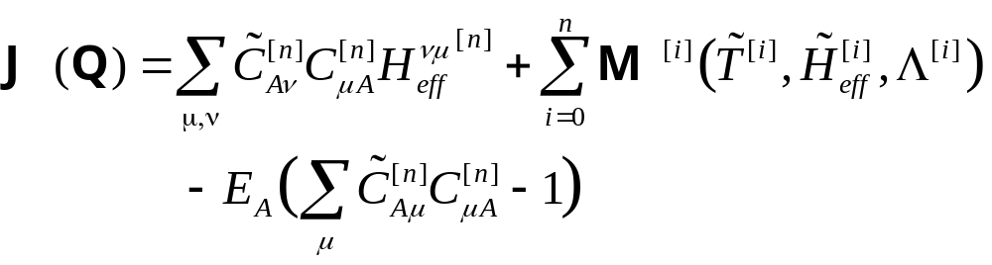
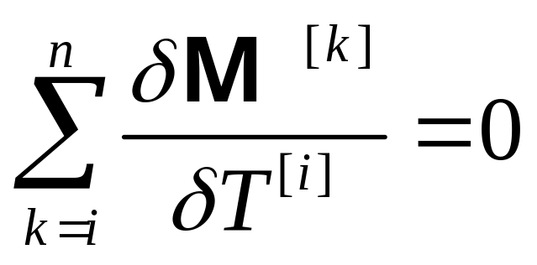

Slide 29
Variants of Multi-reference CC
Effective Hamiltonian theory: Effective Hamiltonian over the model space of principal determinants constructed and energies obtained as eigen values of the effective Hamiltonian
Valence-universal or Fock space: Suitable for difference energies ( Mukherjee, Kutzelnigg, Lindgren, Kaldor and others)
Common vacuum concept; Wave-operator consists of hole-particle excitation and de=excitation of active holes and particles
State-universal or Hilbert space: Suitable for the potential energy surface. Each determinant acts as a vacuum ( Jeziorski and Monkhorst, Jeziorski and Paldus, Balkova and Bartlett)

Slide 30
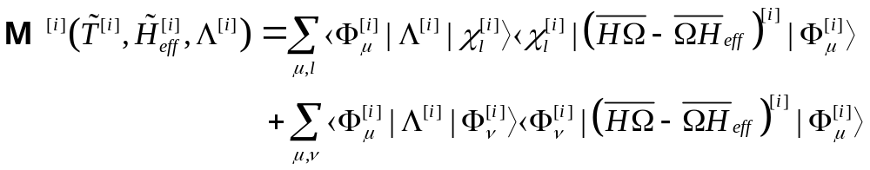
Structure of FSMRCC response equations

Slide 31
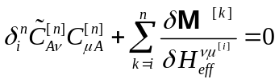

Structure of FSMRCC response equations
The stationary equations are obtained by making the Lagrange functional stationary with respect to the T amplitudes, Λ amplitudes and effective Hamiltonian elements.

Slide 32
Structure of FSMRCC response equations

