Slide 1



Hands-on: Advanced functionals
Iurii Timrov
Theory and Simulation of Materials (THEOS), and National Centre for Computational Design and Discovery of Novel Materials (MARVEL),
École Polytechnique Fédérale de Lausanne (EPFL), Lausanne, Switzerland
Summer School on Advanced Materials and Molecular Modelling with Quantum ESPRESSO
Ljubljana, Slovenia
17 September 2019

Slide 2
Outline
Exercise 1: DFT+U study of FeO
Exercise 2: DFT with hybrid functionals: study of Si
Exercise 3: DFT with Van der Waals functionals: study of graphite

Slide 3
Outline
Exercise 1: DFT+U study of FeO
Exercise 2: DFT with hybrid functionals: study of Si
Exercise 3: DFT with Van der Waals functionals: study of graphite

Slide 4

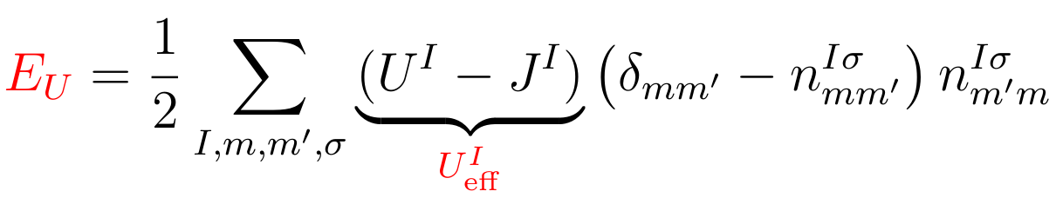
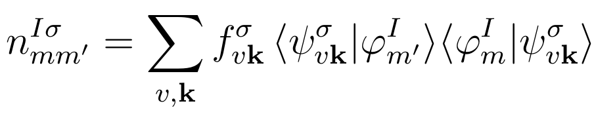
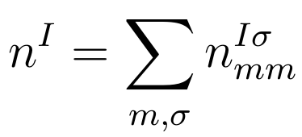
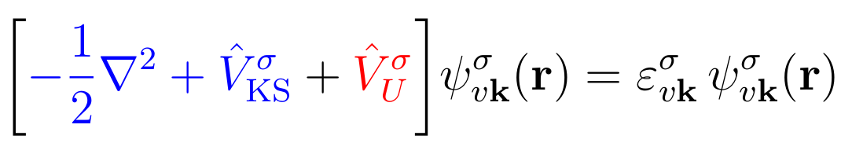
DFT+U
The DFT+U total energy:
The Hubbard correction energy:
effective Hubbard
parameter
The occupation matrix:
The total occupation of localized states (d or f) at site I :
The Kohn-Sham equation:

Slide 5
Localized-states manifold
How do we know to what states of a Hubbard atom the Ueff correction will be applied?
Currently, this is hard-coded (in Quantum ESPRESSO 6.4.1)
Check two subroutines in quantum-espresso/Modules :
set_hubbard_n.f90
set_hubbard_l.f90
principal quantum number “n”
orbital quantum number “l”
For Fe : n = 3
For Fe : l = 2
Apply the Hubbard Ueff correction to the 3d electrons of Fe

Slide 6
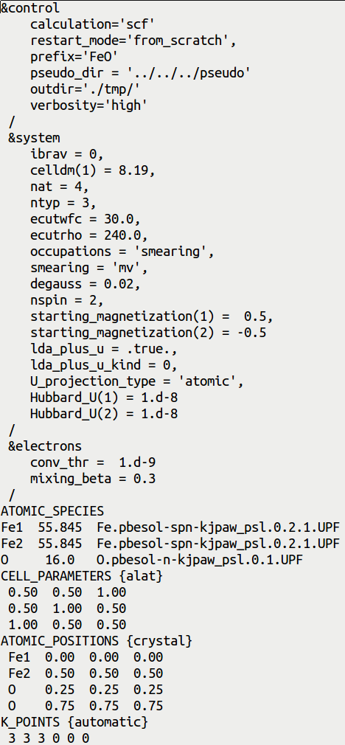
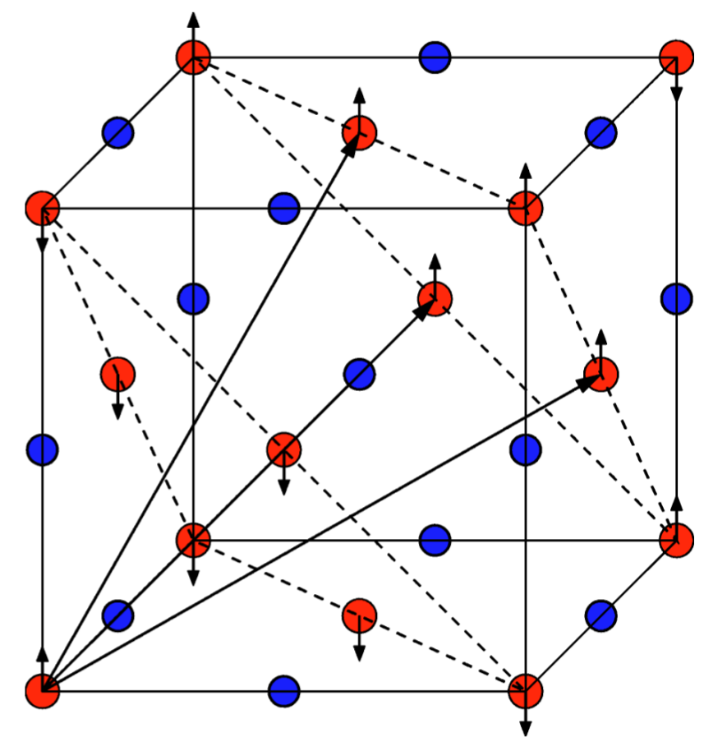
Input file pw.FeO.scf.in
SCF calculation
Experimental lattice parameter
'MV' smearing for metals (FeO is metallic @PBEsol)
Spin-polarized (collinear) calculation
(antiferromagnetic ordering)
Initialize Hubbard parameters for two types of Fe
Two sublattices of Fe atoms
O
Fe

Slide 7
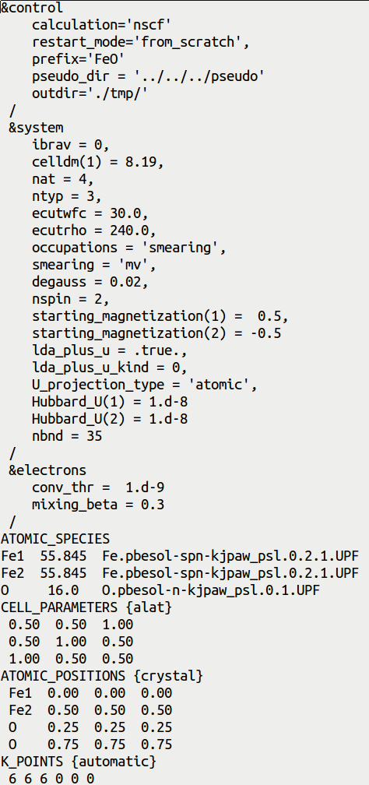
Input file pw.FeO.nscf.in
NSCF calculation
NSCF input is very similar to the SCF input,
but there a few differences which are
highlighted here
Number of electronic bands
Projected DOS must be converged with respect to
the number of k points. Also, number of bands must
be large enough, to have converged projected DOS
in a specific energy range. All this is controlled here.
k points mesh which is denser than in SCF

Slide 8
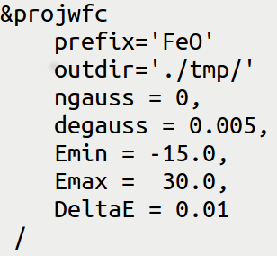
Input file projwfc.FeO.in
Gnuplot script: plot_pdos.gnu
Simple Gaussian broadening of PDOS
Value of Gaussian broadening, in Ry (not eV!)
Minimum and maximum value of energy for the plot, in eV
Energy grid step
Inspect the script: it aims at plotting Fe-3d state (majority spin and minority spin)
and O-2p states.
PDOS is shifted such that the Fermi energy corresponds to the zero of energy.
Visualize the file “FeO_PDOS.eps”

Slide 9
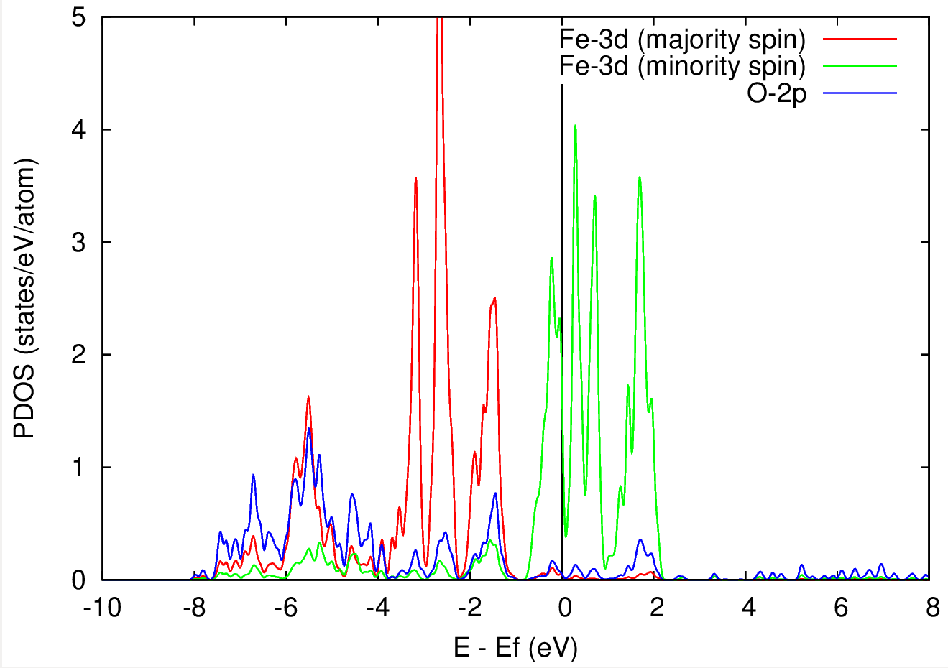
PDOS of FeO from standard DFT calculation
DFT predicts FeO to be metallic (but this is wrong!)
Let's try DFT+U
Experimentally FeO is know to be insulating

Slide 10
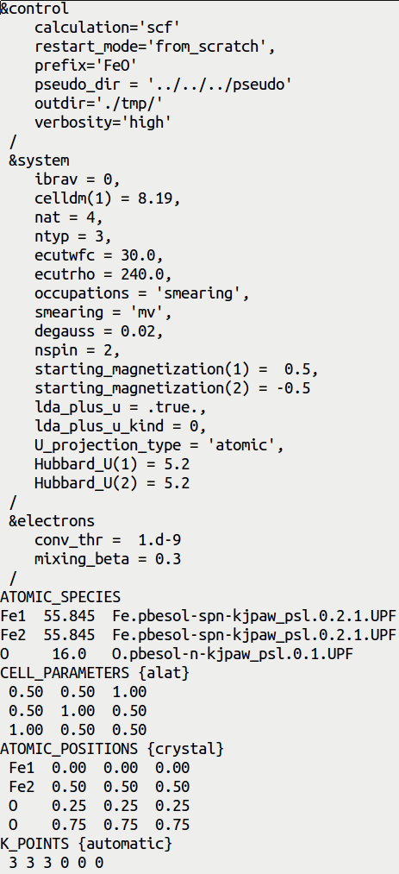
Input file pw.FeO.scf.in for DFT+U
Here we want to put a Hubbard U correction for
3d electrons of Fe atoms
Which value of U to use?
For every material Hubbard U is different; here we use
U = 5.2 eV for Fe-3d states for demonstration purposes
Hubbard U values (in eV) for atomic type 1 & type 2
Hubbard U can be computed from first principles:
I. Timrov, N. Marzari, M. Cococcioni, PRB 98, 085127 (2018)

Slide 11
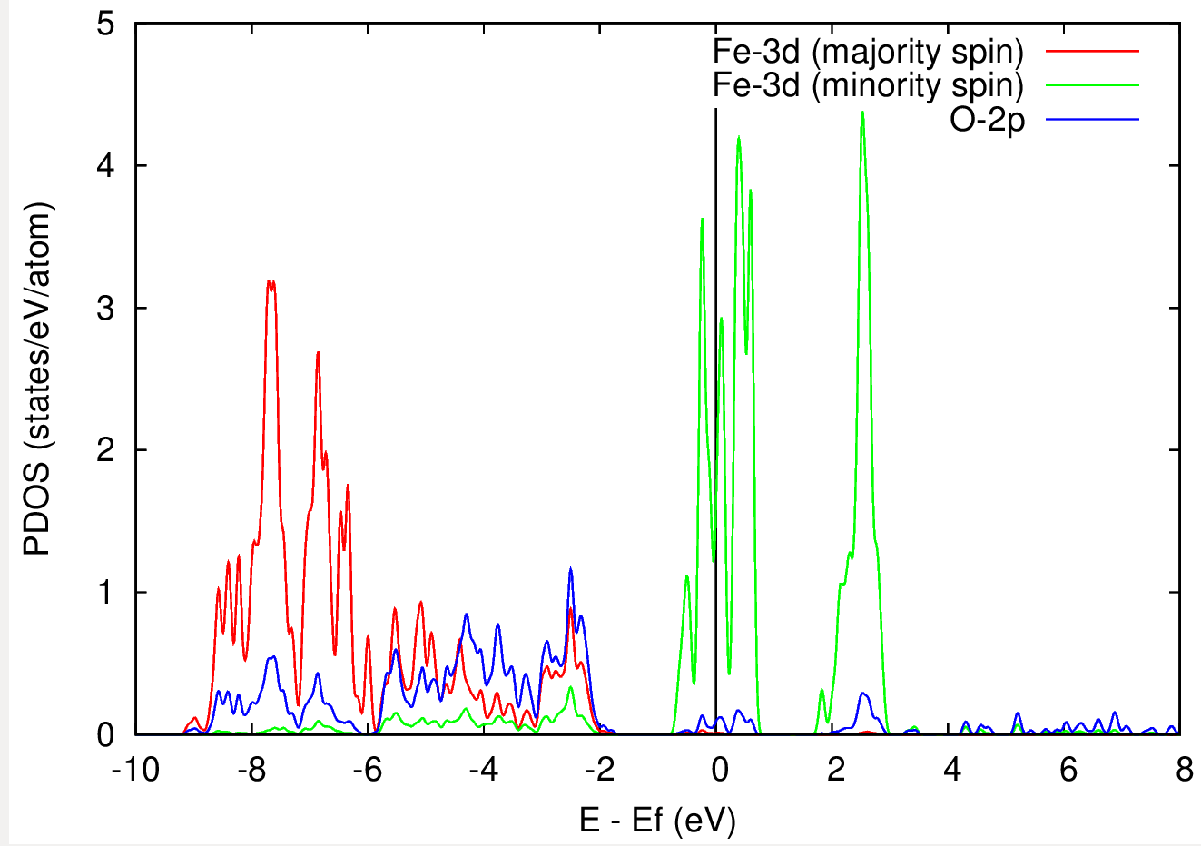
DFT vs DFT+U
DFT
DFT+U
The solution with DFT is metallic
The solution with DFT+U is also metallic...
The 3d states of Fe a fully occupied for the majority spin, while for the minority spin they are still partially occupied.
The reason of this failure of DFT+U is that it gets stuck in a local minimum (which corres- ponds to a metallic state) and it needs a “hint” to reach the correct (insulating) ground state.

Slide 12
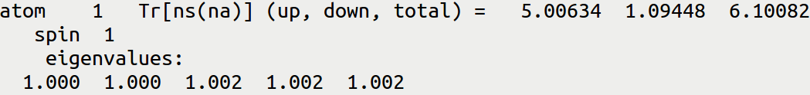
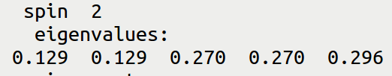
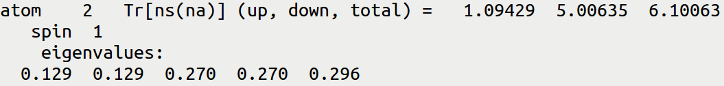

How to “push” DFT+U to the global minimum?
Check the output file pw.FeO.scf.out from the DFT+U calculation
After the 1-st iteration we have:
Fe1
Fe2

Slide 13
How to “push” DFT+U to the global minimum?
Check the output file pw.FeO.scf.out from the DFT+U calculation
After the 1-st iteration we have:
Fe1
starting_ns_eigenvalue(5,2,1)= 1.0
Fe2
starting_ns_eigenvalue(5,1,2)= 1.0
Let's try to force/suggest the occupancy of the 5-th state to be 1.0 instead of 0.296 !
Why 5-th state? Because it is the one which is non-degenerate and if occupied fully could lead
to an insulating result.

Slide 14
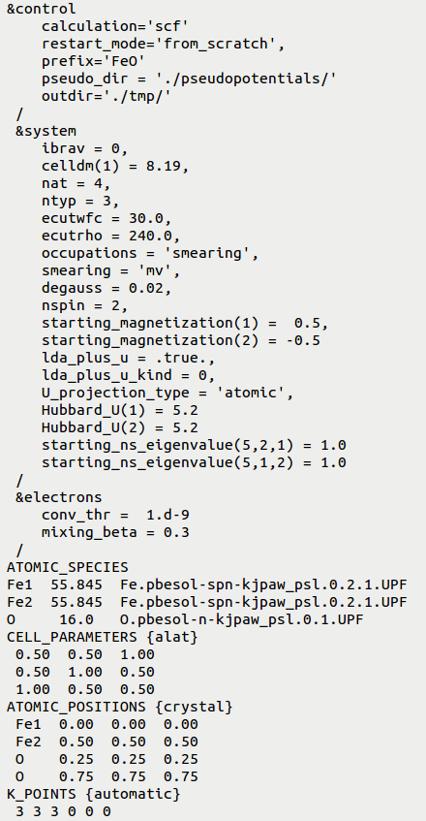
A “hint” for DFT+U where to look for a correct solution
starting_ns_eigenvalue(m,ispin,ityp)
In the first iteration of a DFT+U run it overwrites the
m-th eigenvalue of the ns occupation matrix for the
ispin spin-component of atomic species of type ityp.
Why? This is useful to suggest the desired orbital occu-
pations when the default choice takes another path.
fully
occupied
5-th eigenvalue
spin 2 (down)
type 1: Fe1
starting_ns_eigenvalue(5,2,1)= 1.0
starting_ns_eigenvalue(5,1,2)= 1.0
5-th eigenvalue
spin 1 (up)
type 2: Fe2
fully
occupied

Slide 15
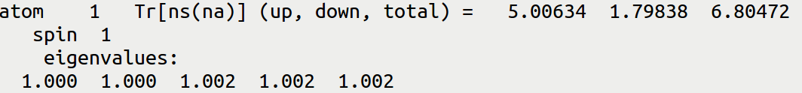

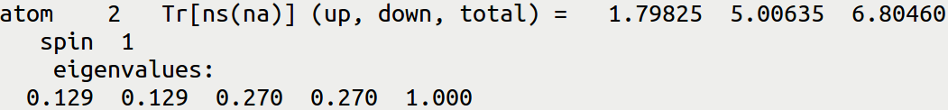

Understanding the setup of starting_ns_eigenvalue
Check the output file pw.FeO.scf.out from the DFT+U calculation (with starting_ns_eigenvalue):
After the 1-st iteration (i.e. when we forced the 1.0 occupancy of the 5-th state) we have:
Fe1
After this the DFT+U calculation converges to an insulating ground state with lower energy
than the previous one.

Slide 16
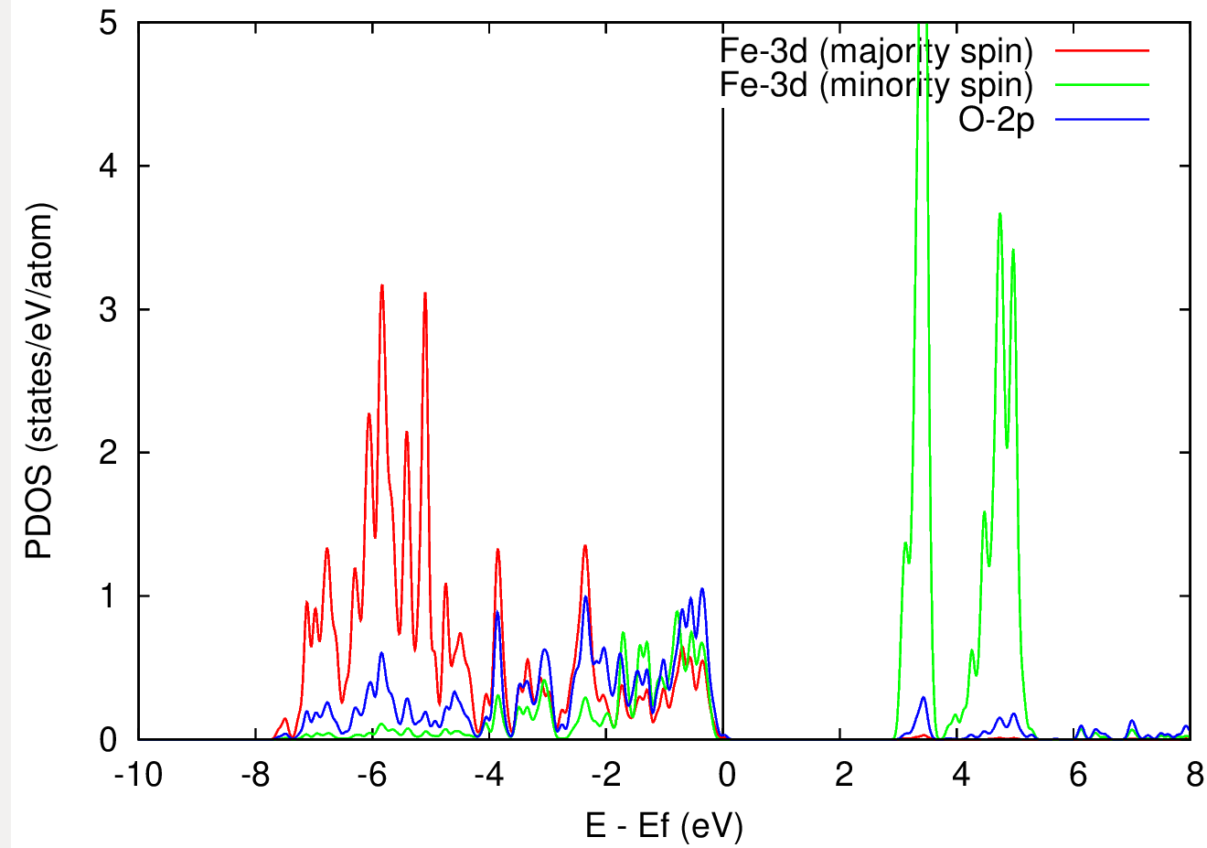
Comparison of DFT+U results w/o and w/ starting_ns_eigenvalue
DFT+U
DFT+U (with starting_ns_eigenvalue)
The solution with DFT+U is metallic
The solution with DFT+U is insulating
Agreement with the experiement!

Slide 17
Outline
Exercise 1: DFT+U study of FeO
Exercise 2: DFT with hybrid functionals: study of Si
Exercise 3: DFT with Van der Waals functionals: study of graphite

Slide 18
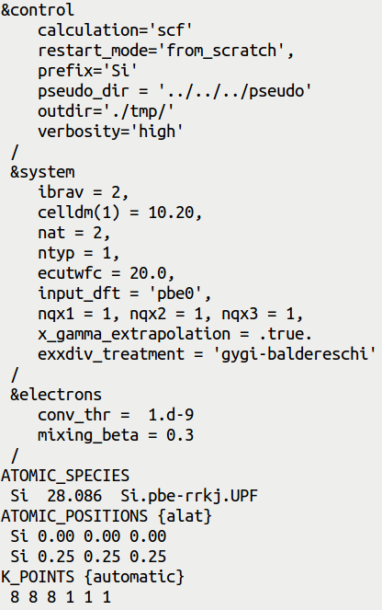
Input file pw.Si.scf.in
SCF calculation
Override the functional written in the PP file.
Important: use a PP for the closest GGA (PBE
In this case), there are no PP's for hybrids.
Grid for the q points
1x1x1 0s the minimal grid (q=0), it is fast
but not very accurate
If .true. Use extrapolation for the q->0 limit
Specifies that the singularity at q->0 is
analytically integrated

Slide 19
Popular hybrid functionals
input_dft = “pbe0”
J.P.Perdew, M. Ernzerhof, K.Burke, JCP 105, 9982 (1996)
C. Adamo, V. Barone, JCP 110, 6158 (1999)
input_dft = “b3lyp”
P.J. Stephens,F.J. Devlin,C.F. Chabalowski,M.J. Frisch, J.Phys.Chem 98, 11623 (1994)
input_dft = “hse”
Heyd, Scuseria, Ernzerhof, J. Chem. Phys. 118, 8207 (2003)
Heyd, Scuseria, Ernzerhof, J. Chem. Phys. 124, 219906 (2006)

Slide 20
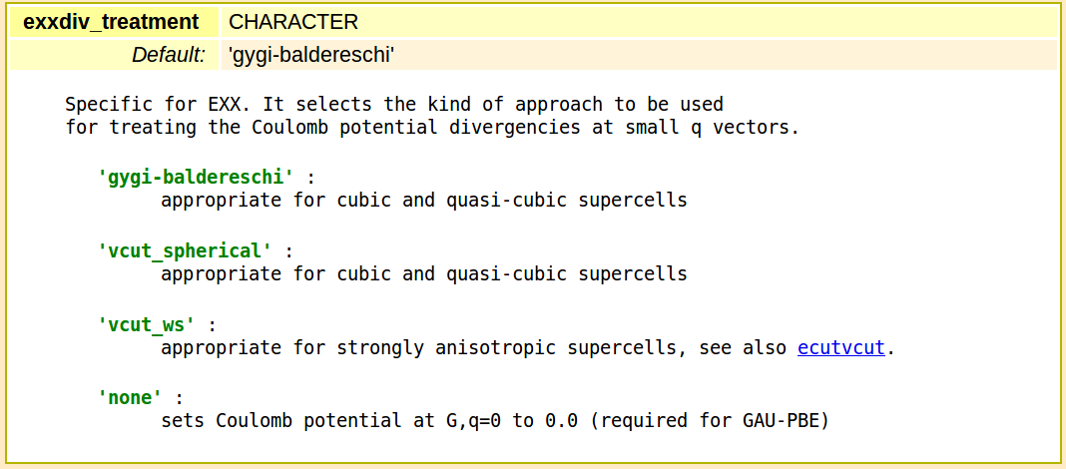
Types of treatement of divergences at q->0

Slide 21
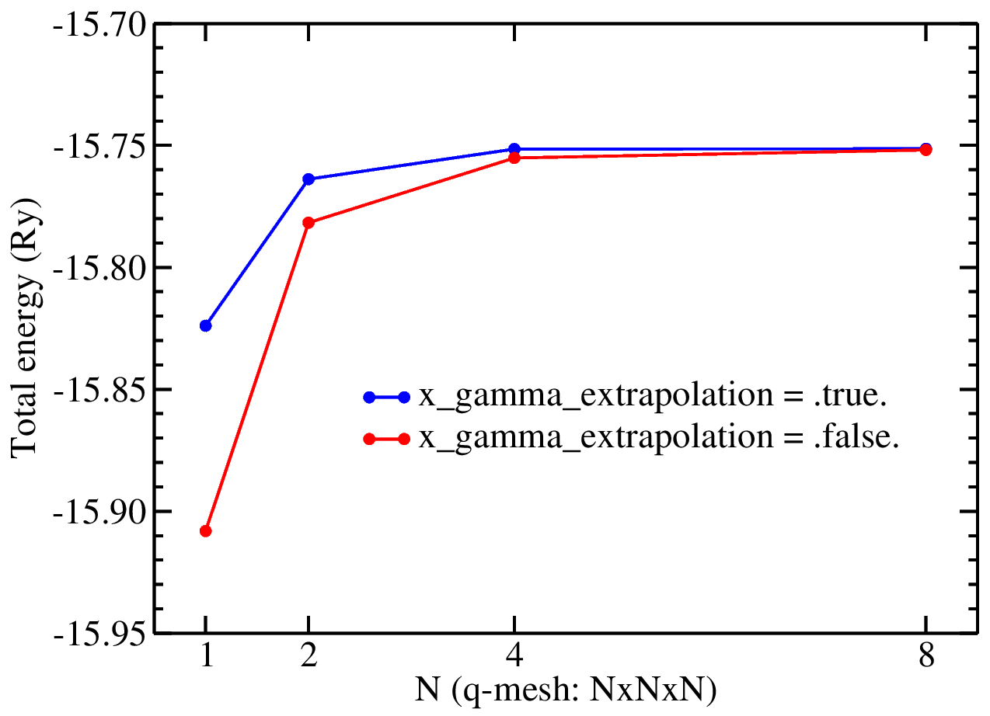
Convergence of the total energy wrt q point grid

Slide 22
Outline
Exercise 1: DFT+U study of FeO
Exercise 2: DFT with hybrid functionals: study of Si
Exercise 3: DFT with Van der Waals functionals: study of graphite

Slide 23
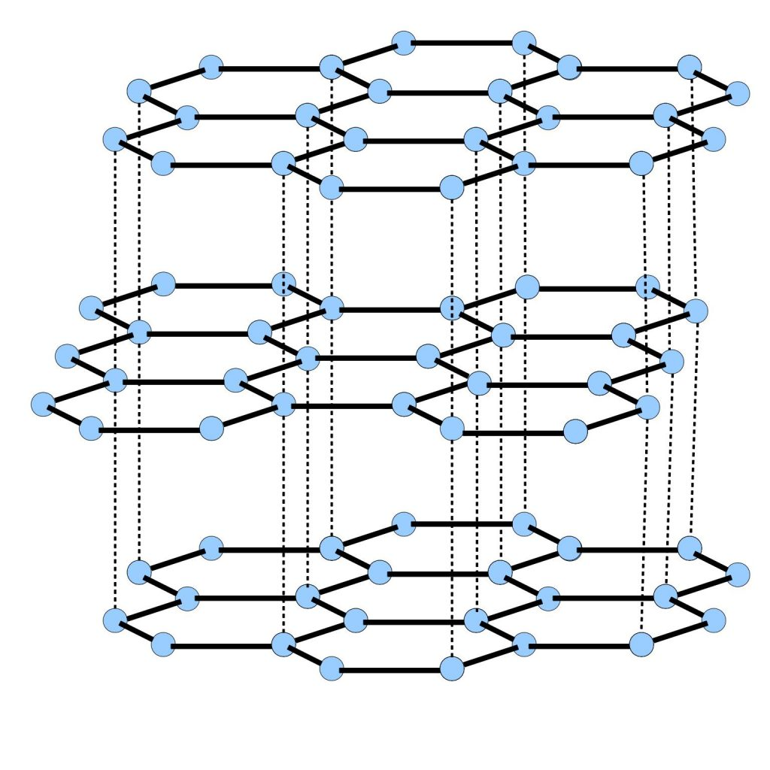
Graphite
Graphite has Van der Waals (dispersive) interactions between layers.
The equilibrium inter-layer distance is too small with LDA, and too large with GGA
with respect to the experimental value (3.336 A).
Van der Waals interactions must be taken into account.

Slide 24
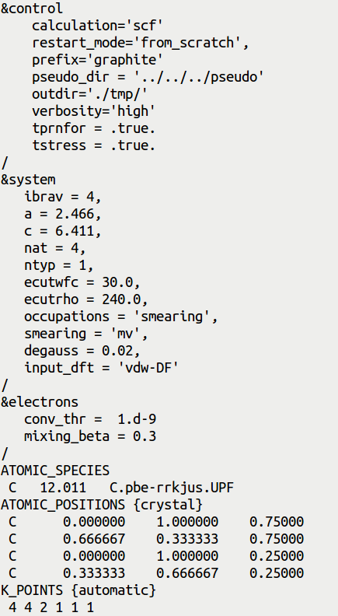
Input file pw.graphite.scf.in
SCF calculation
Calculation of forces and stress
Hexagonal lattice, a and c are in Angtrom!
Override the functional written in the PP file.
Important: use PP for the closest GGA (PBE in
this case), because there are no PP for non-
local functionals
Remember to generate and store the kernel table!
vdW_kernel_table
The k point grid is denser along xy than along z,
reflecting shorter periodicity in the xy plane

Slide 25
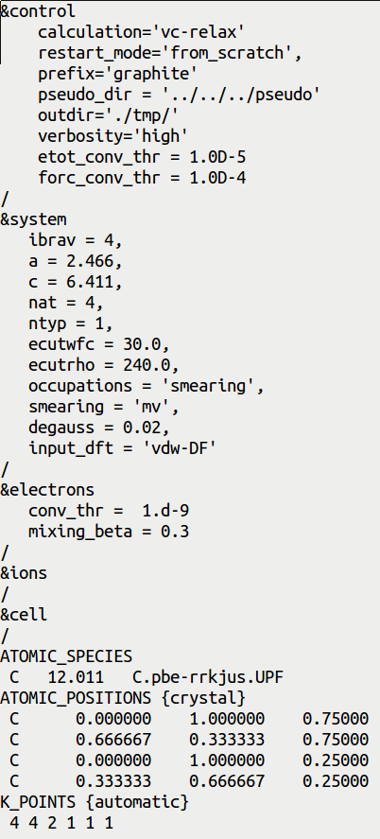
Input file pw.graphite.vc-relax.in
Variable-cell optimization
Variable-cell optimization
If we do not specify anything inside these namelists,
then the default values will be used for various
control parameters

Slide 26
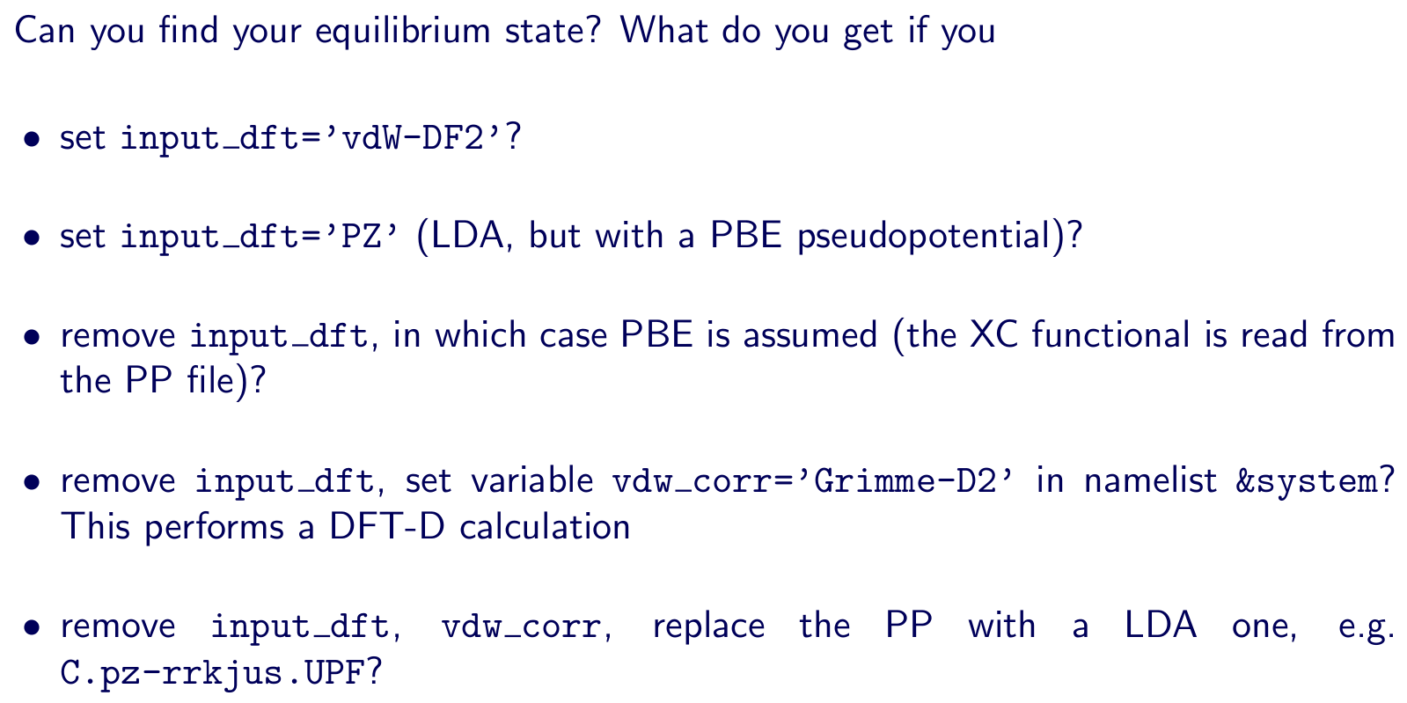
Structural optimization in graphite

