Slide 1


Hands-on session Day 3
Density Functional Perturbation Theory: calculation of phonons
Andrea Urru
SISSA – Scuola Internazionale Superiore di Studi Avanzati, Trieste, Italy
aurru@sissa.it
Summer School on Advanced Materials and Molecular Modelling with QUANTUM ESPRESSO
Jozef Stefan Institute (Ljubljana, Slovenia), September 16th-20th, 2019

Slide 2
Outline
1. Introduction
2. Exercise 1a: Phonons at Gamma in non-polar materials
3. Exercise 1b: Phonon dispersion in non-polar materials
4. Exercise 2a: Phonons at Gamma in polar materials
5. Exercise 2b: Phonon dispersion in polar materials
6. Exercise 3: Phonon dispersion of 2D materials (optional)

Slide 3
Outline
1. Introduction
2. Exercise 1a: Phonons at Gamma in non-polar materials
3. Exercise 1b: Phonon dispersion in non-polar materials
4. Exercise 2a: Phonons at Gamma in polar materials
5. Exercise 2b: Phonon dispersion in polar materials
6. Exercise 3: Phonon dispersion of 2D materials (optional)

Slide 4

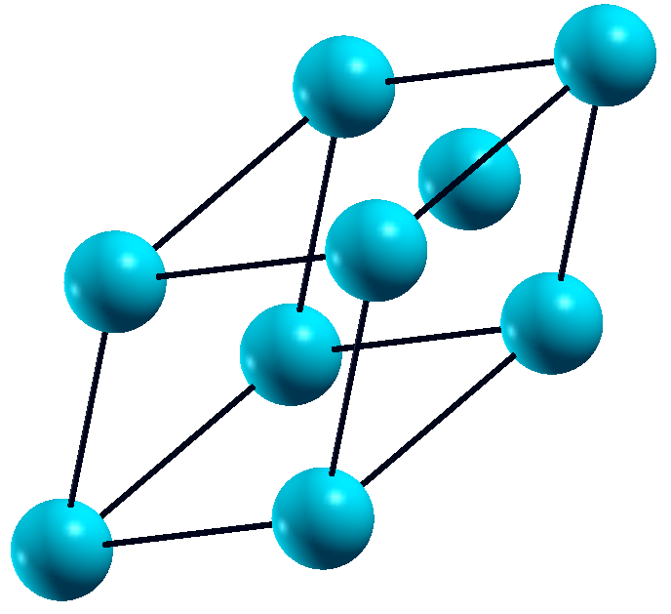







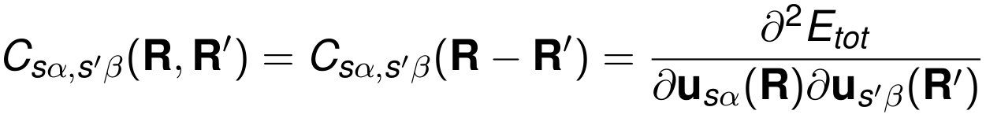


Basic concepts
Let us consider a unit cell with atoms.
index of an atom in the unit cell
is the cartesian index
is the point in the Bravais-lattice, identifying the position of a given unit cell
is the number of unit cells in the crystal
is the - component of the displacement of the s-th atom
variables
Interatomic Force Constants :

Slide 5
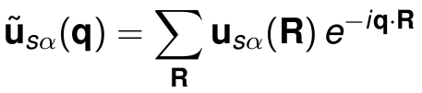
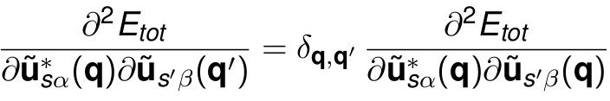
Basic concepts
Fourier transformation:
Essence of the Bloch theorem:
Important concept: We can perform calculations of Interatomic Force Constants for each q independently!

Slide 6
Basic concepts
Important concept: Instead of Interatomic Force Constants
we need only !
Sampling theorem
The number of q points is equal to the number of R points at which Interatomic Force Constants are computed.

Slide 7


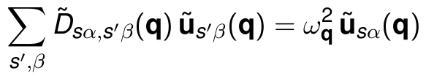
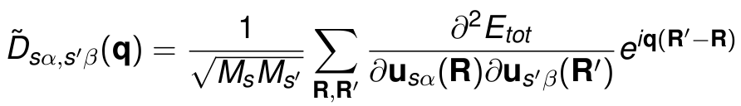
Basic concepts
Normal mode frequencies, , and eigenvectors, are determined by the secular equation:
where
is the dynamical matrix.
Diagonalization of the dynamical matrix gives phonon modes at q.

Slide 8
Outline
1. Introduction
2. Exercise 1a: Phonons at Gamma in non-polar materials
3. Exercise 1b: Phonon dispersion in non-polar materials
4. Exercise 2a: Phonons at Gamma in polar materials
5. Exercise 2b: Phonon dispersion in polar materials
6. Exercise 3: Phonon dispersion of 2D materials (optional)

Slide 9
Exercise 1a: Phonons at Gamma in non-polar materials
Go to the directory with the input files:
cd QE-2019/Day-3/example1a
In this directory you will find:
README.md – File describing how to do the exercise
pw.Si.in – Input file for the SCF ground-state calculation
ph.Si.in – Input file for the phonon calculation at Γ
dynmat.Si.in – Input file to impose the acoustic sum rule
reference – Directory with the reference results

Slide 10
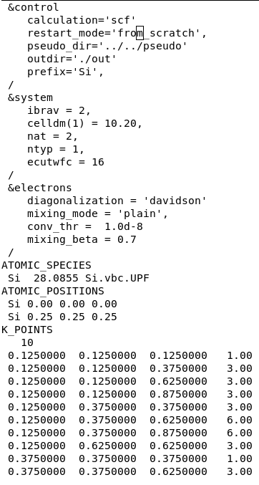
Exercise 1a: Phonons at Gamma in non-polar materials
Step 1. Perform a Self-Consistent Field ground-state calculation for silicon at the equilibrium structure using the pw.x program.
pw.Si.in
pw.x < pw.Si.in > pw.Si.out
Input
Output

Slide 11
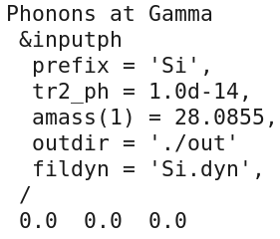
Exercise 1a: Phonons at Gamma in non-polar materials
Step 2. Perform a phonon calculation at Γ using the ph.x program.
ph.Si.in
ph.x < ph.Si.in > ph.Si.out

Slide 12
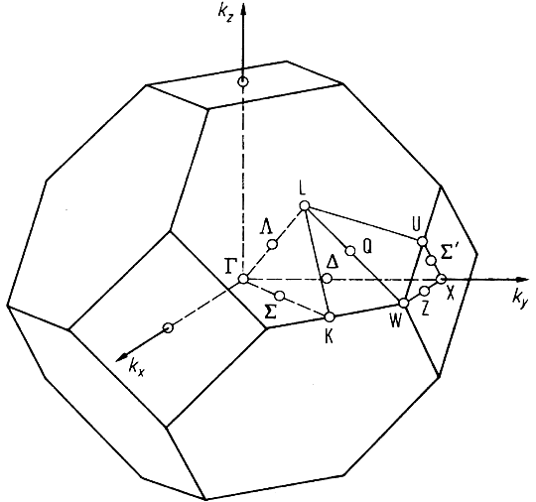
Exercise 1a: Phonons at Gamma in non-polar materials
Step 2. Perform a phonon calculation at Γ using the ph.x program.
ph.Si.in
We consider only the Γ point:
q = 2*pi/a (0.0, 0.0, 0.0)
Brillouin Zone

Slide 13
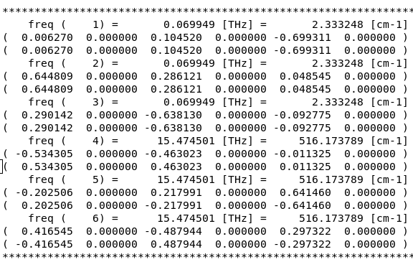
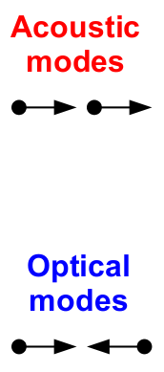
Exercise 1a: Phonons at Gamma in non-polar materials
Dynamical matrix file Si.dyn :

Slide 14
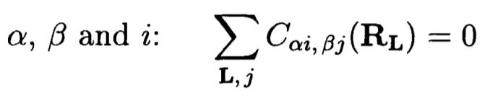
Exercise 1a: Phonons at Gamma in non-polar materials
Acoustic sum rule at Γ
Because of the numerical inaccuracies the interatomic force constants do not strictly satisfy the acoustic sum rule (ASR).
ASR comes directly from the continous translational invariance of the crystal. If we translate the whole solid by a uniform displacement, the forces acting on the atoms must be zero.
As a consequence:
For each
As a consequence, the frequencies of the acoustic modes must be zero.

Slide 15
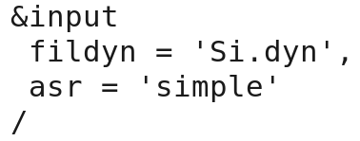
Exercise 1a: Phonons at Gamma in non-polar materials
Acoustic sum rule at Γ
Because of the numerical inaccuracies the interatomic force constants do not strictly satisfy the acoustic sum rule (ASR) => acoustic frequencies are not exactly zero.
However, the ASR can be imposed using the dynmat.x program.
The input file is dynmat.Si.in :
dynmat.x < dynmat.Si.in > dynmat.Si.out

Slide 16
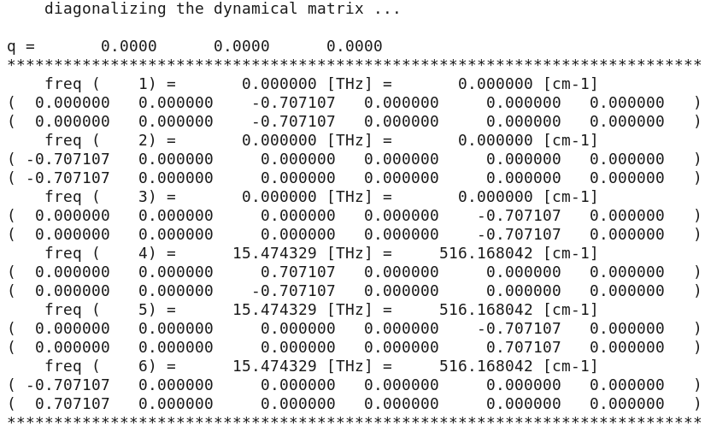
Exercise 1: Phonons at Gamma in non-polar materials
The program dynmat.x produces the file dynmat.out which contains the new acoustic frequencies, which are exactly equal to zero.

Slide 17
Outline
1. Introduction
2. Exercise 1a: Phonons at Gamma in non-polar materials
3. Exercise 1b: Phonon dispersion in non-polar materials
4. Exercise 2a: Phonons at Gamma in polar materials
5. Exercise 2b: Phonon dispersion in polar materials
6. Exercise 3: Phonon dispersion of 2D materials (optional)

Slide 18
Exercise 1b: Phonon dispersion in non-polar materials
Go to the directory with the input files:
cd QE-2019/Day-3/example1b
In this directory you will find:
README.md – File describing how to do the exercise
pw.Si.in – Input file for the SCF ground-state calculation
ph.Si.in – Input file for the phonon calculation on a uniform q-grid
q2r.Si.in – Input file for calculation of Interatomic Force Constants
matdyn.Si.in – Input file for Fourier Interpolation for various q points
plotband.Si.in – Input file for plotting a phonon dispersion
reference – Directory with the reference results

Slide 19
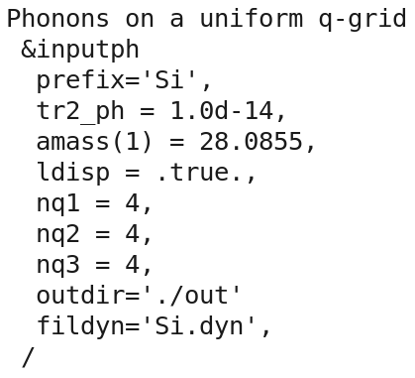
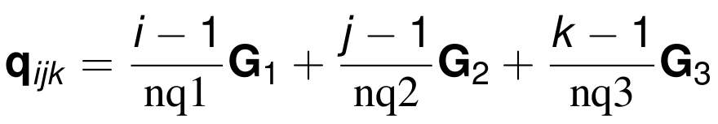
Exercise 1b: Phonon dispersion in non-polar materials
Step 1. Perform a SCF calculation for silicon at the equilibrium structure using the pw.x program.
pw.x < pw.Si.in > pw.Si.out
Step 2. Perform a phonon calculation on a uniform grid of q points using the ph.x program.
ph.x < ph.Si.in > ph.Si.out

Slide 20
Exercise 1b: Phonon dispersion in non-polar materials
Step 1. Perform a SCF calculation for silicon at the equilibrium structure using the pw.x program.
pw.x < pw.Si.in > pw.Si.out
Step 2. Perform a phonon calculation.
We sample the Brillouin zone with a uniform grid of 4x4x4 q points.

Slide 21
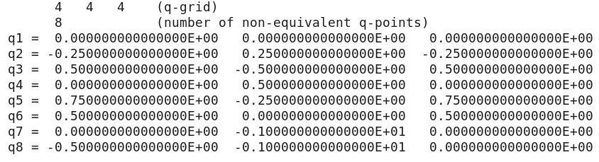
Exercise 1b: Phonon dispersion in non-polar materials
4x4x4 = 64 q-points => Use of symmetry => 8 non-equivalent q points
The file Si.dyn0 contains a list of the non-equivalent q points (8, in this case).
The phonon program ph.x generates files for every non-equivalent q point Si.dyn1, Si.dyn2, ..., Si.dyn8, which contain information about dynamical matrices, phonon frequencies and atomic displacements.

Slide 22
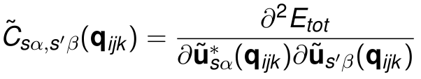


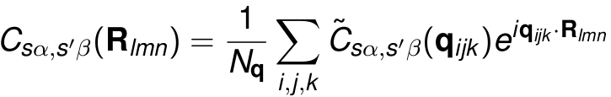


Exercise 1b: Phonon dispersion in non-polar materials
Step 3. Calculation of the Interatomic Force Constants (IFC) using the q2r.x program.
Fourier transforms of IFC's :

Slide 23
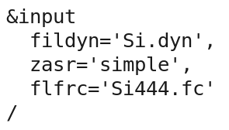
Exercise 1b: Phonon dispersion in non-polar materials
Input file q2r.Si.in :
The denser the grid of q points, the larger the vectors R for which the Interatomic Force Constants are calculated!
To perform the calculation:
q2r.x < q2r.Si.in > q2r.Si.out

Slide 24
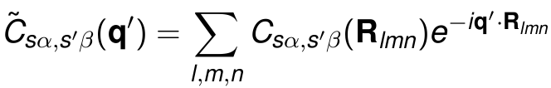

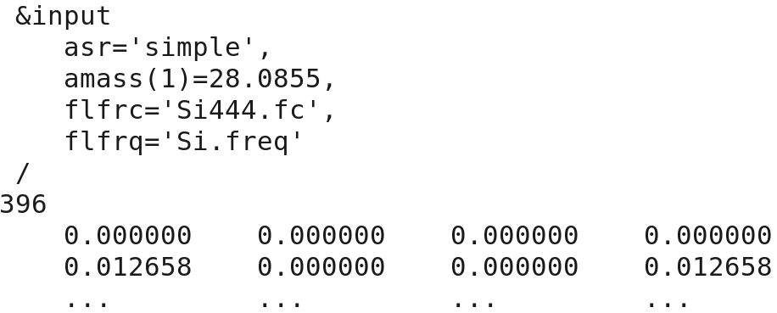
Exercise 1b: Phonon dispersion in non-polar materials
Step 4. Calculate phonons at generic q' points using IFC by means of the code matdyn.x
Input file Si.matdyn.in :
matdyn.x < matdyn.Si.in > matdyn.Si.out

Slide 25
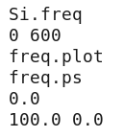
Exercise 1b: Phonon dispersion in non-polar materials
Step 5. Plot the phonon dispersion using the plotband.x program and gnuplot.
Input file plotband.Si.in :
plotband.x < plotband.Si.in > plotband.Si.out
Use gnuplot and the file plot_dispersion.gp in order to plot the phonon dispersion of silicon (experimental_data.dat).
You will obtain a postscript file phonon_dispersion.eps which you can visualize.

Slide 26
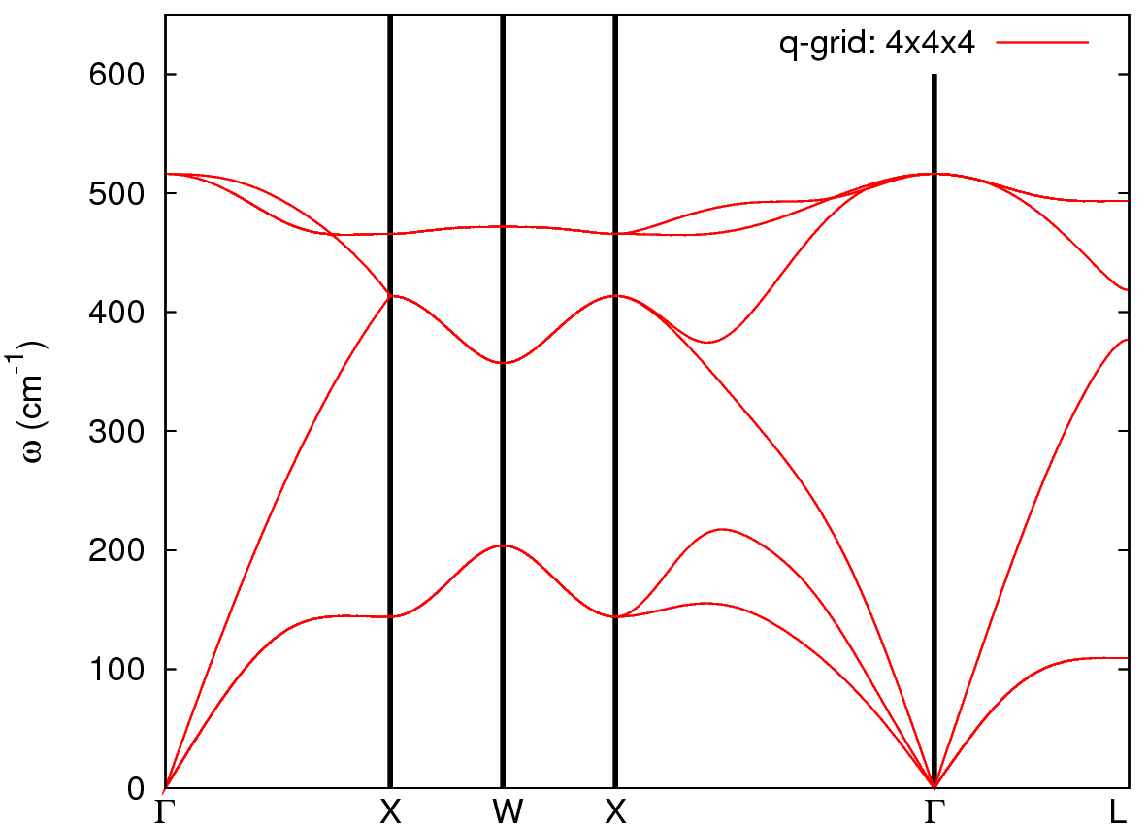
Exercise 1b: Phonon dispersion in non-polar materials
Phonon dispersion of silicon along some high-symmetry directions in the Brillouin zone
(file phonon_dispersion.eps):

Slide 27
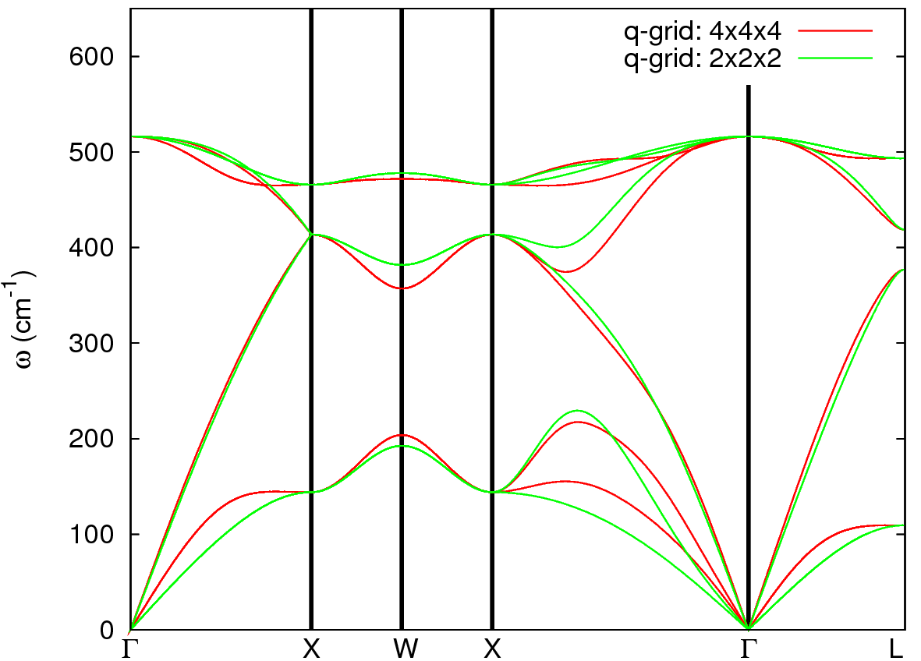
Exercise 1b: Phonon dispersion in non-polar materials
How to determine whether the quality of the Fourier interpolation is satisfactory? Compare with the direct calculation (no interpolation)!

Slide 28
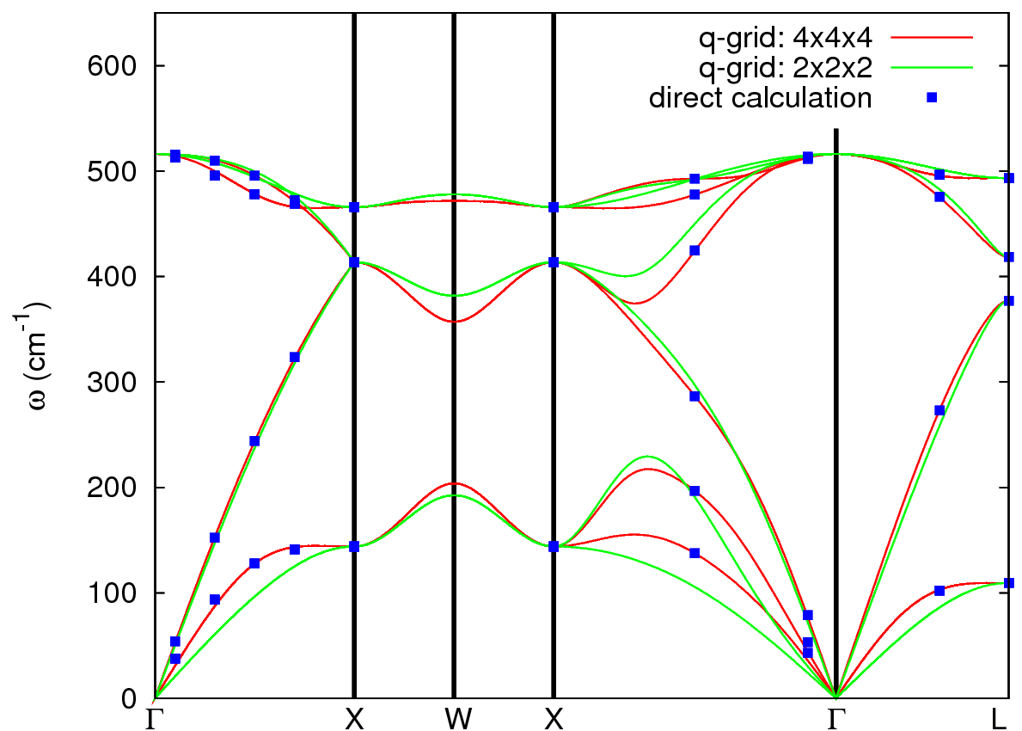
Exercise 1b: Phonon dispersion in non-polar materials
Comparison of the phonon dispersion computed using the Fourier interpolation with the direct calculation at several q points. The q-grid 4x4x4 is very satisfactory for the Fourier interpolation for silicon!

Slide 29
Exercise 1b: Phonon dispersion in non-polar materials
Comparison of the phonon dispersion computed using the Fourier interpolation with the direct calculation at several q points. The q-grid 4x4x4 is very satisfactory for the Fourier interpolation for silicon!
Perform a direct phonon calculation (no interpolation) at several q' points and make a comparison with the phonon frequencies obtained from the interpolation. Use exercise1a as an example. Some q' points along the Gamma-X high symmetry line are listed in the file reference/q_points_direct_calc.txt

Slide 30
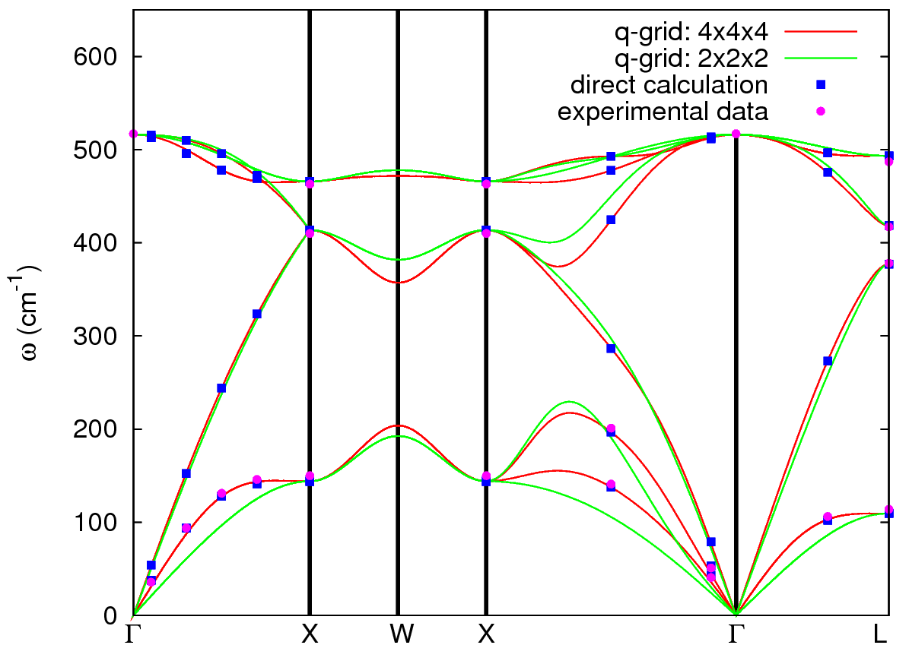
Exercise 1b: Phonon dispersion in non-polar materials
The agreement of ab initio calculation of the phonon dispersion using the Fourier interpolation on a q-grid 4x4x4 is excellent with the experimental data!

Slide 31
Exercise 1b: Phonon dispersion in non-polar materials
The Fourier interpolation works well if the Interatomic Force Constants (IFC's) are known on a sufficiently large supercell, i.e. on a large enough grid of q points in the phonon calculation.
There are cases when the IFC's are long range and the Fourier interpolation does not work properly:
When there are Kohn anomalies in metals. In this case the dynamical matrices are not a smooth function of q and the IFC's are long range.
In polar insulators where the atomic displacements generate long range electrostatic interactions and the dynamical matrix is not analitical for q→0. However, this case can be dealt with by calculating the Born effective charges and the dielectric tensor of the material.

Slide 32
Outline
1. Introduction
2. Exercise 1a: Phonons at Gamma in non-polar materials
3. Exercise 1b: Phonon dispersion in non-polar materials
4. Exercise 2a: Phonons at Gamma in polar materials
5. Exercise 2b: Phonon dispersion in polar materials
6. Exercise 3: Phonon dispersion of 2D materials (optional)

Slide 33
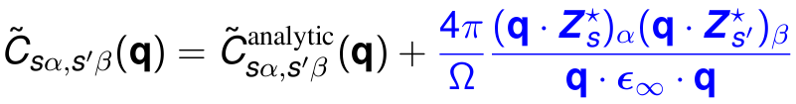

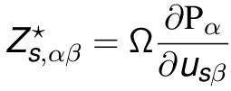

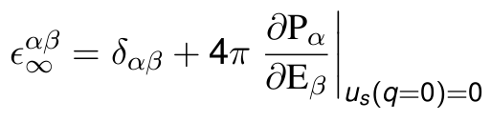
Exercise 2a: Phonons at Gamma in polar materials
Polar materials in the q = 0 limit: a macroscopic electric field appears as a consequence of the long-range character of the Coulomb interaction (incompatible with Periodic Boundary Conditions).
A non-analytic term must be added to Interatomic Force Constants at q = 0:
Effective charges are related to polarization P induced by a lattice distortion:
Dielectric tensor is related to polarization P induced by an electric field E :
All of the above can be calculated from (mixed) second order derivatives of the total energy.

Slide 34
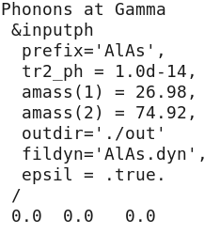
Exercise 2a: Phonons at Gamma in polar materials
Go to the directory with the input files:
cd QE-2019/Day-3/example2a
Step 1. Perform a Self-Consistent Field ground-state calculation for a polar semiconductor AlAs.
Step 2. Perform a phonon calculation at Gamma for AlAs.
If .true. will calculate and store the dielectric tensor and effective charges

Slide 35
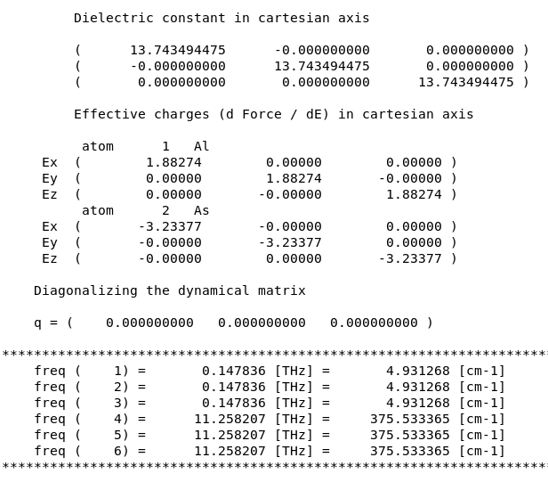
Exercise 2a: Phonons at Gamma in polar materials
In the file ph.AlAs.out you will find an information about the dielectric tensor and effective charges:
No LO-TO splitting

Slide 36
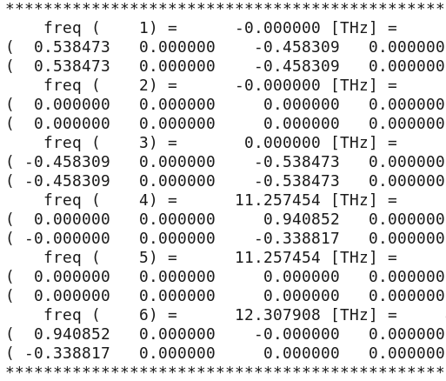
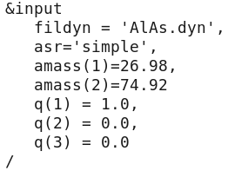
Exercise 2a: Phonons at Gamma in polar materials
Step 3. Impose Acoustic Sum Rule and add the non-analytic LO-TO splitting using the dynmat.x program.
Input file dynmat.AlAs.in :
Output file dynmat.out :
Direction for the LO-TO splitting
LO-TO splitting
dynmat.x < dynmat.AlAs.in > dynmat.AlAs.out

Slide 37
Outline
1. Introduction
2. Exercise 1a: Phonons at Gamma in non-polar materials
3. Exercise 1b: Phonon dispersion in non-polar materials
4. Exercise 2a: Phonons at Gamma in polar materials
5. Exercise 2b: Phonon dispersion in polar materials
6. Exercise 3: Phonon dispersion of 2D materials (optional)

Slide 38
Exercise 2b: Phonon dispersion in polar materials
Go to the directory with the input files:
cd QE-2019/Day-3/example2b
Calculate phonon dispersion in AlAs following the same steps as in exercise 1b.
Where necessary insert the missing information in the input files.

Slide 39


Exercise 2b: Phonon dispersion in polar materials
Step 1. Perform a SCF ground-state calculation for AlAs using pw.x
Step 2. Perform a phonon calculation on a 4x4x4 q-grid using ph.x (dielectric tensor and effective charges will be calculated)
Step 3. Perform Fourier Transformations (FT) of in order to obtain Interatomic Force Constants in real space using q2r.x.
A term having the same behaviour for q -> 0 as the non-analytic term is subtracted from before the FT and re-added to , so that no problem related to non-analytic behaviour and related long-rangeness arises in the FT.
Step 4. Calculate phonons at generic q' points using Interatomic Force Constants (including the non-analytic term) using the code matdyn.x
Step 5. Plot the phonon dispersion of AlAs using plotband.x and gnuplot.

Slide 40
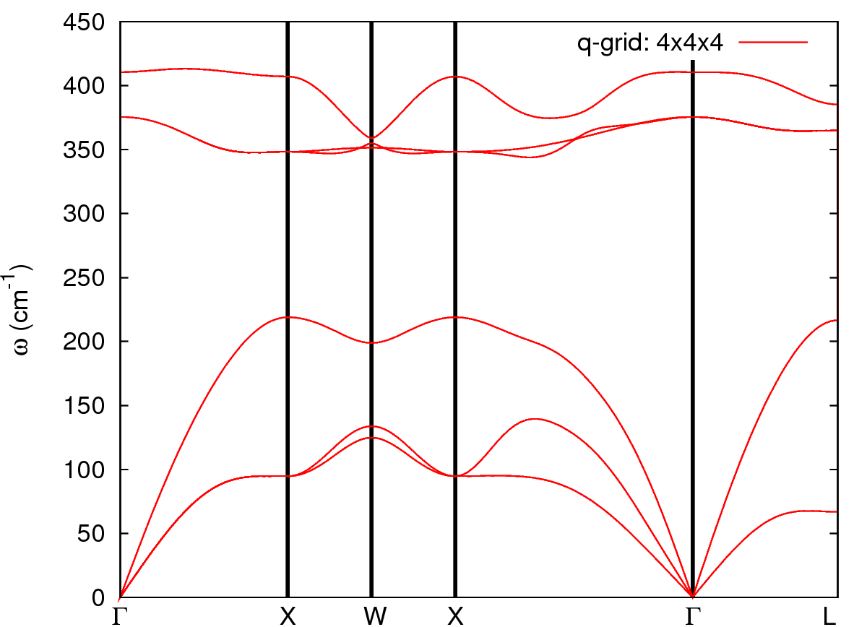
Exercise 2b: Phonon dispersion in polar materials
The phonon dispersion of AlAs:
LO-TO splitting

Slide 41
Outline
1. Introduction
2. Exercise 1a: Phonons at Gamma in non-polar materials
3. Exercise 1b: Phonon dispersion in non-polar materials
4. Exercise 2a: Phonons at Gamma in polar materials
5. Exercise 2b: Phonon dispersion in polar materials
6. Exercise 3: Phonon dispersion in 2D materials (optional)

Slide 42
Exercise 3: Phonon dispersion in 2D materials
Go to the directory with the input files:
cd QE-2019/Day-3/example3
Calculate phonon dispersion in 2D hexagonal BN following the same steps as in exercise 1b and exercise 2b.
Notice that the options assume_isolated='2D' in pw.bn.in and loto_2d=.true. in q2r.bn.in and matdyn.bn.in have been set to properly deal with 2D materials.

Slide 43
Exercise 3: Phonon dispersion in 2D materials
Step 1. Perform a SCF ground-state calculation for 2D h-BN using pw.x
Step 2. Perform a phonon calculation on a 6x6x1 q-grid using ph.x
Step 3. Perform Fourier Transformations (FT) of in order to obtain Interatomic Force Constants in real space using q2r.x.
Step 4. Calculate phonons at generic q' points using Interatomic Force Constants using the code matdyn.x
Step 5. Plot the phonon dispersion of 2D h-BN using plotband.x and gnuplot.

Slide 44
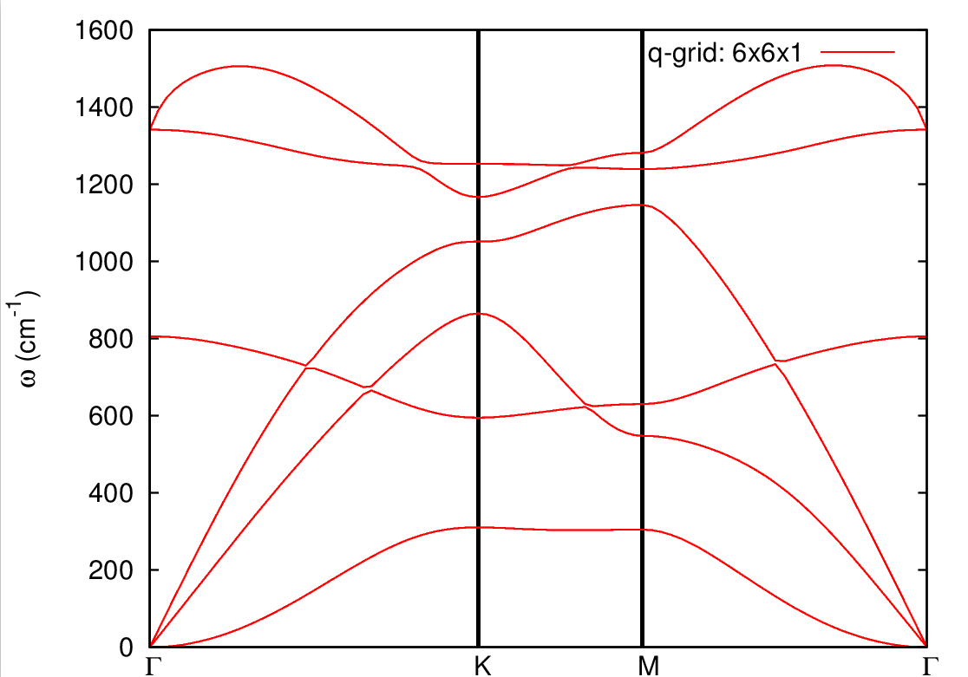
Exercise 3: Phonon dispersion in 2D materials
The phonon dispersion of 2D hexagonal BN:
No LO-TO splitting
Flexural mode

Slide 45
Bibliography
Books
1. N. W. Ashcroft, N. D. Mermin, Solid State Physics (for general discussion)
2. M. Fox, Optical properties of solids (some words about LO-TO splitting)
Papers
1. S. Baroni, P. Giannozzi, and A. Testa, Green's-function approach to linear response in solids, Phys. Rev. Lett. 58, 1861 (1987).
2. P. Giannozzi, S. de Gironcoli, P. Pavone, and S. Baroni, Ab initio calculation of phonon dispersions in semiconductors, Phys. Rev. B 43, 7231 (1991).
3. S. Baroni, S. de Gironcoli, A. Dal Corso, and P. Giannozzi, Phonons and related crystal properties from density-functional perturbation theory, Rev. Mod. Phys. 73, 515 (2001).
4. T. Sohier, M. Gibertini, M. Calandra, F. Mauri, and N. Marzari, Breakdown of Optical Phonons’ splitting in Two-Dimensional Materials, Nano Lett. 2017, 17, 6, 3758-3763.

Slide 46


