Slide 1


Hands-on
Time-Dependent Density Functional Perturbation Theory: calculation of absorption spectra of molecules
Iurii Timrov, Oscar Baseggip
Quantum ESPRESSO Summer School
Ljubljana, Slovenia
18 September 2019

Slide 2
Outline
1. Example 4: Calculation of absorption spectra in the Independent Particle Approximation
2. Example 5: Calculation of absorption spectra of interacting electrons using the turboDavidson program
3. Example 6: Calculation of absorption spectra of interacting electrons using the turboLanczos program
4. Example 7: Calculation of absorption spectra using B3LYP pseudo-potential

Slide 3
Outline
1. Example 4: Calculation of absorption spectra in the Independent Particle Approximation
2. Example 5: Calculation of absorption spectra of interacting electrons using the turboDavidson program
3. Example 6: Calculation of absorption spectra of interacting electrons using the turboLanczos program
4. Example 7: Calculation of absorption spectra using B3LYP pseudo-potential

Slide 4


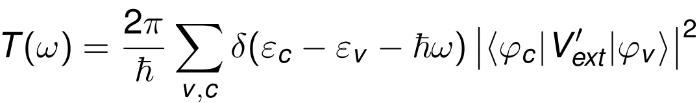






Independent Particle Approximation
The simplest approximation: Independent Particle Approximation (IPA) which allows us to describe single-particle excitations.
Fermi's golden rule
The transition probability per unit time from occupied states to empty states reads:
is the external potential induced by the electric field.
and
are the eigenvalues
are the eigenvalues
and the eigenfunctions of the ground-state Kohn-Sham equation
Absorption coefficient:

Slide 5
Example 4: Calculation of absorption spectra in IPA
Go to the directory with the input files:
cd Day-3/example4
In this directory you will find:
README.md – File describing how to do the exercise
pw.benzene.in – Input file for the SCF ground-state calculation
epsilon.benzene.in – Input file for a calculation of spectrum in IPA
plot_spectrum.gp – Script to plot spectrum using gnuplot
reference – Directory with the reference results

Slide 6
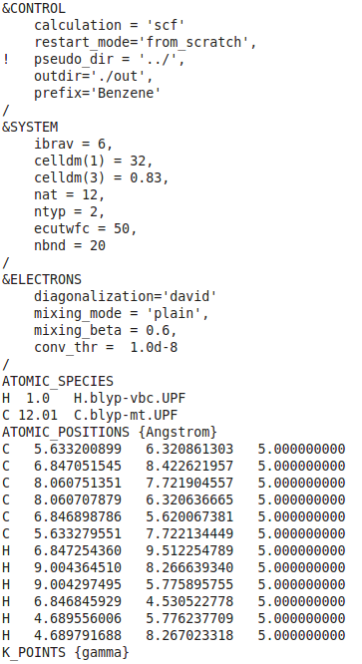
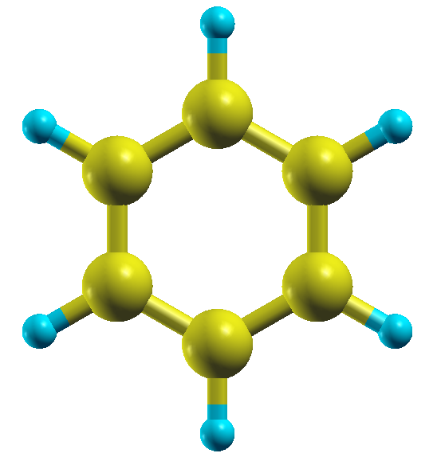

Example 4: Calculation of absorption spectra in IPA
Step 1. Perform a Self-Consistent Field ground-state calculation for benzene at the equilibrium structure using the pw.x program.
pw.benzene.in
pw.x < pw.benzene.in > pw.benzene.out
Input
Output

Slide 7
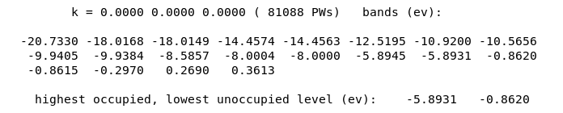
Example 4: Calculation of absorption spectra in IPA
The output SCF file pw.benzene.out :
HOMO
LUMO
HOMO – Highest Occupied Molecular Orbital
LUMO – Lowest Unoccupied Molecular Orbital
Energy gap = LUMO – HOMO = 5.0 (eV)

Slide 8
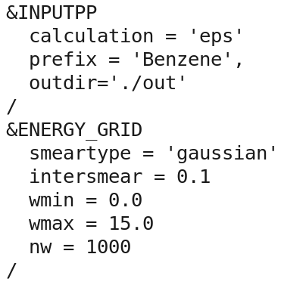
Example4: Calculation of absorption spectra in IPA
Step 2. Perform a calculation of the absorption spectrum of benzene in the Independent Particle Approximation using the epsilon.x program.
epsilon.benzene.in
Input file for the calculation of spectrum
epsilon.x < epsilon.benzene.in > epsilon.benzene.out

Slide 9
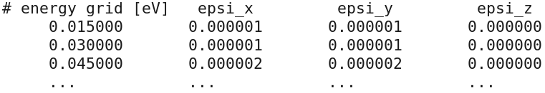
Example 4: Calculation of absorption spectra in IPA
The code epsilon.x produces 4 files:
epsr.dat – Real part of the response
epsi.dat – Imaginary part of the response (this is what we need)
eels.dat – Electron energy loss spectrum
ieps.dat – Response computed on the imaginary axis of frequency
The content of epsi.dat looks like:
Use gnuplot and the script plot_spectrum.gp in order to plot the absorption spectrum of benzene Benzene_spectrum.eps

Slide 10
Example 4: Calculation of absorption spectra in IPA
Absorption spectrum of benzene in the Independent Particle Approximation (file Benzene_spectrum.eps):
Energy gap = LUMO – HOMO = 5.0 (eV)

Slide 11
Outline
1. Example 4: Calculation of absorption spectra in the Independent Particle Approximation
2. Example 5: Calculation of absorption spectra of interacting electrons using the turboDavidson program
3. Example 6: Calculation of absorption spectra of interacting electrons using the turboLanczos program
4. Example 7: Calculation of absorption spectra using B3LYP pseudo-potential

Slide 12
turboDavidson program for calculations of absorption spectra
The turbo_davidson.x program allows us to calculate absorption spectra of molecules using time-dependent density functional perturbation theory (TDDFpT).
The interactions of electrons (Hartree and Exchange-Correlation effects) are taken into account fully ab initio and self-consistently.
The electronic transitions from occupied to empty states can be analyzed by selecting a frequency range in which the transitions occur.
However, calculations of overall absorption spectra in a wide frequency range are computationally rather expensive, because many eigenvalues of the Hamiltonian must be computed.
Theory: Xiaochuan Ge, PhD thesis “Seeing colors with TDDFT”, SISSA (2013).

Slide 13
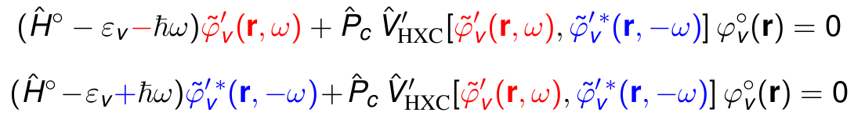
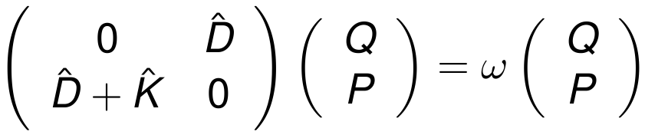


turboDavidson program for calculations of absorption spectra
Coupled linear-response TDDFpT equations (resonant and anti-resonant):
These equations can be re-written as Casida's matrix equation:
interaction terms
where and
Davidson algorithm is used (the same algorithm as in the ground state SCF calculation) to solve the Casida's equations and to obtain the eigenvalues which are used for a calculation of the absorption coefficient.

Slide 14
Example 5: Calculation of absorption spectra using turboDavidson
Go to the directory with the input files:
cd Day-3/example5
In this directory you will find:
README.md – File describing how to do the exercise
pw.benzene.in – Input file for the SCF ground-state calculation
turbo_davidson.benzene.in – Input file for a Davidson calculation of the eigenvalues
turbo_spectrum.benzene.in – Input file for a post-processing calculation of the spectrum
plot_spectrum.gp – Script to plot spectrum using gnuplot
reference – Directory with the reference results

Slide 15
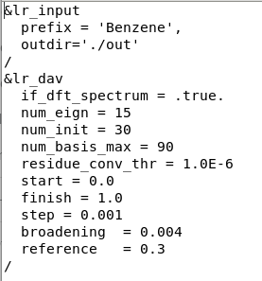
Example 5: Calculation of absorption spectra using turboDavidson
Step 1. Perform a SCF ground-state calculation:
pw.x < pw.benzene.in > pw.benzene.out
Step 2. Perform the turboDavidson calculation without the electronic interaction using the turbo_davidson.x program.
turbo_davidson.x < turbo_davidson.benzene.in > turbo_davidson.benzene.out

Slide 16
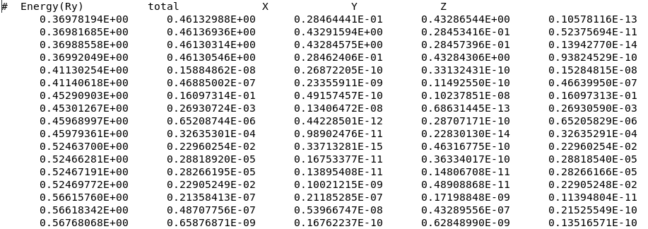
Example 5: Calculation of absorption spectra using turboDavidson
The code turbo_davidson.x produces a file Benzene-dft.eigen containing single-particle excitation eigenvalues:

Slide 17
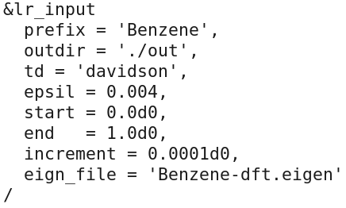
Example 5: Calculation of absorption spectra using turboDavidson
Step 3. Perform a spectrum calculation using the turbo_spectrum.x program and using the eigenvalues computed in the previous step.
The input file turbo_spectrum.benzene.in reads:
turbo_spectrum.x < turbo_spectrum.benzene.in > turbo_spectrum.benzene.out

Slide 18
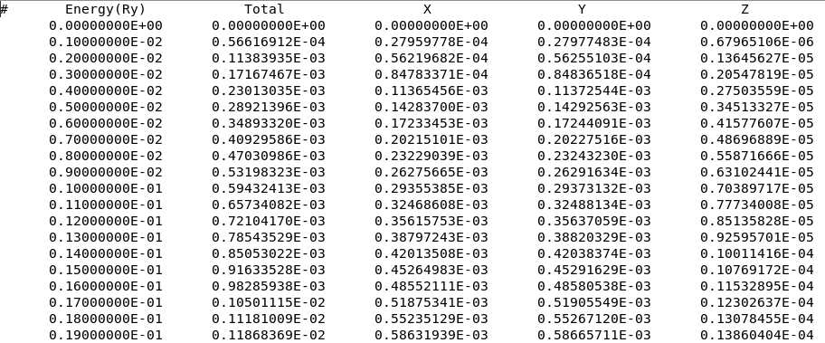
Example 5: Calculation of absorption spectra using turboDavidson
The turbo_spectrum.x program produces the file Benzene.plot.dat which contains the absorption spectrum in a tabular format:

Slide 19
Example 5: Calculation of absorption spectra using turboDavidson
Step 4. Plot the spectrum using gnuplot and the script plot_spectrum.gp
Since the interaction was switched off (if_dft_spectrum=.true.), you should obtain the same absorption spectrum as the one obtained using the epsilon.x program in the example4.
The script plot_spectrum.gp will do such a comparison, and it will produce the file Benzene_spectrum.eps which you can visualize.

Slide 20
Example 5: Calculation of absorption spectra using turboDavidson
Comparison of the absorption spectrum of benzene computed in the Independent Particle Approximation using turbo_davidson.x and epsilon.x (file Benzene_spectrum.eps):

Slide 21
Example 5: Calculation of absorption spectra using turboDavidson
Now switch on the interaction!
Make the following modifications in the input files:
In the file turbo_davidson.benzene.in set if_dft_spectrum = .false.
In the file turbo_spectrum.benzene.in set eign_file = 'Benzene.eigen'
In plot_spectrum.gp change the title to: 'turbo-davidson.x (interacting electrons)'
Once these modifications are done, repeat steps 2, 3, and 4:
Note! The calculation will be a bit too long. Therefore, let us see the output files in the directory 'reference'.

Slide 22
Example 5: Calculation of absorption spectra using turboDavidson
Comparison of the absorption spectrum of benzene computed using turbo_davidson.x with interaction and using epsilon.x in the Independent Particle Approximation (file Benzene_spectrum.eps):
Interaction opens the gap and blue-shifts the peaks

Slide 23
Outline
1. Example 4: Calculation of absorption spectra in the Independent Particle Approximation
2. Example 5: Calculation of absorption spectra of interacting electrons using the turboDavidson program
3. Example 6: Calculation of absorption spectra of interacting electrons using the turboLanczos program
4. Example 7: Calculation of absorption spectra using B3LYP pseudo-potential

Slide 24
turboLanczos program for calculation of absorption spectra
The turbo_lanczos.x program allows us to calculate absorption spectra of molecules using time-dependent density functional perturbation theory (TDDFpT) without computing empty states!
The interactions of electrons (Hartree and Exchange-Correlation effects) are taken into account fully ab initio and self-consistently.
The electronic transitions from occupied to empty states cannot be analyzed (use turbo_davidson.x for this purpose).
The overall absorption spectrum in a wide frequency range can be calculated at once!
Theory: Dario Rocca, PhD thesis “TDDFT: New algorithms with applications to molecular spectra”, SISSA (2007).

Slide 25
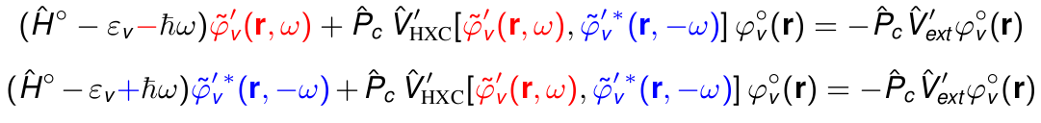
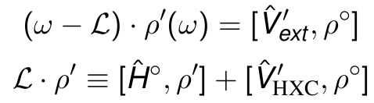

turboLanczos program for calculation of absorption spectra
Coupled linear-response TDDFpT equations (resonant and anti-resonant):
perturbation
interaction terms
These equations can be re-written as a quantum Liouville equation:
Absorption coefficient is computed as:
Lanczos algorithm is used to solve recursively quantum Liouville equation in the standard batch representation. This allows us to avoid inversions and multiplications of large matrices.

Slide 26
Example 6: Calculation of absorption spectra using turboLanczos
Go to the directory with the input files:
cd Day-3/example6
In this directory you will find:
README.md – File describing how to do the exercise
pw.benzene.in – Input file for the SCF ground-state calculation
turbo_lanczos.benzene.in – Input file to perform Lanczos recursions
turbo_spectrum.benzene.in – Input file for a postprocessing calculation of spectrum
plot_spectrum.gp – Script to plot spectrum using gnuplot
reference – Directory with the reference results

Slide 27
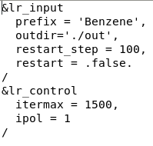
Example 6: Calculation of absorption spectra using turboLanczos
Step 1. Perform a SCF ground-state calculation:
pw.x < pw.benzene.in > pw.benzene.out
Step 2. Perform Lanczos recursions using the turbo_lanczos.x program The input file is turbo_lanczos.benzene.in :
turbo_lanczos.x < turbo_lanczos.benzene.in > turbo_lanczos.benzene.out

Slide 28
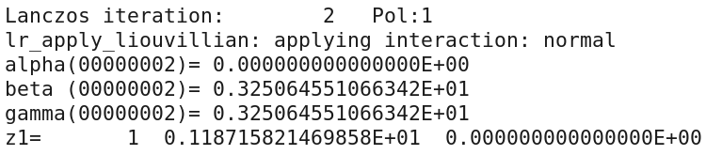
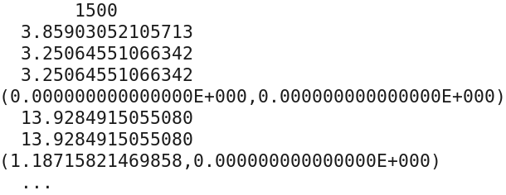
Example 6: Calculation of absorption spectra using turboLanczos
Note! The calculation will be a bit too long. Therefore, let us see the output files in the directory reference.
In the output file turbo_lanczos.benzene.out there is information about each Lanczos iteration :
In the directory out, which contains temporary files, there is a file Benzene.beta_gamma_z.1 which contains the information about Lanczos coefficients:

Slide 29
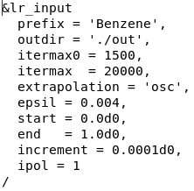
Example 6: Calculation of absorption spectra using turboLanczos
Step 3. Perform a spectrum calculation using the post-processing program turbo_spectrum.x and using the Lanczos coefficients computed in the previous step.
The input file turbo_spectrum.benzene.in reads:
turbo_spectrum.x < turbo_spectrum.benzene.in > turbo_spectrum.benzene.out

Slide 30
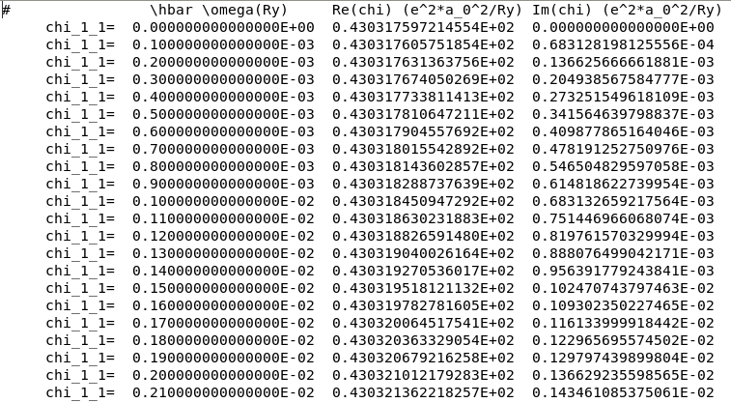
Example 6: Calculation of absorption spectra using turboLanczos
The code turbo_spectrum.x produces a file Benzene.plot_chi.dat which can be used for plotting the absorption spectrum :

Slide 31
Example 6: Calculation of absorption spectra using turboLanczos
Step 4. Plot the spectrum using gnuplot and the script plot_spectrum.gp
You should obtain the same excitation peak in the spectrum as was obtained using the code turbo_davidson.x in the example5 including interaction.
The script plot_spectrum.gp will do such a comparison, and it will produce the file Benzene_spectrum.eps which you can visualize.

Slide 32
Example 6: Calculation of absorption spectra using turboLanczos
Comparison of the absorption spectrum of benzene computed using turbo_lanczos.x and using turbo_davidson.x both including the interation (file Benzene_spectrum.eps):

Slide 33
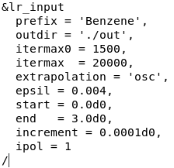
Example 6: Calculation of absorption spectra using turboLanczos
turbo_lanczos.x allows us to obtain the absorption spectrum in a wide frequency range just by repeating a post-processing calculation using turbo_spectrum.x in a larger frequency range. This cannot be done with turbo_davidson.x
Make changes in turbo_spectrum.benzene.in
turbo_spectrum.x < turbo_spectrum.benzene.in > turbo_spectrum.benzene.out

Slide 34
Example 6: Calculation of absorption spectra using turboLanczos
turbo_lanczos.x allows us to obtain the absorption spectrum in a wide frequency range just by repeating a post-processing calculation using turbo_spectrum.x in a larger frequency range. This cannot be done with turbo_davidson.x
Make changes in the script plot_spectrum.gp:
set xrange [0:30.0]
set xtics 0.0, 5.0, 30.0
Use gnuplot and the modified script plot_spectrum.gp to produce the graph Benzene_spectrum.eps .

Slide 35
Example 6: Calculation of absorption spectra using turboLanczos
Comparison of the absorption spectrum of benzene computed using turbo_lanczos.x and using turbo_davidson.x both including the interation (file Benzene_spectrum.eps):
Many more eigenvalues must be computed in turboDavidson in order to obtain spectrum in a wide frequency range!
One Lanczos calculation to obtain spectrum in any wide frequency range!

Slide 36
Outline
1. Example 4: Calculation of absorption spectra in the Independent Particle Approximation
2. Example 5: Calculation of absorption spectra of interacting electrons using the turboDavidson program
3. Example 6: Calculation of absorption spectra of interacting electrons using the turboLanczos program
4. Example 7: Calculation of absorption spectra using B3LYP pseudo-potential

Slide 37
Example 7: Calculation of absorption spectra using B3LYP pseudo-potential
Go to the directory with the input files:
cd Day-3/example7
In this directory you will find:
README.md – File describing how to do the exercise
pw.methane.in – Input file for the SCF ground-state calculation
turbo_davidson.methane.in – Input file for a Davidson calculation of the eigenvalues
turbo_spectrum.methane.in – Input file for a post-processing calculation of the spectrum
plot_spectrum_nohyb.gp – Script to plot spectrum using gnuplot
plot_spectrum_hyb.gp – Script to plot spectrum using gnuplot
reference – Directory with the reference results

Slide 38
Example 7: Calculation of absorption spectra using B3LYP pseudo-potential
Step 1. Perform a SCF ground-state calculation:
pw.x < pw.methane.in > pw.methane.out
Step 2. Perform the turboDavidson calculation without B3LYP using the program.
turbo_davidson.x < turbo_davidson.methane.in > turbo_davidson.methane.out
Step 3. Perform a spectrum calculation using the turbo_spectrum.x program and using the eigenvalues computed in the previous step.
turbo_spectrum.x < turbo_spectrum.methane.in > turbo_spectrum.methane.out
Step 4. Plot the spectrum using gnuplot and the script plot_spectrum_nohyb.gp
you should obtain the spectra without hybrid potential
The script plot_spectrum_nohyb.gp will produce the file Methane_spectrum.eps which you can visualize.

Slide 39
Example 7: Calculation of absorption spectra using B3LYP pseudo-potential
Absorption spectrum of methane using turbo_davidson.x (file Methane_spectrum.eps):

Slide 40
Example 7: Calculation of absorption spectra using B3LYP pseudo-potential
Now use B3LYP hybrid pseudo-potential!
Make the following modifications in the input files:
In the file pw.methane.in add input_dft = ’B3LYP’
In the file turbo_davidson.methane.in set d0psi_rs = .true.
Use plot_spectrum_hyb.gp
Once these modifications are done, repeat all steps:
Note! The calculation will be a bit too long. Therefore, let us see the output files in the directory 'reference'.

Slide 41
Example 7: Calculation of absorption spectra using B3LYP pseudo-potential
Hybrid exchange-correlation functionals open the energy gap and blue-shift the peaks:

Slide 42
Bibliography
1. B. Walker, R. Gebauer, Ultrasoft pseudopotentials in time-depepndent density-functional theory, J. Chem. Phys. 127, 164106 (2007).
2. D. Rocca, R. Gebauer, Y. Saad, and S. Baroni, Turbo charging time-dependent density-functional theory with Lanczos chains, J. Chem. Phys. 128, 154105 (2008).
3. O. Malcioglu, R. Gebauer, D. Rocca, and S. Baroni, turboTDDFT – A code for the simulation of molecular spectra using the Liouville-Lanczos approach to TDDFPT, Comp. Phys. Comm. 182, 1744 (2011).
4. S. Baroni and R. Gebauer, 'The Liouville-Lanczos approach to TDDFPT' in 'Fundamentals of TDDFT', Springer, Berlin (2012).
5. X. Ge, S. Binnie, D. Rocca, R. Gebauer, and S. Baroni, turboTDDFT 2.0 – Hybrid functionals and new algorithms within TDDFPT, Comp. Phys. Comm. 185, 2080 (2014).

