Slide 1

QE-2021: Hands-on session – Day-4
(Advanced functionals)
Iurii Timrov, Andrea Urru, Sukanya Ghosh,
Nandhakumar Velankanni, Yaning Cui

Slide 2
Outline
Example 1: DFT+U study of FeO
Example 2: DFT with hybrid functionals: study of Si
Example 3: DFT with Van der Waals functionals: study of graphite
(We will use HPC for this hands-on, because the examples are quite heavy)

Slide 3
Outline
Example 1: DFT+U study of FeO
Example 2: DFT with hybrid functionals: study of Si
Example 3: DFT with Van der Waals functionals: study of graphite

Slide 4

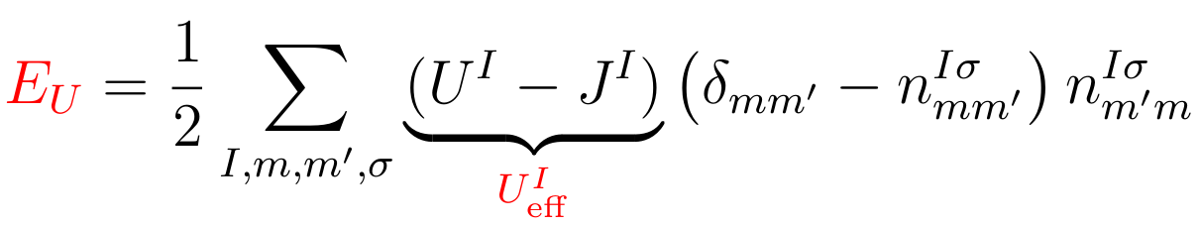
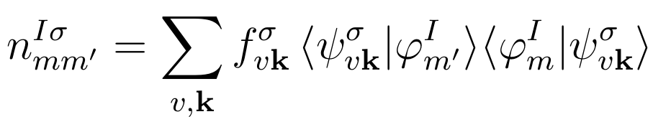
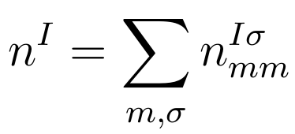
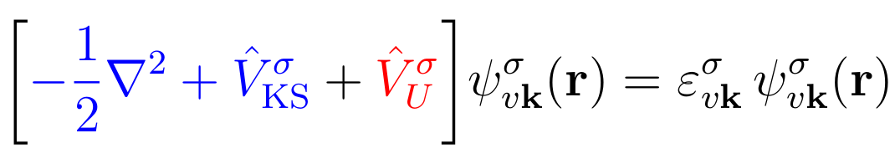
DFT+U
The DFT+U total energy:
The Hubbard correction energy:
effective Hubbard
parameter
The occupation matrix:
The total occupation of localized states (d or f) at site I :
The Kohn-Sham equation:

Slide 5
Localized-states manifold
How do we know to what states of a Hubbard atom the Ueff correction will be applied?
Currently, this is hard-coded (in Quantum ESPRESSO 6.7)
Check two subroutines in quantum-espresso/Modules :
set_hubbard_n.f90
set_hubbard_l.f90
principal quantum number “n”
orbital quantum number “l”
For Fe : n = 3
For Fe : l = 2
Apply the Hubbard Ueff correction to the 3d electrons of Fe

Slide 6
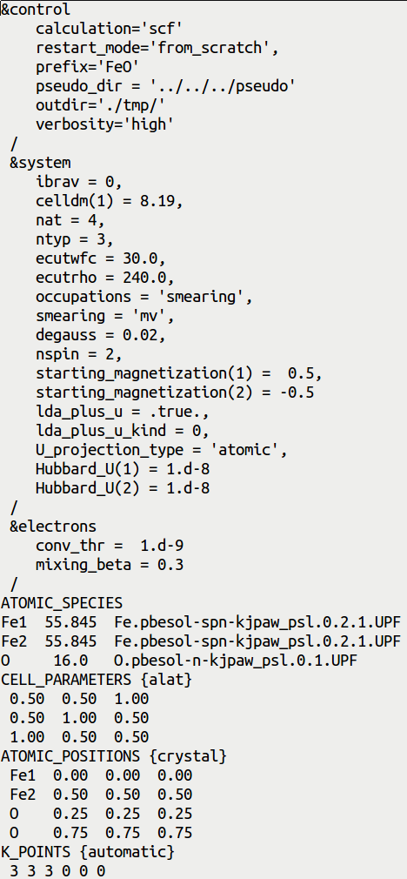
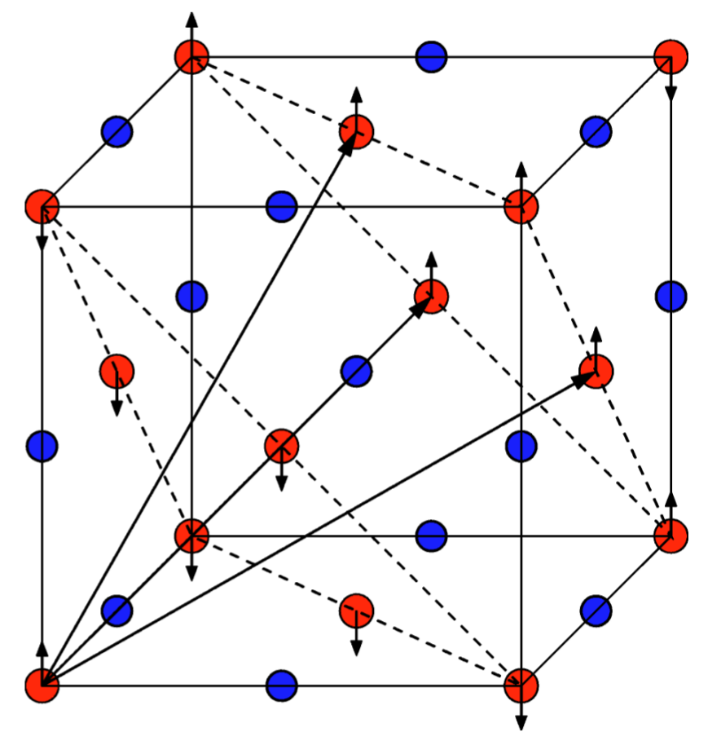
Input file pw.FeO.scf.in
SCF calculation
!
ESPRESSO_PSEUDO and ESPRESSO_TMPDIR
!
Experimental lattice parameter
'MV' smearing for metals (FeO is metallic @PBEsol)
Spin-polarized (collinear) calculation
(antiferromagnetic ordering)
Initialize Hubbard parameters for two types of Fe
Two sublattices of Fe atoms
O
Fe

Slide 7
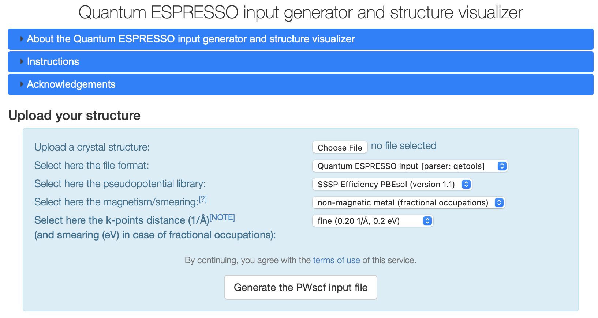
QE input generator
https://www.materialscloud.org/work/tools/qeinputgenerator

Slide 8
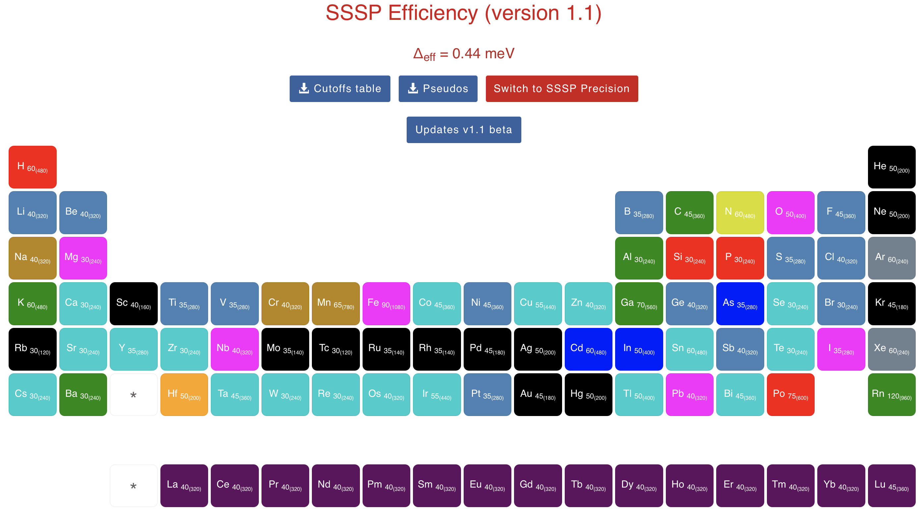
SSSP library
https://www.materialscloud.org/discover/sssp/table/efficiency

Slide 9
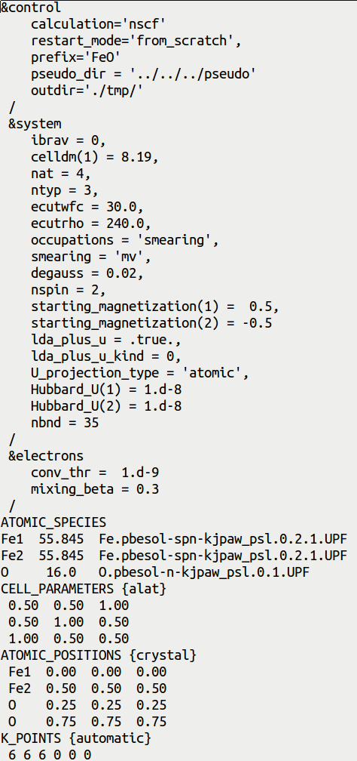
Input file pw.FeO.nscf.in
NSCF calculation
!
!
NSCF input is very similar to the SCF input,
but there are a few differences which are
highlighted here
Number of electronic bands
Projected DOS must be converged with respect to
the number of k points. Also, number of bands must
be large enough, to have converged projected DOS
in a specific energy range. All this is controlled here.
k points mesh which is denser than in SCF

Slide 10
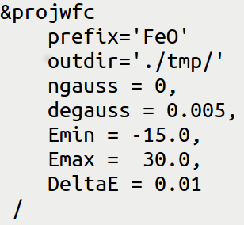
Input file projwfc.FeO.in
Gnuplot script: plot_pdos.gp
!
Simple Gaussian broadening of PDOS
Value of Gaussian broadening, in Ry (not eV!)
Minimum and maximum value of energy for the plot, in eV
Energy grid step
Inspect the script: it aims at plotting Fe-3d state (majority spin and minority spin)
and O-2p states.
PDOS is shifted such that the Fermi energy corresponds to the zero of energy.
Visualize the file “FeO_PDOS.eps”

Slide 11
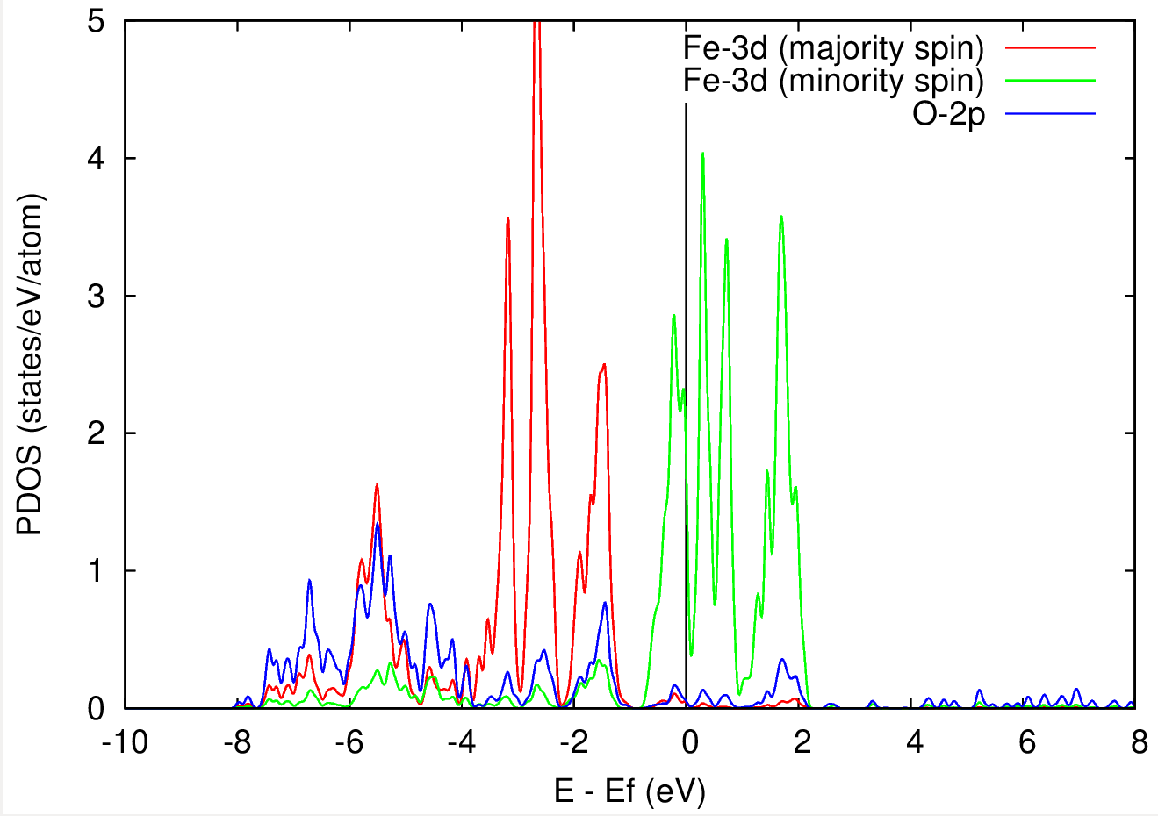
PDOS of FeO from standard DFT calculation
DFT predicts FeO to be metallic (but this is wrong!)
Let's try DFT+U
Experimentally FeO is know to be insulating

Slide 12
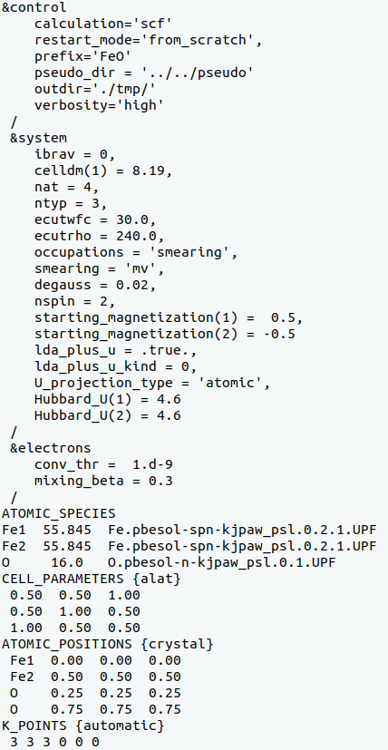
Input file pw.FeO.scf.in for DFT+U
!
Here we want to put a Hubbard U correction for
3d electrons of Fe atoms
!
Which value of U to use?
For every material Hubbard U is different; here we use
U = 4.6 eV for Fe-3d states (see next slides)
Hubbard U values (in eV) for atomic type 1 & type 2

Slide 13
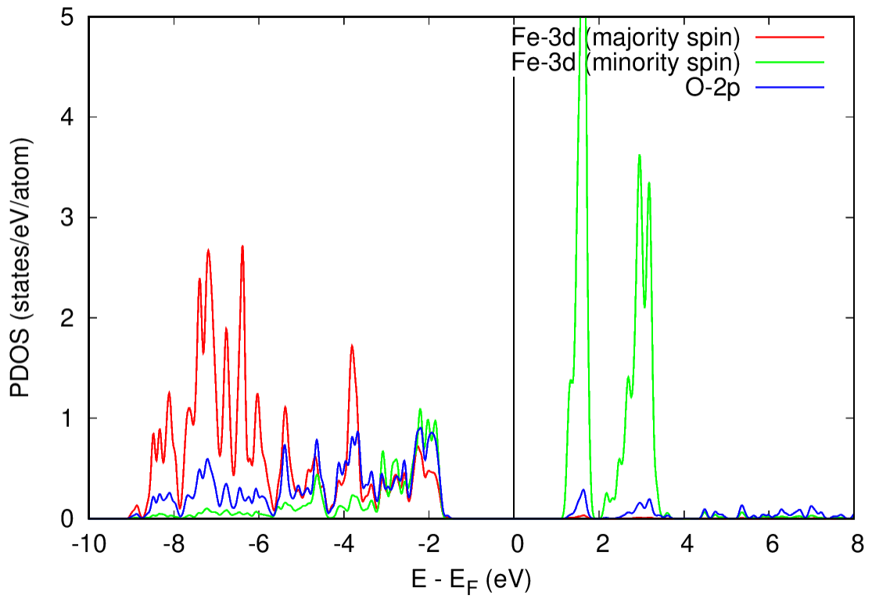
DFT vs DFT+U
DFT
DFT+U
The solution with DFT+U is metallic
The solution with DFT+U is insulating
If DFT+U does not give the insulating solution,
use starting_ns_eigenvalue. Check for more
details this paper: PRB 71, 035105 (2005).
Agreement with the experiement!

Slide 14
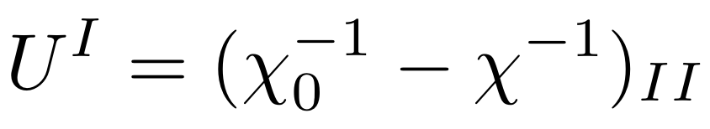
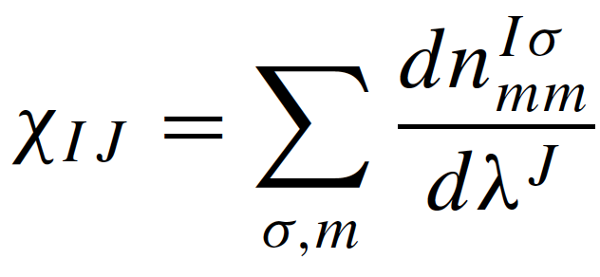
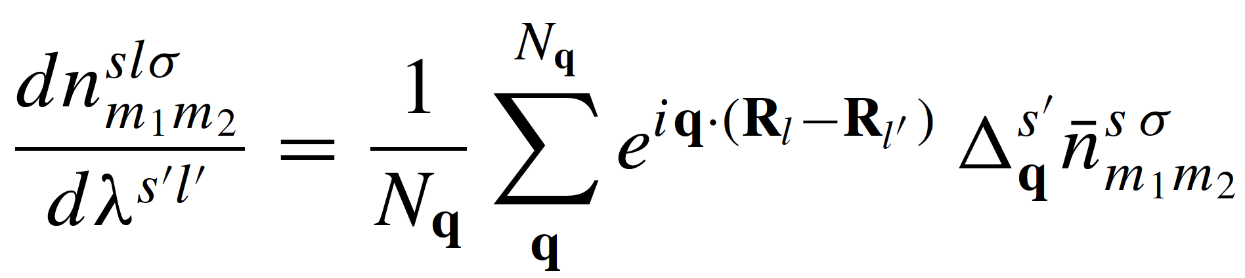
How to compute the Hubbard U parameter?
Linear response theory
Density-functional perturbation theory (DFPT)
Sum over all q points in a q mesh

Slide 15
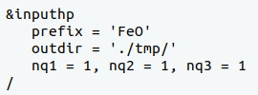
How to compute the Hubbard U parameter?
Using the HP (Hubbard Parameters) code of Quantum ESPRESSO
Input file “hp.FeO.in”:
Prefix and outdir must be exactly the same as in
the input file pw.FeO.scf.in
!
Size of the q point mesh: 1x1x1 in this case
U = 4.6 eV
Warning: This U value is not converged with respect to the k and q meshes!!!
Documentation: quantum-espresso/HP/Doc/INPUT_HP.txt
Theory:
I. Timrov, N. Marzari, M. Cococcioni, PRB 98, 085127 (2018)
I. Timrov, N. Marzari, M. Cococcioni, PRB 103, 045141 (2021)

Slide 16
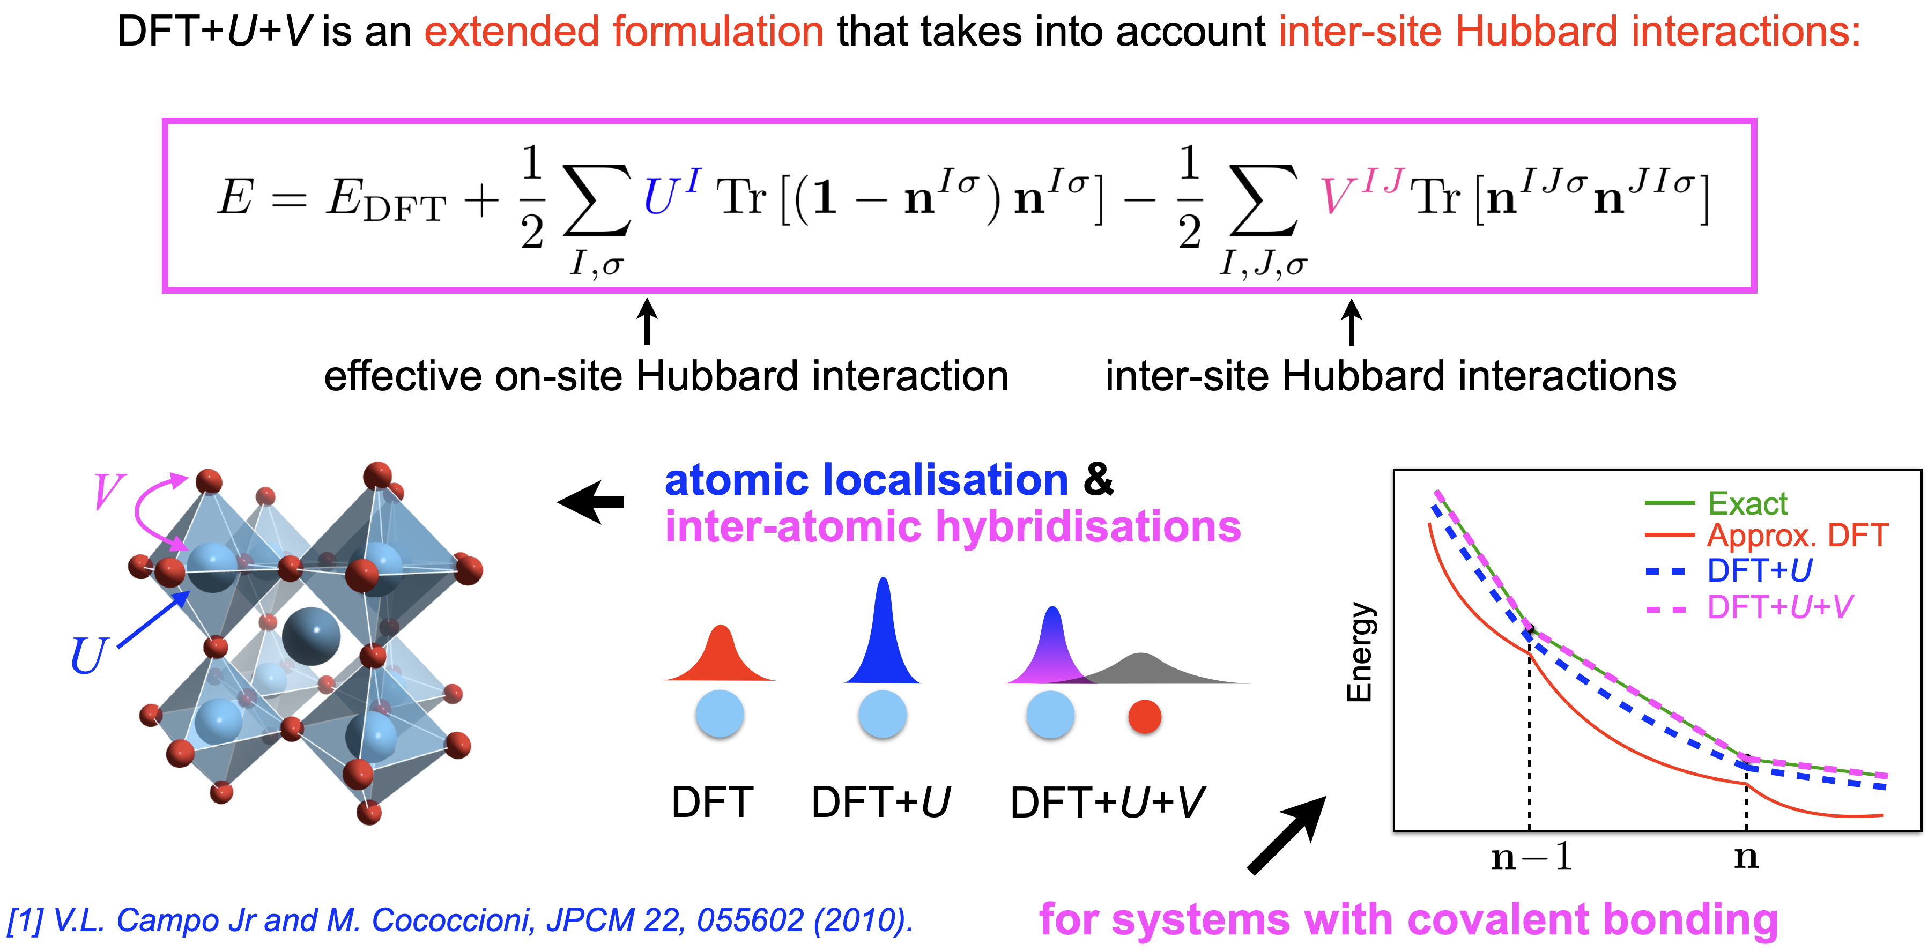
DFT+U+V
Both U and V can be
computed using the
HP code
Theory:
V.L. Campo Jr and M. Cococcioni, JPCM 22, 055602 (2010)
I. Timrov, N. Marzari, M. Cococcioni, PRB 103, 045141 (2021)

Slide 17
Outline
Example 1: DFT+U study of FeO
Example 2: DFT with hybrid functionals: study of Si
Example 3: DFT with Van der Waals functionals: study of graphite

Slide 18
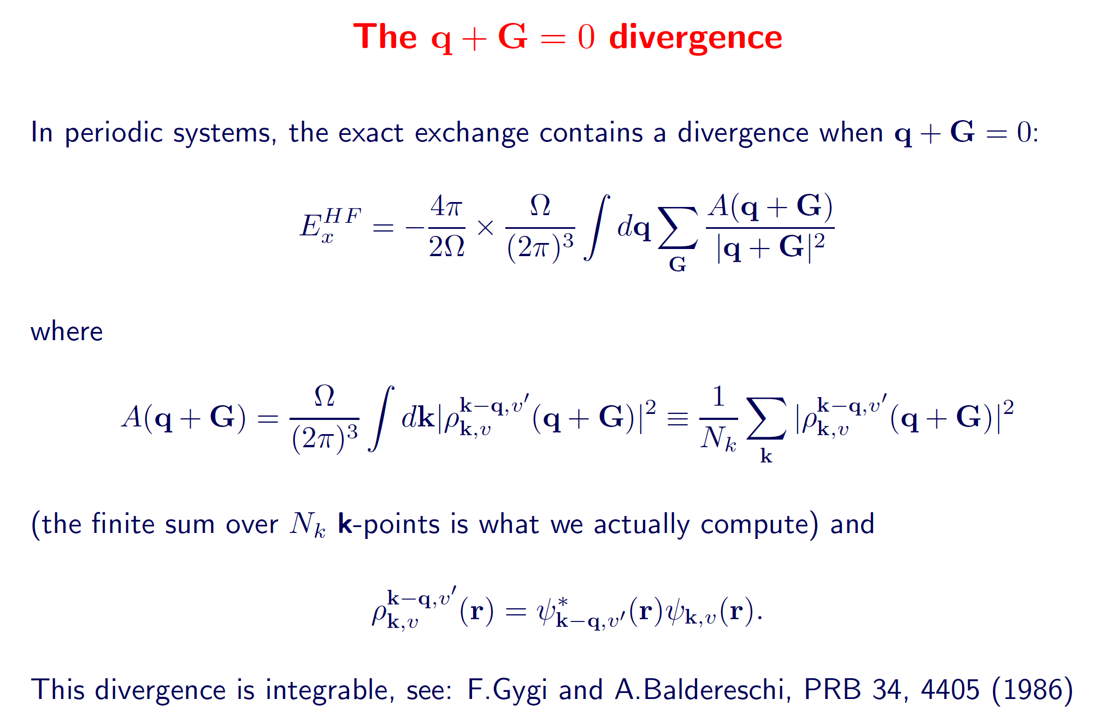
We need to setup the q mesh

Slide 19
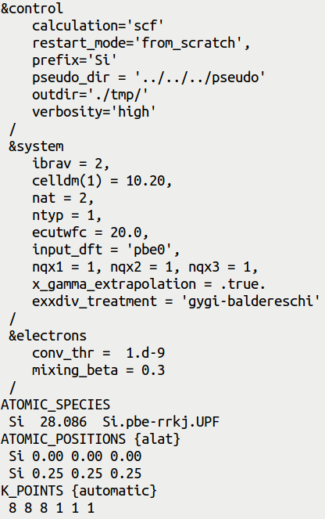
Input file pw.Si.scf.in
Hybrid functionals are very computationally expensive!
SCF calculation
!
Override the functional written in the pseudo-
potential (PP) file.
Important: use a PP for the closest GGA (PBE
in this case), there are no PP's for hybrids.
!
Mesh for the q points 1x1x1 is the minimal
grid (q=0), it is fast but not very accurate
If .true. use extrapolation for the q->0 limit
Specifies that the singularity at q->0 is
analytically integrated

Slide 20
Popular hybrid functionals
input_dft = “pbe0”
J.P.Perdew, M. Ernzerhof, K.Burke, JCP 105, 9982 (1996)
C. Adamo, V. Barone, JCP 110, 6158 (1999)
input_dft = “b3lyp”
P.J. Stephens,F.J. Devlin,C.F. Chabalowski,M.J. Frisch, J.Phys.Chem 98, 11623 (1994)
input_dft = “hse”
Heyd, Scuseria, Ernzerhof, J. Chem. Phys. 118, 8207 (2003)
Heyd, Scuseria, Ernzerhof, J. Chem. Phys. 124, 219906 (2006)

Slide 21
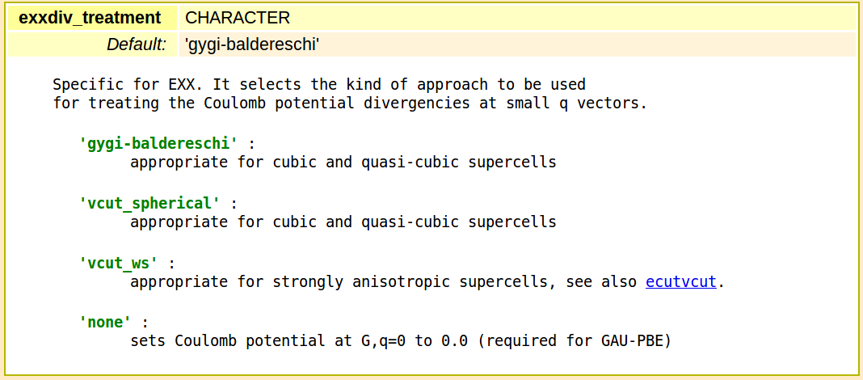
Types of treatement of divergences at q->0

Slide 22
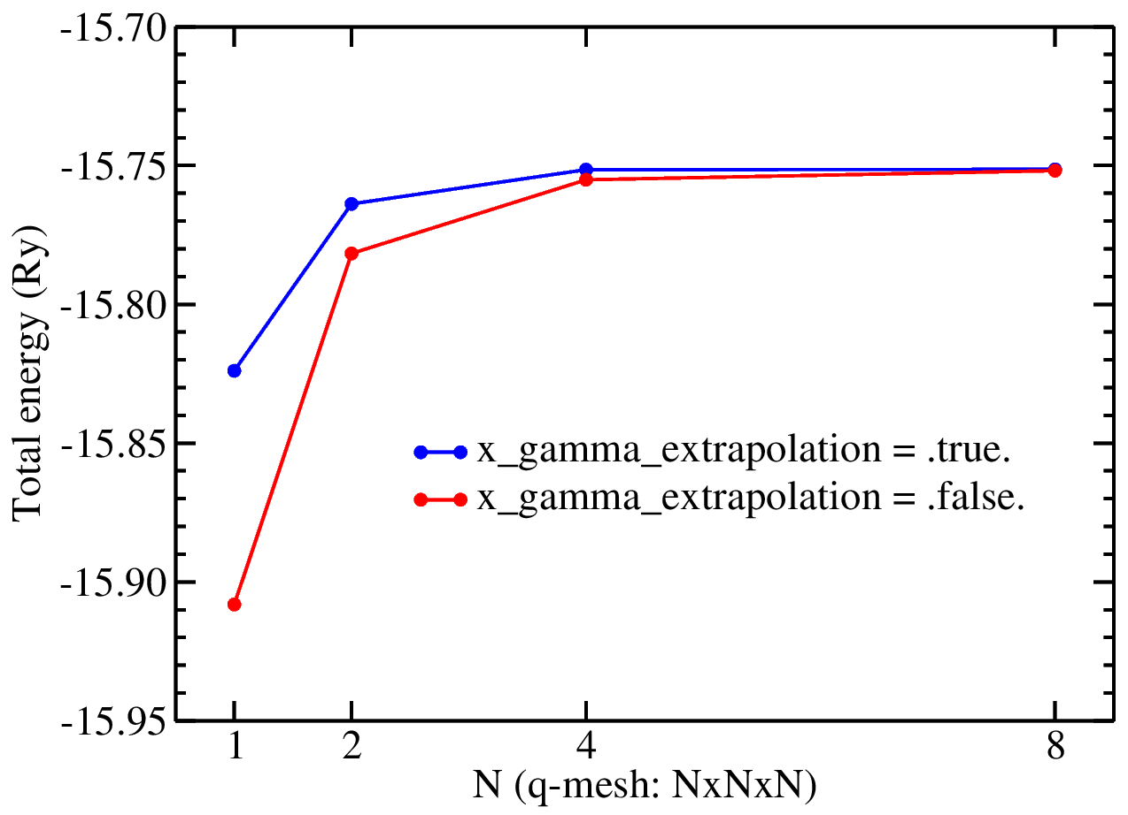
Convergence of the total energy wrt q point grid
Slow calculations do for scarce q meshes and check the “reference” folder

Slide 23
Outline
Example 1: DFT+U study of FeO
Example 2: DFT with hybrid functionals: study of Si
Example 3: DFT with Van der Waals functionals: study of graphite

Slide 24
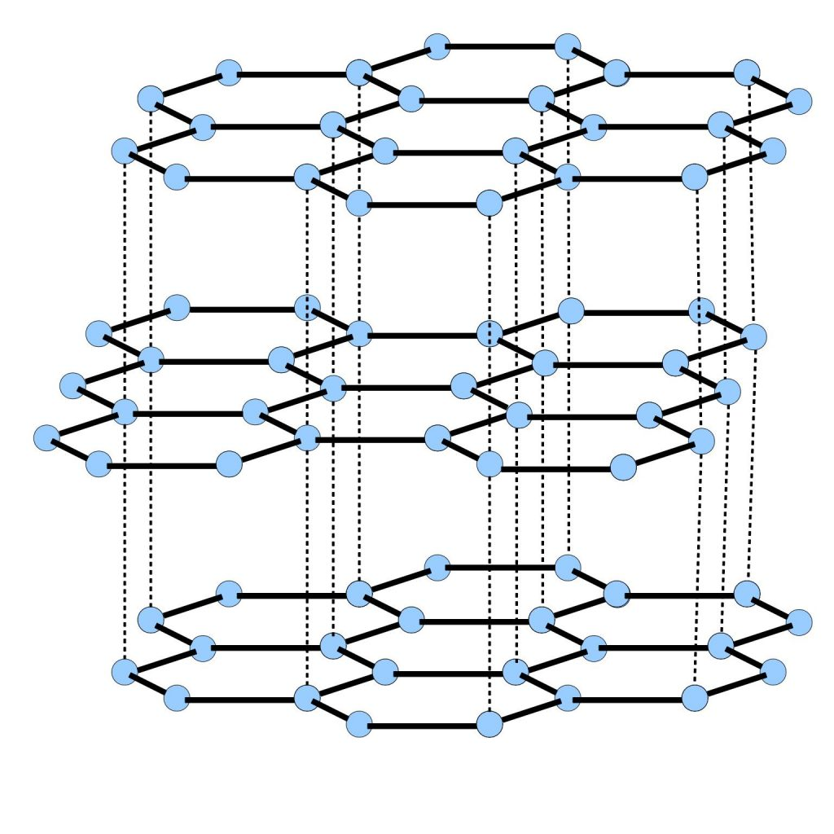
Graphite
Graphite has Van der Waals (dispersive) interactions between layers.
The equilibrium inter-layer distance is too small with LDA, and too large with GGA
with respect to the experimental value (3.336 A).
Van der Waals interactions must be taken into account.

Slide 25
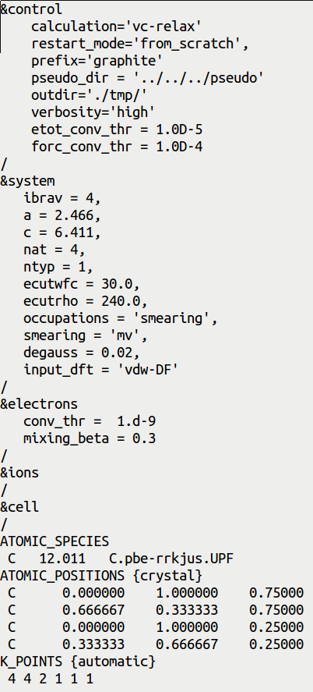
Input file pw.graphite.vc-relax.in
Variable-cell optimization
Variable-cell optimization
!
!
Hexagonal lattice, a and c are in Angtrom!
Override the functional written in the PP file.
Important: use PP for the closest GGA (PBE in
this case), because there are no PP for non-
local functionals
If we do not specify anything inside these namelists,
then the default values will be used for various
control parameters
The k point grid is denser along xy than along z,
reflecting shorter periodicity in the xy plane

Slide 26
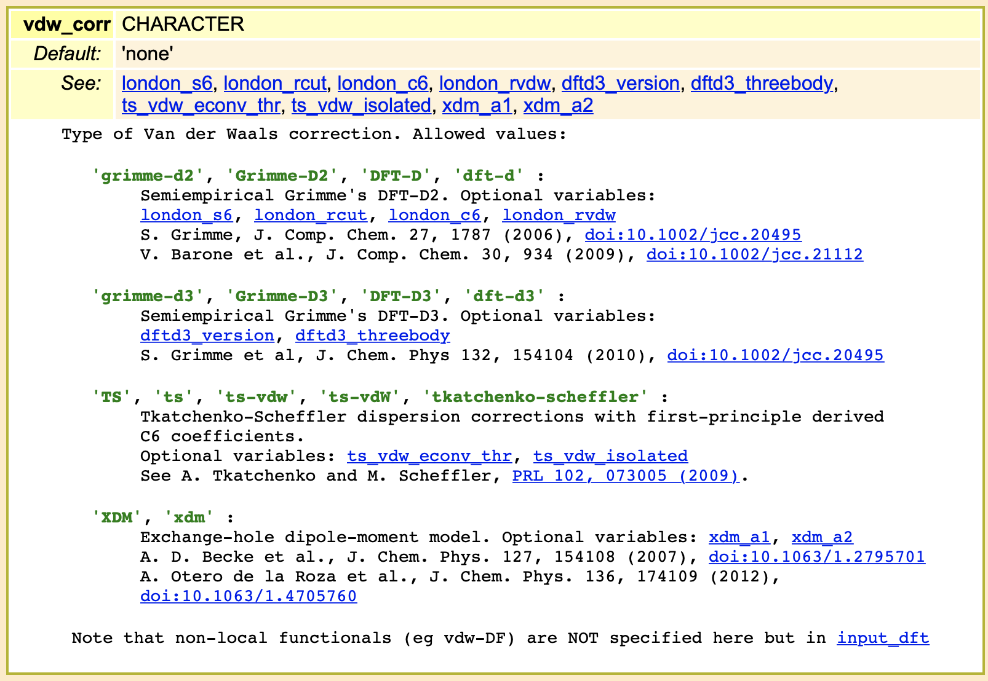
Types of the van der Waals correction

Slide 27
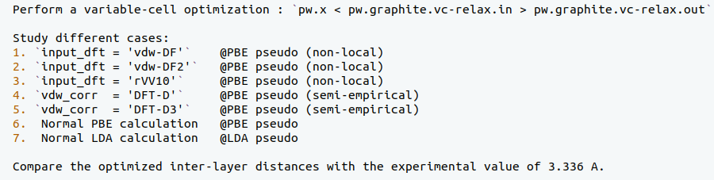
Structural optimization in graphite

Slide 28
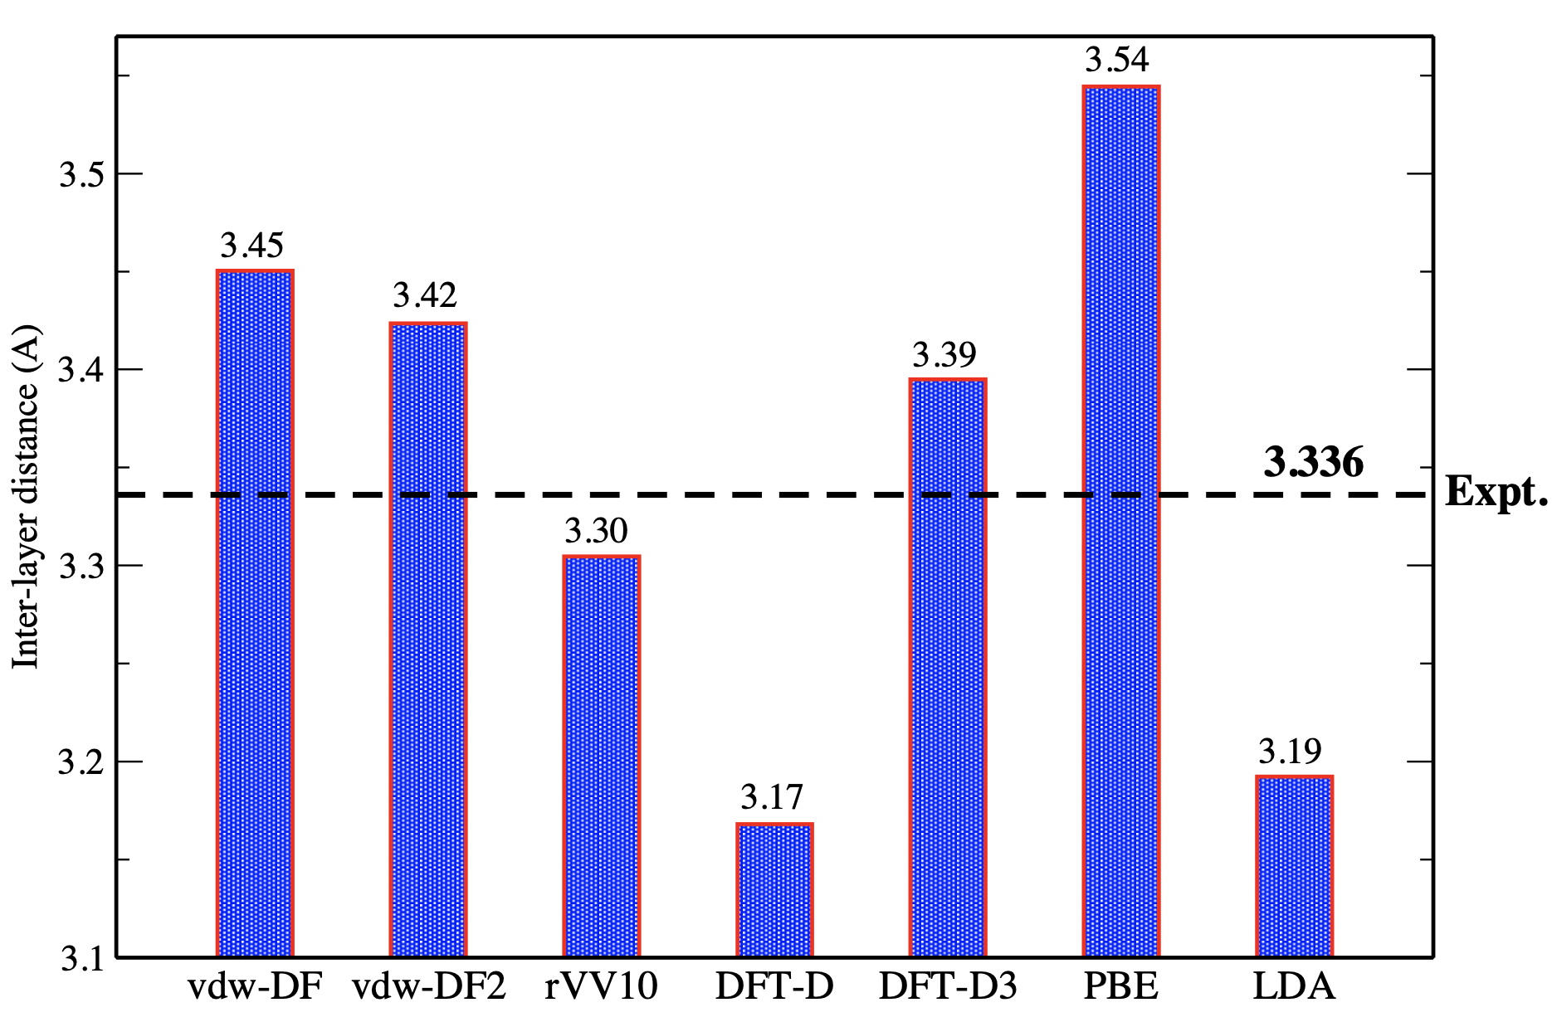
Inter-layer distance in graphite
Note: these results must be carefully converged (cutoff, k points, etc.)

