Slide 1

QE-2021: Hands-on session – Day-6
TDDFPT
Iurii Timrov (EPFL, Switzerland)
Oscar Baseggio (SISSA, Italy)

Slide 2
Outline
1. Part I – Optical absorption in molecules
2. Part II – EELS in solids

Slide 3
Part I – Optical absorption in molecules
1. Exercise 1: turboDavidson – from the Independent Particle Approximation (IPA) to interacting electrons
2. Exercise 2: turboLanczos – total spectra at low cost for interacting electrons

Slide 4
turboDavidson program for calculations of absorption spectra
The turbo_davidson.x program allows us to calculate absorption spectra of molecules using time-dependent density functional perturbation theory (TDDFpT).
The interactions of electrons (Hartree and Exchange-Correlation effects) are taken into account fully ab initio and self-consistently (or they can be neglected if_dft_spectrum=.false.).
The electronic transitions from occupied to empty states can be analyzed by selecting a frequency range in which the transitions occur.
However, calculations of overall absorption spectra in a wide frequency range are computationally rather expensive, because many eigenvalues of the Hamiltonian must be computed.

Slide 5
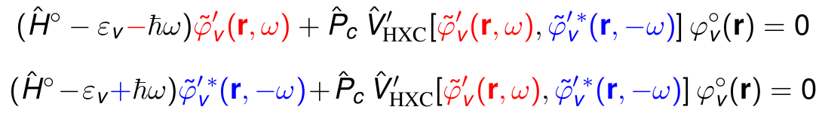
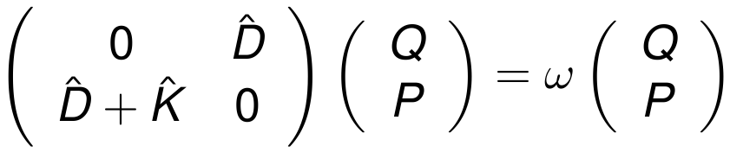


turboDavidson program for calculations of absorption spectra
Coupled linear-response TDDFpT equations (resonant and anti-resonant):
These equations can be re-written as Casida's matrix equation:
interaction terms
where and
Davidson algorithm is used (the same algorithm as in the ground state SCF calculation) to solve the Casida's equations and to obtain the eigenvalues which are used for a calculation of the absorption coefficient.

Slide 6


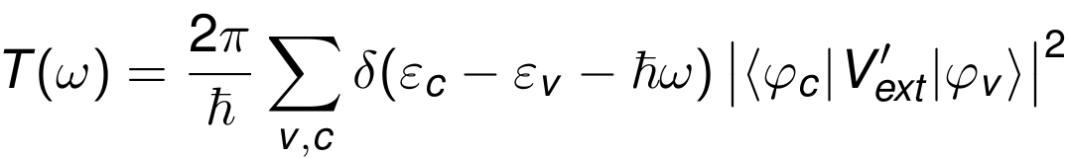





Independent Particle Approximation
The simplest approximation: Independent Particle Approximation (IPA) - a sum of independent excitations from occupied to empty states.
Fermi's golden rule
The transition probability per unit time from occupied states to empty states reads:
is the external potential induced by the electric field.
and
are the eigenvalues
are the eigenvalues
and the eigenfunctions of the ground-state Kohn-Sham equation

Slide 7
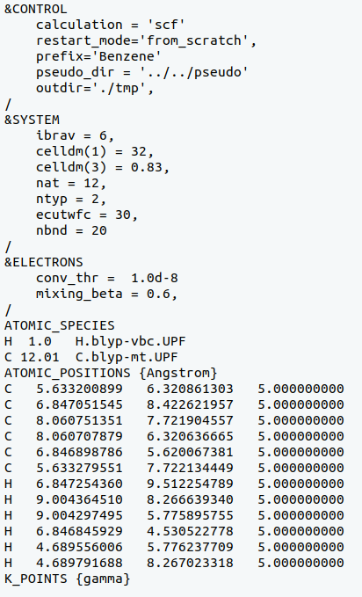
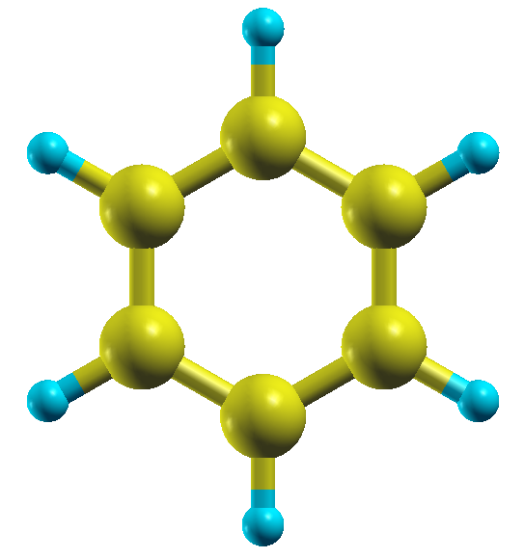

Exercise 1: Input file for PWscf
Step 1. Perform a Self-Consistent Field ground-state calculation for benzene at the equilibrium structure using the pw.x program.
Specify the total number of Kohn-Sham bands
(occupied + some empty states)
Input
Output
pw.x < pw.benzene.scf.in > pw.benzene.scf.out

Slide 8
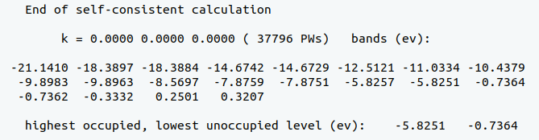
Exercise 1: Output file of PWscf
The output SCF file pw.benzene.scf.out :
HOMO
LUMO
HOMO – Highest Occupied Molecular Orbital
LUMO – Lowest Unoccupied Molecular Orbital
Energy gap = LUMO – HOMO = 5.1 (eV)

Slide 9
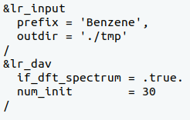
Exercise 1: Calculation of absorption spectra using turboDavidson (IPA)
Perform the turboDavidson calculation without the electronic interaction using the turbo_davidson.x program.
Same as in PWscf
This means we are using IPA
Obsolete variable for the IPA case
(will not be needed in future version of
QE for the IPA case)
turbo_davidson.x < turbo_davidson.benzene.davidson.in >...
...turbo_davidson.benzene.davidson.out

Slide 10
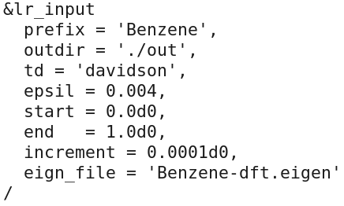
Exercise 1: Post-processing step
Perform a spectrum calculation using the turbo_spectrum.x program
and using the eigenvalues computed in the previous step.
turbo_spectrum.Benzene.tddfpt_pp.in :
tmp
turbo_spectrum.x < turbo_spectrum.benzene.davidson.in >...
...turbo_spectrum.benzene.davidson.out

Slide 11
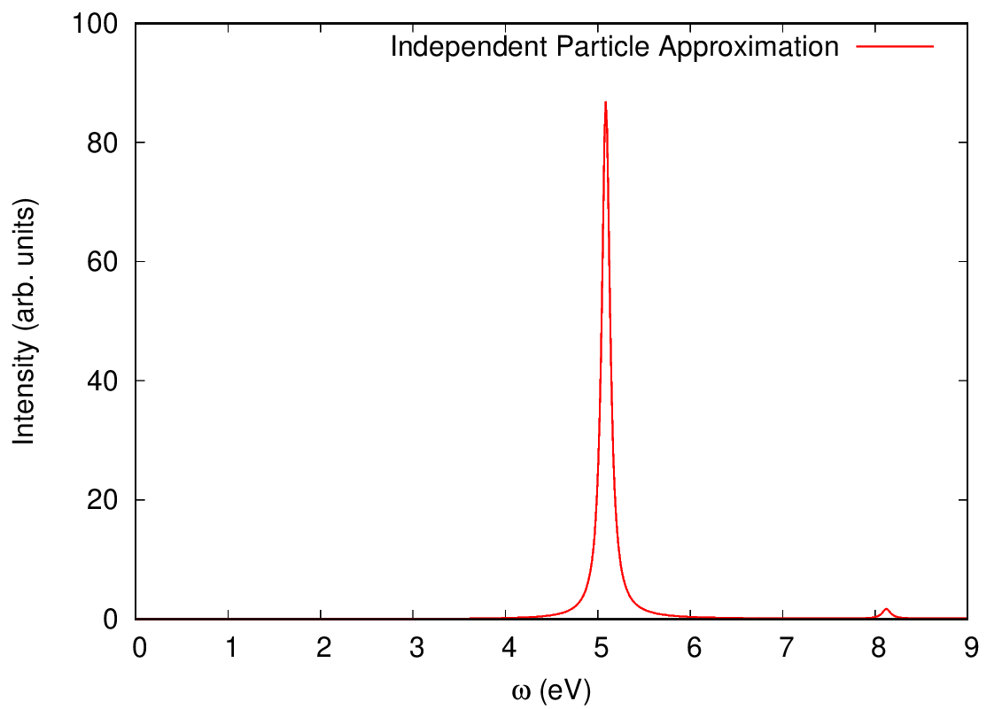
Exercise 1: Calculation of absorption spectra in IPA
Absorption spectrum of benzene in the Independent Particle Approximation (file Benzene_spectrum.eps):
Energy gap = LUMO – HOMO = 5.1 (eV)

Slide 12
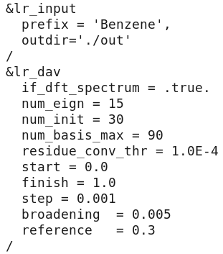
Exercise 1: Spectra including interactions
Perform the turboDavidson calculation without the electronic interaction using
the turbo_davidson.x program.
tmp
.false.
Switch on the interactions
turbo_davidson.x < turbo_davidson.benzene.davidson.in >...
...turbo_davidson.benzene.davidson.out

Slide 13
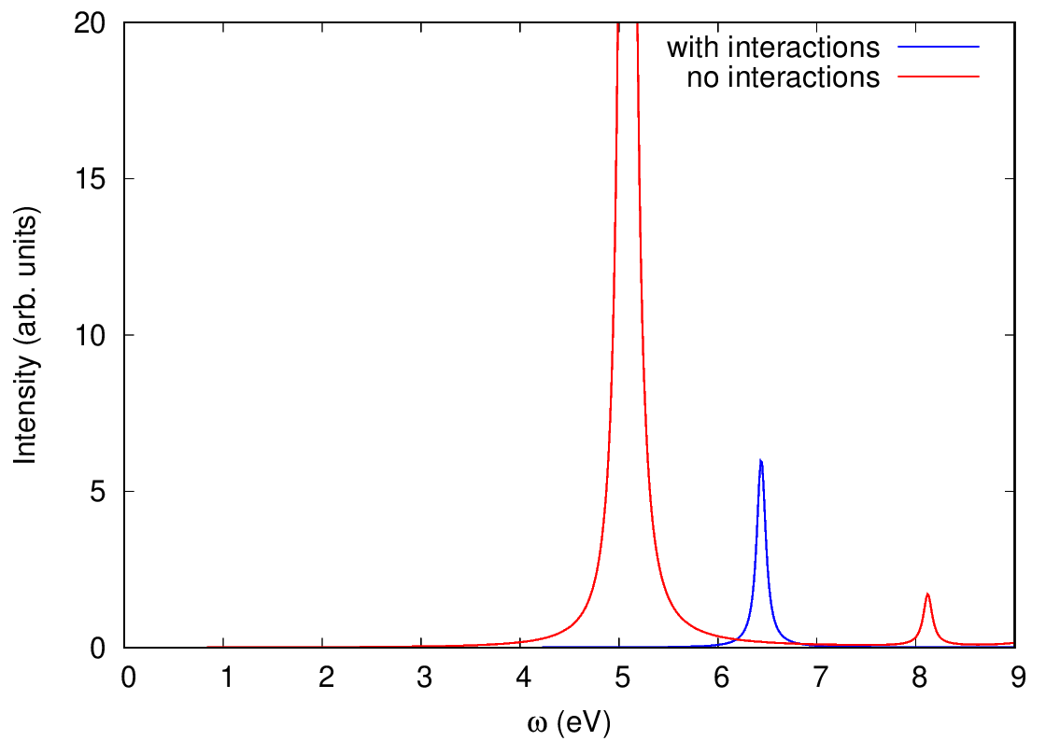
Exercise 1: Comparison of spectra with and without
interactions
Interaction increases the gap and thus blue-shifts the peaks

Slide 14
turboLanczos program for calculation of absorption spectra
The turbo_lanczos.x program allows us to calculate absorption spectra of molecules using time-dependent density functional perturbation theory (TDDFpT) without computing empty states!
The interactions of electrons (Hartree and Exchange-Correlation effects) are taken into account fully ab initio and self-consistently.
The electronic transitions from occupied to empty states cannot be analyzed (use turbo_davidson.x for this purpose).
The overall absorption spectrum in a wide frequency range can be calculated at once!

Slide 15
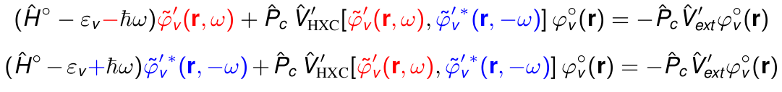
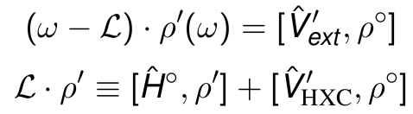

turboLanczos program for calculation of absorption spectra
Coupled linear-response TDDFpT equations (resonant and anti-resonant):
perturbation
interaction terms
These equations can be re-written as a quantum Liouville equation:
Absorption coefficient is computed as:
Lanczos algorithm is used to solve recursively quantum Liouville equation in the standard batch representation. This allows us to avoid inversions and multiplications of large matrices.

Slide 16
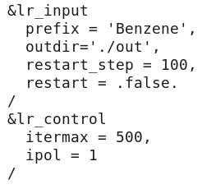
Exercise 2: Calculation of absorption spectra using turboLanczos
Step 1. Perform a SCF ground-state calculation (no nbnd in the input):
pw.x < pw.benzene.scf.in > pw.benzene.scf.out
Step 2. Perform Lanczos recursions using the turbo_lanczos.x program.
tmp
turbo_lanczos.x < turbo_lanczos.benzene.lanczos.in >... ...turbo_lanczos.benzene.lanczos.out

Slide 17
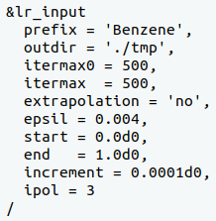
Exercise 2: Post-processing step
Perform a spectrum calculation using the post-processing program turbo_spectrum.x and using the Lanczos coefficients computed in the previous step.
1
turbo_spectrum.x < turbo_spectrum.benzene.in >... ...turbo_spectrum.benzene.out

Slide 18
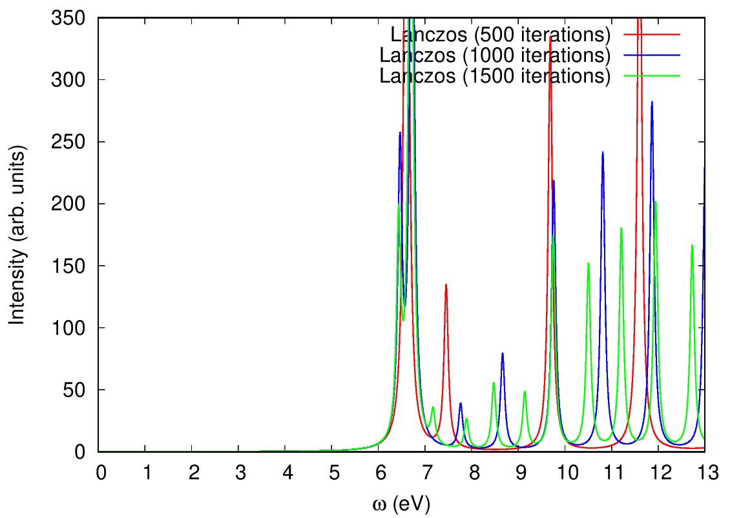
Exercise 2: Post-processing step
No extrapolation of Lanczos coefficients
No convergence yet even after
1500 iterations

Slide 19

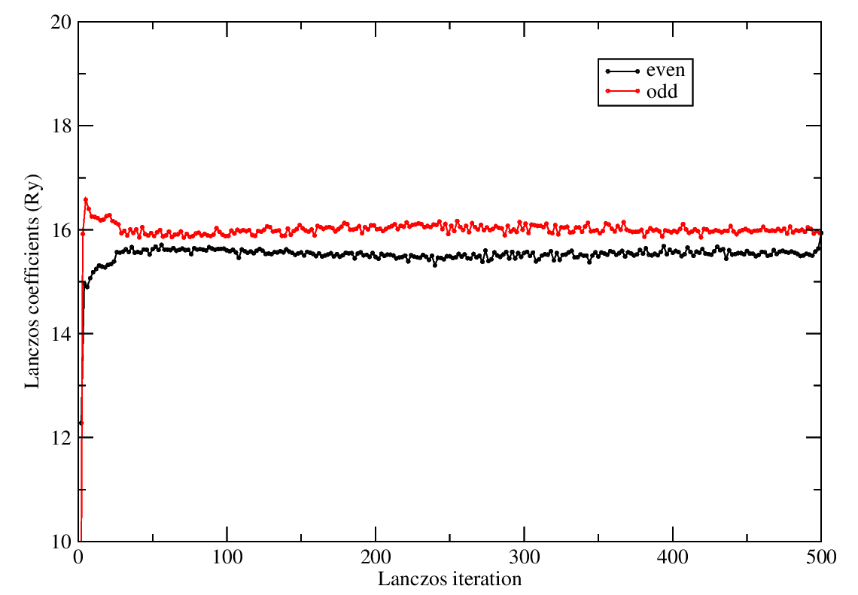
Exercise 2: Lanczos coefficients
Behavior of Lanczos coefficients
Lanczos coefficients oscillate around half of the kinetic-energy cutoff (~30/2 = 15 Ry in this case). Hence, we can extrapolate these coefficients.

Slide 20


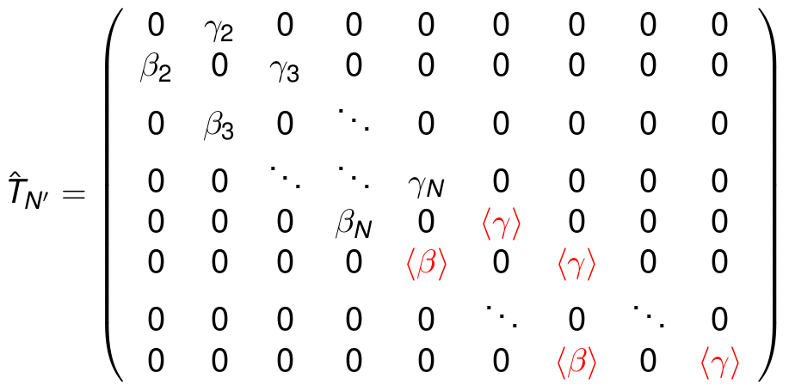
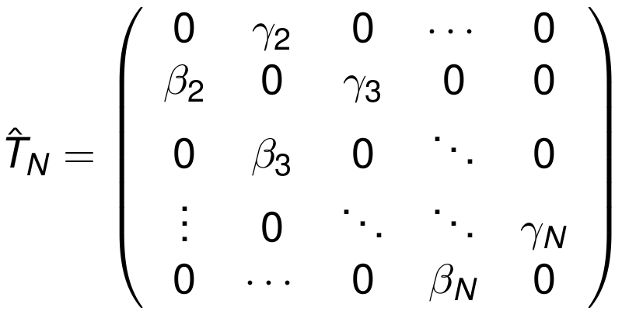


Exercise 2: Extrapolation of Lanczos coefficients
In the Liuoville-Lanczos approach, the absorption coefficient is computed as:
where is the tridiagonal matrix composed of the Lanczos coefficients.
Extrapolation

Slide 21
Exercise 2: Post-processing step
No extrapolation of Lanczos coefficients
turbo_lanczos.benzene.lanczos.in
turbo_spectrum.benzene.lanczos.in
tmp
1
Must be equal !
You can use restart = .true. option in order not to start from scratch, when you want to increase the number of Lanczos iterations.

Slide 22
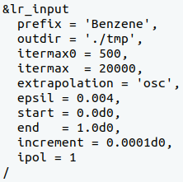
Exercise 2: Post-processing step
With extrapolation of Lanczos coefficients
turbo_lanczos.benzene.lanczos.in
turbo_spectrum.benzene.lanczos.in
tmp
Must be equal !
Must be equal !
Extrapolation until 20000
You can use restart = .true. option in order not to start from scratch, when you want to increase the number of Lanczos iterations.

Slide 23
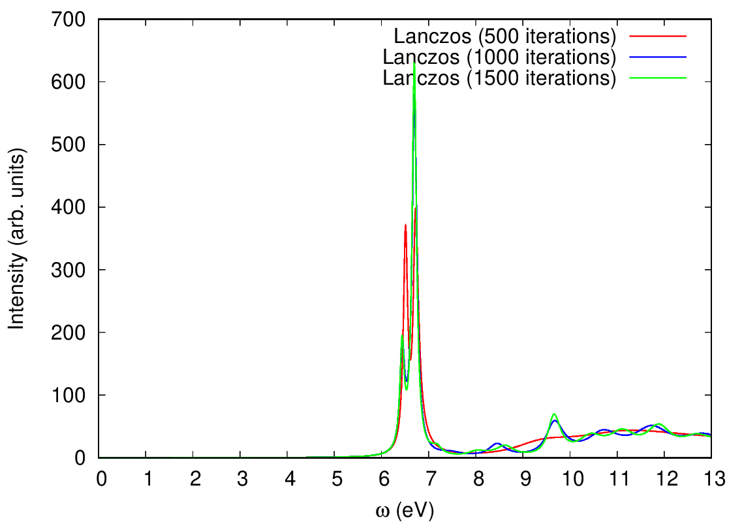
Exercise 2: Post-processing step
With extrapolation of Lanczos coefficients
The spectrum is relatively well
converged after 1500 iterations
One Lanczos calculation to obtain spectrum in any wide frequency range!

Slide 24
Part II – EELS in solids
1. Exercise 1: EELS spectrum of Si using Lanczos
2. Exercise 2: EELS spectrum of Si using Sternheimer

Slide 25
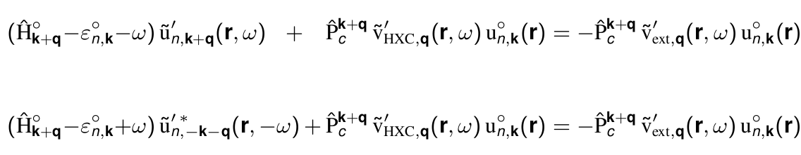



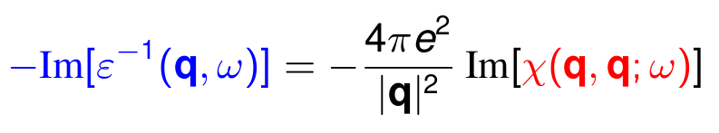
Basic equations
Coupled (resonant and anti-resonant) frequency-dependent Kohn-Sham equations:
interaction terms
perturbation
These equations can be re-written as a quantum Liouville equation:
Susceptibility
Loss function

Slide 26
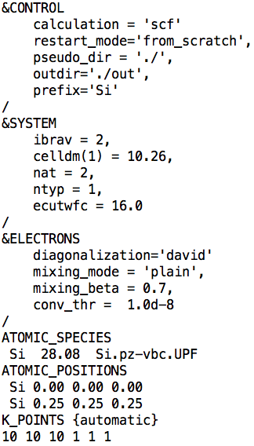
Exercise 1: Calculation of EELS of bulk silicon
Step 1. Perform a Self-Consistent Field ground-state calculation for silicon at the equilibrium structure using the pw.x program.
Si.scf.in
pw.x < Si.scf.in > Si.scf.out
Input
Output

Slide 27
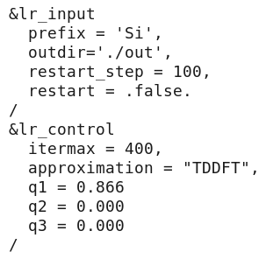
Exercise 1: Calculation of EELS of bulk silicon
Step 2. Perform Lanczos recursions using the turbo_eels.x program in order to compute Lanczos coefficients, which will be needed in Step 3.
Si.eels.in
How to specify q1, q2, q3 ? -> Next slide
turbo_eels.x < Si.eels.in > Si.eels.out

Slide 28
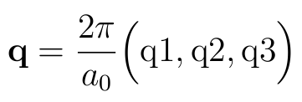



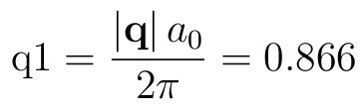


Exercise 1: Calculation of EELS of bulk silicon
Step 2. Perform Lanczos recursions using the turbo_eels.x program in order to compute Lanczos coefficients, which will be needed in Step 3.
- lattice parameter
Example: and .
Therefore, we obtain:

Slide 29
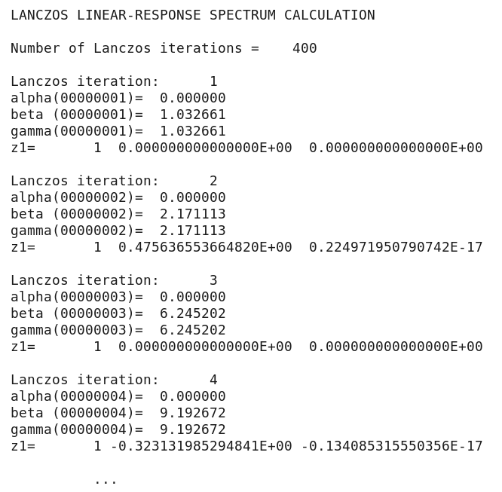
Exercise 1: Calculation of EELS of bulk silicon
In the output file Si.eels.out there is information about each Lanczos iteration :

Slide 30
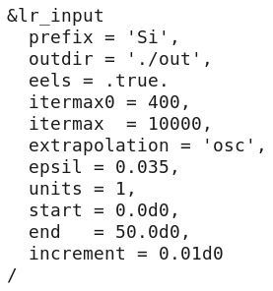
Exercise 1: Calculation of EELS of bulk silicon
Step 3. Perform a spectrum calculation using the post-processing program turbo_spectrum.x and using the Lanczos coefficients computed in the previous step.
Si.tddfpt_pp.in
turbo_spectrum.x < Si.tddfpt_pp.in > Si.tddfpt_pp.out

Slide 31
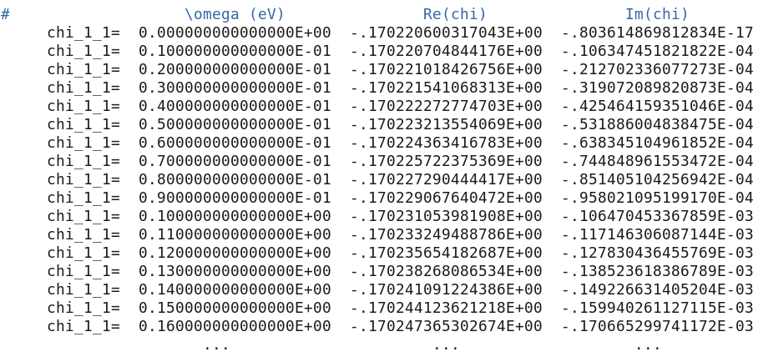
Exercise 1: Calculation of EELS of bulk silicon
The code turbo_spectrum.x produces a file Si.plot_chi.dat which contains the real and imaginary parts of the polarizability :

Slide 32
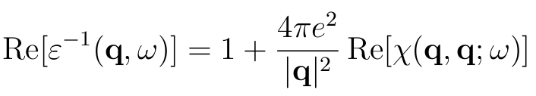
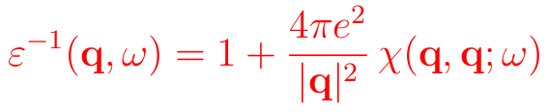
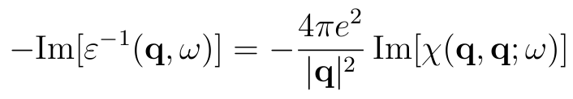
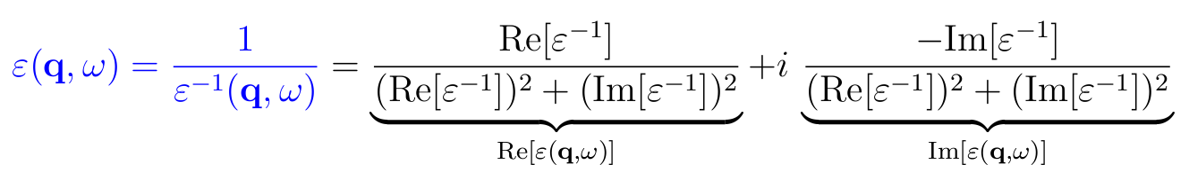
Exercise 1: Calculation of EELS of bulk silicon
The code turbo_spectrum.x also produces a file Si.plot_eps.dat which contains the real and imaginary parts of the dielectric function and its inverse:

Slide 33
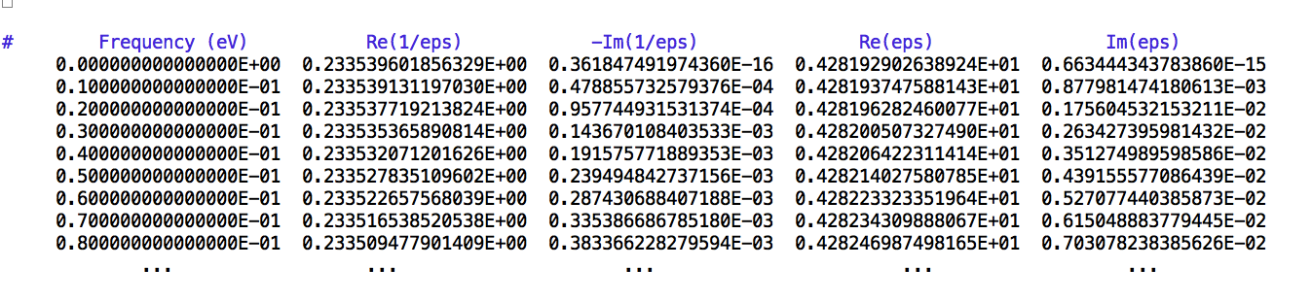
Exercise 1: Calculation of EELS of bulk silicon
The code turbo_spectrum.x also produces a file Si.plot_eps.dat which contains the real and imaginary parts of the dielectric function and its inverse:

Slide 34
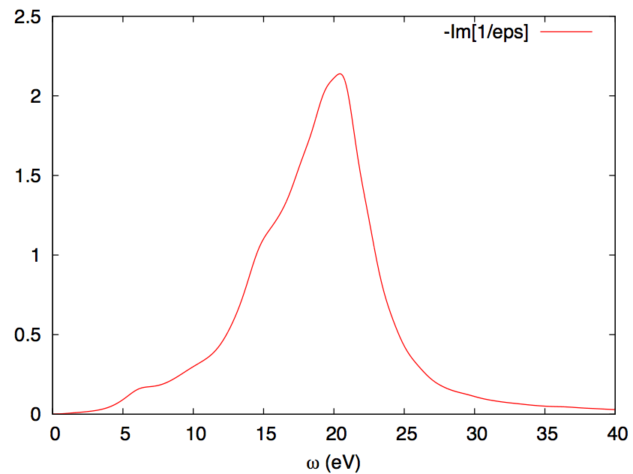

Exercise 1: Calculation of EELS of bulk silicon
Step 4. Plot the spectrum using gnuplot and the script plot_spectrum.gnu
Electron Energy Loss Spectrum of bulk silicon (file Spectrum.eps):
Is the spectrum converged? -> exercise2 What is the origin of peaks?

Slide 35
Exercise 1: Calculation of EELS of bulk silicon
The code turbo_spectrum.x also produces a file Si.plot_eps.dat which contains the real and imaginary parts of the dielectric function and its inverse:

Slide 36
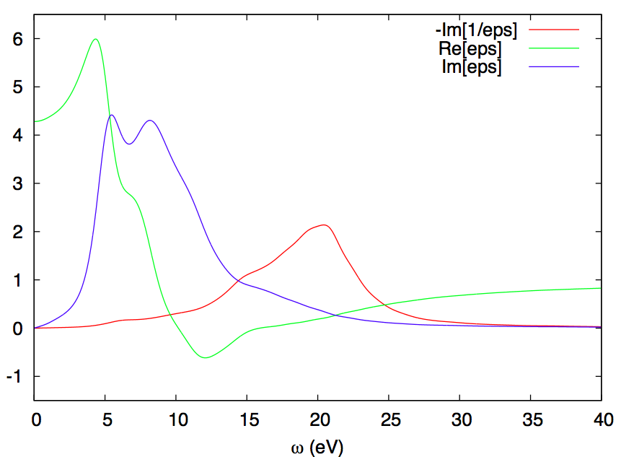
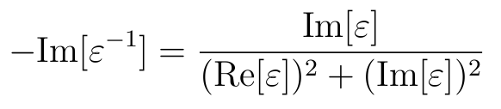

Exercise 1: Calculation of EELS of bulk silicon
What is the origin of peaks?
plasmon

Slide 37
Outline
1. Introduction
2. Exercise 1: Calculation of EELS of bulk silicon
3. Exercise 2: Convergence of EELS of bulk silicon
4. Exercise 3: Calculation of EELS of Al(111)

Slide 38
Exercise 2: Convergence of EELS of bulk silicon
Go to the directory with the input files:
cd Hands-on_TDDFPT_EELS/exercise2
1. Study the convergence of the loss spectrum of bulk silicon with respect to:
k points mesh
Number of Lanczos iterations
2. Compute the plasmon dispersion, i.e. change in the position of the plasmon peak when changing the value of the transferred momentum:

Slide 39
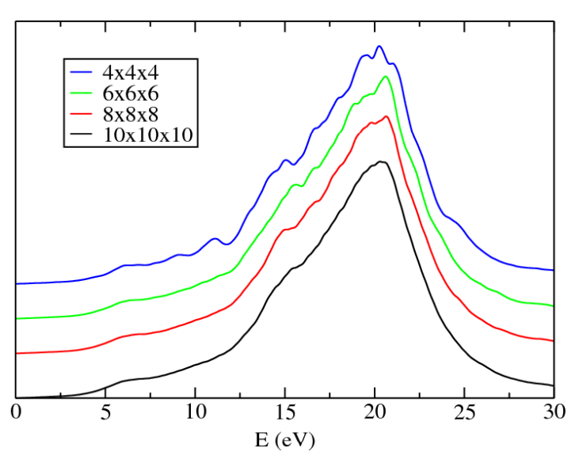
Exercise 2: Convergence of EELS of bulk silicon
Convergence of EELS with respect to the k points mesh
Here, 400 Lanczos iterations + extrapolation was used.

Slide 40
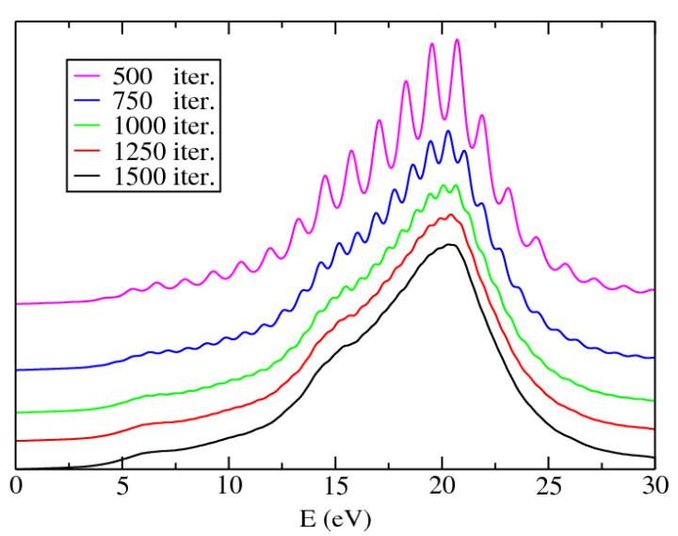
Exercise 2: Convergence of EELS of bulk silicon
Convergence of EELS with respect to the number of Lanczos iterations (no extrapolation)
Here, k points mesh 10x10x10 1 1 1 was used.

Slide 41
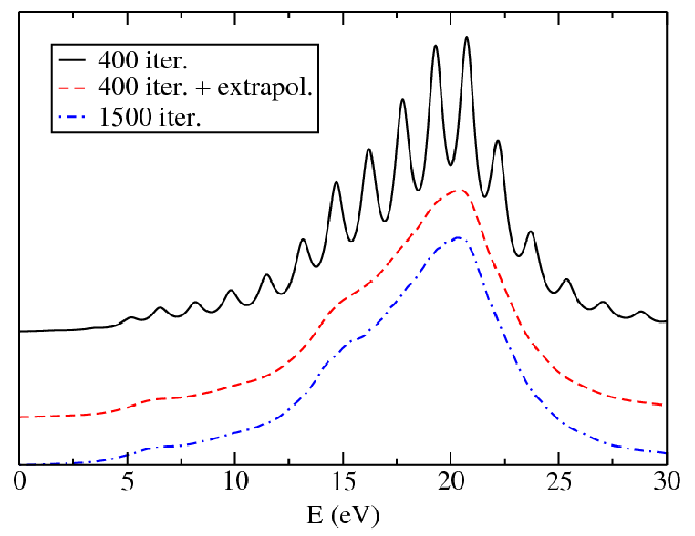
Exercise 2: Convergence of EELS of bulk silicon
Convergence of EELS with respect to the number of Lanczos iterations (with and without extrapolation)
Here, k points mesh 10x10x10 1 1 1 was used.

Slide 42
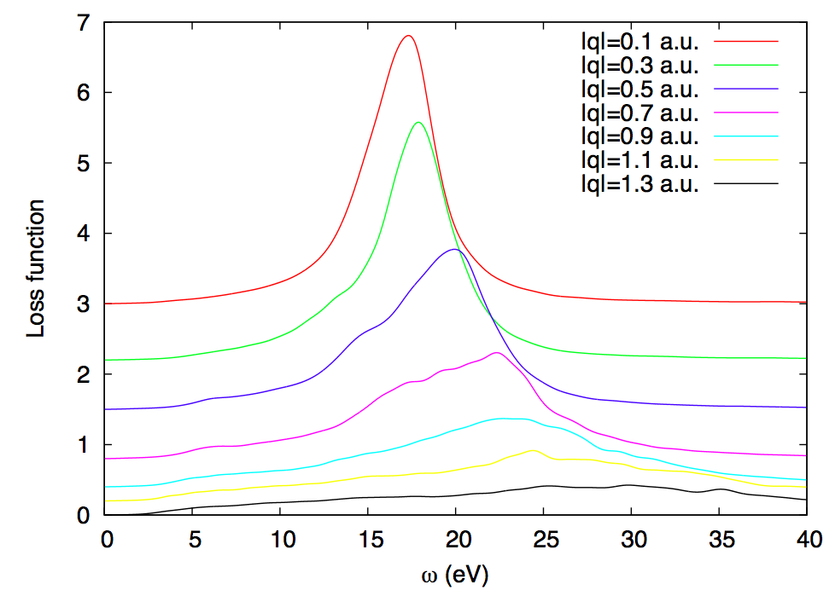
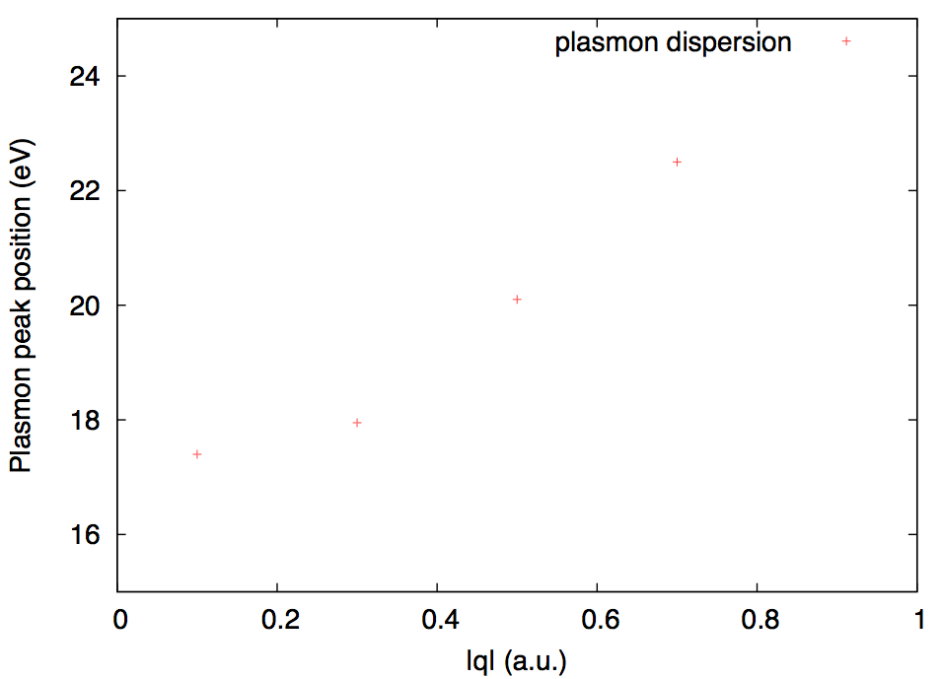

Exercise 2: Convergence of EELS of bulk silicon
Plasmon dispersion in bulk silicon
Here, k points mesh 10x10x10 1 1 1 was used and 400+extrapol. Lanczos iterations. By incresing q, the plasmon peak blue-shifts and broadens, because it enters in the electron-hole continuum.

Slide 43
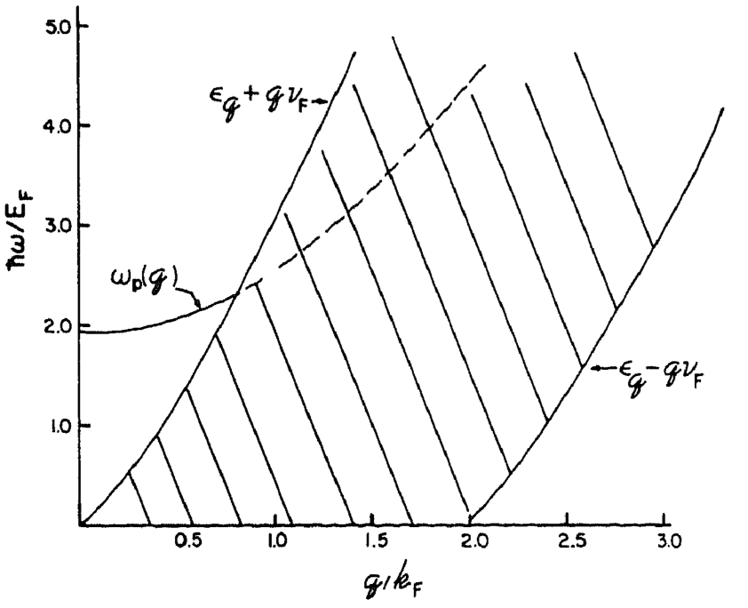
Exercise 2: Convergence of EELS of bulk silicon
The excitation region of the electron gas in (q,w) space
The plasmon line becomes higly damped in the region of electron-hole pairs, which is shown hatched.
G. D. Mahan, Many-Particle Physics, Plenum Press, 2nd ed. New York, (1975)

