Slide 1
FANTASY CRICKET PREDICTOR

Slide 2
WHAT IS FANTASY CRICKET?
Fantasy Sports is a new and exciting game where players can select fantasy teams from real-world professional sports. The aim is to build a team that can score the most points compared to another team. Fantasy sports allow users to make the best use of their sports knowledge and earn real cash by taking part in fantasy sports leagues.

Slide 3
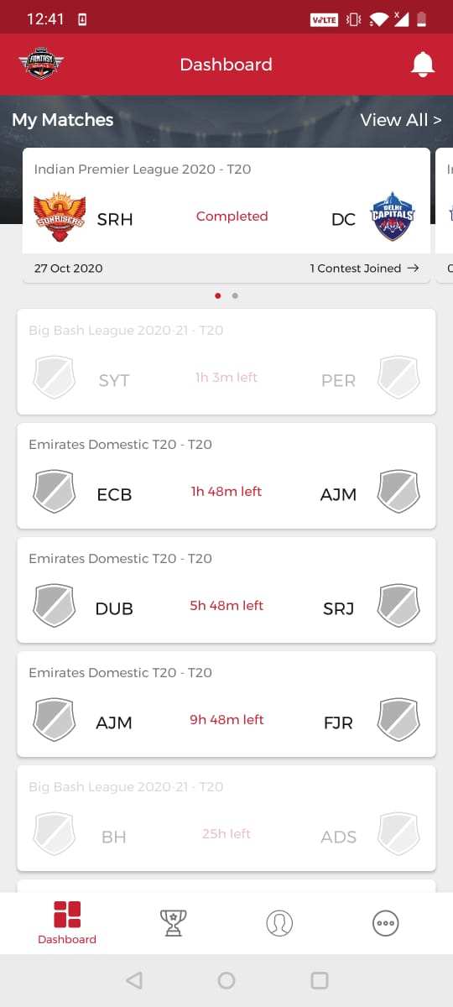
HOW TO PLAY FANTASY SPORTS
Fantasy Game Dashboard

Slide 4
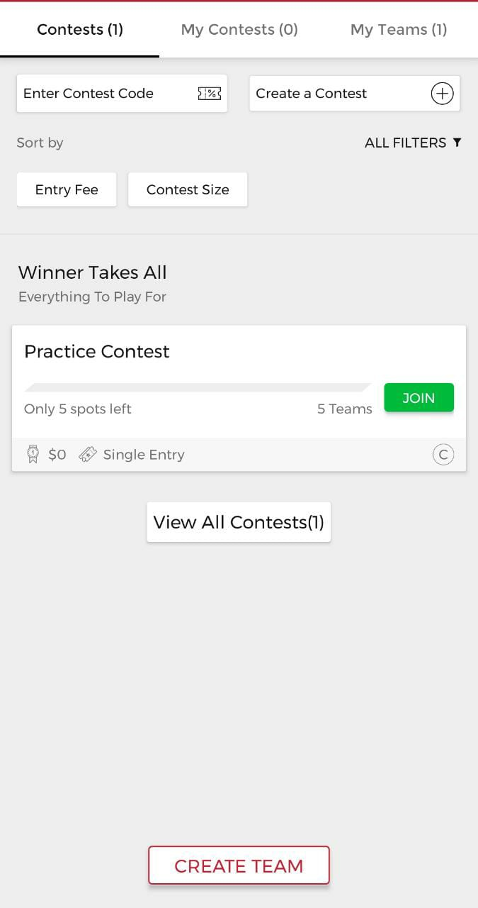
Create a team

Slide 5
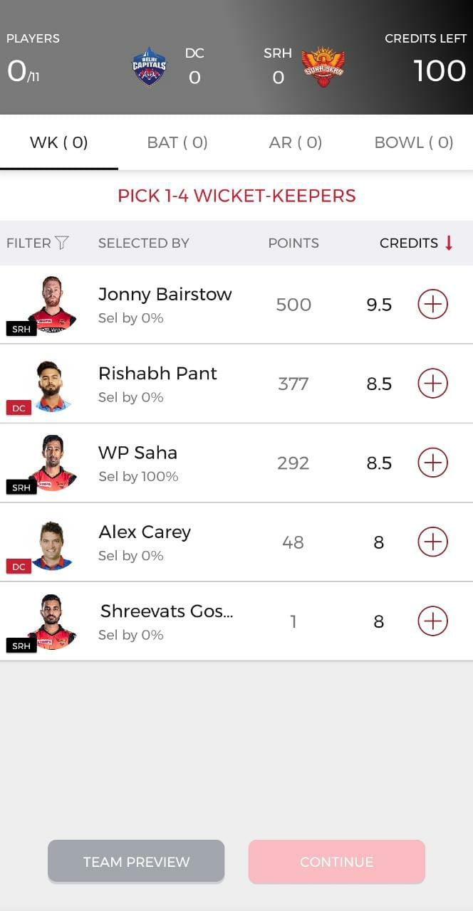
Pick Wicket Keeper

Slide 6
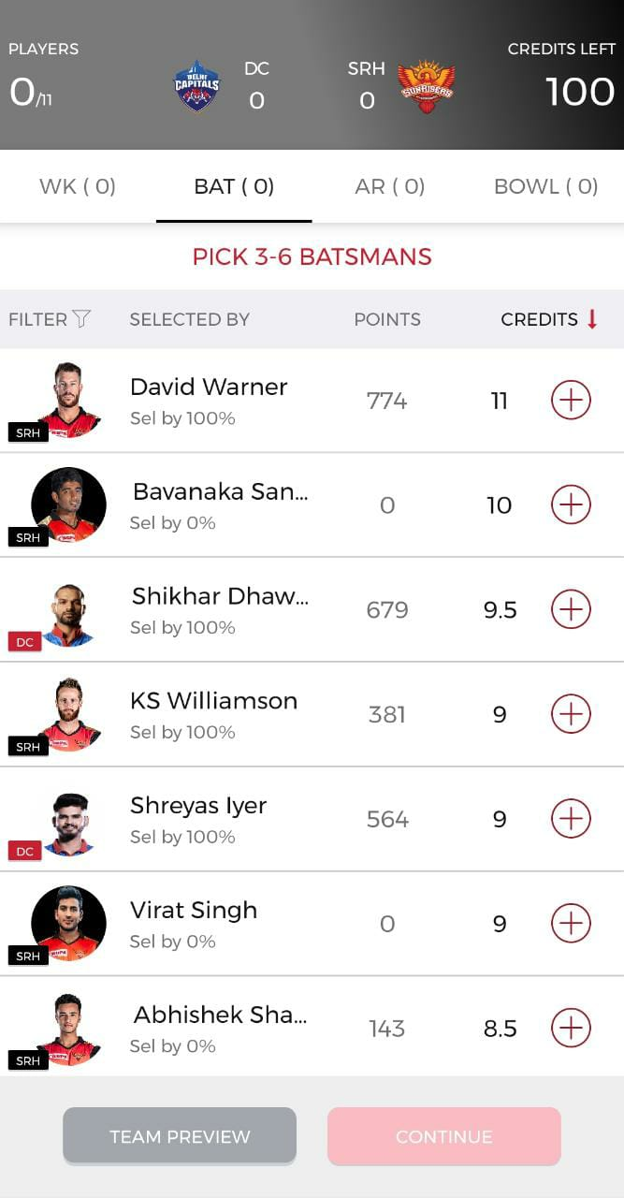
Pick Batsmen

Slide 7
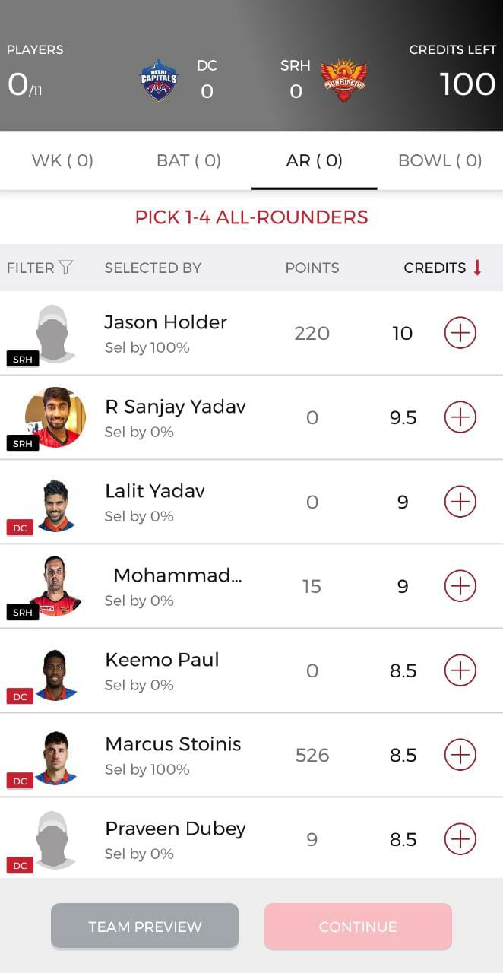
Pick All Rounder(s)

Slide 8
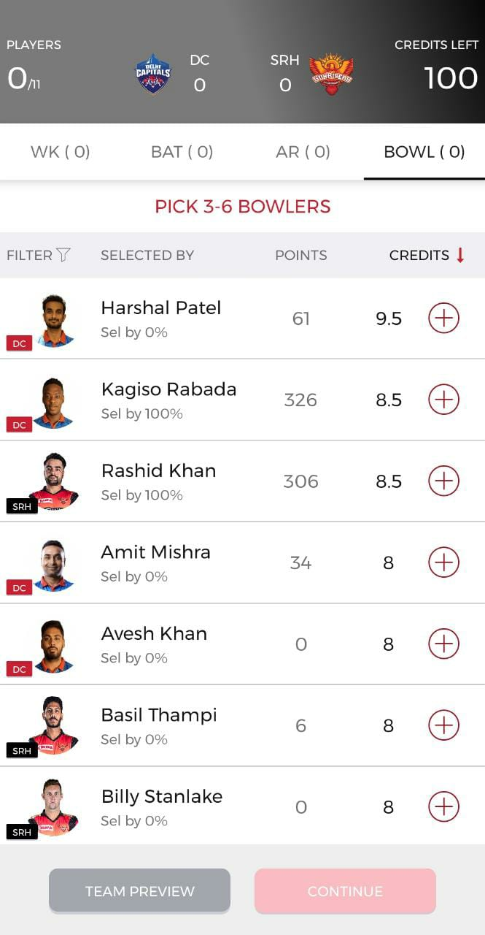
Pick Bowlers

Slide 9
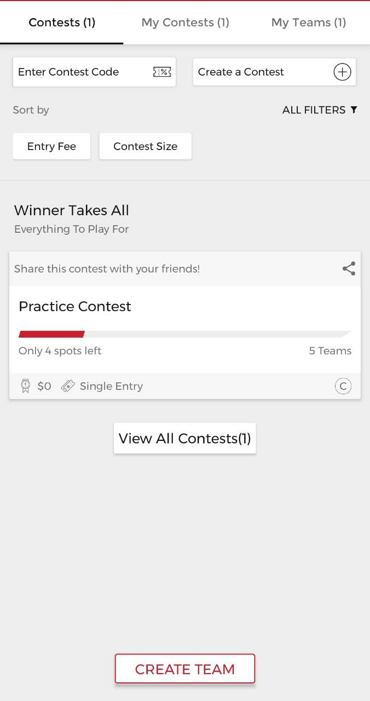
Final step, Join a League

Slide 10
PROBLEM STATEMENT
Select the team of 11 players out of the pool of 30 players that would get the maximum total points in an IPL match under Fantasy Sport Game constraints.

Slide 11
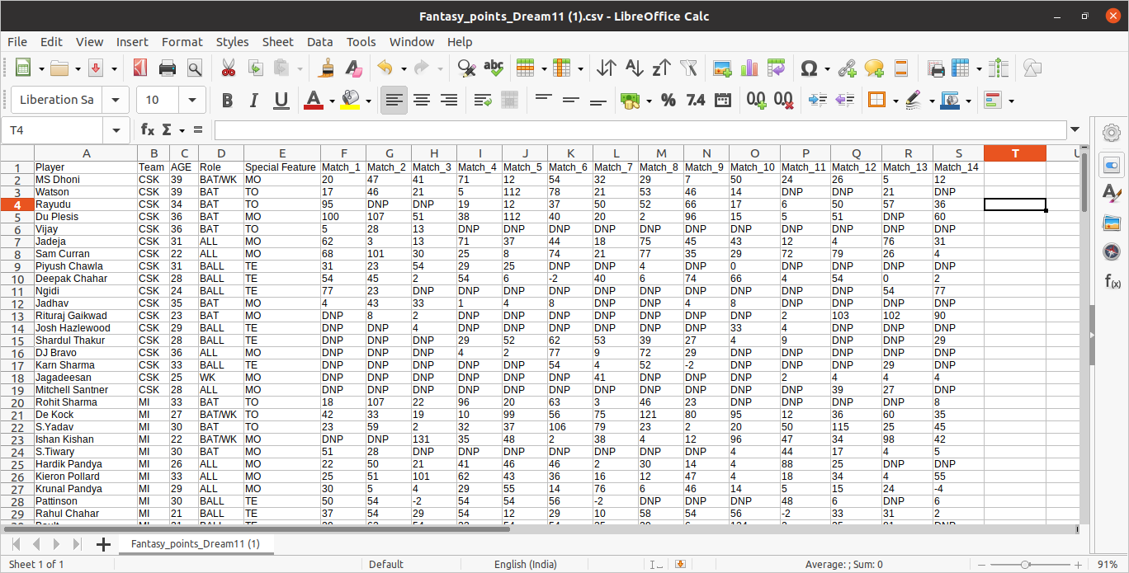
RAW DATA

Slide 12
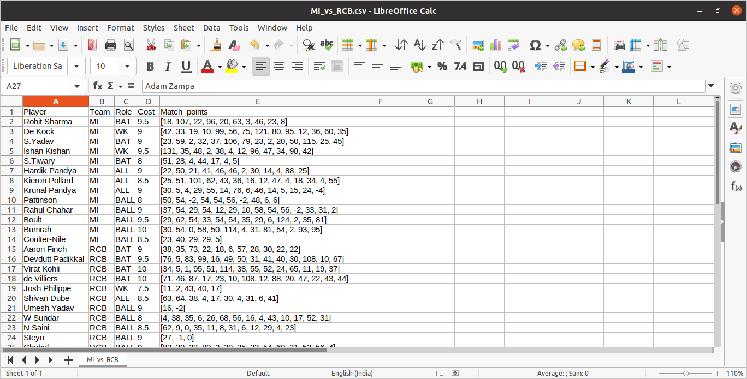
WHAT IS FANTASY CRICKET?

Slide 13
TECHNOLOGY USED
- PYTHON
- DJANGO
- HTML
- CSS

Slide 14
METHODS
- Exponentially Weighted Average
- Linear Programming

Slide 15
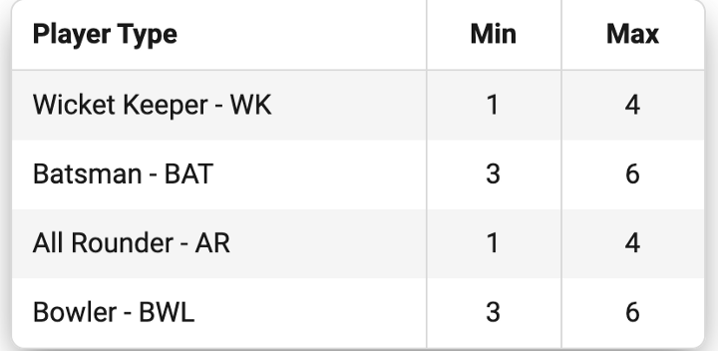
CONSTRAINTS

Slide 16
RESULT
- The algorithm is completely automated and gives the top 11 Players from two teams that maximizes the probability of scoring the highest points.

Slide 17
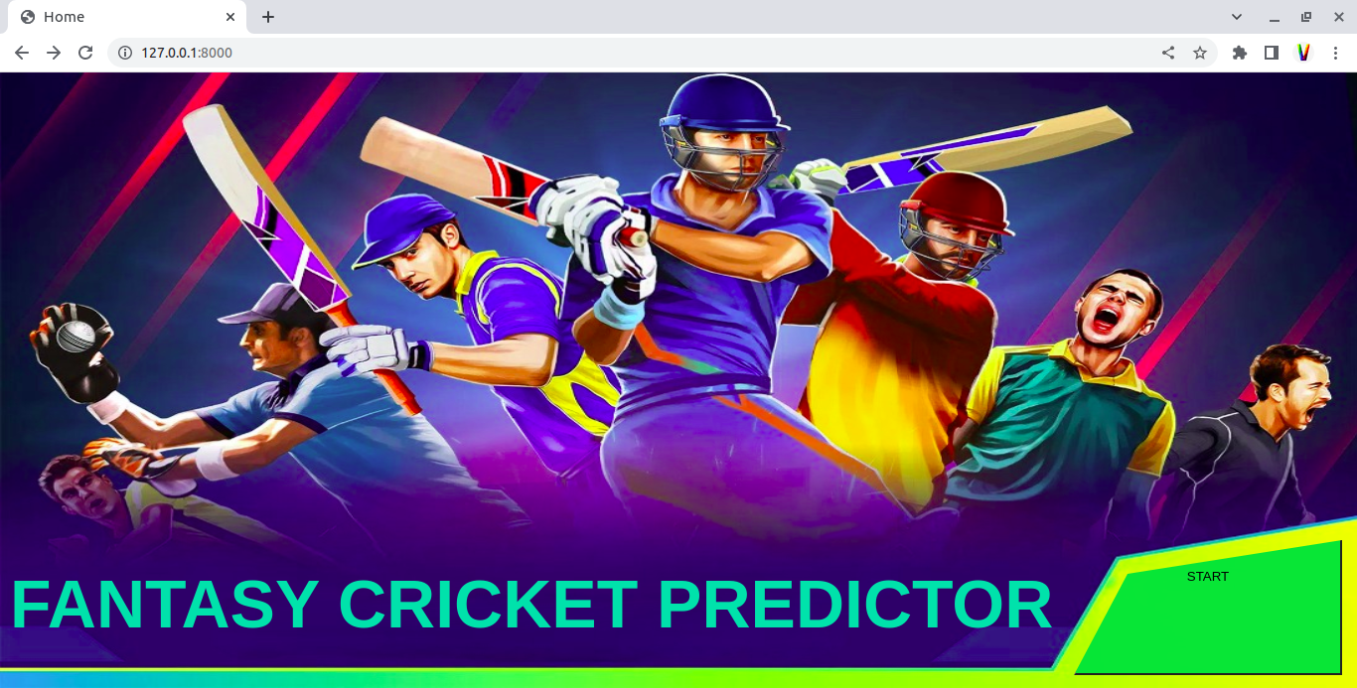

Slide 18
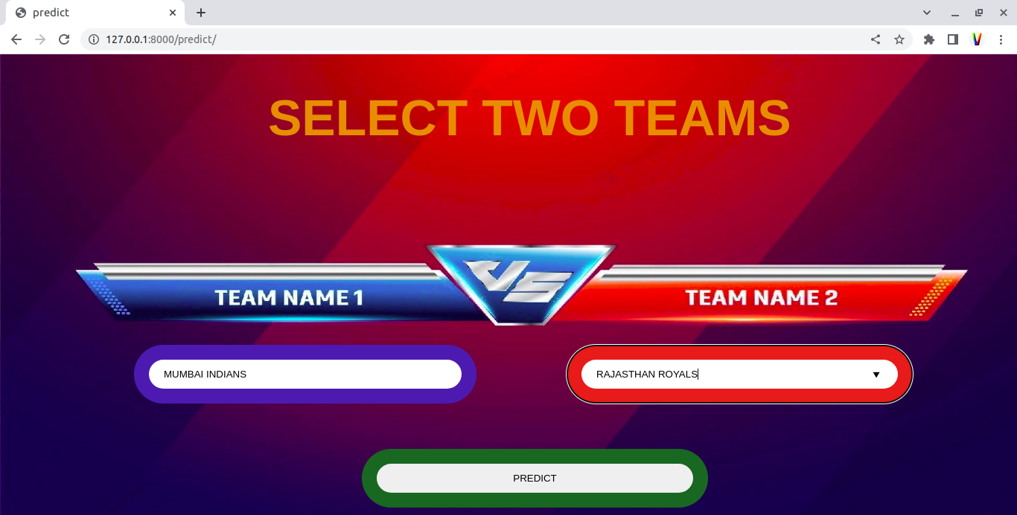

Slide 19
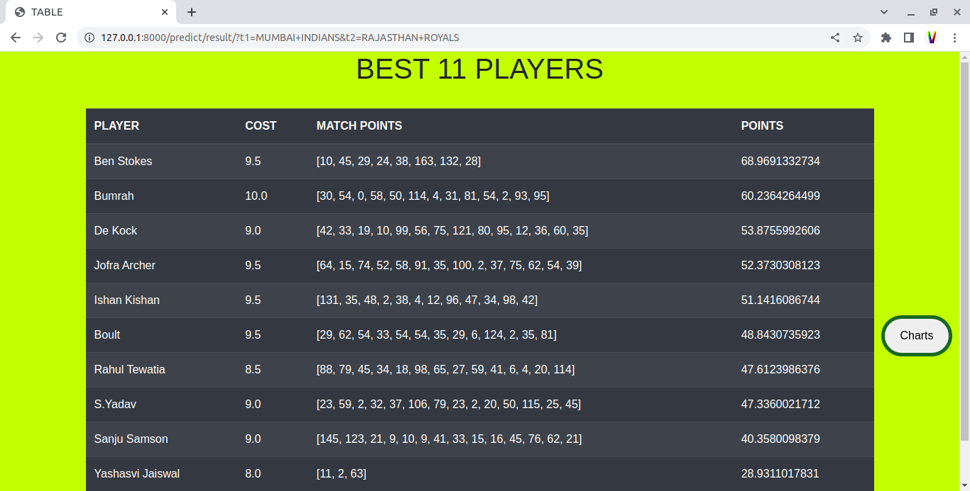

Slide 20
