Slide 1
FOOD CALORIE METER (A DEEP LEARNING APPROACH )

Slide 2
PROBLEM STATEMENT
We present a system which can recognize the contents of your meal from a single image, and then predict its calories. The simplest version assumes that the user(student) is eating at the college canteen for which we know the menu. In this case, we can collect images ofﬂine to train a multi-label classiﬁer using a CNN-based classiﬁer.
In this case, we need to estimate the size of the foods. This requires solving segmentation and depth-volume estimation from a single image. We present CNN-based approaches to solve these problems.

Slide 3
STATE OF ART
Many people are interested in tracking what they eat to help them achieve weight loss goals or manage their diabetes or food allergies. However , most current mobile apps(MyFitnessPal, LoseIt , etc.) require manual data entry, which is tedious and time consuming. Consequently, most users do not use such apps for very long.
Several previous approaches rely on an expert nutritionist to analyze the image offline. Other approaches use crowd sourcing to interpret the image in lieu of an expert. However, crowd sourcing is both costly and slow.
A web-based application is proposed which detects whether the user has habits considered as risk factors for obesity. The application acquires and registers data about diet, exercise, sleep, and fat mass, by using a web application and health information sensors. The major drawback of such systems is its inconvenience and its difficult learning process for the user
In “Proposal of Food Intake Measuring System in Medical Use” by Seiki -a set of pictures is taken for before and after food consumption in order to recognize and classify the food and determine its size. In such method, the existence of a premeasured and predefined measurement pattern is used inside the images to translate the size in pixels of each portion.

Slide 4
LIMITATIONS
System not trained for different ingredients – Our model does not ask the user for the ingredients of the food item which may lead to some extent of inaccuracy in the result.
Dependence on ambient light- With poor lighting conditions even though food is easily detected, sometimes the system is unable to detect it’s characteristic features. So it gives on erroneous result which must be taken care of. In real time scenario infrared backlights should be used to avoid poor lighting conditions.
Food images not trained- Food items that are not trained by the model are falsely predicted as another trained item already existing in our model.

Slide 5
OBJECTIVE
Our main objective is to present a system which can recognize the contents of the meal from a single image, and then predict its nutritional contents, such as calories. Most importantly our model focuses on the students of our college. Our dataset includes maximum of the food items available in our college cafeteria. Here we use a CNN based approach to help the students in maintaining a healthy weight and lifestyle.
WORK DISTRIBUTION
Code implementation by all.
Dataset by all.
Report and PPT by all.

Slide 6
PROPOSED SOLUTION
Given a image, this project proceeds the following steps to generate the desired output:
Step 1: The ﬁrst step in our pipeline is to determine the image. Can be phrased as a simple binary classiﬁcation problem. To tackle this problem, we have a suitable dataset. To make a dataset suitable for binary classiﬁcation, combining all the food classes into one generic “food” class.
Step 2 :We train a classiﬁer to map from image to label.

Slide 7
Step 3: In addition to predicting the presence of certain foods, it is useful to localize them in the image. Since most foods are amorphous, it is better to segment out the region corresponding to each food, rather than putting a bounding box around them. Such a segmented image will enable further analysis, such as counting and size estimation, which is essential for nutrition estimation.
Step 4: Having segmented the foods, the next step is to estimate their physical size (3d volume). We ﬁrst predict the distance of every pixel from the cam- era, using the same CNN architecture. Next is to calculate the average height and depth map of the image. The CNN based approach to estimate volume is more accurate.
Step 5: The ﬁnal step is to map from the volume to the calorie content. This requires knowing the caloriﬁc density of each kind of food.
In summary, this project makes 3 main contributions. First, we develop a system that can recognize the contents of a meal. Second, we introduce a dataset, and show how it can be used to train and test image tagging and segmentation systems. Third, we show some promising preliminary results on the challenging problem of mapping image to calories.

Slide 8
IMPLEMENTATION
Training an artificial neural network on few thousand images of food (for eg. Pizza or hotdog) and make the CNN learn to predict which class the image belongs to, next time it sees an image having a Pizza or Soup . Using Keras deep learning library in python to build our CNN. A dataset suitable for classiﬁcation to determine the image. Once we have the dataset, we train a classiﬁer to map from image to label.
We implement our model in the following steps:
Initializing a neural network by a sequence of layers.
Performing the convolution operation, that is the first step of a CNN, on the training images.
Pooling operation for maximum value pixel from the respective region of interest.

Slide 9
Flattening, which is the process of converting all the resultant 2 dimensional arrays into a single long continuous linear vector.
To perform the full connection of the neural network.
Compiling the CNN model.
Using keras.preprocessing library for synthesizing the training data.
Fitting our images to the neural network.
Making new predictions from our trained model.
Once the area of the food item is identified, we were able to calculate the volume of food items by approximating it to a geometric shape like sphere, cylinder, etc. Once we have the volume, the mass of the food item is calculated using standard density. Using already available information of nutritional content of the given class of food, the total calorie content in the food image is estimated.

Slide 10
RESULT AND ANALYSIS
TEST CASE | INPUT | STATUS | Calories
[1] | Cupcake | Predicted | 186.5694
[2] | Hot Dog | Predicted | 339.2422
[3] | Veg Pizza | Predicted | 1301.60698
[4] | Chicken Pizza | Predicted | 2356.6894
[5] | Slice of Chicken Pizza | Predicted | 317.25409
We are successfully able to predict a Food image when given to our classifier model among the classes our model is trained on. Incase of an image that isn’t trained, it fails to predict or predict it similar to a training set data.

Slide 11
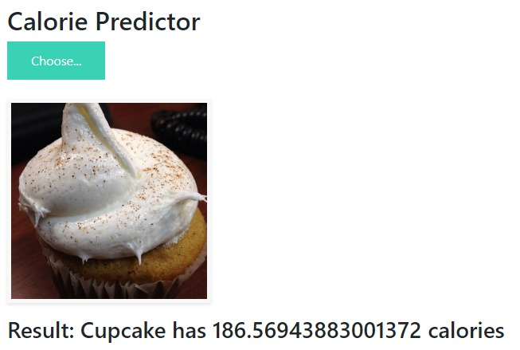
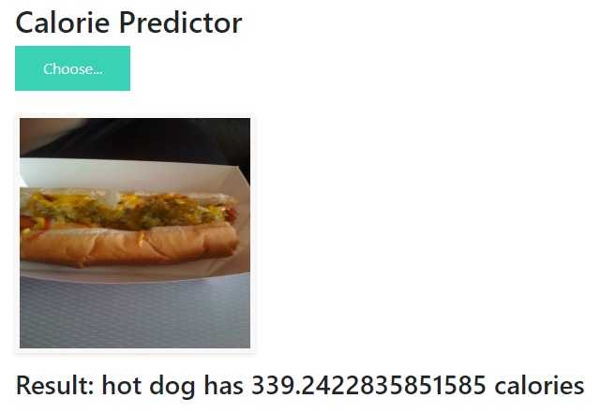

Slide 12
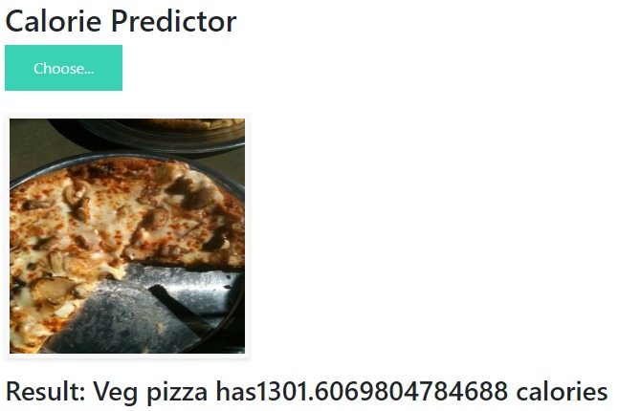
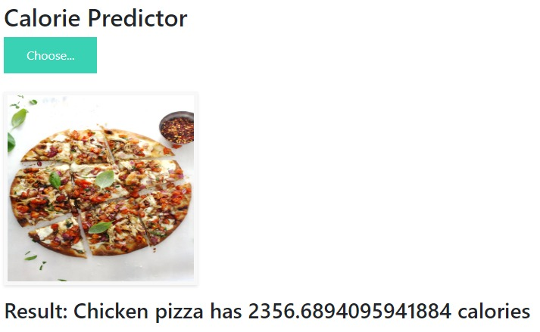

Slide 13
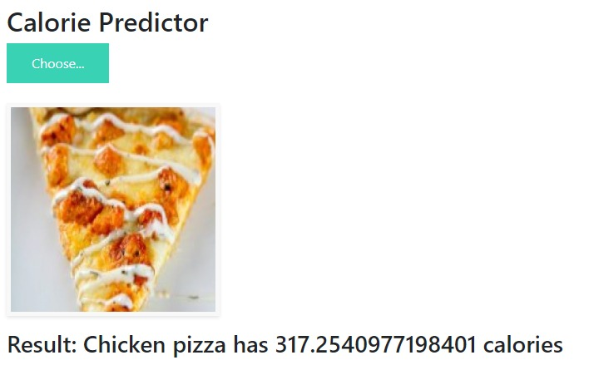

Slide 14
CONCLUSION
Food Calorie Meter has the ability to recognize the content of the meal from a single image, and then predict its nutritional content, such as calories. After training a classiﬁer to map from image to label which trains the model on thousand images for various classes, our CNN model learnt how to predict which class the image belongs to, a Pizza or French fries. With a test accuracy of 94.90% and validation accuracy 72.4%, which tells about how accurately it will predict the test image and identify the class to which it belongs. Using several image segmentation techniques we calculated the area of the food image and volume by approximating it to a geometric shape like sphere, cylinder, etc and thus will be successfully able to calculate the Total Calorie content of the food content in image.

Slide 15
FUTURE SCOPE
In future the dataset on our project can be increased to include more number of food items. We can also change our web interface to a mobile app which is more handy to the users. We can also add a functionality that asks the exact ingredients of any food item thus leading to increased accuracy.

