Slide 1
ACHIEVING T-CLOSENESS USING PSO AND VALUE SWAPPING METHOD

Slide 2
PROBLEM STATEMENT
Past two decades have seen a growing interest in methods for providing privacy preserving data publishing. Several models, algorithms and system designs have been proposed in the literature to protect identities in the published data.
A number of these have been implemented and are successfully in use by diverse applications such as medical, supermarkets and e-commerce.
The most prevalent and famous technique is k- anonymity. But it has some limitations. To overcome these limitations, we have two techniques – l diversity and t closeness.
In this project we emphasize on t closeness and how we can achieve t closeness using PSO clustering algorithm and value swapping method.

Slide 3
STATE OF ART
SABRE is one of the approach specifically designed for t-closeness.
In SABRE the data set is first partitioned into a set of buckets and then the equivalence classes are generated by taking an appropriate number of records from each of the buckets. Both the buckets and the number of records from each bucket that are included in each equivalence class are selected with t-closeness in mind.
Another approach is Microaggregation which has several advantages over generalization/recoding for k-anonymity that are mostly related to data utility preservation .The microaggregation algorithm is run on the quasi-identifier attributes of the original data set; this step produces a k-anonymous data set. Then, clusters of microaggregated records are merged until t-closeness is satisfied. We iteratively improve the level of t-closeness by: i) selecting the cluster whose confidential attribute distribution is most different from the confidential attribute distribution in the entire data set (that is, the cluster farthest from satisfying t-closeness); and ii) merging it with the cluster closest to it in terms of quasi identifiers.

Slide 4
INTRODUCTION
The need for data privacy is orthogonal to the extent of data utility. When data related to an individual is published and made available online, it increases the avenues of use of this data but the privacy concerns get elevated too.
This is especially true for medical data of individuals which may contain information related to their demographics, DNA, discharge summaries or clinical information.
Even though this data, if shared or published, can facilitate future research, yet a patient’s data contains sensitive information, like her diagnosis details, laboratory test results. These details, if shared, are susceptible to attacks, which is against legislation.
With reference to relational data, researchers have proposed many methods such as k-anonymity, l-diversity, t-closeness etc. to anonymize such kind of data.

Slide 5
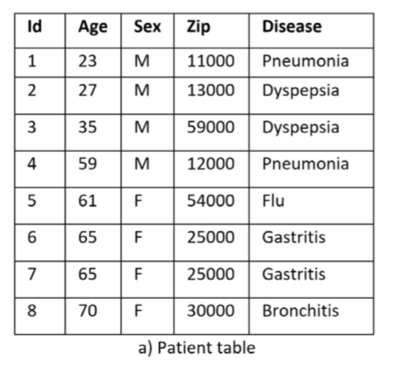
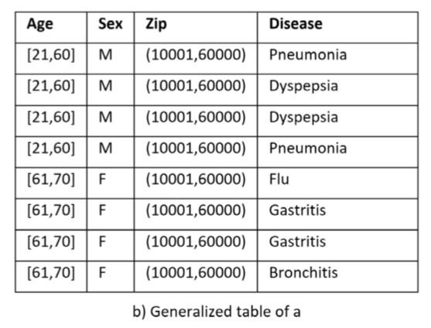
K - ANONIMITY
The k-anonymity model guarantees that the information of each user stored in the published dataset cannot be differentiated from at least k-1 records which is captured in the same dataset.

Slide 6
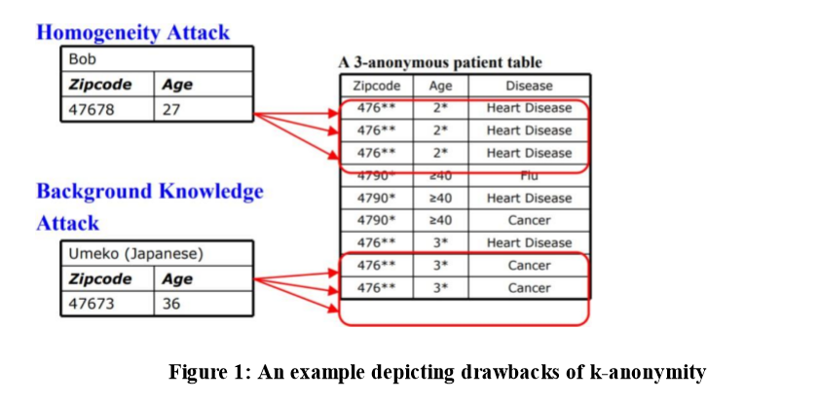
DRAWBACK OF K-ANONIMITY
K-Anonymity does not provide privacy if:
1. Sensitive values in an equivalence class lack diversity
2. The attacker has background knowledge

Slide 7
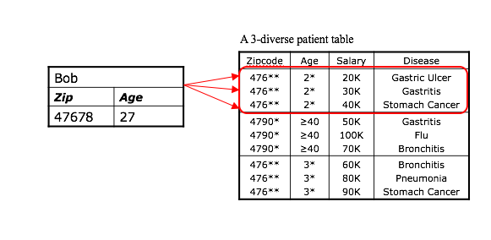
L-DIVERSITY
A block is l-diverse if it contains at least l ‘well represented” values for the sensitive attribute S. A table is l-diverse if every block is l-diverse Each equivalence class has at least l well-represented sensitive values.

Slide 8
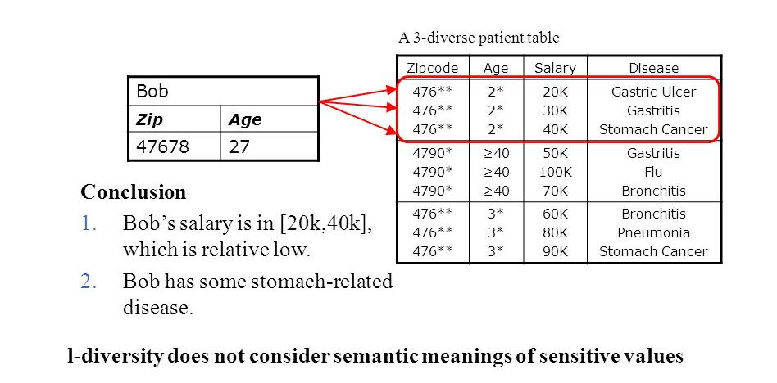
DRAWBACKS OF L-DIVERSITY
Doesn’t prevent the probabilistic inference attacks.
Ex. In one equivalent class, there are ten tuples. In the “Disease” area, one of them is “Cancer”, one is “Heart Disease” and the remaining eight are “Flu”. This satisfies 3-diversity, but the attacker can still affirm that the target person’s disease is “Flu” with the accuracy of 80%.

Slide 9
T-CLOSENESS
Distribution that have the same level of diversity may provide very different levels of privacy, because different values have very different levels of sensitivity.
Thus, comes into picture the t closeness. It requires that the distribution of a sensitive attribute in any eq. class is close to the distribution of a sensitive attribute in the overall table. An equivalence class is said to have t-closeness if the distance between the distribution of a sensitive attribute in this class and the distribution of the attribute in the whole table is no more than a threshold t. A table is said to have tcloseness if all equivalence classes have t-closeness.

Slide 10
OBJECTIVE
Our objective is to find the optimum solution using particle swarm optimization to limit disclosure risk of patient’s data to an acceptable level while maximizing the benefit. This is achieved by anonymizing the data before release. The goal is to provide a technique that is easy to understand and it should prevent maximum of background knowledge attacks and should be easily enforceable. Our work in this project can be used in the future to solve problems in privacy preserving data publishing and the work can be further polished in possible directions for future work in this domain.

Slide 11
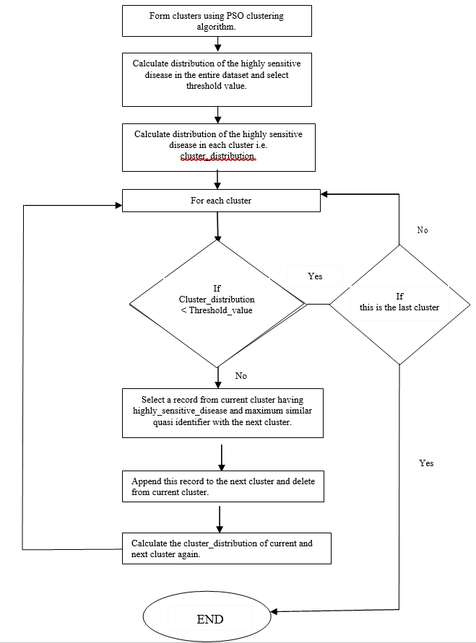
PROPOSED SOLUTION

Slide 12
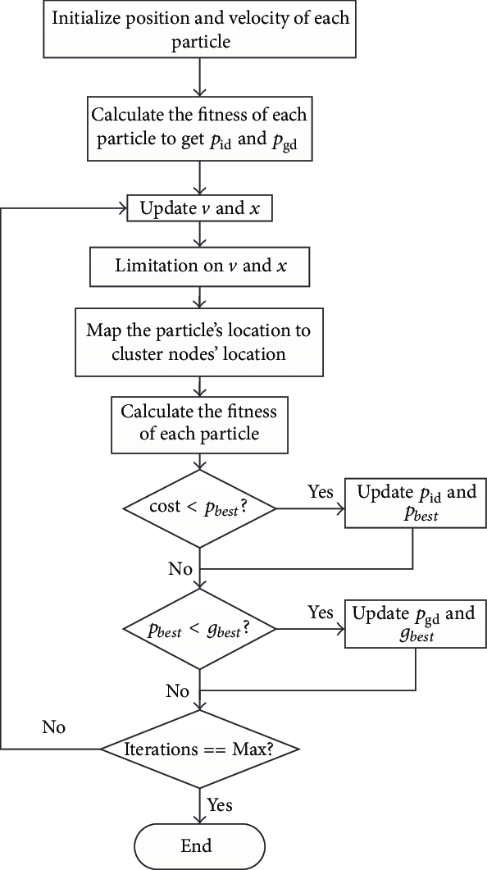
Step 1:
USING PSO TO FIND OPTIMAL CLUSTERS:
Particle swarm optimization (PSO) has been proven to be a promising technique for solving complex optimization problems. In PSO, each particle in the search space represents a solution to a given problem. Each particle is associated with a position and velocity. Fitness function evaluates the positions of particles. The velocities of the particles are calculated according to the historical best positions of the population and positions of particles are updated in each iteration. The particles move towards better centroid through their own effort and with the cooperation of other particles.

Slide 13
STEP 2:
CALCULATING DISTRIBUTION OF HIGHLY SENSITIVE DISEASE:
Calculate distribution of the highly sensitive disease in the entire dataset and select threshold_value.
To calculate the distribution of the highly sensitive disease in each cluster, we use the formula:
Cluster_distribution =
No. of records having highly sensitive disease/Total no. of records in the cluster
STEP 3:
REORDERING RECORDS IN THE CLUSTERS:
To achieve t-closeness, we have to ensure that the cluster_distribution of each cluster is less than the threshold value. If the cluster_distribution of any cluster is greater than the threshold value, we reorder the records of that cluster to achieve the optimum cluster_distribution. For this, we select only those records from the current cluster (source cluster), whose non sensitive attributes are most similar to next cluster (destination cluster). We then append the selected records to the destination cluster and also drop these records from the source cluster. Now, the cluster_distribution is calculated again and the process is repeated till we get cluster_distribution < threshold value.

Slide 14
IMPLEMENTATION
The entire process of implementation are as follows:-
Form clusters using PSO clustering algorithm.
Calculate distribution of the highly sensitive disease in the entire dataset and select threshold_value.
Calculate distribution of the highly sensitive disease in each cluster i.e. cluster_distribution.
For each cluster check if the cluster_distribution < threshold_value.
If yes, check for next cluster.
If no, Select a record from current cluster having highly_sensitive_disease and maximum similar quasi identifier with the next cluster.
Append selected record to the next cluster and delete from current cluster.
Calculate the cluster_distribution of current cluster again and check if the value is less than threshold.
Repeat steps 4-8 till an optimum cluster_distribution is reached.

Slide 15
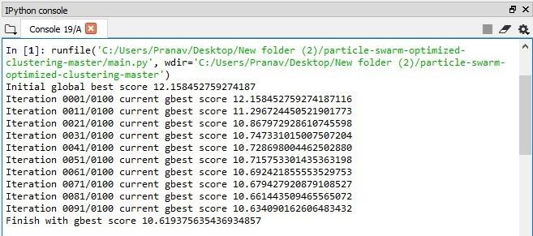
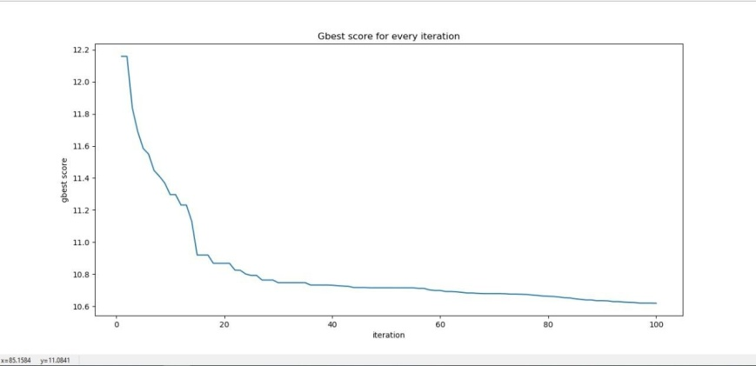
RESULTS AND ANALYSIS
THE GBEST SCORES OBTAINED:
GRAPHICAL REPRESENTATION OF THE GBEST SCORES OBTAINED:
(As the gbest score is decreasing, the similarity score for our data points in a particular cluster is increasing.)

Slide 16
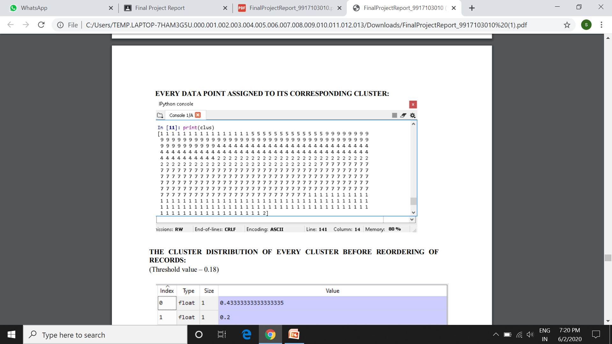
EVERY DATA POINT ASSIGNED TO ITS CORRESPONDING CLUSTER:

Slide 17
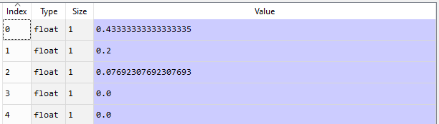
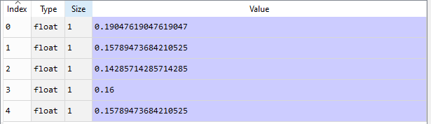
THE DISTRIBUTION OF SENSITIVE ATTRIBUTE IN EVERY CLUSTER BEFORE REORDERING OF RECORDS:
(Threshold value – 0.18)
THE DISTRIBUTION OF SENSITIVE ATTRIBUTE IN EVERY CLUSTER AFTER REORDERING OF RECORDS:
(Threshold value – 0.18)

Slide 18
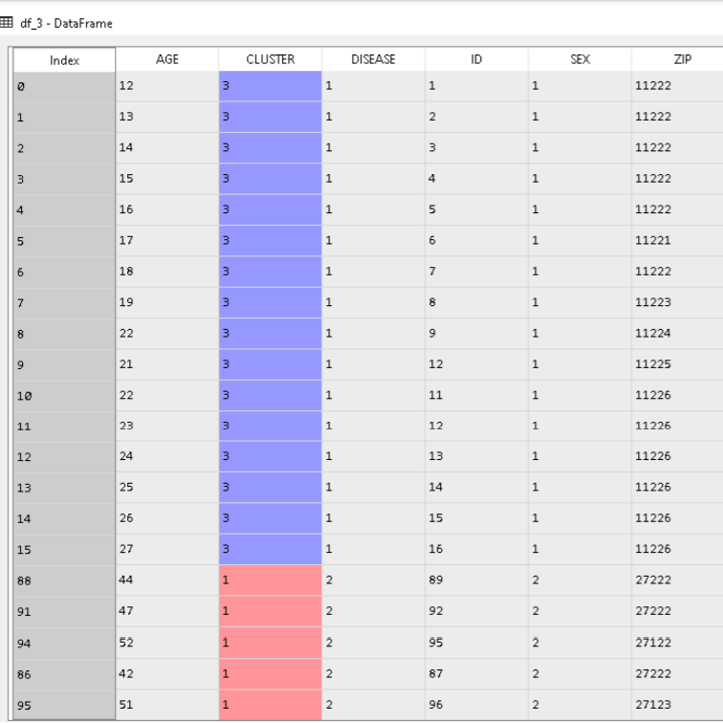
RECORDS OF A CLUSTER – A BEFORE REORDERING:
(Here, disease 2 is the highly sensitive disease. In this cluster, there is a high concentration of disease 2 )

Slide 19
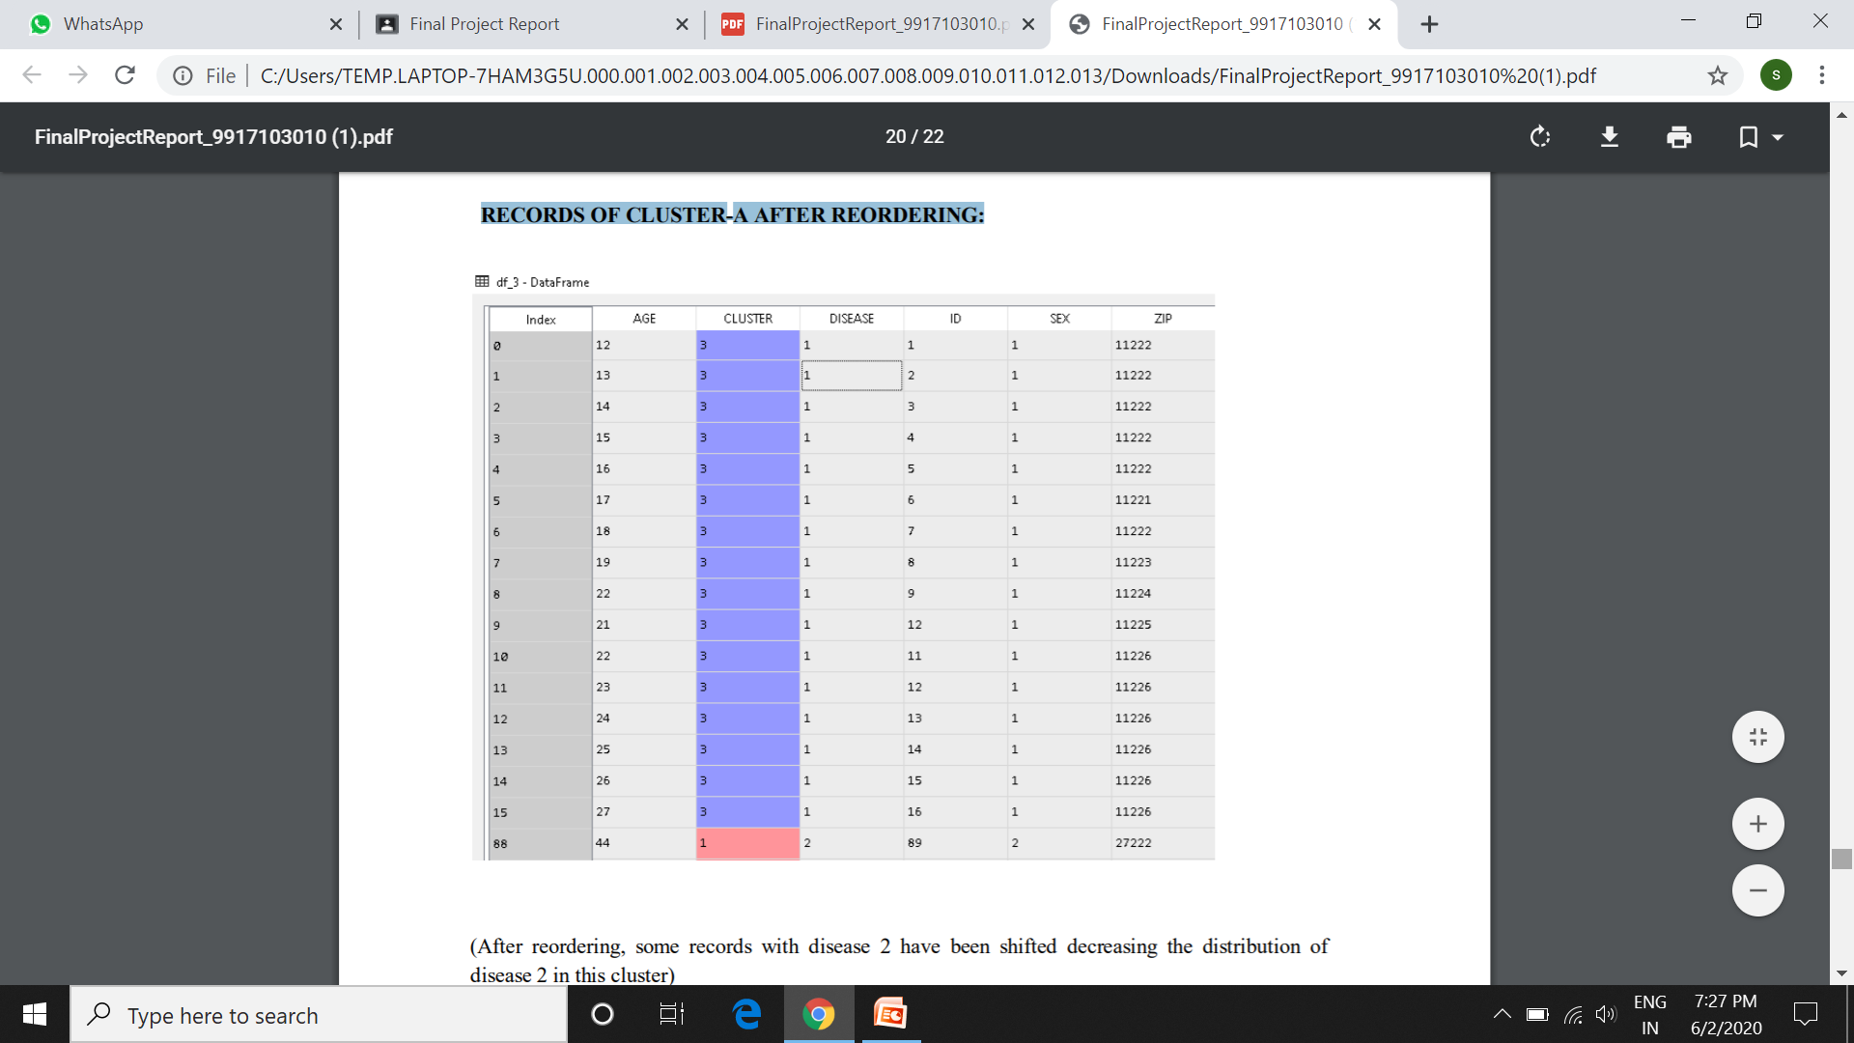
RECORDS OF CLUSTER-A AFTER REORDERING:
(After reordering, some records with disease 2 have been shifted decreasing the distribution of disease 2 in this cluster)

Slide 20
ANALYSIS USING CLUSTER SIZE AND ITS IMPACT ON DATA UTILITY
The variation in cluster sizes of the clusters formed after applying t-closeness should be small. Huge cluster size is undesirable because the larger the cluster size, the higher the information loss.
To calculate the variation in cluster sizes, the following steps were implemented:
For 15 iterations of our code, we noted the minimum and average cluster size out of the resultant clusters.
The mean of the minimum and average values is calculated:
mean(min) = summation of minimum values for 15 iterations/ 15
mean(avg) = summation of average values for 15 iterations/ 15
We calculated the ratio of the minimum and average cluster sizes to the size of the entire dataset :
Ratio(min) = mean(min)/size of dataset
Ratio(avg) = mean(avg)/size of dataset
4. The variation in the minimum and average cluster sizes is calculated as :
Variation_value = Ratio(avg)/ Ratio(min)
The nearer the variation_value is to 1, the lesser the variation.

Slide 21
After 15 iterations, values at threshold = 0.09 were:
Mean(min) = 384.0
Mean(avg) = 600.0
Ratio(min) = 384.0/3000 = 0.128
Ratio(avg) = 600.0/3000 = 0.200
Thus,
Variation_value = 0.200/0.128 = 1.562
For comparison, the research paper we selected is : “t-Closeness through Microaggregation: Strict Privacy with Enhanced Utility Preservation” whose authors are : “jordi Soria-Comas, and Josep Domingo-Ferrer”
For threshold = 0.09 and size of dataset considered = 1080, the values recorded in the paper are as follows:
Mean(min) = 330.0
Mean(avg) = 540.0
Ratio(min) = 330.0/1080 = 0.305
Ratio(avg) = 540.0/1080 = 0.500
Variation_value = 0.500/0.305 = 1.639

Slide 22
The variation_value achieved by our proposed algorithm < the variation_value achieved in the past. This means, the sizes of the clusters formed by our algorithm have less variation and so provide lesser information loss.
If the variation in cluster sizes is more i.e. one cluster has a huge number of records, the data utility decreases which deviates us from the main aim of privacy preserving data publishing.
Thus we conclude that our algorithm provides an efficient solution for achieving t-closeness with decreased information loss and increased data utility.

Slide 23
CONCLUSION
While k-anonymity protects against identity disclosure, it does not provide sufficient protection against attribute disclosure. The notion of l - diversity attempts to solve this problem by requiring that each equivalence class has at least well-represented values for each sensitive attribute. L - diversity has a number of limitations and thus a novel privacy notion called t-closeness is used, which requires that the distribution of a sensitive attribute in any equivalence class is close to the distribution of the attribute in the overall table (i.e., the distance between the two distributions should be no more than a threshold t). Using the PSO approach we aim to propose a solution which could cluster the patients data in such a way that the similarity between the non-sensitive attributes in a cluster is minimized making it more and more difficult for the attacker to get into patient’s sensitive information.

Slide 24
FUTURE SCOPE
Our work in this project can be used in the future to solve problems in privacy preserving data publishing and the work can be further polished in possible directions for future work in this domain.

