Slide 1
Machine Learning: K-Means Clustering

Slide 2
Overview
Understanding K-means Clustering
Use Case: Categorizing Flowers
Running K-means Clustering
Model Summary: K-Means
Determining "K"

Slide 3
Understanding K-Means Clustering

Slide 4


K-Means Clustering Use Cases
Customer Segmentation
Segment customers and buyers into distinct groups (cluster) based on similar attributes like age, income, product preferences, etc. in order to target promotions, provide support and explore cross-sell opportunities
Fraud Detection
Identify individual observations that don’t align to a distinct group (cluster) and identify types of clusters that are more likely to be at risk of fraudulent behavior

Slide 5
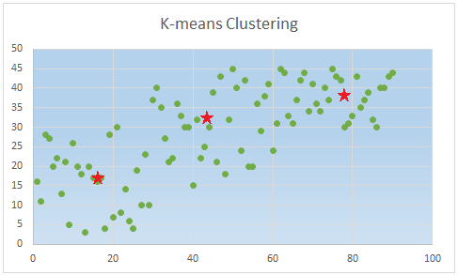
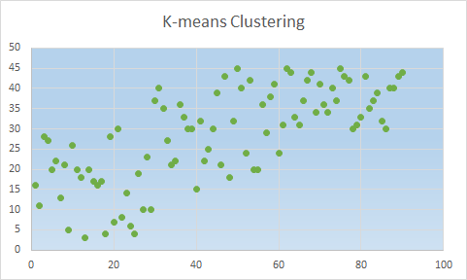
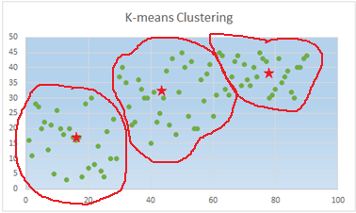
What is K-Means Clustering?
A popular, simple method for classification
It is an unsupervised algorithm
Partitions n observations into k clusters in which each observation belongs to a specific cluster based on similar properties
K-Means works by identifying cluster "centers" and associated data points to the nearest cluster center to its vicinity
Notes:
Unsupervised: Unlabeled data

Slide 6
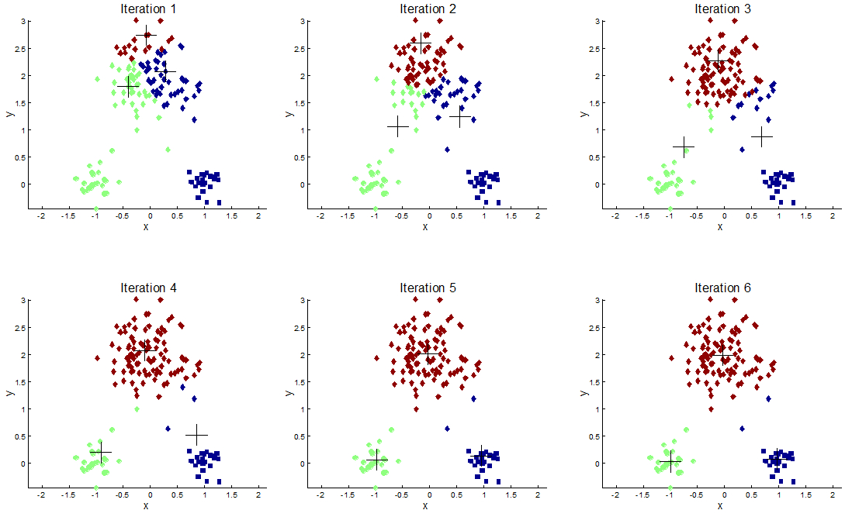
K-Means Clustering
You supply the "K"
Start with random centroids
Assign every point to the centroid to which it is closest
Update the locations of the centroids based on the mean of the observations assigned to that centroid
Reassign all points to their closest centroid
Repeat steps 4-5 until convergence
Convergence means that the points don't move between clusters and the centroids stabilize

Slide 7

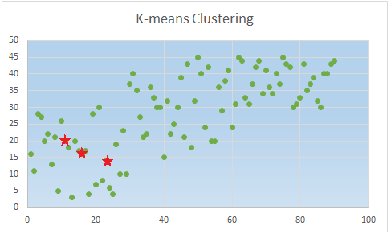
K-Means Initialization - Random
Starting with random data points as cluster centroids is easy, but problematic
While this does ensure that our centroids are near data (because the point itself is a data point)
It could also randomize all k centroids near the same location, thus skewing our clustering

Slide 8
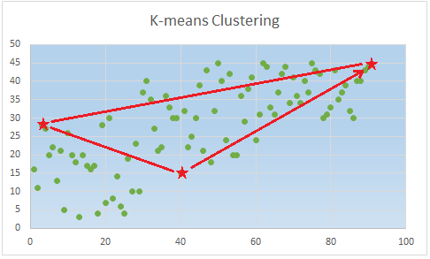
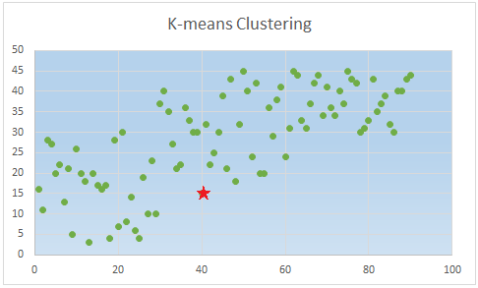
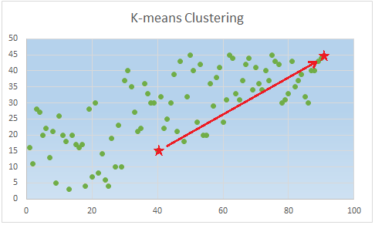
K-Means Initialization - Distance
Start with one random point
Then find the point farthest away
Then score all the data points by their distance from these cluster centroids
For the next cluster centroid, find the point that is furthest away from the existing cluster centroids
Repeat until we have k centroids
The distance algorithm is good, but could end up choosing outliers, which could complicate results
Also isn't terribly random - so multiple runs tend to produce similar results

Slide 9
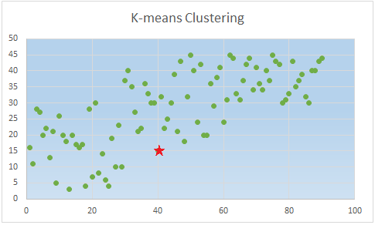
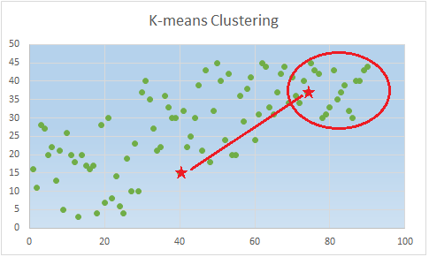
K-Means Initialization - K-means++
Developed by David Arthur and Sergei Vassilvitskii (Stanford (2007)
K-means++ is a combination of Distance and Random methods
First, pick a random point
Then pick a point based on the probability of the squared distance to the original centroid
K-means++ is a good balance between the two other algorithms, and provides a good deal of randomness as well
K-means++ is the default algorithm for K-means clustering in Vertica

Slide 10
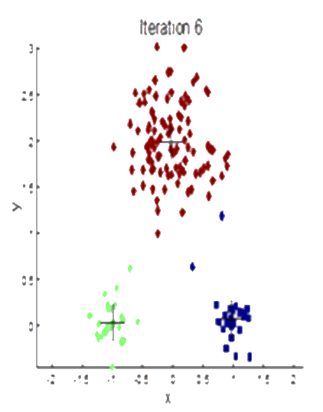
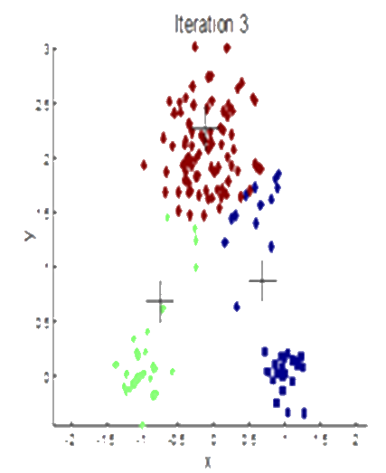
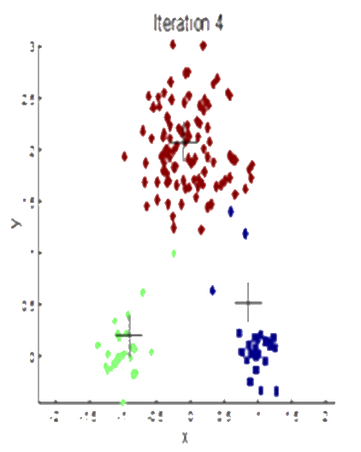
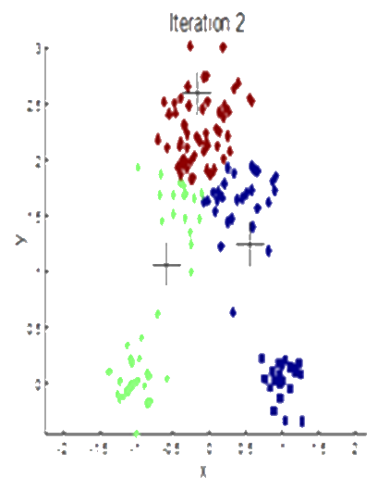
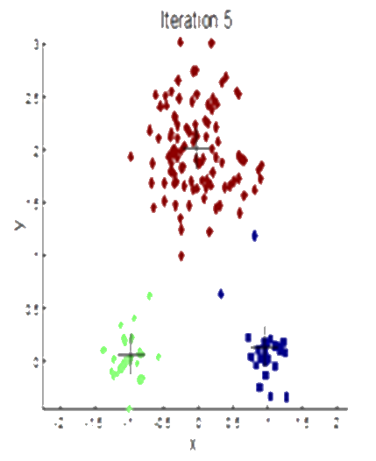
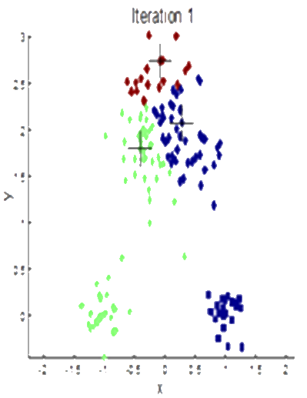
K-Means Visualized
Notes:
K = 3

Slide 11
Use Case: Categorizing Flowers

Slide 12
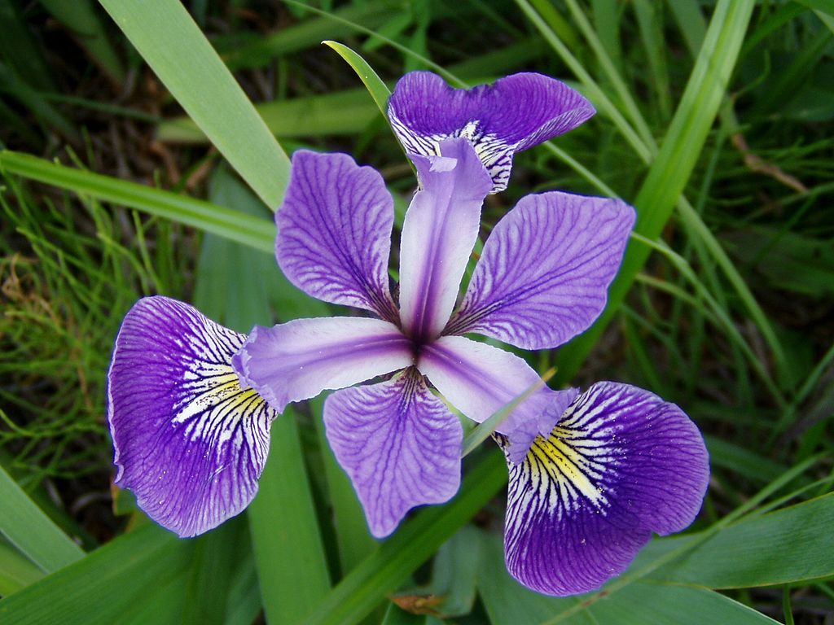
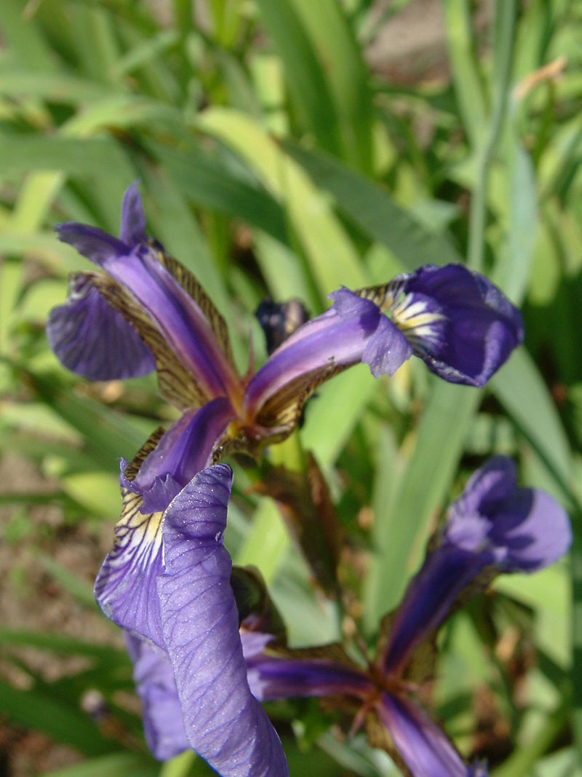
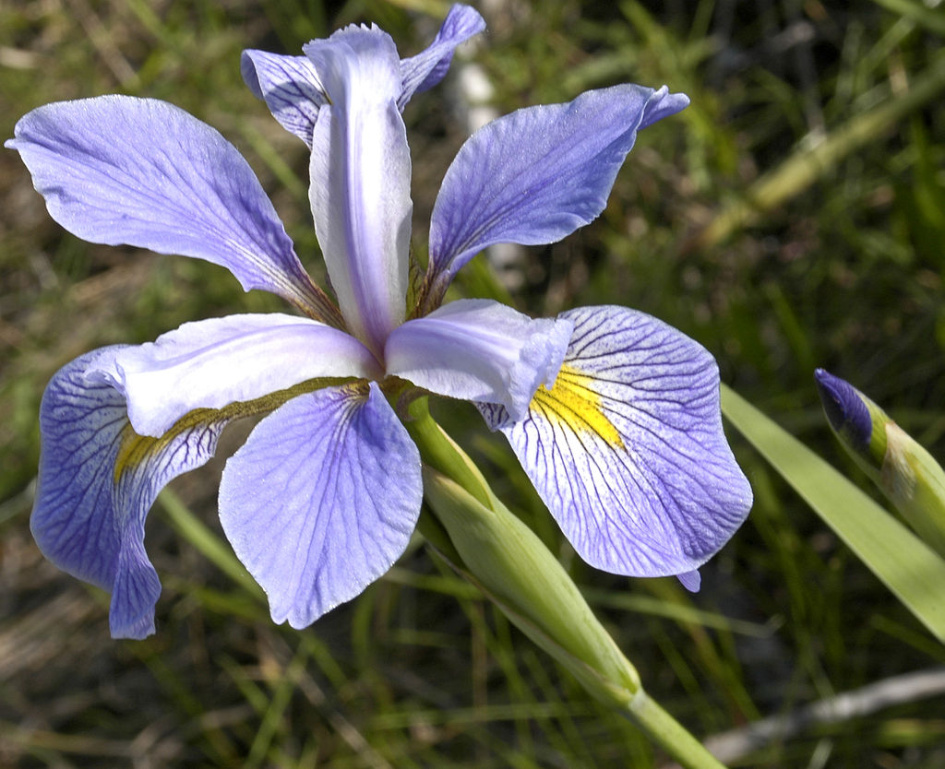
Flower Species
Iris Versicolor
Iris Virginica
Iris Setosa

Slide 13
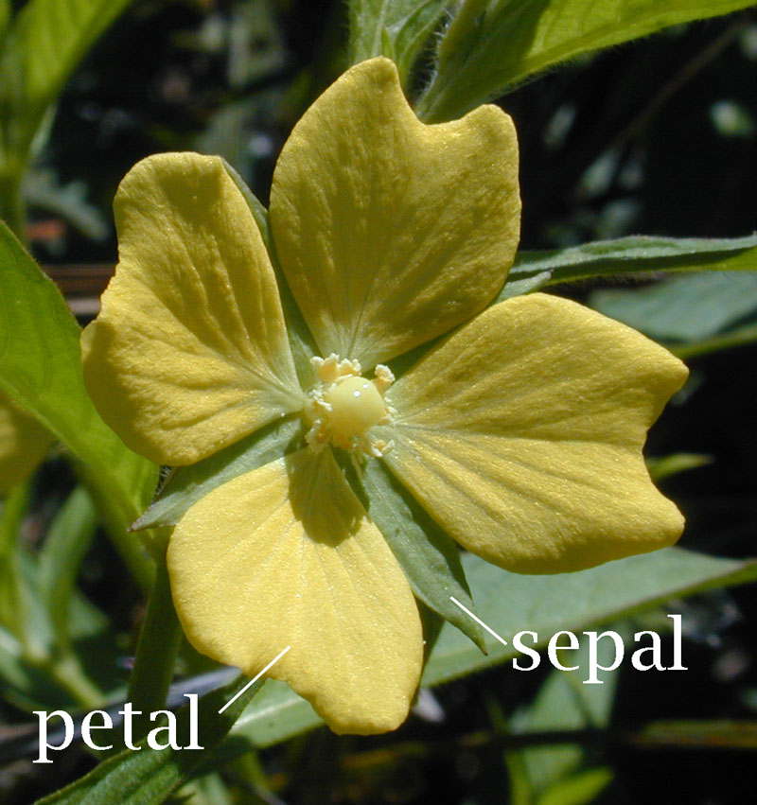
Understanding the Data
In 1936, British statistician and biologist Ronald Fisher introduced the data
Published in a paper titled The use of multiple measurements in taxonomic problems
The data was collected by botanist Edgar Anderson
The data includes petal and sepal width and lengths (in centimeters) of 3 different species of iris
The dataset is sometimes referred to as Anderson's Iris data set, or Fisher's Iris data set

Slide 14
Running K-Means Clustering

Slide 15
KMeans (1 of 3)
KMEANS ( 'model_name', 'input_relation', 'input_columns', num_clusters
USING PARAMETERS [exclude_columns=['col1, col2, ... coln' ]
[, max_iterations=value ]
[, epsilon=value ]
[, {init_method=method} |
, {initial_centers_table=table_name} ]
[, output_view=output_view ]
[, key_columns='key_columns ])
model_name - a name for the K-means model
input_relation - the source table
input_columns - the columns to be used for clustering
num_clusters - the k in k-means - how many clusters you want to create
cont…
Notes:
There are a LOT of parameters.

Slide 16
KMeans (2 of 3)
KMEANS ( 'model_name', 'input_relation', 'input_columns', num_clusters
USING PARAMETERS [exclude_columns=['col1, col2, ... coln' ]
[, max_iterations=value ]
[, epsilon=value ]
[, {init_method=method} |
, {initial_centers_table=table_name} ]
[, output_view=output_view ]
[, key_columns='key_columns ])
---
(optional) exclude_columns - list of columns to exclude from predictor_columns
(optional) max_iterations - maximum number of algorithm iterations
(optional) epsilon=value - determines the accuracy of the result (Default: 0.0001)
cont…

Slide 17
KMeans (3 of 3)
KMEANS ( 'model_name', 'input_relation', 'input_columns', num_clusters
USING PARAMETERS [exclude_columns=['col1, col2, ... coln' ]
[, max_iterations=value ]
[, epsilon=value ]
[, {init_method=method} |
, {initial_centers_table=table_name} ]
[, output_view=output_view ]
[, key_columns='key_columns ])
---
(optional) init_method - two options available
'random' - initial points are chosen randomly
'kmeanspp' - (kmeans++) algorithm (Default)
Or (optional) initial_centers_table - optional table storing initial cluster centers
(optional) output_view - the name of the view where cluster assignments are stored
(optional) key_columns - used to identify the rows of output in the output_view
Notes:
Parameters init_method and initial_centers_table are mutually exclusive. If you set both, the function returns an error.

Slide 18
KMeans Example
=> SELECT KMEANS('myKmeansModel', 'iris1', '*', 5
USING PARAMETERS max_iterations=20
,output_view='myKmeansView'
,key_columns='id'
,exclude_columns='Species' );
WARNING 2005: Not converged before max_iterations 20
KMEANS
----------------------------
Finished in 20 iterations
(1 row)
This example builds a k-means cluster of 5 clusters called 'myKmeansModel' and pulls data from the "iris1" table, clustering on all the columns (except 'Species'), and allows for up to 20 iterations
Note that in this example, it did not converge even after 20 iterations

Slide 19
Apply_KMeans
APPLY_KMEANS ( col1, col2, ..., coln
USING PARAMETERS model_name='name_of_model_created_previously' )
col1, col2, etc. - the columns to use from the input table
model_name - the name of the model
Apply_Kmeans applies all the rows of a table to the cluster centroids that were defined by the previously created model
In the previous example, the view ‘myKmeansView’ is defined as follows:
SELECT iris1.id, public.apply_kmeans(iris1.id, iris1.Sepal_Length, iris1.Sepal_Width, iris1.Petal_Length, iris1.Petal_Width USING PARAMETERS model_name='myKmeansModel'::varchar(386)) AS cluster_id FROM public.iris1;

Slide 20
Apply_KMeans Example
=> SELECT id, APPLY_KMEANS(Sepal_Length, Sepal_Width, Petal_Length,
Petal_Width USING PARAMETERS
model_name='myKmeansModel') FROM iris2;
id | APPLY_KMEANS
-----+--------------
21 | 1
25 | 1
33 | 0
48 | 0
51 | 0
65 | 0
75 | 3
96 | 3
…
(60 rows)
The "APPLY_KMEANS" function returns the cluster ID
Because we specified a K of 5 – we get 5 clusters, 0-4

Slide 21
Model Summary: K-Means

Slide 22
Get_Model_Summary – K-Means (1 of 2)
dbadmin=> select get_model_summary(using parameters model_name = 'myKmeansModel') ;
get_model_summary
---------------------------------------------------------------------------------------
=======
centers
=======
sepal_length|sepal_width|petal_length|petal_width
------------+-----------+------------+-----------
5.03667 | 3.44000 | 1.45333 | 0.25333
6.08261 | 2.82174 | 4.72174 | 1.56522
5.48571 | 2.55000 | 3.75000 | 1.14286
7.42500 | 3.06250 | 6.22500 | 1.91250
6.58667 | 3.09333 | 5.46000 | 2.03333
...
This section shows the cluster centers – 5 rows; 1 for each cluster
These are points in a 4-dimensional space
Notes:
This half of the model describes straight-forward stuff - all the data points that are the centroids for the various clusters that we've identified.
It also lists how many clusters we requested (5), and the columns that considered (sepal_length, width, etc.) for our inputs.

Slide 23
Get_Model_Summary – K-Means (2 of 2)
...
=======
metrics
=======
Evaluation metrics:
Total Sum of Squares: 402.52322
Within-Cluster Sum of Squares:
Cluster 0: 7.071
Cluster 1: 7.4434783
Cluster 2: 4.4614286
Cluster 3: 2.2575
Cluster 4: 3.856
Total Within-Cluster Sum of Squares: 25.089407
Between-Cluster Sum of Squares: 377.43382
Between-Cluster SS / Total SS: 93.77%
Number of iterations performed: 3 Converged: True
Call:
kmeans('public.myKmeansModel', 'iris1', '*', 5
USING PARAMETERS exclude_columns='Species', max_iterations=20, epsilon=0.0001, init_method='kmeanspp', distance_method='euclidean', output_view='myKmeansView', key_columns='id')
Notes:
Note that the output at the end of the summarize model includes parameters that aren’t even necessarily documented, and/or that weren’t supplied. We didn’t supply “distance_method” (and it might not even be documented at the time this is used in a classroom setting), but it appears in the output nevertheless.

Slide 24
Get_Model_Summary Explained (1 of 2)
...
Evaluation metrics:
Total Sum of Squares: 402.52322
Within-Cluster Sum of Squares:
Cluster 0: 7.071
Cluster 1: 7.4434783
Cluster 2: 4.4614286
Cluster 3: 2.2575
Cluster 4: 3.856
Total Within-Cluster Sum of Squares: 25.089407
...
Total Sum of Squares (TSS) is the sum of all squared Euclidean distances for all observations from the Mean
Within-Cluster Sum of Squares (WSS) is the sum of the squared Euclidean distances within each of the clusters
It is a measure of how "compact" a cluster is to its centroid
Sometimes referred to as "Cohesion"
Total Within-Cluster Sum of Squares is simply the sum of all the WSS values

Slide 25
Get_Model_Summary Explained (2 of 2)
...
Between-Cluster Sum of Squares: 377.43382
Between-Cluster SS / Total SS: 93.77%
Number of iterations performed: 3
Converged: True
Call:
kmeans('public.myKmeansModel', 'iris1', '*', 5
USING PARAMETERS exclude_columns='id, Species', max_iterations=20, epsilon=0.0001, init_method='kmeanspp', distance_method='euclidean', output_view='myKmeansView', key_columns='id')
(1 row)
Between-Cluster Sum of Squares is just the difference between the TSS and the WSS
The ratio gives you a kind of "score" to show how clean the clustering is
Converged tells you whether convergence has been reached within the allowed iterations
What can we change if we don't reach convergence?
The remainder of the output shows you the parameters used in order to generate the model
Notes:
What can we change if we don't reach convergence?
Two really good answers: Increase the max_iterations until it converges (will of course make it take longer to converge). That’s the easy, obvious answer.
Second answer, much harder: increase the epsilon value. This is the “wiggle room” constant that allows the convergence factor to decide whether it has satisfactorily managed to converge or not. Setting it very high will cause convergence VERY quickly (and also produce crappy results). So, be careful with that one.

Slide 26
Bisecting K-Means

Slide 27


Use Case - Megapolis
Megapolis is mobile city-building game
Debuted in 2012
Over 10 million players (including me)
Played in over 20 countries

Slide 28
select bisecting_kmeans('megapolis_bisecting_kmeans_k5', 'megapolis2', 'coins_per_minute_per_square, xp_per_minute_per_square', 5) ;
bisecting_kmeans
------------------
Finished.
(1 row)

Slide 29
select name, apply_bisecting_kmeans (coins_per_minute_per_square, xp_per_minute_per_square using parameters model_name = 'megapolis_bisecting_kmeans_k5') from megapolis2 ;
name | apply_bisecting_kmeans
----------------------------------------------------+------------------------
Aircraft Design Bureau | 7
Anichkov Palace | 3
Arabic Bank | 6
Architectural Studio | 3
Arizona Capitol | 3
Art Museum in Zaragoza | 3
Artillery Museum | 8
...

Slide 30
Determining "K"

Slide 31
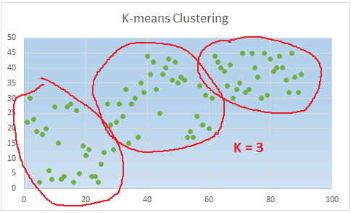
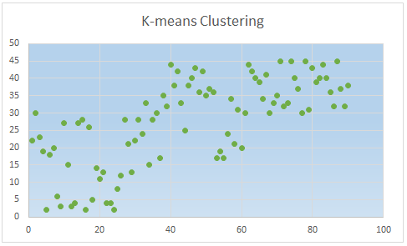
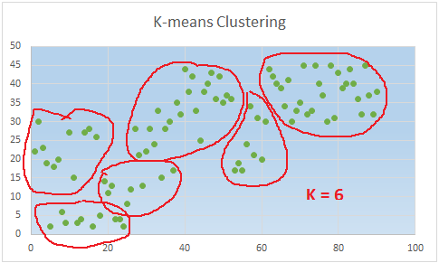
Determining "K"
There is no perfect way to determine K
There are a variety of methods
Business constraints can control the value of K
There is always room for interpretation
How many clusters here?
Notes:
It's amazing to me how our brains really feel a sense of satisfaction after we've grouped up a bunch of chaotically placed dots.
One could also make a case here for, 4, 5, or some other of # of clusters as well.
Regarding point #3 - let's say you're in the manufacturing business, and you're trying to cluster a kind of widget to product. 5 clusters would mean that you would need to create 5 different sized widgets. But, that's too expensive for your business to do that, so you opt to make 4 different sized widgets instead. More on this later.

Slide 32

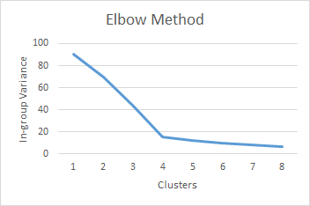
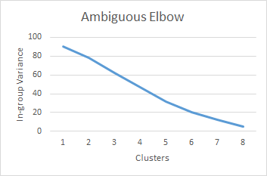
"Elbow" Method
The "elbow" method is a simple way to determine the value of "K"
Generate multiple clusters with varying K
Take the "WSS" for each model – plot them on a graph
The number of clusters at the "elbow" is the optimal "k"
The elbow method is not always so evident
Notes:
With larger data sets, the "elbow" might not always be so obvious, as evidenced by the 2nd chart.
The method used to find the "percentage of variance" is called an f-test.

Slide 33
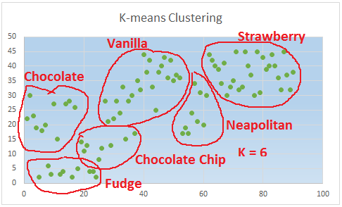
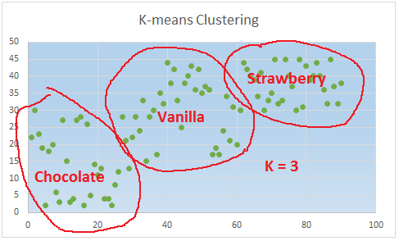
Business Constraints
Don't overlook the needs or constraints of your business
If this is your data…
And this is what your customers like…
But you don't have the resources to make
6 different flavors of ice cream…
You might have to settle on just 3

Slide 34
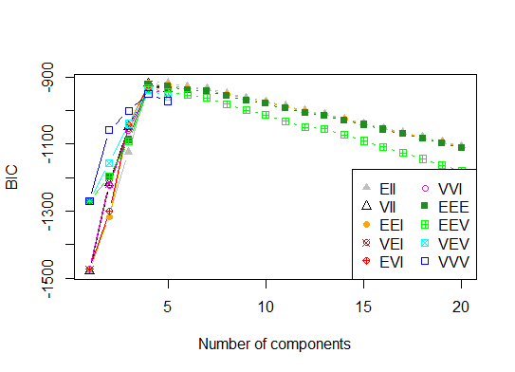
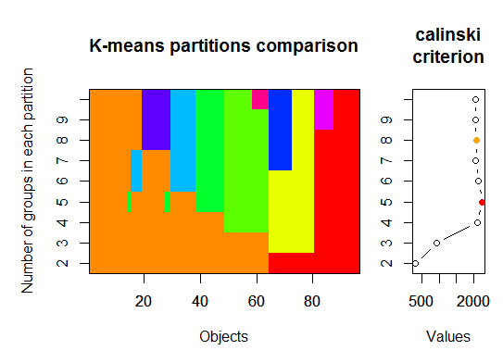
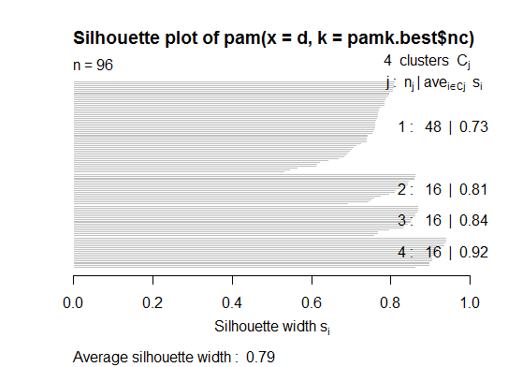
Other Methods
There are a variety of other methods used to find "k"
The Silhouette Method
Calinsky Criterion
Affinity Propagation Clustering
Gap Statistic
And several others
Unfortunately further study on these methods is far beyond the scope of this class
Notes:
Wikipedia has a fairly good article on "determining the number of clusters in a data set", which is a fairly good place to start for those interested in the topic.

Slide 35
LAB

Slide 36
Lab
Examine the data in world
Identify the world table in your database
Verify that it was loaded correctly
Examine the data in the table
Use K-Means clustering to categorize the countries
Create a K-Means model using all the columns of the table
Use a K of "3"
What kind of data preparation (if any) should we apply to this data?
Does a value of 3 make sense?
What happens if you use a value of 4 (or more) for K?
Which value is best?
Notes:
HDI = human development index
Near as I can tell, EM might mean "emerging market"; not exactly sure what it means
select kmeans('world_kmeans', 'world', '*', 3 using parameters key_columns='country', exclude_columns='country') ;
create table countries_kmeans as
select country, apply_kmeans( HDI ,em1970 ,em1971 ,em1972 ,em1973 ,em1974 ,em1975 ,em1976 ,em1977 ,em1978 ,em1979
,em1980 ,em1981 ,em1982 ,em1983 ,em1984 ,em1985 ,em1986 ,em1987 ,em1988 ,em1989 ,em1990 ,em1991 ,em1992 ,em1993
,em1994 ,em1995 ,em1996 ,em1997 ,em1998 ,em1999 ,em2000 ,em2001 ,em2002 ,em2003 ,em2004 ,em2005 ,em2006 ,em2007
,em2008 ,em2009 ,em2010 ,gdp1970 ,gdp1971 ,gdp1972 ,gdp1973 ,gdp1974 ,gdp1975 ,gdp1976 ,gdp1977 ,gdp1978 ,gdp1979 ,gdp1980
,gdp1981 ,gdp1982 ,gdp1983 ,gdp1984 ,gdp1985 ,gdp1986 ,gdp1987 ,gdp1988 ,gdp1989 ,gdp1990 ,gdp1991 ,gdp1992 ,gdp1993 ,gdp1994
,gdp1995 ,gdp1996 ,gdp1997 ,gdp1998 ,gdp1999 ,gdp2000 ,gdp2001 ,gdp2002 ,gdp2003 ,gdp2004 ,gdp2005 ,gdp2006 ,gdp2007 ,gdp2008
,gdp2009 ,gdp2010
using parameters model_name='world_kmeans' ) from world ;
This one is kind of a pain, since there's no "exclude_columns" option for apply_kmeans. Which means you have to specify

Slide 37
Lab Results
select * From countries_kmeans where apply_kmeans = 0;
country | apply_kmeans
----------------+--------------
Austria | 0
Belgium | 0
Ireland | 0
Israel | 0
Singapore | 0
Denmark | 0
Japan | 0
Sweden | 0
United States | 0
...
(21 rows)
There's no perfect solution to this problem!
Data preparation functions that could be applied include PCA and Normalization (and maybe both!)
There's not really a clear winner for K here, but a value of 5 looks like it could make some sense
Notes:
FYI - Luxembourg is a developed country, with an advanced economy and one of the world's highest GDP (PPP) per capita.
In my models, Luxembourg literally ended up in a class all by itself (cluster size = 1)

Slide 38
Overview
Understanding K-means Clustering
Use Case: Categorizing Flowers
Running K-means Clustering
Model Summary: K-Means
Determining "K"

