Slide 1
Consumer Preferences: Analyzing Factors Influencing Vehicle Demand and Sales in the Automobile Industry
Exploratory Data Analysis (EDA)
Name: Srilekha Pothula
Shivani Maddela
Pratik Naik
Paul Morales

Slide 2
Introduction
The automotive industry is a dynamic and highly competitive field influenced by an array of factors, from technological advancements to fluctuating consumer preferences.
In recent years, vehicle demand and sales have been shaped not only by the economic landscape but also by evolving consumer priorities around price, performance, fuel efficiency, and brand value. Understanding these preferences is essential for manufacturers and stakeholders who seek to optimize their strategies and align with market expectations.
This study delves into the critical variables affecting vehicle demand and sales in the automobile industry, offering a data-driven perspective on what drives consumer decisions in a diverse market.

Slide 3
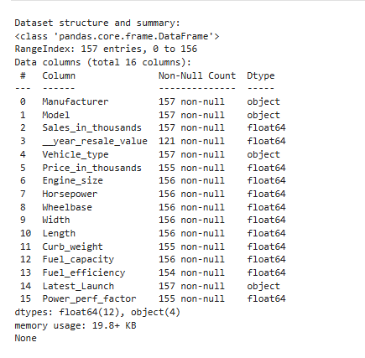
Dataset
The dataset under analysis, sourced from Kaggle: car sales data, provides valuable insights into the automotive industry, detailing factors that may influence vehicle demand and sales.
This dataset includes 157 entries, each representing a vehicle model, with 16 attributes such as manufacturer, model, vehicle type, sales volume, resale value, and various technical specifications such engine size, horsepower, fuel efficiency).
These variables help capture consumer preferences, cost-related factors, and technical aspects that are key to understanding market trends and making data-driven recommendations in the automotive sector.

Slide 4
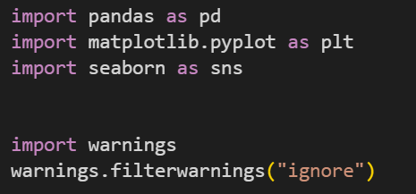
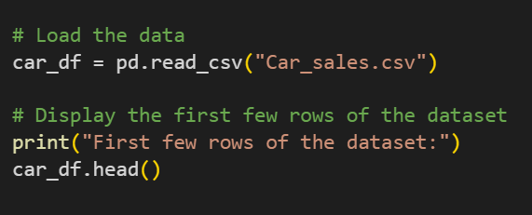
Import Libraries and Load Data

Slide 5
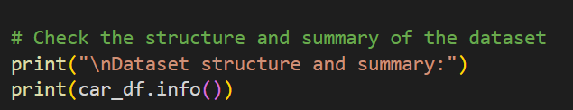
Initial Data Inspection
It's about taking a quick look to see how the data is organized and if there are any problems that need to fix. Initial data inspection is a quick check to see if the data is well organized and clean, for deeper analysis.

Slide 6
EDA
Exploratory Data Analysis(EDA) is a process of summarizing and understanding key characteristics of a dataset.
The Exploratory Data Analysis (EDA) for analyzing factors influencing vehicle demand and sales was performed using a structured approach aimed at cleaning, describing, visualizing, and understanding the dataset’s relationships.

Slide 7
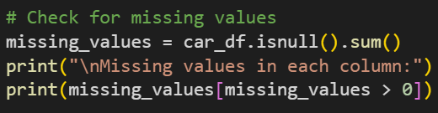
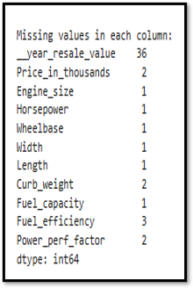
Data Cleaning
i. Missing Value Analysis: ​
We identified missing values in key variables, which may impact interpretations and accuracy of our analysis. ​
Missing values were found in varibles like resale (36 missing), Price with 2 missing, and Fuel efficiency (3 missing), among others which were replaced using their medians. ​
The dataset had 0 duplicate values.

Slide 8
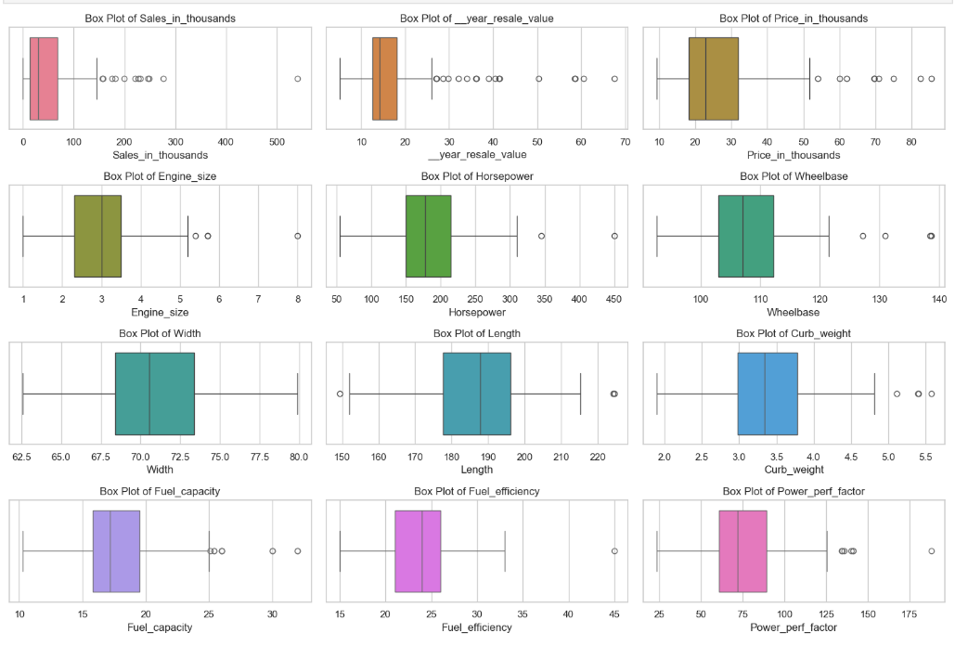
EDA Methodology
We generated descriptive statistics for numeric variables to capture central tendency, variability, and distribution. Key metrics, including the mean and standard deviation of different variables provided an overview of the dataset’s diversity in vehicle sales and pricing.
Box plots were used to visually assess outliers in continuous variables. For instance, outliers in Sales_in_thousands and Price_in_thousands were noted, indicating unusually high or low values, which may represent niche market segments or luxury brands with distinct demand patterns.

Slide 9
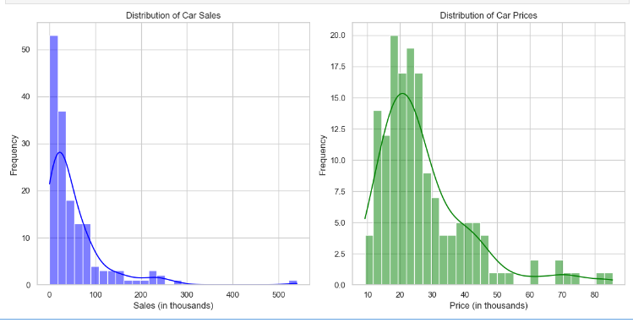
Univariate Analysis: Distribution of Sales and Car prices
The distribution of car sales shows a right-skewed curve, with a peak around 30,000 cars sold. The majority of cars sold are in the lower end of the range, with a long tail of fewer cars sold at higher sales volumes.
The distribution of car prices shows a bimodal distribution, with a primary peak around $15,000 and a secondary peak around $17,000. The prices are concentrated in the $10,000 to $20,000 range, with fewer cars priced above $20,000 and below $10,000.

Slide 10
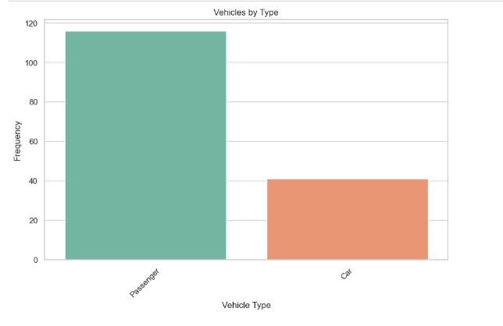
Univariate Analysis:Distribution of Vehicle types
The passenger vehicle type has a very high frequency, with over 100 vehicles, while the car type has a much lower frequency, around 30-40 vehicles.

Slide 11
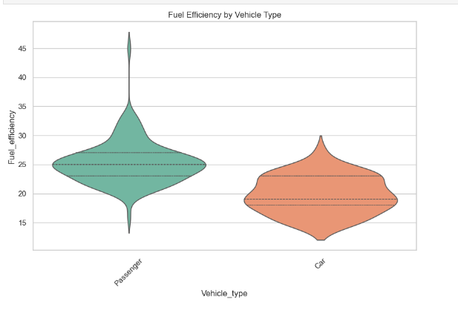
Binivariate Analysis:Fuel Efficiency by Vehicle
The passenger vehicle type has a much higher fuel efficiency, with a peak around 36 miles per gallon, while the car type has a lower fuel efficiency, with a peak around 24 miles per gallon.

Slide 12
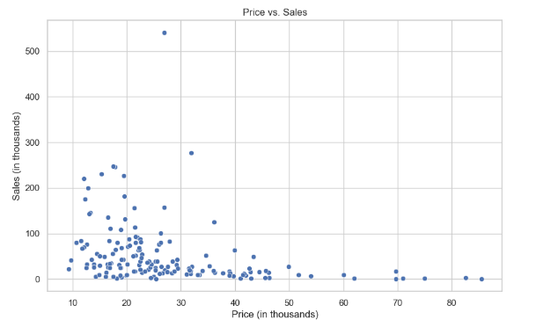
Binivariate Analysis: Price vs. Sales Relationship
Negative Relationship: There is an overall negative relationship between price and sales. As the price increases, the sales generally decrease, and vice versa.
Wide Dispersion: The data points are widely dispersed, indicating a significant amount of variability in the relationship between price and sales. There are both high-priced vehicles with low sales, as well as low-priced vehicles with high sales.
Clustering: The data points appear to be clustered in certain price and sales ranges, suggesting that there may be different segments or categories of vehicles in the dataset.
Outliers: There are a few outlier data points with very high prices and relatively low sales, or very low prices and high sales, which deviate significantly from the overall trend.

Slide 13
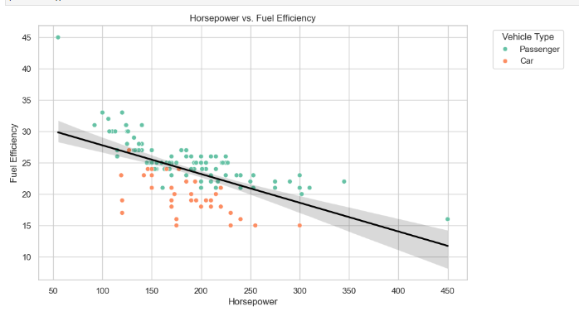
Multivariate Analysis: Horsepower vs. Fuel Efficiency
This analysis suggests that passenger vehicles, likely larger or more powerful models, prioritize performance (higher horsepower) over fuel efficiency, while cars focus more on fuel economy (higher fuel efficiency) with relatively lower horsepower.
The clear separation between the passenger and car vehicle types indicates that these two classes of vehicles have distinct design priorities and trade-offs in terms of horsepower and fuel efficiency.

Slide 14
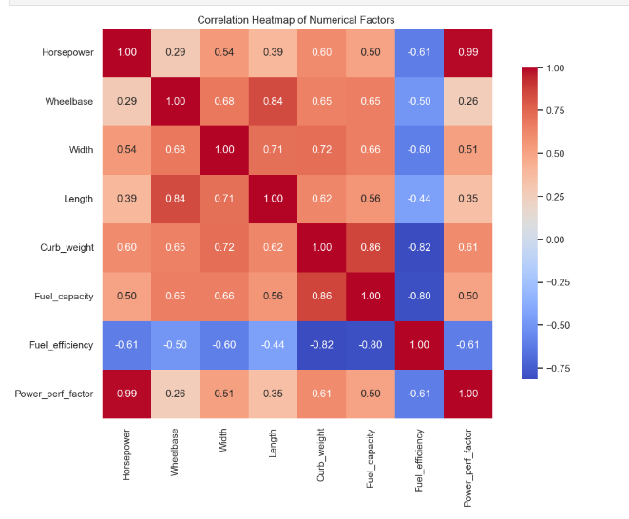
Multivariate Analysis: Correlation Heat map of Numeric Variables
The correlation analysis reveals that vehicle size, power, and performance factors like Horsepower, Curb_weight, and Fuel_capacity are generally associated with reduced Fuel_efficiency.
Higher Horsepower and larger vehicle dimensions correlate strongly with greater Curb_weight and Fuel_capacity, indicating that more powerful and heavier vehicles tend to be less fuel-efficient.
This analysis highlights key trade-offs in vehicle design between performance and fuel economy.

Slide 15
Recommendations and Further Analysis
Market Segmentation: Use cluster analysis to group vehicles by features like price and fuel efficiency, enabling targeted strategies for different consumer groups.
Sales Trends: Adding a time-series dimension could reveal seasonal or economic patterns affecting vehicle demand, aiding in future sales forecasting.
Consumer Demographics: Analyzing demographic factors linked to vehicle type preferences (e.g., regional trends) could guide targeted marketing efforts.
Fuel Efficiency Impact: Investigate the influence of fuel economy on sales, highlighting consumer priorities relative to performance and size.
Brand and Competitor Analysis: Comparing sales by brand could uncover loyalty trends and competitive advantages for strategic benchmarking.
Environmental Shifts: Explore how electric and hybrid models impact sales to anticipate shifts toward sustainable vehicles.

Slide 16
Thank You!!!

