Slide 1
AGENDA
Objectives
Solutions using Blockchain Technology
Literature Review
Implementation
Future Scope
Current Challenges in Blockchain Technology
Flowchart
Limitations

Slide 2

Objectives
Use Blockchain technology for solving existing land registration problems.
Write a smart contract and deploy it on ethereum network.
Provide a easy-to-use GUI using flutter.

Slide 3
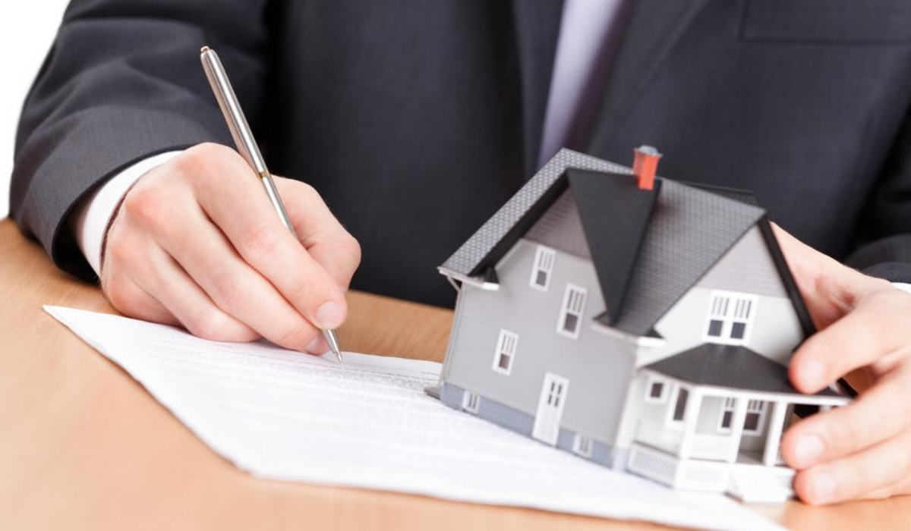
CURRENT CHALLENGES IN LAND REGISTRATION
Middlemen , brokers – process becomes expensive and tedious
Fraud Cases – fake ownership
Time Delay – two to three months from registration to completion
Human error – human interaction increases the probability of errors

Slide 4
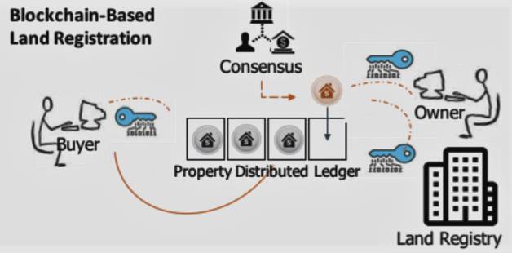
SOLUTIONS USING BLOCKCHAIN TECHNOLOGY
BETTER TRANSPARENCY
ENHANCED SECURITY
TIME TRACEABILITY
REDUCED COST

Slide 5

Literature Review
S.N. | Paper Title | Description
1. | "Land Registration system using Bockchain” Year of Publication : 2020 | To overcome the problems faced by existing land registration system author has proposed blockchain implemented by Hyperledger Fabric to replace the existing system. The author has also laid out the comparison between Ethereum and Hyperledger and has specified why the Hyperledger has been prefered over Ethereum.
2. | “Land Registry Using Blockchain - A Survey of existing systems and proposing a feasible solution“ Year of Publication: 2019 | In this system, when a land is bought by a person, the government authority will provide the person with the hard copy of property papers and the system will store the documents into the Inter Planetary File System (IPFS), a decentralised database. The IPFS network will generate the hash of document.
3. | “Digitalization of Land Records using Blockchain Teachnology” Year of Publication: 2021 | The aim of this paper is two-fold: to identify the Georgian country-specific solution for legal validity and presumption of proof of property ownership and to add the Georgian experience for a future cross country comparative studies.

Slide 6
Implementation
Frontend – Flutter
Backend – Smart Contract Using Solidity Programming Language
Integrating with Truffle and Ganache

Slide 7

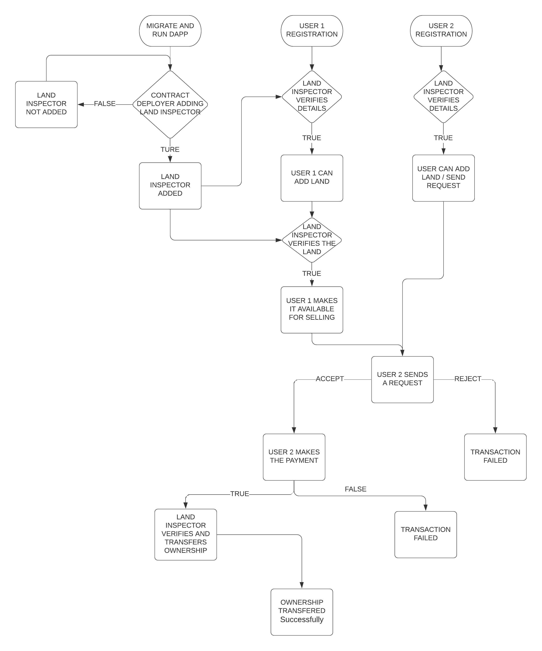
SCHEMATIC DIAGRAM OF OUR PROJECT:

Slide 8
LIMITATIONS
Amount of Data – blockchain best at transmitting small amounts of data
Technology still early
Hard to explain and talk about to users
There must be a clear legal basis for enforcement of agreements made while setting up the blockchain

Slide 9
FUTURE SCOPE
Use Hyperledger Fabric instead of ethereum for the following reasons –
Only nodes that belong to the business are allowed to enter the network
Privacy and confidentiality of the business deal are maintained
More specific and business oriented

Slide 10

Thank You

