Slide 1







AGENDA
Objectives
Current Challenges in Blockchain Technology
Solutions using Blockchain Technology
Implementation
Flowchart
Limitations
Future Scope

Slide 2
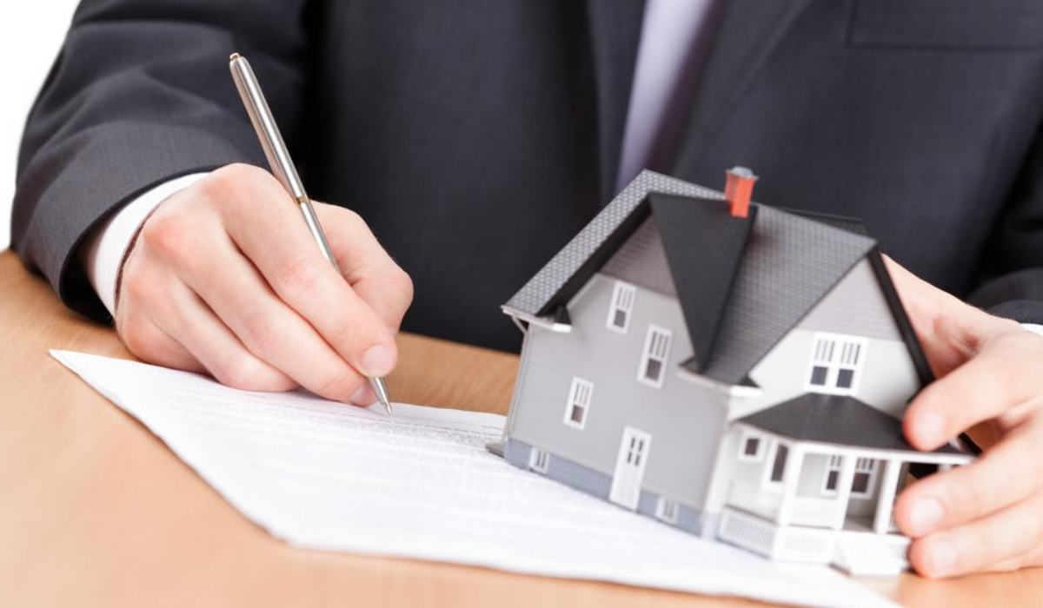
CURRENT CHALLENGES IN LAND REGISTRATION
Middlemen , brokers – process becomes expensive and tedious
Fraud Cases – fake ownership
Time Delay – two to three months from registration to completion
Human error – human interaction increases the probability of errors

Slide 3




Objectives
Use Blockchain technology for solving existing land registration problems.
Write a smart contract and deploy it on ethereum(Ropsten) network.
Provide a easy-to-use GUI using flutter.

Slide 4
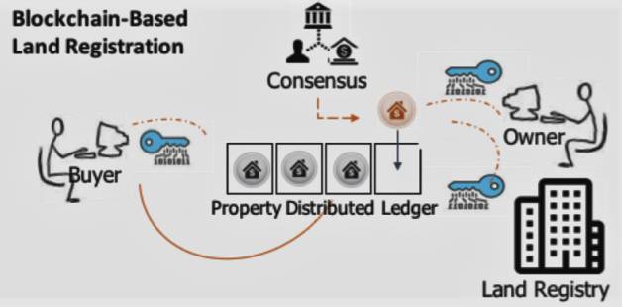
SOLUTIONS USING BLOCKCHAIN TECHNOLOGY
BETTER TRANSPARENCY
ENHANCED SECURITY
TIME TRACEABILITY
REDUCED COST

Slide 5



Implementation
Frontend – Flutter(Decentralised App.)
Backend – Smart Contract Using Solidity Programming Language
Testing with Ganache
Integrating with Truffle and IPFS

Slide 6

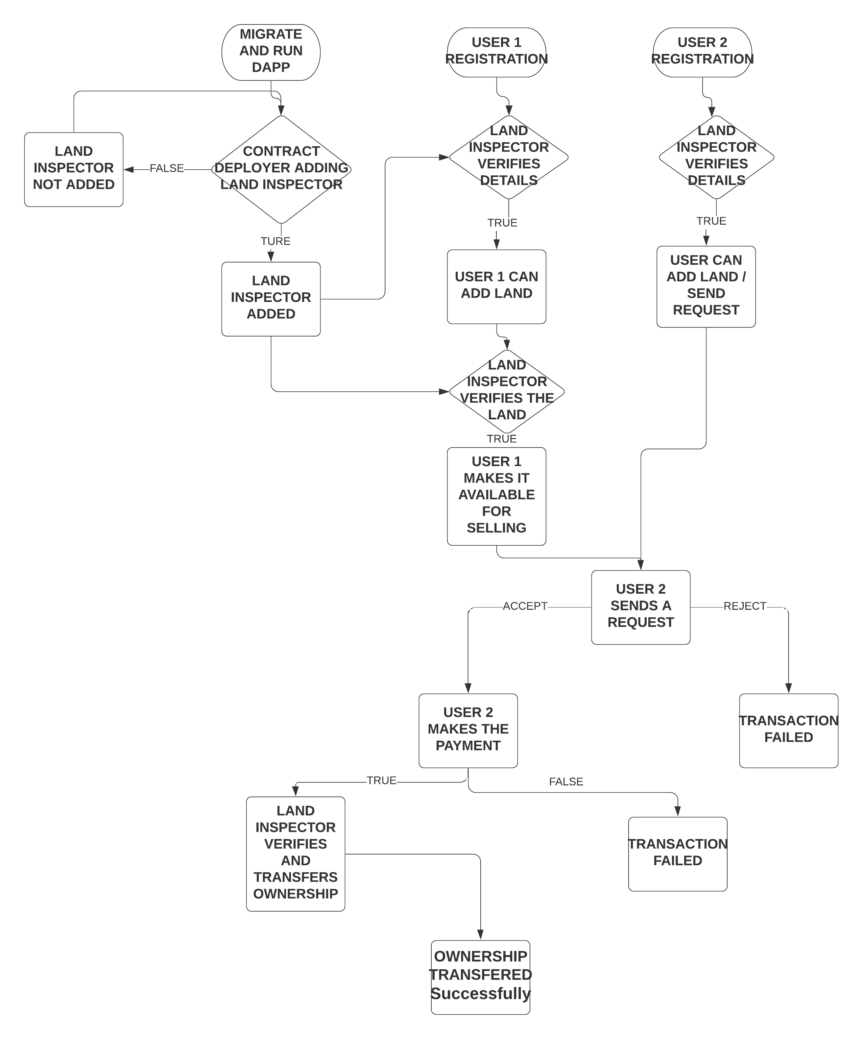
SCHEMATIC DIAGRAM OF OUR PROJECT:

Slide 7
Demo Links
Youtube video: https://youtu.be/0Coz_ivOaHs
Github Repository : https://github.com/saurabh-m-w/Blockchain-Based-Property-Registration
Deployed Website: https://landregistry.live/

Slide 8
LIMITATIONS
Amount of Data – blockchain best at transmitting small amounts of data
Technology still early
Hard to explain and talk about to users
There must be a clear legal basis for enforcement of agreements made while setting up the blockchain

Slide 9
FUTURE SCOPE
Use Hyperledger Fabric instead of Ethereum for the following reasons –
Only nodes that belong to the business are allowed to enter the network
Privacy and confidentiality of the business deal are maintained
More specific and business oriented

Slide 10

Thank You

