Slide 1
Chapter 1. Introduction (ppt)
Chapter 2. Supervised Learning (ppt): VC dimension, PAC learning
Chapter 3. Bayesian Decision Theory (ppt) : losses/risk, utility theory, value of information, Bayesian Belief Networks
Chapter 4. Parametric Methods (ppt): MLE, bias/variance, model selection precedures
Chapter 5. Multivariate Methods (ppt): parameter estimation, missing values…
Chapter 6. Dimensionality Reduction (ppt): mostly skipped
Chapter 7. Clustering (ppt): mixture densities, EM
Chapter 8. Nonparametric Methods (ppt)
Chapter 9. Decision Trees (ppt)
Chapter 10. Linear Discrimination (ppt)
Chapter 11. Multilayer Perceptrons (ppt)
Chapter 12. Local Models (ppt): Self Organizing Networks
Chapter 13. Hidden Markov Models (ppt)
Chapter 14. Assessing and Comparing Classification Algorithms (ppt)
Chapter 15. Combining Multiple Learners (ppt)
Chapter 16. Reinforcement Learning (ppt): introduction

Slide 2
What is Learning
Webster's definition of “to learn”
  “To gain knowledge or understanding of, or skill in
  by study, instruction or experience''
    Learning a set of new facts
    Learning HOW to do something
    Improving ability of something already learned
Simon's definition of “machine learning”
  ``Learning denotes changes in the system that are adaptive in the sense that they enable the system to do the same task or tasks drawn from the same population more effectively the next time''
  -- Machine Learning I, 1993, Chapter 2.

Slide 3
Why “Learn” ?
Machine learning is programming computers to optimize a performance criterion using example data or past experience.
There is no need to “learn” to calculate payroll
Learning is used when:
  Human expertise does not exist (navigating on Mars),
  Humans are unable to explain their expertise (speech recognition)
  Solution changes in time (routing on a computer network)
  Solution needs to be adapted to particular cases (user biometrics)

Slide 4
Major paradigms of machine learning
Rote learning – One-to-one mapping from inputs to stored representation. “Learning by memorization.” Association-based storage and retrieval.
Induction – Use specific examples to reach general conclusions
Clustering – Unsupervised identification of natural groups in data
Analogy – Determine correspondence between two different representations
Discovery – Unsupervised, specific goal not given
Genetic algorithms – “Evolutionary” search techniques, based on an analogy to “survival of the fittest”
Reinforcement – Feedback (positive or negative reward) given at the end of a sequence of steps

Slide 5
Inductive learning framework
Raw input data from sensors are typically preprocessed to obtain a feature vector, X, that adequately describes all of the relevant features for classifying examples
Each x is a list of (attribute, value) pairs. For example,
  X = [Person:Sue, EyeColor:Brown, Age:Young, Sex:Female]
The number of attributes (a.k.a. features) is fixed (positive, finite)
Each attribute has a fixed, finite number of possible values (or could be continuous)
Each example can be interpreted as a point in an n-dimensional feature space, where n is the number of attributes

Slide 6
What We Talk About When We Talk About“Learning”
Learning general models from a data of particular examples
Data is cheap and abundant (data warehouses, data marts); knowledge is expensive and scarce.
Example in retail: Customer transactions to consumer behavior:
  People who bought “Da Vinci Code” also bought “The Five People You Meet in Heaven” (www.amazon.com)
Build a model that is a good and useful approximation to the data.

Slide 7
Data Mining
Retail: Market basket analysis, Customer relationship management (CRM)
Finance: Credit scoring, fraud detection
Manufacturing: Optimization, troubleshooting
Medicine: Medical diagnosis
Telecommunications: Quality of service optimization
Bioinformatics: Motifs, alignment
Web mining: Search engines
...

Slide 8
What is Machine Learning?
Optimize a performance criterion using example data or past experience.
Role of Statistics: Inference from a sample
Role of Computer science: Efficient algorithms to
  Solve the optimization problem
  Representing and evaluating the model for inference

Slide 9
Applications
Association
Supervised Learning
  Classification
  Regression
Unsupervised Learning
Reinforcement Learning

Slide 10
Learning Associations
Basket analysis:
P (Y | X ) probability that somebody who buys X also buys Y where X and Y are products/services.
Example: P ( chips | beer ) = 0.7

Slide 11
The inductive learning problem
Extrapolate from a given set of examples to make accurate predictions about future examples
Supervised versus unsupervised learning
  Learn an unknown function f(X) = Y, where X is an input example and Y is the desired output.
  Supervised learning implies we are given a training set of (X, Y) pairs by a “teacher”
  Unsupervised learning means we are only given the Xs and some (ultimate) feedback function on our performance.
Concept learning or classification
  Given a set of examples of some concept/class/category, determine if a given example is an instance of the concept or not
  If it is an instance, we call it a positive example
  If it is not, it is called a negative example
  Or we can make a probabilistic prediction (e.g., using a Bayes net)

Slide 12
Supervised concept learning
Given a training set of positive and negative examples of a concept
Construct a description that will accurately classify whether future examples are positive or negative
That is, learn some good estimate of function f given a training set {(x₁, y₁), (x₂, y₂), ..., (x_{n}, y_{n})} where each y_{i} is either + (positive) or - (negative), or a probability distribution over +/-

Slide 13
Supervised Learning
Given: Training examples (x; f(x)) for some unknown function f
Find: A good approximation to f.
Example Applications
Handwriting Recognition
  x: Data from pen motion.
  f(x): Letter of the alphabet.
Disease diagnosis
  x: Properties of patient (symptoms, lab tests)
  f(x): Disease (or maybe, recommended therapy)
Face recognition
  x: Bitmap picture of person's face
  f(x): Name of the person.
Spam Detection
  x: Email message
  f(x): Spam or not spam.

Slide 14
Applications for Supervised Learning
Situations where there is no human expert
  x: Bond graph for a new molecule.
  f(x): Predicted binding strength to AIDS protease molecule.
Situations where humans can perform the task but can't describe how they do it.
  x: Bitmap picture of hand-written character
  f(x): Ascii code of the character
Situations where the desired function is changing frequently
  x: Description of stock prices and trades for last 10 days.
  f(x): Recommended stock transactions
Situations where each user needs a customized function f
  x: Incoming email message.
  f(x): Importance score for presenting to user (or deleting without presenting).

Slide 15
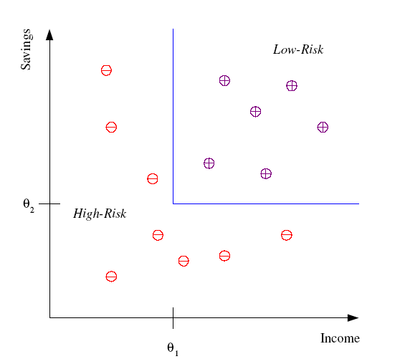
Classification
Example: Credit scoring
Differentiating between low-risk and high-risk customers from their income and savings
Discriminant: IF income > θ₁ AND savings > θ₂
THEN low-risk ELSE high-risk

Slide 16
Classification: Applications
Face recognition: Pose, lighting, occlusion (glasses, beard), make-up, hair style
Character recognition: Different handwriting styles.
Speech recognition: Temporal dependency.
  Use of a dictionary or the syntax of the language.
  Sensor fusion: Combine multiple modalities; eg, visual (lip image) and acoustic for speech
Medical diagnosis: From symptoms to illnesses
...

Slide 17








Face Recognition
Training examples of a person
Test images
AT&T Laboratories, Cambridge UK
http://www.uk.research.att.com/facedatabase.html

Slide 18
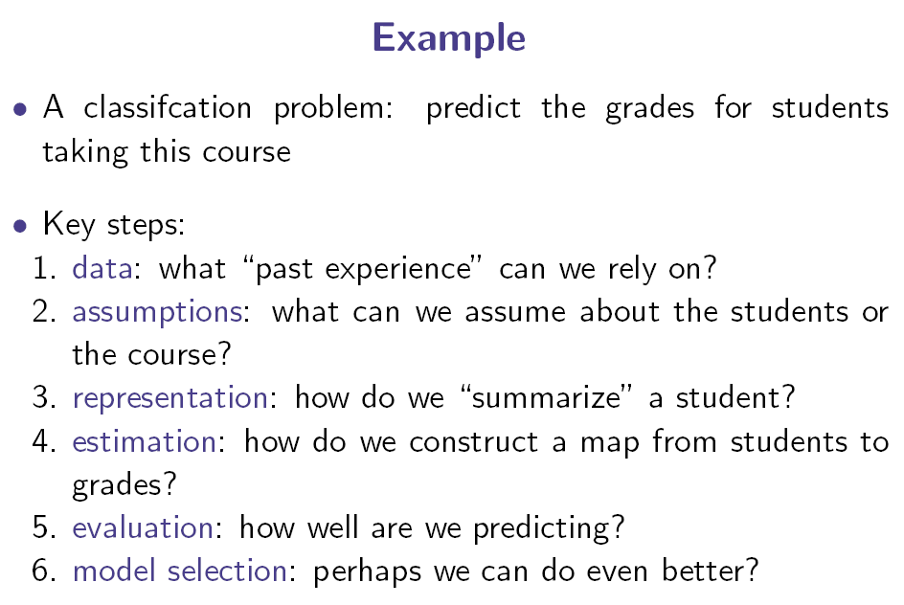

Slide 19
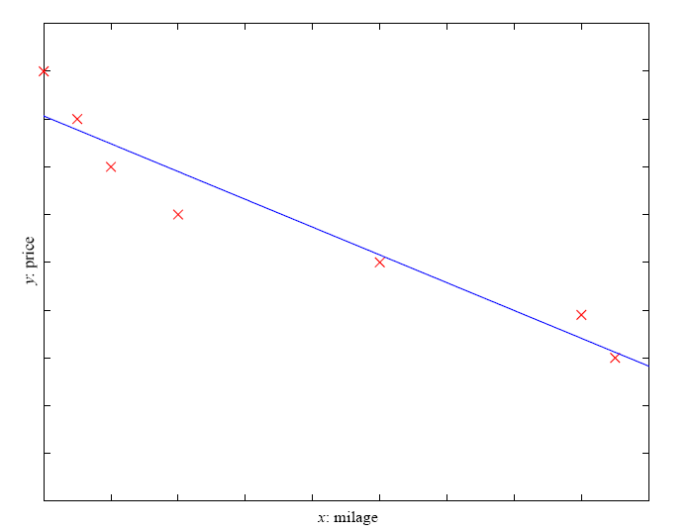
Regression
Example: Price of a used car
x : car attributes
y : price
y = g (x | θ )
g ( ) model,
θ parameters
y = wx+w₀

Slide 20
Regression Applications
Navigating a car: Angle of the steering wheel (CMU NavLab)
Kinematics of a robot arm
(x,y)
α₂
α₁= g₁(x,y)
α₂= g₂(x,y)
α₁
Response surface design

Slide 21
Supervised Learning: Uses
Prediction of future cases: Use the rule to predict the output for future inputs
Knowledge extraction: The rule is easy to understand
Compression: The rule is simpler than the data it explains
Outlier detection: Exceptions that are not covered by the rule, e.g., fraud

Slide 22
Unsupervised Learning
We are interested in capturing inherent organization in the data
  clustering,
  density estimation
No output
Example applications
  Customer segmentation in CRM
  Image compression: Color quantization
  Bioinformatics: Learning motifs

Slide 23
Reinforcement Learning
We only get feedback in the form of how well we are doing (not what we should be doing)
No supervised output but delayed reward
Credit assignment problem
Game playing
Robot in a maze
Multiple agents, partial observability, ...

Slide 24
References

Slide 25
Resources: Datasets
UCI Repository: http://www.ics.uci.edu/~mlearn/MLRepository.html
UCI KDD Archive: http://kdd.ics.uci.edu/summary.data.application.html
Statlib: http://lib.stat.cmu.edu/
Delve: http://www.cs.utoronto.ca/~delve/

Slide 26
Resources: Journals
Journal of Machine Learning Research www.jmlr.org
Machine Learning
Neural Computation
Neural Networks
IEEE Transactions on Neural Networks
IEEE Transactions on Pattern Analysis and Machine Intelligence
Annals of Statistics
Journal of the American Statistical Association
...

Slide 27
Resources: Conferences
International Conference on Machine Learning (ICML)
  ICML05: http://icml.ais.fraunhofer.de/
European Conference on Machine Learning (ECML)
  ECML05: http://ecmlpkdd05.liacc.up.pt/
Neural Information Processing Systems (NIPS)
  NIPS05: http://nips.cc/
Uncertainty in Artificial Intelligence (UAI)
  UAI05: http://www.cs.toronto.edu/uai2005/
Computational Learning Theory (COLT)
  COLT05: http://learningtheory.org/colt2005/
International Joint Conference on Artificial Intelligence (IJCAI)
  IJCAI05: http://ijcai05.csd.abdn.ac.uk/
International Conference on Neural Networks (Europe)
  ICANN05: http://www.ibspan.waw.pl/ICANN-2005/
...

Slide 28
PrTools
Pattern Recognition Toolbox from Delft University of Technology
PrTools 4.0

Slide 29
Terminology
Training example. An example of the form (x; y). x is usually a vector of features, y
is called the “class label". We will index the features by j, hence x_{j} is the j-th feature of
x. The number of features is n.
Target function. The true function f, the true conditional distribution P(y|x), or the
true joint distribution P(x; y)
Hypothesis. A proposed function or distribution h believed to be similar to f or P.
Concept. A boolean function. Examples for which f(x) = 1 are called positive examples or positive instances of the concept. Examples for which f(x) = 0 are called
negative examples or negative instances.
Classifier. A discrete-valued function. The possible values f(x) ∈ {1, …, k} are called
the classes or class labels.
Hypothesis Space. The space of all hypotheses that can, in principle, be output by a
particular learning algorithm.
Version Space. The space of all hypotheses in the hypothesis space that have not yet
been ruled out by a training example.
Training Sample (or Training Set or Training Data) a set of N training examples
drawn according to P(x; y).
Test Set. A set of training examples used to evaluate a proposed hypothesis h.
Validation Set. A set of training examples (typically a subset of the training set) used
to guide the learning algorithm and prevent overtting.

