Slide 1
NLP and Digital Preservation Annotation Platform
Phase 1 Report
TEAM MEMBERS
Riddhiman Puzari
Priya Saikia
Nandita Das
TARGET LANGUAGES
Assamese (Primary)
Bodo
Karbi
Dimasa etc.

Slide 2
1. Comparative Study of Existing Platforms
Mozilla Common Voice, Bhashini (BhashaDaan), and Xobdo

Slide 3
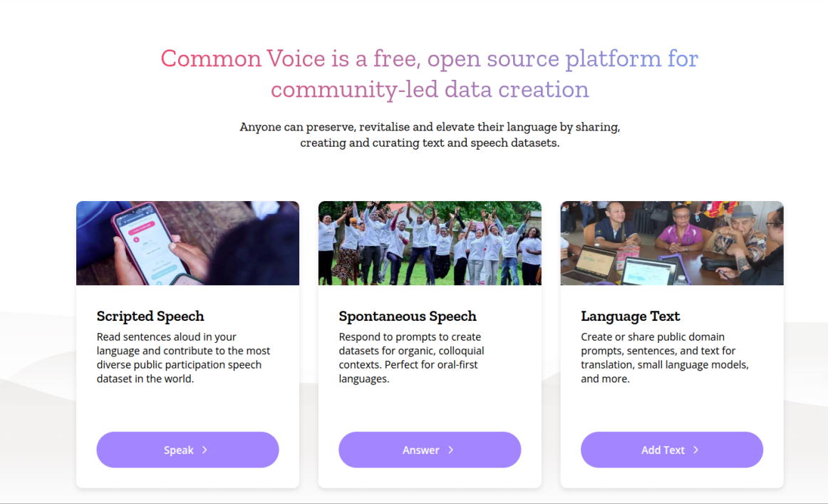
1.1 Mozilla Common Voice — Overview
Community-Led: Gold standard for open-source, community-led data creation.
Open Access: Allows anyone to download complete datasets for research and commercial applications.
Contribution Modes: Collects language data via three distinct modes:
• Scripted Speech: Reading pre-approved sentences aloud.
• Spontaneous Speech: Responding to prompts (ideal for oral-first languages).
• Language Text: Submitting public-domain text and reviewing transcriptions.
NLP & Digital Preservation Annotation Platform | Phase 1 Report
3

Slide 4
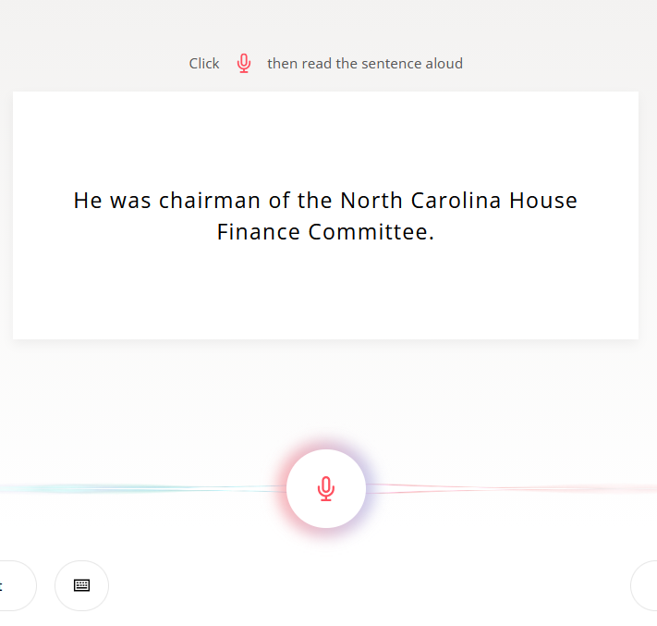
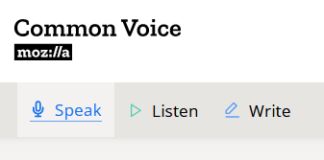
Mozilla Common Voice — Speak Mode Details
Speak Interface: This mode collects 'Scripted Speech.' Users read specific, highlighted sentences aloud.
User Action: Volunteers press a record button, speak, and save. The UI is designed to be highly intuitive and responsive.
Spontaneous speech: The project supports spontaneous responses to prompts, ensuring natural speech and colloquial nuances are recorded.
Review and Submit: Volunteers can review, rerecord, or submit their voice donations seamlessly.
NLP & Digital Preservation Annotation Platform | Phase 1 Report
4

Slide 5
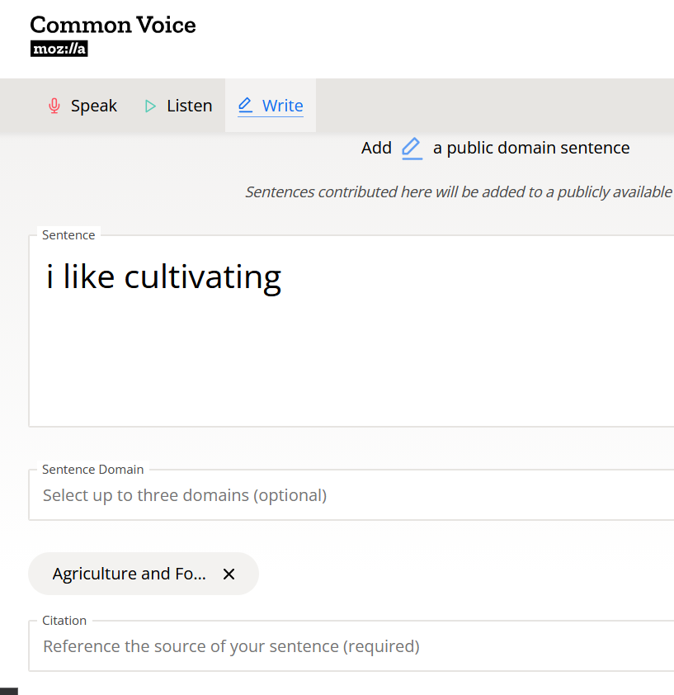
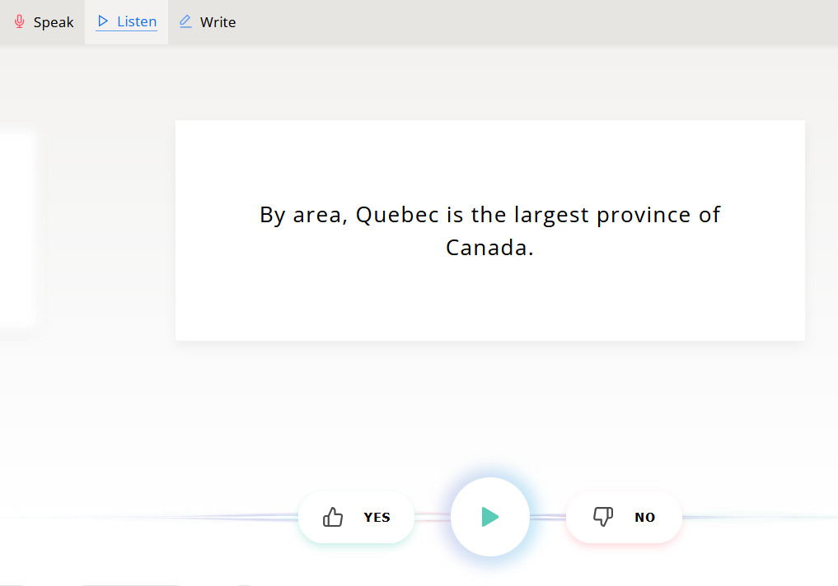
Mozilla Common Voice — Listen & Write Modes
Listen Module: Quality assurance through peer validation. Users listen to voice clips and verify they match the text.
Validation Flow: Requires a simple yes/no response to validate the accent, pronunciation, and clarity of the recording.
Write Module: Allows text corpus donations. Volunteers write or share public-domain prompts.
Reviewing Text: Includes reviewing text inputs to maintain high-quality text for subsequent voice donation cycles.
NLP & Digital Preservation Annotation Platform | Phase 1 Report
5

Slide 6
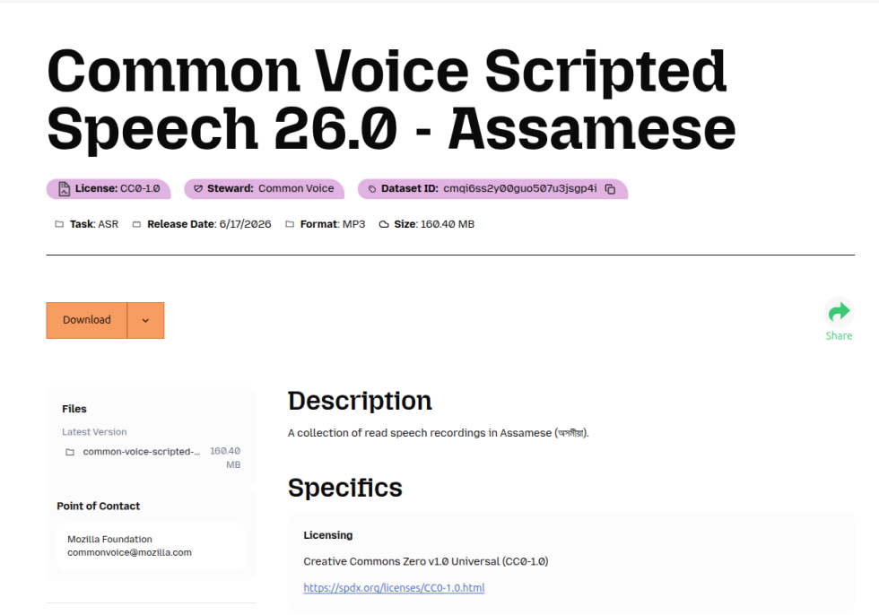
Mozilla Common Voice — Assamese Dataset Status
Progress Metrics: Shows total hours recorded, validated hours, and progress towards speech recognition utility.
Demographics: Volunteers can track the overall language status and demographic breakdown (gender, age, accent).
Community Need: Assamese remains a low-resource language requiring active community mobilization.
Value of Data: Highlights how open speech data provides a foundation for regional AI models.
NLP & Digital Preservation Annotation Platform | Phase 1 Report
6

Slide 7
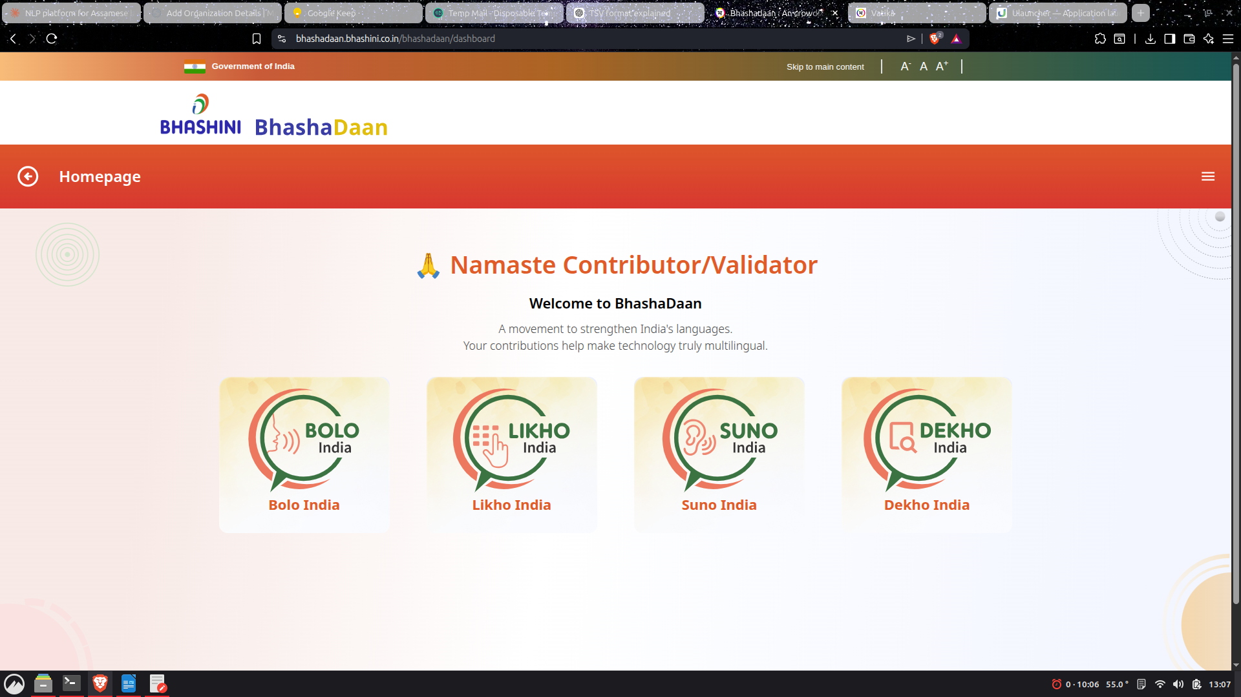
1.2 Bhashini — BhashaDaan Overview
Mission Goal: India's National Language Translation Mission aimed at bridging the digital divide.
BhashaDaan: Crowdsourcing initiative of Bhashini, empowering citizens to donate voice and text data.
Gamified Tasks: Organized into four distinct tasks representing the data lifecycle:
• Bolo India (Speak): Donate voice recordings by reading text.
• Likho India (Write): Translate or transcribe text inputs.
• Suno India (Listen): Listen and validate speech data.
• Dekho India (See): Tag, label or transcribe images.
NLP & Digital Preservation Annotation Platform | Phase 1 Report
7

Slide 8
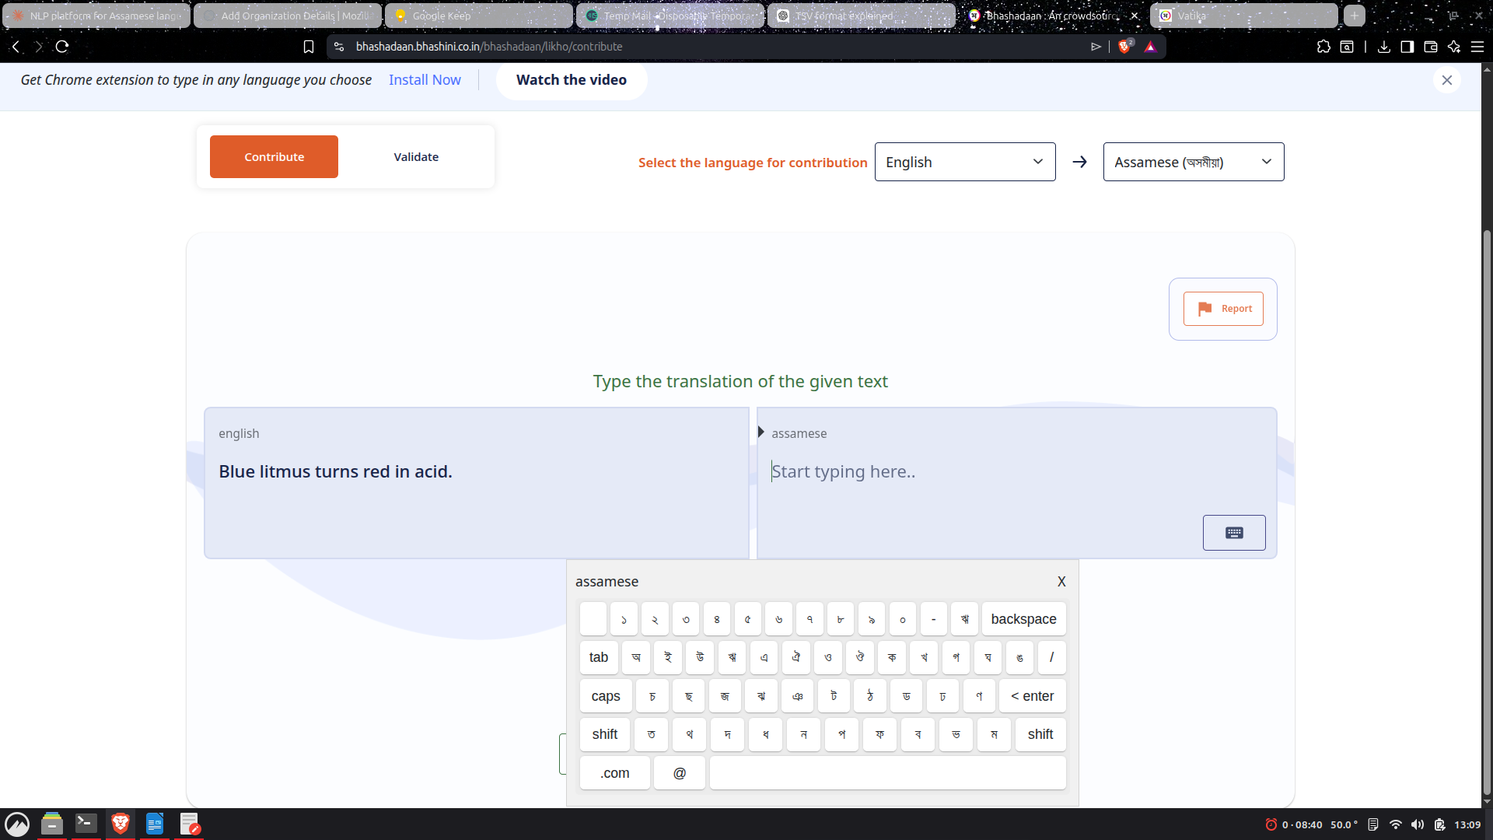
Bhashini — Likho India Translation Module
Translation Board: Direct translation interface where contributors translate prompts from source (e.g. English) to target languages.
Virtual Keyboard: Integrates a specialized Assamese virtual keyboard directly in the browser.
Accessibility: Allows contribution from devices that lack native regional script configurations.
Text Validation: Supports standard text formatting and validation checks prior to final submission.
NLP & Digital Preservation Annotation Platform | Phase 1 Report
8

Slide 9
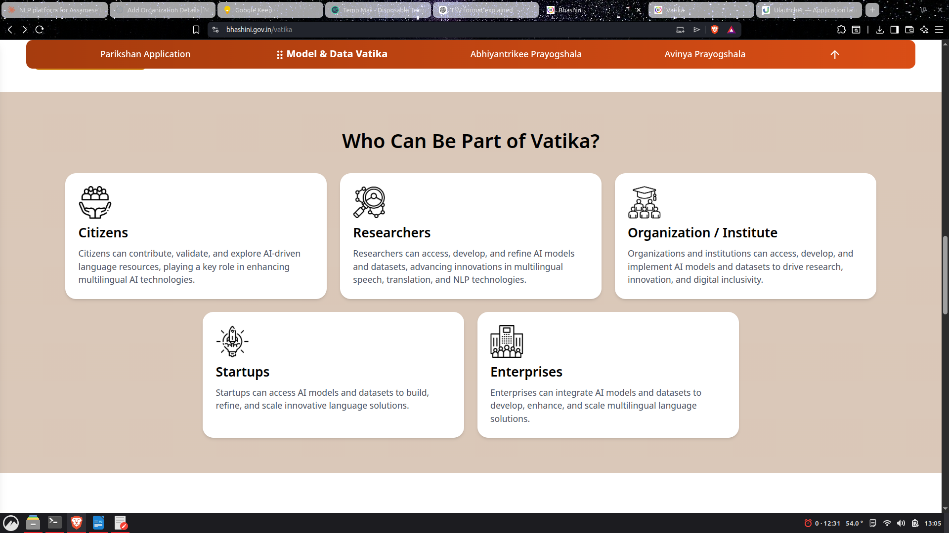
Bhashini — Vatika (Data Marketplace)
Vatika Ecosystem: A centralized marketplace hosting verified models and datasets for Indian regional languages.
Distribution Model: Serves as an institutional model for distributing processed datasets.
Stakeholder Categories: Supports five core stakeholder groups in the language ecosystem:
• Citizens: Individuals donating data and using AI tools.
• Researchers: Accessing large corpora for academic/linguistic studies.
• Organizations: Government agencies and non-profits sharing localized content.
• Startups: Developing localized consumer applications and products.
• Enterprises: Scaling large language models and speech services.
NLP & Digital Preservation Annotation Platform | Phase 1 Report
9

Slide 10
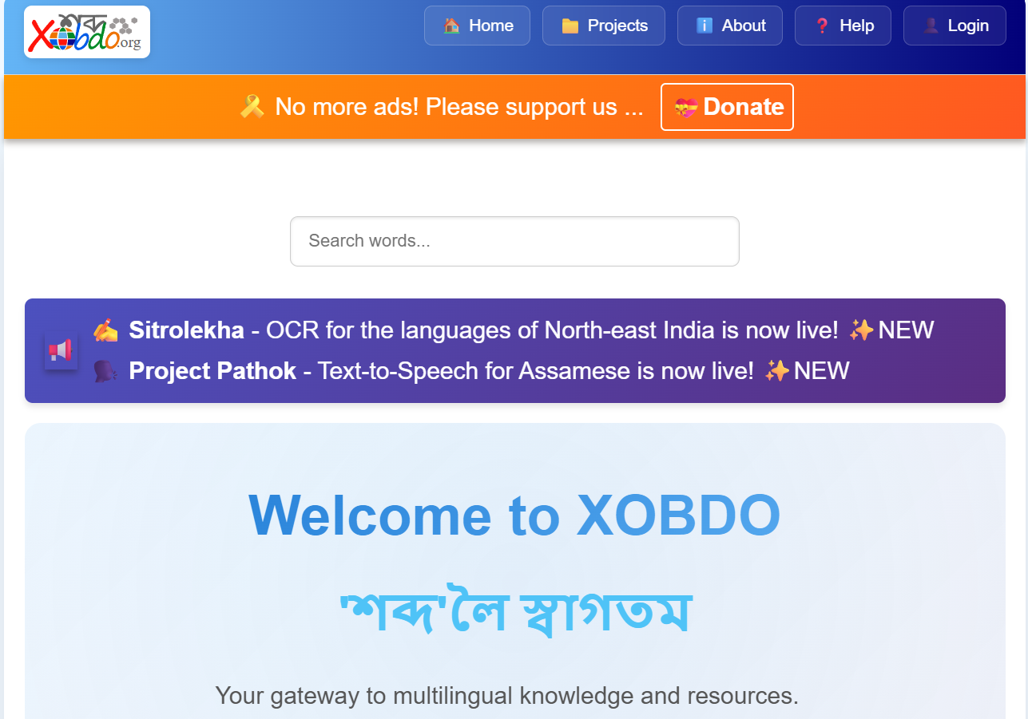
1.3 Xobdo — Assamese Community Platform
Core Mission: Community-driven dictionary and language resource platform for Assamese and other North-East languages.
Resource Focus: Focuses on structural digital resources (vocabularies, definitions, and spelling rules) rather than raw speech data.
Verification Model: Integrates community inputs with an active editorial board to maintain accuracy.
Reference Platform: Serves as a reference platform for Assamese digital preservation efforts since its inception.
NLP & Digital Preservation Annotation Platform | Phase 1 Report
10

Slide 11
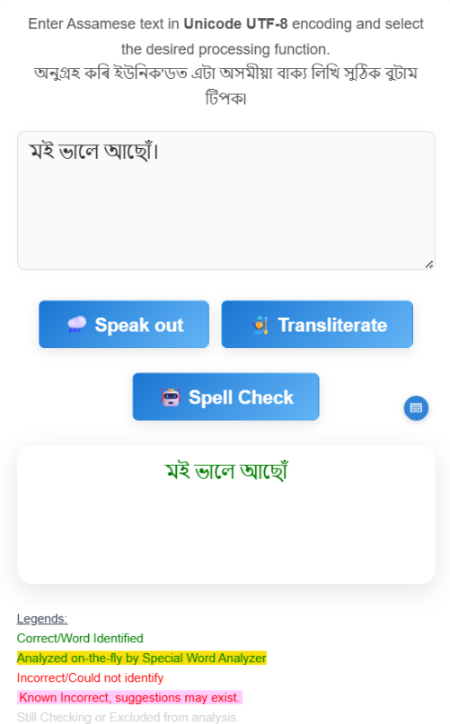
Xobdo — AI-Litikai Language Tools
AI-Litikai Initiative: An initiative by XOBDO deploying practical applications using their digital lexicon.
Available Tools: Provides essential NLP tools for low-resource languages:
• Spell Checker: Ensuring lexical correctness in text input.
• Text-to-Speech (TTS): Synthesized audio output for digital texts.
• Speech-to-Text: Voice transcription for Assamese (SrutoLipi).
• Transliteration: Converting script phonetics to romanized text.
• Optical Character Recognition (OCR): Extracting text from scanned regional documents.
NLP & Digital Preservation Annotation Platform | Phase 1 Report
11

Slide 12
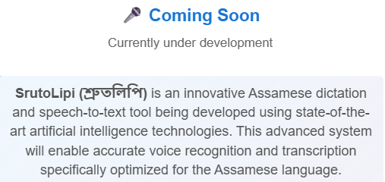
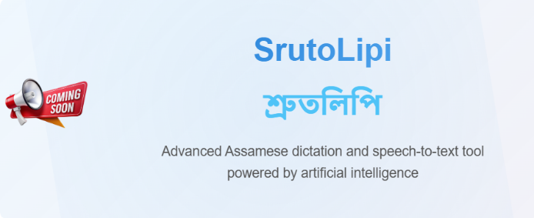
Xobdo — Speech-to-Text (SrutoLipi)
SrutoLipi System: Speech-to-Text translation engine built specifically for Assamese phonetics and syntax.
Functional Goal: Converts spoken regional inputs directly into typed Assamese characters.
Dialect Support: Aims to support diverse local dialects and real-world background noise scenarios.
Downstream Impact: Demonstrates how community-annotated speech and transcriptions yield downstream AI tools.
NLP & Digital Preservation Annotation Platform | Phase 1 Report
12

Slide 13
Xobdo — Verification & Key Observations
Editorial Verification Model: Community members submit words, meanings, or corrections, but they must undergo editor review before being published. This keeps quality high and prevents lexical pollution.
1. Community Power: Crowdsourcing and dictionary tools can scale rapidly when backed by native community members.
2. Quality Over Quantity: Low-resource languages require strict verification mechanisms to remain valuable for machine learning.
3. AI Readiness: Once structured data is consolidated, functional APIs and NLP tools can be trained and released.
4. Integrated Ecosystem: A single, integrated platform can bridge lexicography, transcriptions, and raw acoustic data.
NLP & Digital Preservation Annotation Platform | Phase 1 Report
13

Slide 14
1.4 Comparative Summary of Existing Platforms
Platform | Primary Focus | Verification Model | Key Takeaway
BhashaDaan (Bhashini) | Indian regional languages, government-backed | Structured review via institutional flow | Task-type segmentation (Bolo/Likho/Suno/Dekho) for gamified UX
Mozilla Common Voice | Open-source multilingual speech datasets | Peer validation and public dataset release | Three contribution modes including spontaneous speech for oral languages
Xobdo | Community-driven dictionary & language resources | Editor review and validation before publishing | Demonstrates how community participation can preserve regional languages while supporting AI tools
NLP & Digital Preservation Annotation Platform | Phase 1 Report
14

Slide 15
2. Proposed Database Schema
Relational Design & Fine-Grained Syntax Annotation (JSONB)

Slide 16
2. Proposed Database Schema — Design Overview
Relational Core: Organized around four relational core tables (Users, Raw_Phrases, Annotations, and Verifications) to ensure integrity.
JSONB Extensions: Includes a flexible JSONB column inside Annotations to map complex syntax, morphology, and dependency relations.
Dialect-Aware: Designed with regional dialects in mind, tracking metadata like Goalpariya, Kamrupi, and Standard Assamese.
Verification Workflow: Features a multi-peer validation process using trust scores to auto-approve high-quality data and flag outliers.
Export-Friendly: Enables instant, clean export for ML training: e.g., 'all Assamese-to-English translations with status=Approved and at least 3 positive votes.'
NLP & Digital Preservation Annotation Platform | Phase 1 Report
16

Slide 17
Schema — Users & Raw_Phrases Tables
2.1 Users Table
2.2 Raw_Phrases Table
Column | Type | Description
user_id | PK, Integer | Unique identifier for each contributor
username / email | Text | Display name and login credentials
native_dialect | Text | e.g., Kamrupi, Goalpariya, Standard Assamese
trust_score | Integer | Gamification metric based on approved submissions
Column | Type | Description
phrase_id | PK, Integer | Unique identifier for the source sentence
text_content | Text | The original Assamese phrase or paragraph
source_type | Text | Literature, News, Spoken, or User-submitted
dialect_metadata | Text | Regional variant of the source phrase
NLP & Digital Preservation Annotation Platform | Phase 1 Report
17

Slide 18
Schema — Annotations & Verifications Tables
2.3 Annotations Table
2.4 Verifications Table
Column | Type | Description
annotation_id | PK, Integer | Unique identifier for the annotation work
phrase_id / user_id | FK | Links to Raw_Phrases and Users tables
task_type | Text | Translation, Syntax Tagging, Audio Recording
content | JSONB | Translation text or structured POS/dependency tags
status | Text | Pending, Approved, or Rejected state
Column | Type | Description
verification_id | PK, Integer | Unique identifier for the verification action
annotation_id / user_id | FK | Links reviewer to target annotation
vote | Integer | +1 correct vote, -1 incorrect vote
timestamp | Datetime | When the verification vote was cast
NLP & Digital Preservation Annotation Platform | Phase 1 Report
18

Slide 19
2.5 Handling Complex Syntax (JSONB Payload)
Agglutinative Support: Instead of parsing every grammatical token into individual relational database rows, XOBDO-like systems benefit from a structured content document.
Why JSONB? Assamese grammar relies heavily on suffixes, case endings, and classifiers. A relational model splits these, losing coherence. JSONB stores them as an integrated object.
ML Preservation: The payload preserves root, POS tag, classifier, case, and dependency head/relation for direct feeding into Machine Learning frameworks.
[ { "token_id": 1, "original_word": "মানুহজনক", "root": "মানুহ", "pos_tag": "NOUN", "morphology": { "classifier": "জন", "case": "ACCUSATIVE" }, "dependency": { "head_token_id": 3, "relation": "OBJECT" } } ]
NLP & Digital Preservation Annotation Platform | Phase 1 Report
19

Slide 20
3. Recommended Full-Stack Architecture
FastAPI backend, React.js frontend, PostgreSQL, and Firebase

Slide 21
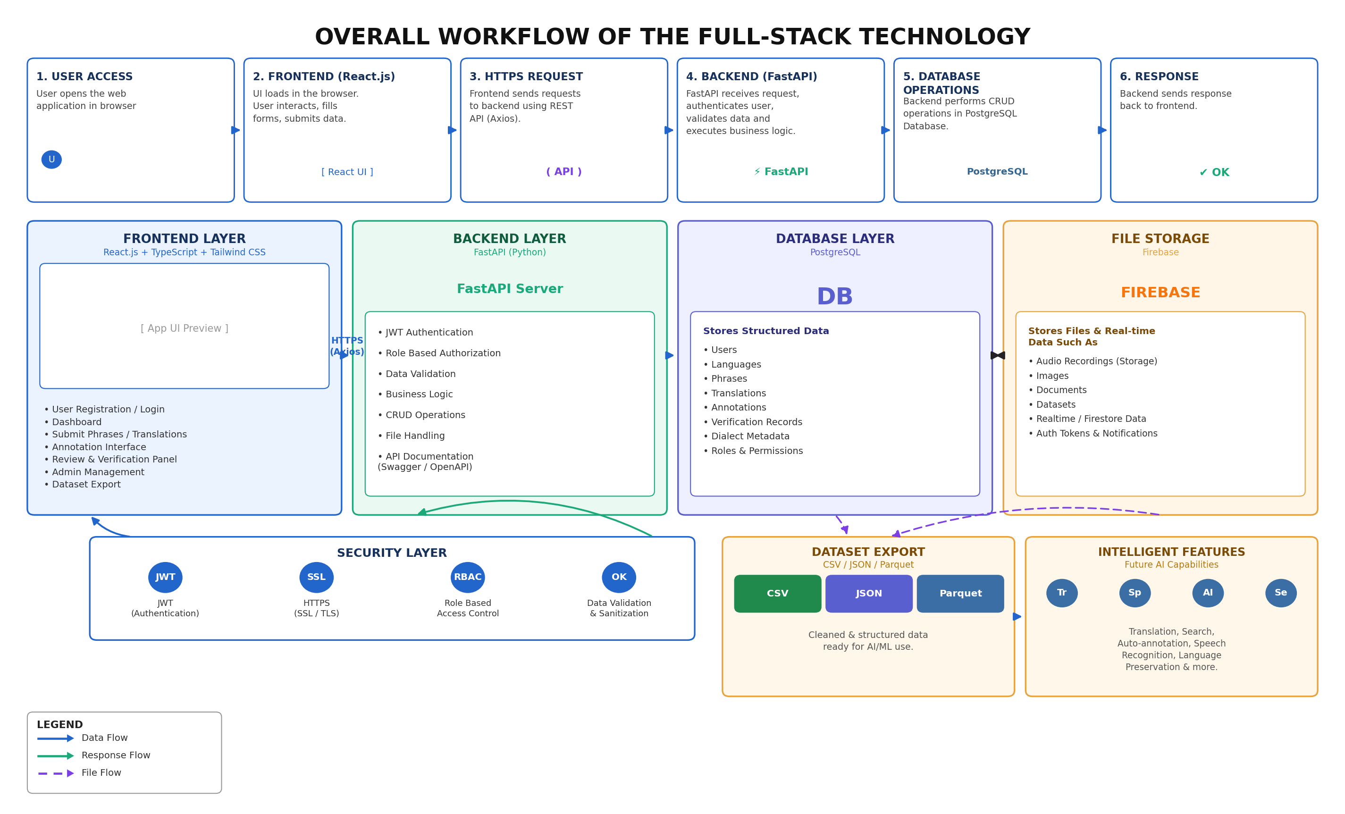
3. Recommended Full-Stack Architecture Overview
1. Frontend Layer: React.js + TypeScript + Tailwind CSS for a modern, responsive, and interactive crowdsourcing layout.
2. Backend Layer: FastAPI (Python) as a high-performance RESTful API mediator for business logic.
3. Relational Database: PostgreSQL for strongly-typed relational and JSONB schemas.
4. Object Storage: Firebase for secure, real-time metadata and audio recording file storage.
Security & Control: Features a modular request-response cycle wrapping security checks and export controllers.
NLP & Digital Preservation Annotation Platform | Phase 1 Report
21

Slide 22
3.1 End-to-End Request Flow (6 Stages)
Stage 1: User Access — Contributor opens the web portal, displaying the available translation, tagging, or recording tasks.
Stage 2: Frontend (React.js) — The UI dynamically loads state, accepts input, and captures metadata (audio files, coordinates, dialect variants).
Stage 3: HTTPS Request — The client application triggers secure HTTP calls utilizing Axios to backend routing endpoints.
Stage 4: Backend (FastAPI) — FastAPI middleware processes JWT tokens, verifies authorization, and validates the request body schema.
Stage 5: Database Operations — The backend initiates transactions to write rows, update scores, or save JSONB fields in PostgreSQL.
Stage 6: Response — FastAPI returns structured JSON metadata. The UI updates dynamically and increments the user's trust score.
NLP & Digital Preservation Annotation Platform | Phase 1 Report
22

Slide 23
Frontend & Backend Layer Implementation
3.2 Frontend Layer (React.js + TypeScript)
Secure login and registration with dialect profiling.
Gamified contributor dashboard with real-time trust metrics.
Annotation interface featuring syntax tagging and Web Audio API recording.
Verification panel showing peer contributions side-by-side for review.
Dataset export console for admin monitoring.
3.3 Backend Layer (FastAPI / Python)
High-performance processing utilizing Python async features.
Role-Based Access Control (RBAC) separating contributors, reviewers, and admins.
Pydantic models for strict static request/response validation.
Audio handling endpoints parsing raw blobs, converting formats, and shipping to Firebase.
Auto-generating Swagger/OpenAPI documentation directly from python scripts.
NLP & Digital Preservation Annotation Platform | Phase 1 Report
23

Slide 24
3.4 Database Split & 3.5 Security Layers
Data Storage Split
Security Protections
Layer | Technology | Stores
Structured Data | PostgreSQL | Users, languages, phrases, translations, annotations, verification records, dialects, roles
Files & Real-time | Firebase | Audio recordings, source documents, raw assets, authentication tokens, real-time sync states
JWT: Token-based user authentication verifying identity across API boundaries.
SSL: SSL/TLS encrypted transport covering all HTTP endpoints and database calls.
RBAC: Fine-grained permissions defining what a contributor vs. reviewer can perform.
Validation: Pydantic-based payload sanitation preventing SQL Injection and script execution.
NLP & Digital Preservation Annotation Platform | Phase 1 Report
24

Slide 25
3.6 Dataset Export & Intelligent Features
Dataset Export Formats
CSV Format: Exports processed translation pairs and dialect metadata directly to comma-separated files.
JSON Format: Outputs raw hierarchical syntax trees, POS classifications, and complex morphology mappings.
Parquet Format: Highly compressed, columnar data structures optimized for training large language models (LLMs).
Filtering: Admins can filter by minimum verification score, language variant, and contributor reliability.
Future Intelligent Features
Translation AI: Building sequence-to-sequence translation models between Assamese, Bodo, and English.
Auto-Annotation: Using morphology annotations to suggest POS tags automatically on user uploads.
Speech Recognition: Developing custom Speech-to-Text and Text-to-Speech voices with local dialect accents.
Digital Preservation: Cataloging and preserving oral-only languages (Karbi, Dimasa) before lexical decay occurs.
NLP & Digital Preservation Annotation Platform | Phase 1 Report
25

