Slide 1
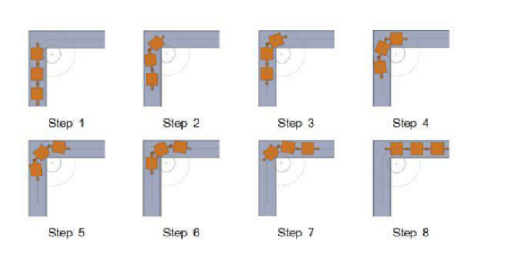
How does the Robot Turn?

Slide 2
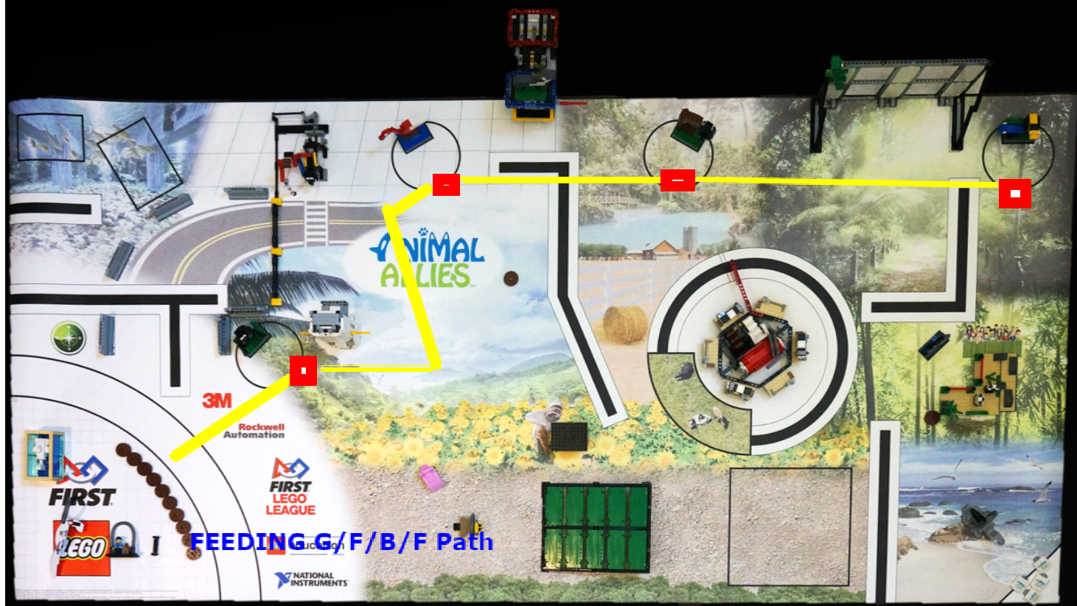
Feeding Gorilla/Bat/Flamingo/Frog

Slide 3
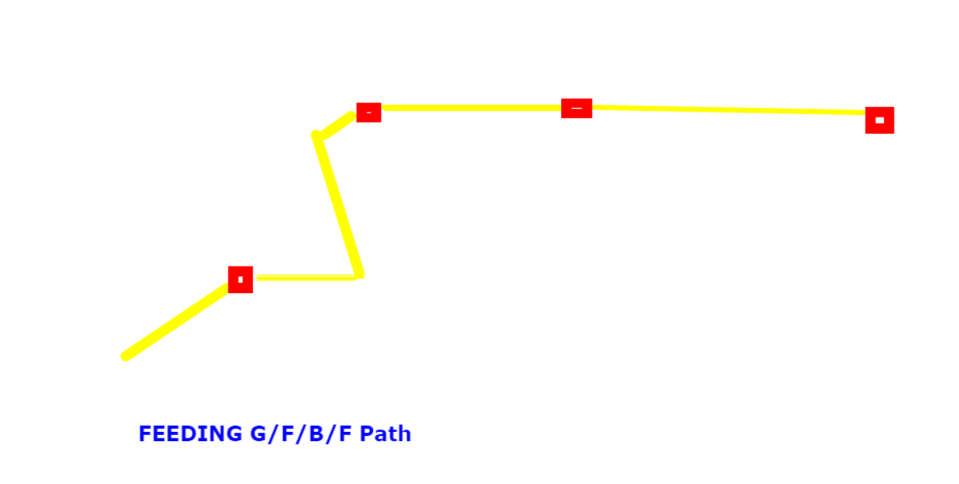
Feeding Gorilla/Bat/Flamingo/Frog

Slide 4
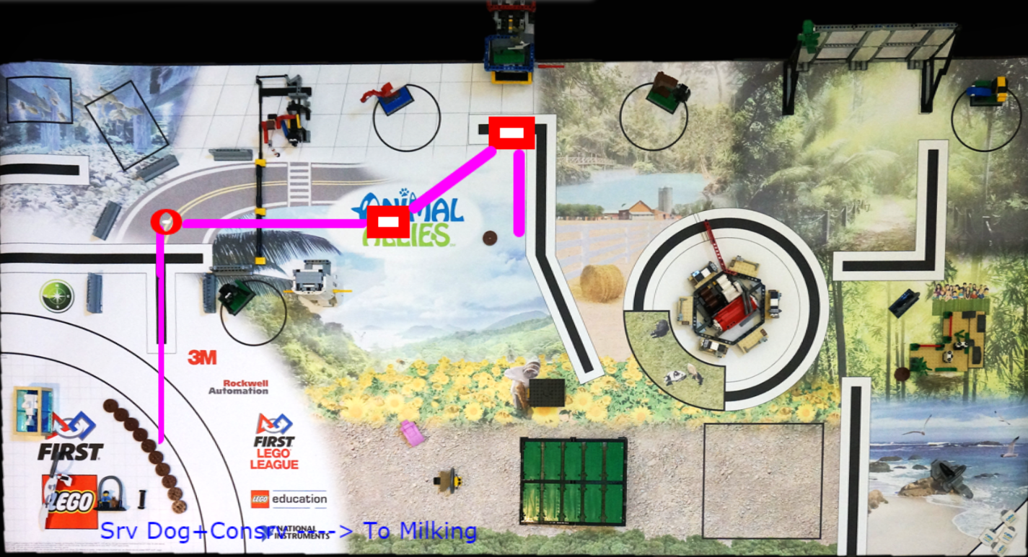
Service Dog + Consrv -> to Milking

Slide 5
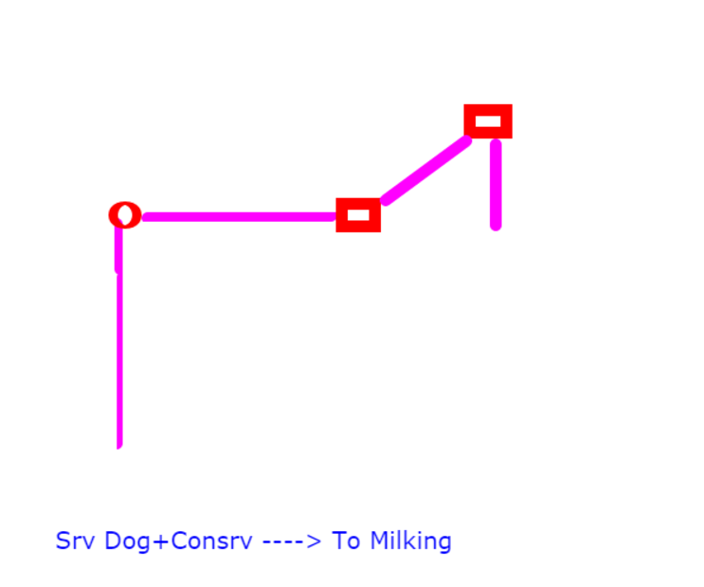
Service Dog + Consrv -> to Milking

