Slide 1
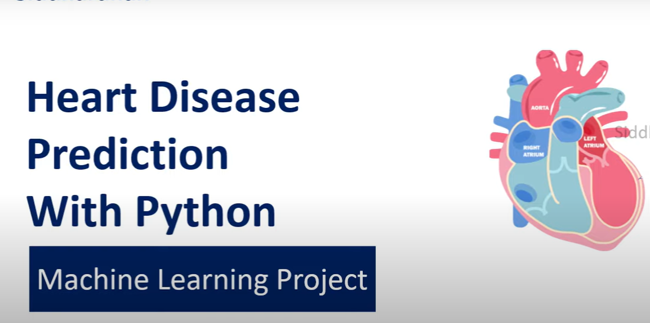
Vansh Rajput (E22CSEU0843)
Gungun Pachauri (E22CSEU1748)
Kushagra Pandey (E22CSEU0845)

Slide 2
Introduction
Heart disease is a leading cause of death globally, requiring early detection for effective treatment.
Machine learning offers efficient and accurate analysis of medical data, aiding in early diagnosis.
By using patient data (ECG, health records), machine learning models can predict heart conditions with high precision.

Slide 3
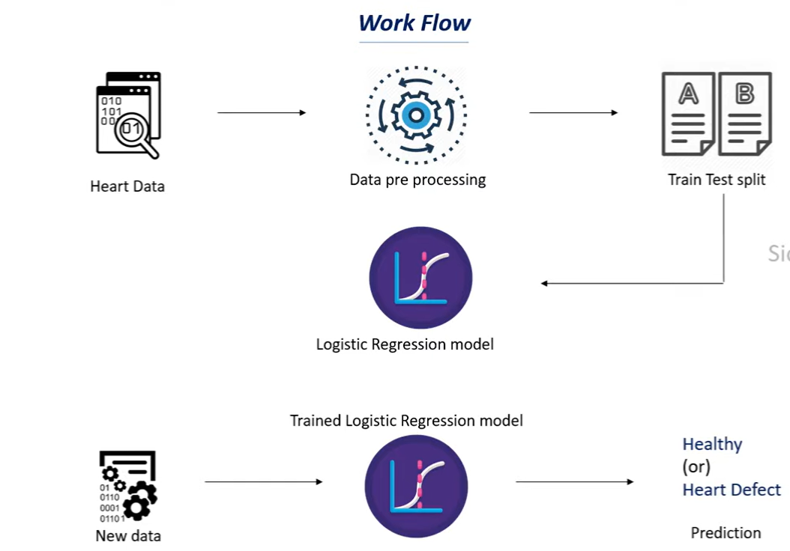

Slide 4

DATASET
Dataset link - https://www.kaggle.com/datasets/johnsmith88/heart-disease-dataset
This data set dates from 1988 and consists of four databases: Cleveland, Hungary, Switzerland, and Long Beach V. It contains 76 attributes, including the predicted attribute, but all published experiments refer to using a subset of 14 of them. The "target" field refers to the presence of heart disease in the patient. It is integer valued 0 = no disease and 1 = disease.

Slide 5
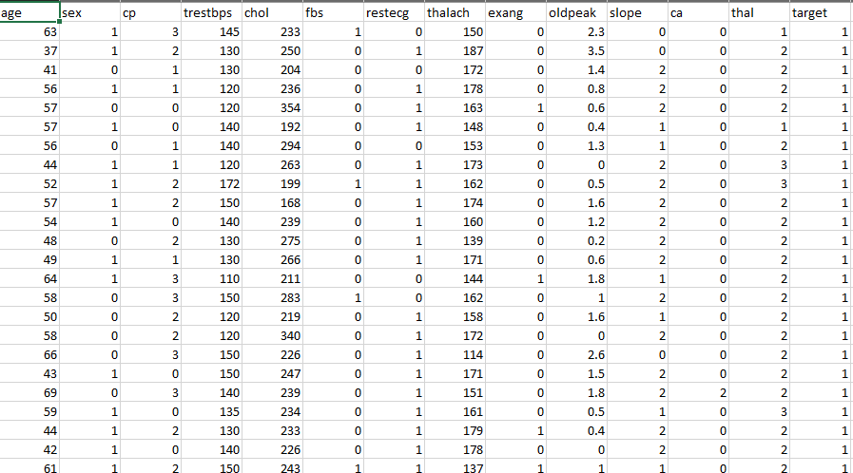
Dataset as csv file

Slide 6
Libraries
NumPy: For numerical operations (arrays, matrices).
Pandas: For loading, cleaning, and manipulating data.
train_test_split: To split the dataset into training and testing sets.
LogisticRegression: For applying logistic regression to classify data.
accuracy_score: To measure how well the model predicts on unseen data.

Slide 7
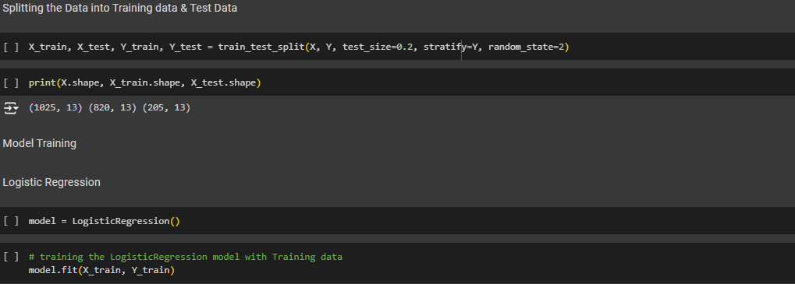
Model Training

Slide 8
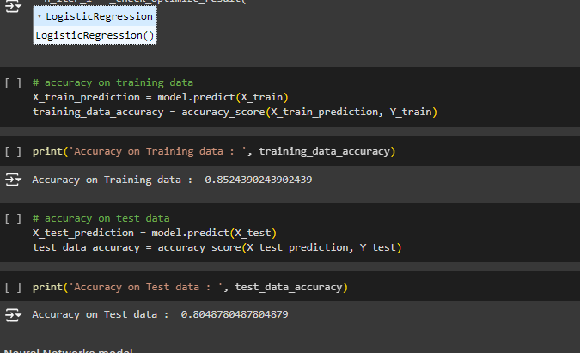
Accuracy Score on train and test data

Slide 9
Future Scope
Training the model on large or various datasets.
Training the model for various other diseases like diabetes, Parkinsons, etc.
Using different training models like Decision tree classifier, Neural networks, etc.
Deploy a practical website that can detect disease after we upload our medical report .

Slide 10
THANK YOU

