Slide 1
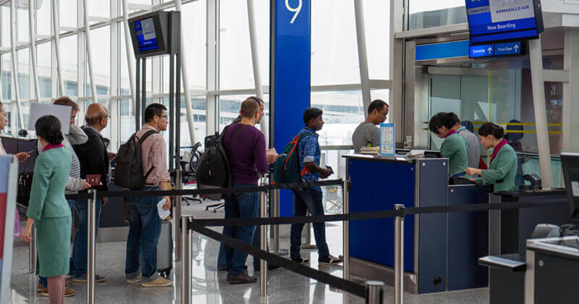
Quicket System
A passive ticketing system designed to reduce queue times across a variety of settings.
Team members: Drew Mohundro, Alex Bigej, Preston May, Carol Pollard, Garrett Smith
Figure 1: Queue
Source: [1]

Slide 2
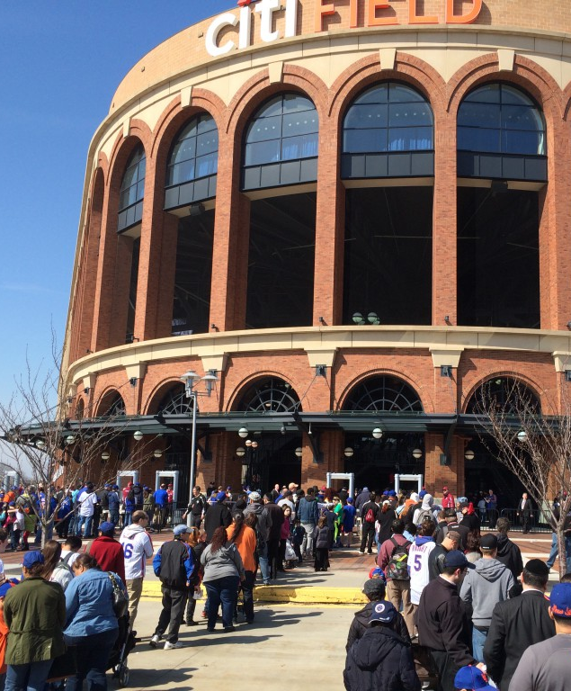
Problem / Opportunity
Long wait times
Increased personnel costs
Hard to keep up with paper tickets
Security measures further slowing entry
Similar devices are expensive and limited on volume
Figure 2: Long Lines
Source: [2]

Slide 3
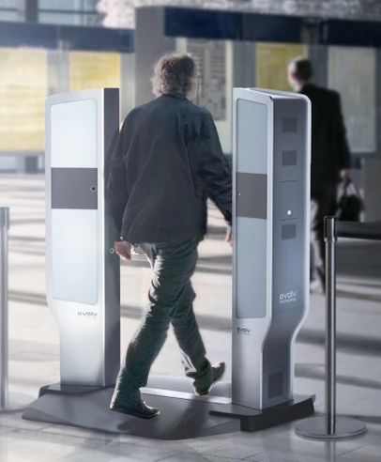
Solution
Sensor reads RFID tag
Controller receives tag ID
System checks account for ticket
Thermal imaging determines person count
LED notification system for any errors
Individuals directed to manual check upon error
Figure 3: Gate
Source: [3]

Slide 4
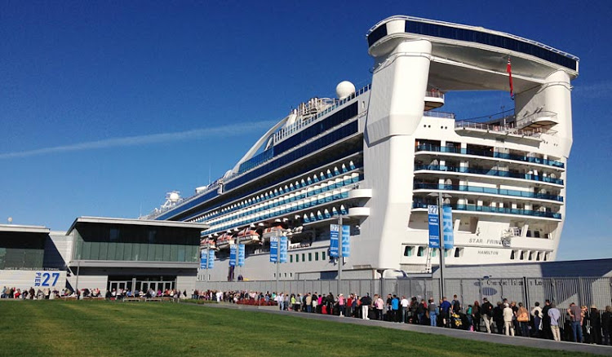
Target Customer
Cruise Ship Lines
Airlines/Airports
Event Planners
Large Venue Owners
Figure 4: Customers
Source: [4]

Slide 5
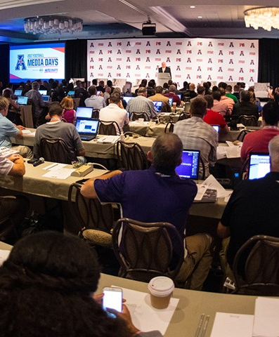
Sales
Demonstrate high reliability and throughput
Target businesses and venues
Allow owners to customize integration
Utilize social media platforms
Figure 5: Conferences
Source: [5]

Slide 6
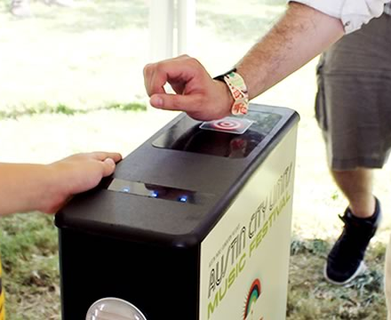
Competitive Advantage
Viable competitors for single-use, unmanned solutions
Also viable competitors for multi-user, manned solutions
The Quicket System offers an unmanned, multi-user solution
Figure 6: RFID Music Festival Gate
Source: [6]

Slide 7
References
[1] "Boarding Gate." Access-IS.com. https://www.access-is.com/boarding (accessed Aug. 31, 2020).
[2] N. DeMause. "Metal Detectors at MLB games proving to be just as bad an idea as everyone feared." Field of Schemes. http://www.fieldofschemes.com/2015/04/07/8776/metal-detectors-at-mlb-games-proving-to-be-just-as-bad-an-idea-as-everyone-feared/ (accessed Aug. 21, 2020).
[3] J. Griffin. "Evolv Technology provides a new way forward in threat detection." SecurityInfoWatch.com. https://www.securityinfowatch.com/perimeter-security/threat-detection-imaging-inspection/article/12426086/evolv-technologyprovides-a-new-way-forward-in-threat-detection (accessed Aug. 31, 2020).
[4] G. Bembridge. "What embarkation day is like." Cruiseable. https://cruiseable.com/what-embarkation-day-is-like-on-a-cruise-ship (accessed Aug. 31, 2020).
[5] "Media Services." The American. http://theamerican.org/sports/2013/8/8/ABOUT_0808134329.aspx?path=about (accessed Aug. 21, 2020).
[6] "Intelligent Control of Meeting and Exhibition tickets." cxjrfidfactory.com. https://www.cxjrfidfactory.com/intelligent-control-of-meeting-and-exhibition-tickets-rfid-ticket (accessed Aug. 31, 2020).

