Slide 1

Nombre del Producto
The QVD Training
Commercial and Sales Training
Virtual Dekstop Demo
Fulanito de Tal
Cargo

Slide 2

Training Overview
Virtual Desktop Demo
Typical end-user experience
User-interface options
Step-by-step guide to loading a virtual desktop

Slide 3
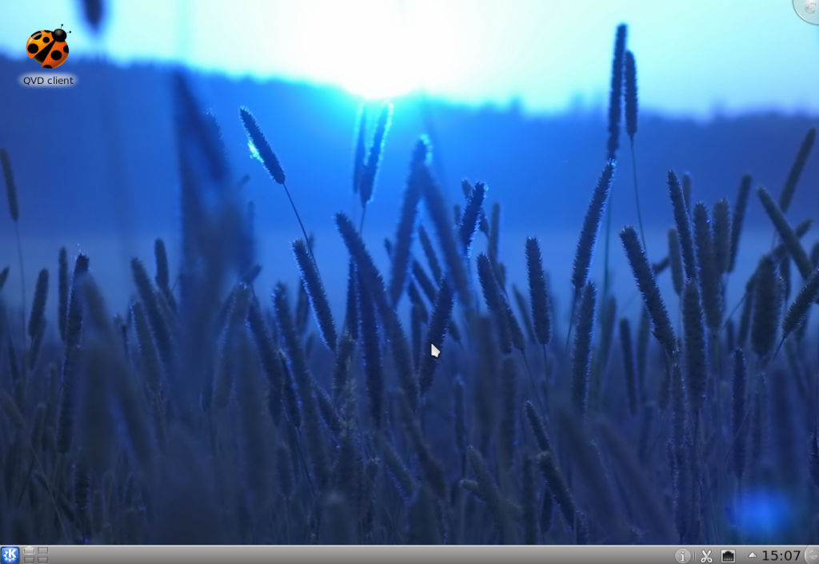
Virtual Desktop Demo
Accessing the Client from a Standard Workstation
The QVD Client can be installed on any Linux or Windows system and can be accessed by clicking on a shortcut to the application...
Click on the QVD Client
desktop shortcut...
...or use the Applications Menu
to locate the client

Slide 4
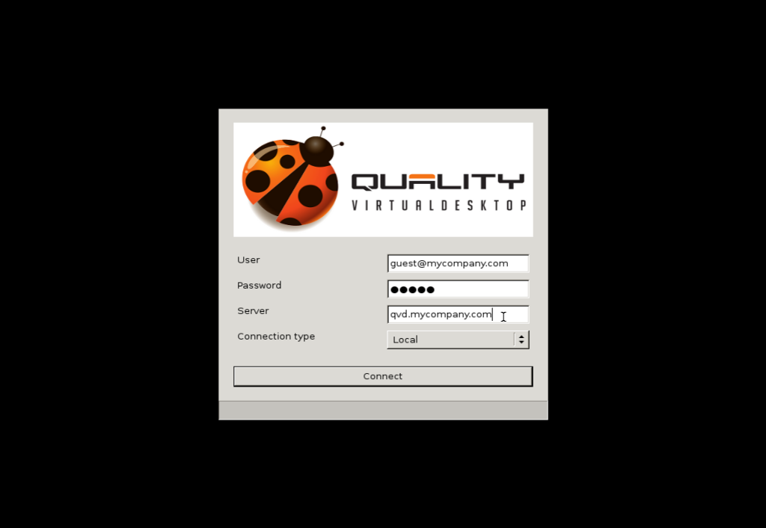
Virtual Desktop Demo
Accessing the Client from a ThinClient
If using a ThinClient setup, ideally the QVD Client should load at boot so that any underlying environment is hidden from the end user...

Slide 5
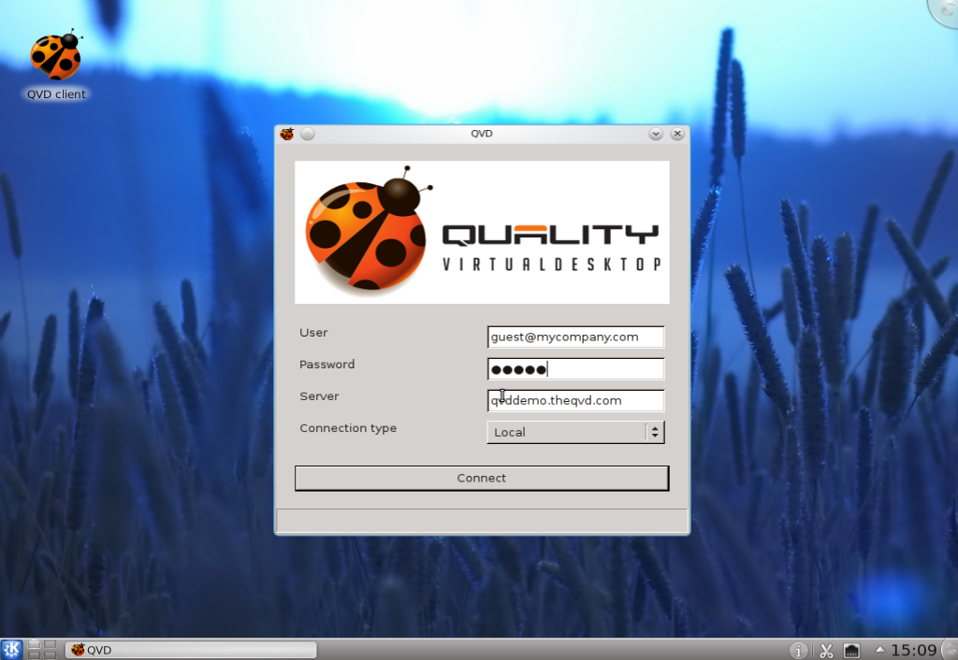
Virtual Desktop Demo
Entering User Credentials
When the client first loads, a panel is displayed allowing a user to enter login credentials, server details and the connection type...

Slide 6
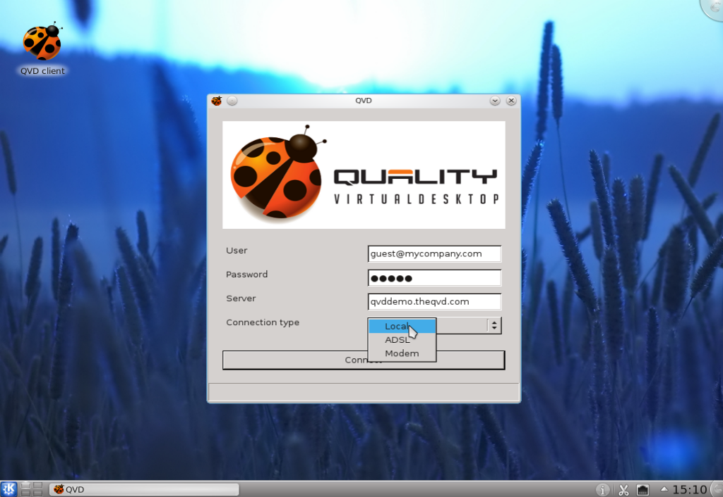
Virtual Desktop Demo
Selecting Connection Type
Depending on your network connectivity you can select a Connection Type from the drop-down menu, to control screen responsiveness vs display quality...

Slide 7
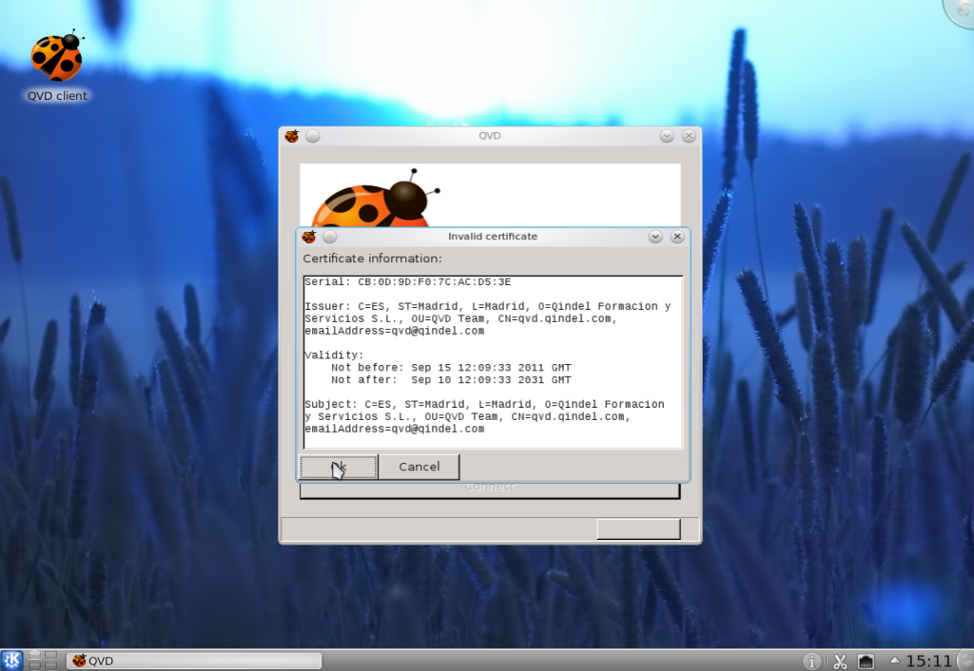
Virtual Desktop Demo
Accepting the Server Certificate
After you click Connect, you will be presented with the QVD Server certificate which will be used to encrypt and secure your connection...

Slide 8
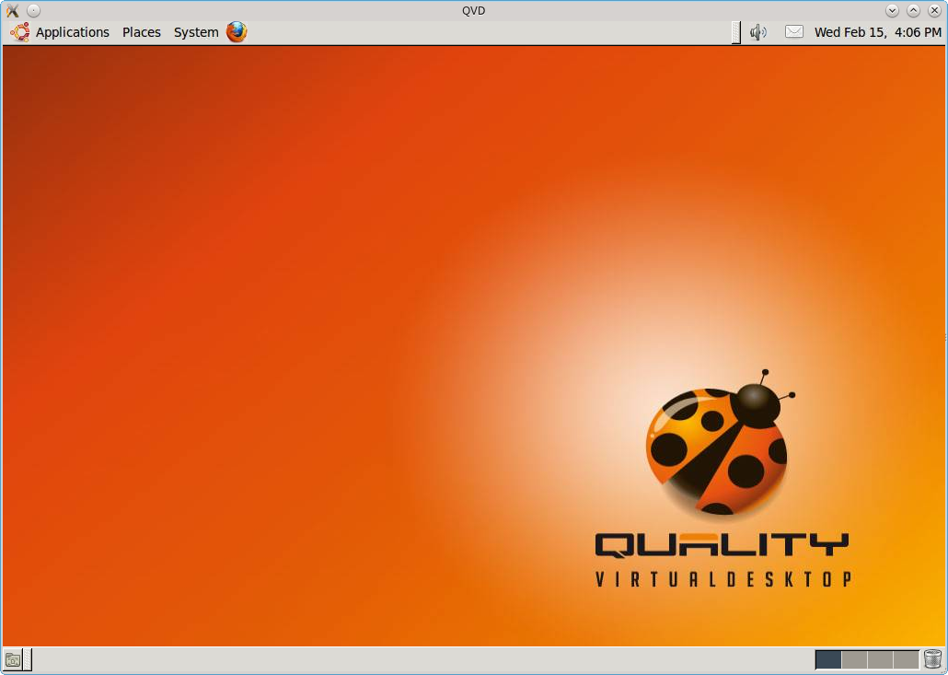
Virtual Desktop Demo
Loading the Virtual Desktop
Once authenticated, the virtual desktop will load within a Window on the your workstation desktop, but can be configured to load in 'fullscreen' mode...

Slide 9
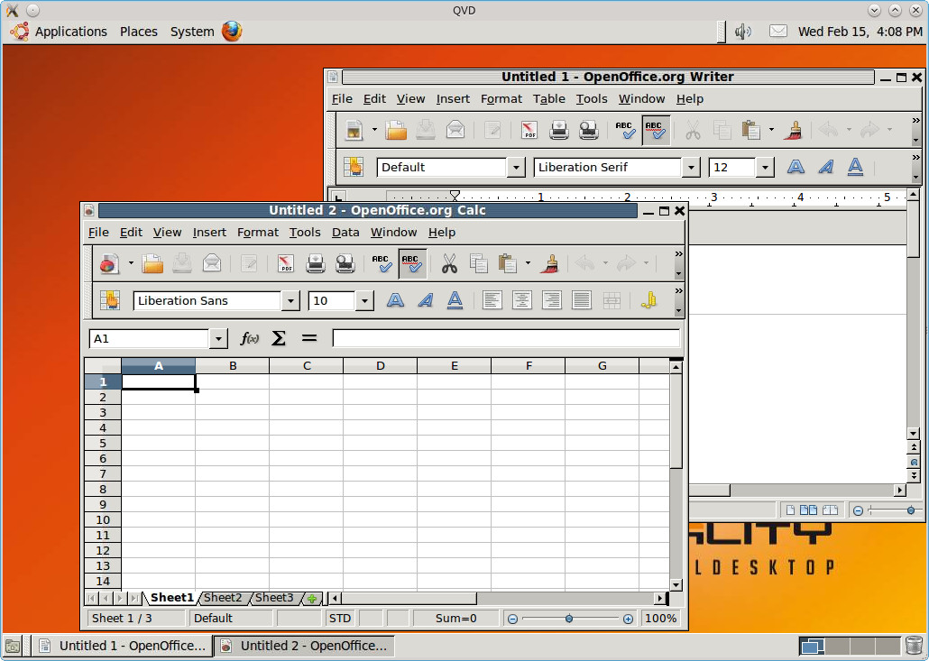
Virtual Desktop Demo
Access your Documents and Applications
Immediately, you will be able to access any documents that you have saved in your Virtual Desktop, and can run any applications available to you...
Run applications
like Firefox,
OpenOffice.org,
or custom Java
apps.

Slide 10
Virtual Desktop Demo
Download the Client and Test the User Experience
This Demo is provided within a slide presentation to demonstrate the QVD VDI in environments where it is not possible to use the live application and demonstration environment.
We encourage you to register on our website to try the QVD for yourself:
http://theqvd.com/product/demo
You can also download the QVD Client from the website at:
http://theqvd.com/product/download#_qvd_gui_client

Slide 11
Qindel Group
http://theqvd.com
Tel: 917662421
Julián Camarillo n.29 Ed D2 4I, 28037 Madrid, España

