Slide 1

Nombre del Producto
The QVD Training
Introduction to QVD
Fulanito de Tal
Cargo

Slide 2

Training Overview
QVD Basics:
What does QVD have to offer?
How does QVD work?
QVD Component Overview
QVD General Architecture
QVD Component Interactions
Underlying Technologies
QVD Component Requirements

Slide 3
QVD Basics
What is QVD?
QVD is Virtual Desktop Infrastructure (VDI) software that facilitates remote virtual desktop access via a client application that connects to a managed server environment where user data, profiles and virtual operating system images are stored.
QVD is primarily oriented toward offering a low-cost and open-source alternative to other mainstream VDI platforms, taking advantage of existing open-source software to provide a robust and versatile environment to deliver virtual desktops to end users while offering a simple and easy-to-use management interface to administrative staff.
Currently, QVD only strives to provide a facility to deliver Linux based virtual desktops within its environment, since we believe that most user requirements can be easily met using Linux software, offering customers much better ROI

Slide 4
QVD Basics
What does QVD have to offer?
QVD provides a complete platform to manage end-user desktop environments, allowing administrative staff to:
  easily manage and provision users
  control software installation and configuration
  have better control over user data backup and recovery
  offer rapid recovery of a desktop environment for end-users
  offer alternative distribution or application access for users
  provide remote access to desktop applications and data
  Implement auditing and logging facilities across your environment
Linux software results in lower software costs offering greater ROI.
QVD provides all of the tools to implement and manage a VDI, including a Layer-7 Router (to broker client sessions) and client application software to access the Virtual Desktops.
Administration can be performed either using the scriptable CLI, or through the user-friendly web-based administration tool.

Slide 5
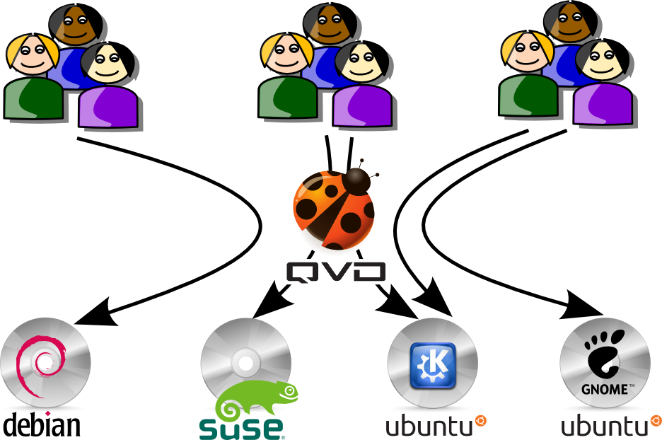
QVD Basics
QVD Users Connect To One or More Virtual Desktops

Slide 6
QVD Basics
How does QVD work?
A virtual Disk Image is created to contain a snapshot of the operating system as it should look to any end user that connects to the virtual desktop
The Disk Image is stored within QVD to serve one or more users
The QVD Database is used to store information about Disk Images and Users, as well as session information and information about different components within the infrastructure
When a user connects to a QVD Node Server, using the QVD Client software, the Node Server authenticates the user and brokers the session so that the user is able to access their desktop
User data is stored in a dedicated virtual disk to provide persistence
From the end-user's perspective the process of logging in will present the desktop environment as if it is running on the local workstation or device that is being used

Slide 7
QVD Basics
An Overview of QVD Components
QVD is comprised of a number of different logical components:
  QVD-DB: the database that is used for different components to interact
  QVD Storage: a shared storage system to allow different components access to virtual disk images and user data
  QVD Node Server: responsible for interfacing with the client software, load-balancing connections, authenticating users, brokering sessions, starting and stopping virtual machines etc
  QVD Web Administration Server: an optional component that eases management of the entire QVD environment
  QVD Client Software: the client application running of a workstation or device to connect a user to their virtual desktop environment

Slide 8
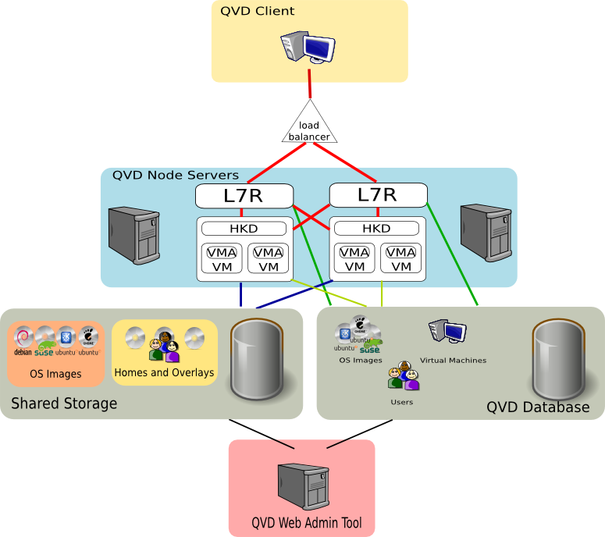
QVD Basics
An Overview of QVD Components

Slide 9
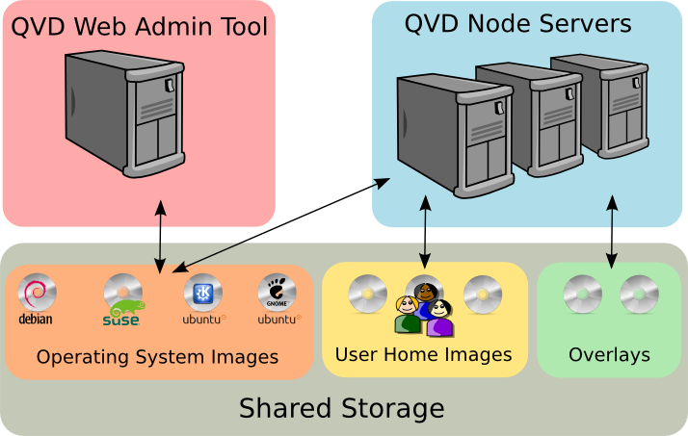
QVD Architecture
Component Interaction: Shared Storage
QVD Server components make use of a Shared Storage facility to access commonly used files such as Operating System Images, User Home Disk Images and Overlay Files

Slide 10
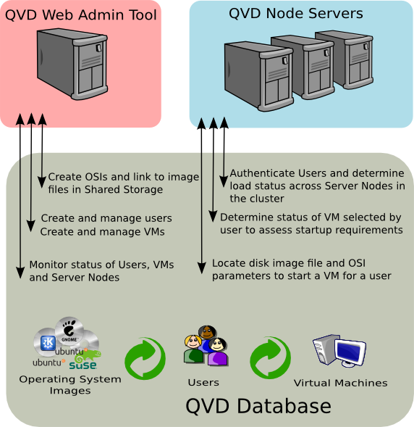
QVD Architecture
Component Interaction: QVD-DB
QVD Server components access a common Database in order to manage users, virtual machines and to keep track of other components in the VDI

Slide 11
QVD Architecture
Component Interaction: QVD Server Nodes
QVD Server Nodes provide end-points that the Client Application connects to in order to authenticate and for session brokerage
Server Nodes are comprised of 2 logical sub-components:
  L7R: the layer 7 router responsible for authenticating users, performing load-balancing and proxying NX connections between client software and the VMA running within a virtual machine
  HKD: the house keeping daemon responsible for starting and stopping virtual machines for users
The L7R and HKD components interact directly with the QVD-DB to perform these duties.
The HKD accesses the Shared Storage in order to access disk images that are required to start a virtual machine appropriately for a user
The L7R will assess load across the cluster of Server Nodes to determine the most appropriate node to route a request to for servicing
The L7R also connects directly to the VMA within a virtual machine

Slide 12
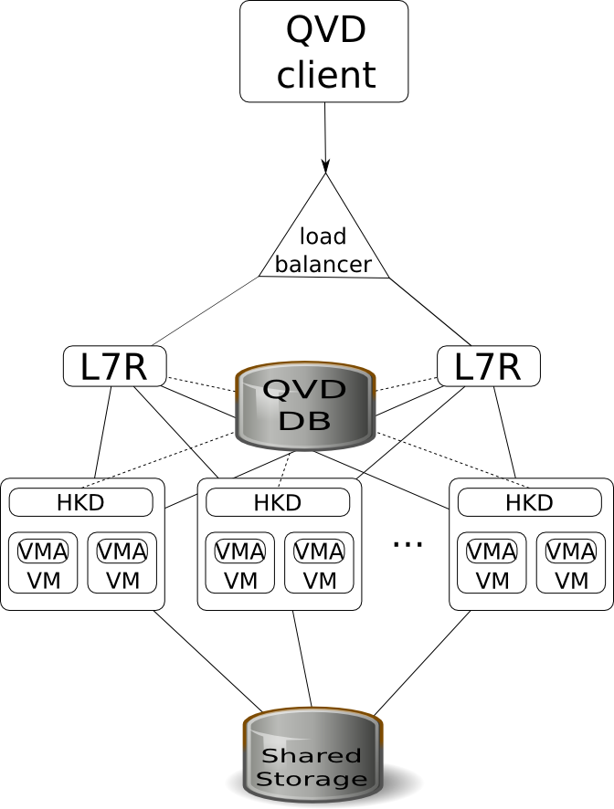
QVD Architecture
Component Interaction: QVD Server Nodes

Slide 13
QVD Architecture
Underlying Technologies – Shared Storage
QVD supports any networked shared storage facility that can be mounted within a Linux filesystem
Typical usage takes advantage of the following network file systems: NFS, OCFS2 or GFS2
Mount points should be identical on all component systems within the infrastructure, as system paths for QVD are defined within the QVD-DB
By default mount points are as follows:
  /var/lib/qvd/storage/homes: user home images
  /var/lib/qvd/storage/images: operating system images
  /var/lib/qvd/storage/overlays: overlay images
  /var/lib/qvd/storage/staging: staging directory for unloaded images

Slide 14
QVD Architecture
Underlying Technologies – Database
QVD uses the PostGreSQL database to store its data
Documentation is available to describe basic database management functions including backup, restore and basic database setup
Training includes guidelines for setting up a database cluster
Perl scripts are included with the software to initialize and populate the database with the appropriate tables and base data

Slide 15
QVD Architecture
Underlying Technologies – Web Admin Tool
QVD uses the Apache licensed Perl Catalyst Framework in order to implement its Web Administration Tool
Authentication of administration users is handled within the QVD-DB
A Perl script is provided to manage the infrastructure from the command-line, making the Web Admin Tool an optional component within the infrastructure

Slide 16
QVD Architecture
Underlying Technologies – Server Node (HKD)
The QVD HKD, that runs within each QVD Server Node, is capable of loading virtual machines using QEMU/KVM functionality:
  KVM: provides a full kernel-based virtual machine environment, which offers absolute separation from the underlying operating system.
The approaches to building Operating System Images varies according to the technology that you choose to make use of
QCow2 images are used to store Home directories and to handle Overlay requirements
Future versions of the software will support alternative virtualization technology such as LXC, which is less resource hungry than KVM, but is more dependent on the underlying operating system.

Slide 17
QVD Architecture
Underlying Technologies – Virtual Machine Agent
The VMA which runs within each virtual machine and which is installed into an Operating System Image is written in Perl
The VMA loads an nxagent that is responsible for redirecting X Server video output across the network using the NX protocol
The VMA makes use of PulseAudio's networked audio facility to redirect audio output to a connecting client
The VMA makes use of CUPS to handle the redirection of printer traffic to local printers within the client's network environment

Slide 18
QVD Architecture
Underlying Technologies – Server Node (L7R)
The L7R component that runs within a server node is written in Perl
Authentication modules can be easily added to the L7R. By default authentication is performed against user data held in the QVD-DB, but LDAP and OpenSSO/OpenAM support is available. Alternative authentication modules can be easily developed.
A custom built load-balancing algorithm handles the distribution of connections across the cluster. This is written in Perl and accesses the QVD-DB to determine load across nodes in the cluster. Alternative implementations are possible.
The L7R makes use of the nxproxy software to facilitate client connectivity to the VMA within a running virtual machine.

Slide 19
Qindel Group
http://theqvd.com
Tel: 917662421
Julián Camarillo n.29 Ed D2 4I, 28037 Madrid, España

