Slide 1

Nombre del Producto
The QVD Training
Database Setup and Configuration
Fulanito de Tal
Cargo

Slide 2

Summary of Training
Database Setup:
Installation
Config files (postgres)
Database Creation and Deployment
Redeploy the database
Database Administration:
How to: start/stop/check, connect to the database
Backup and restore of database
Logs and rotation
Advanced Database Topics:
HA Database Clustering
Database Schema
Bootstrapping QVD Components

Slide 3
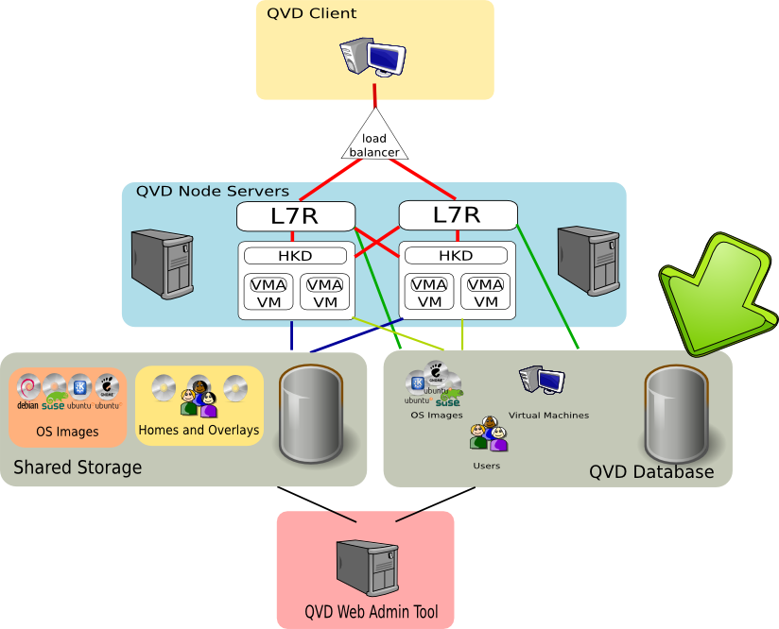
Summary of Training

Slide 4
Database Setup
Installing QVD-DB and PostGreSQL
QVD makes use of PostGreSQL as its database management system
QVD provides a 'qvd-db' package that includes PostGreSQL among its core dependencies, so in order to install the database on a fresh Ubuntu system, you need to run the following commands:
On a fresh SuSE Linux system, it is possible to install the QVD Database by running the following commands:
* Note: There is no requirement to install a QVD package on the database system, as the database can be deployed into an existing environment. The package will simply make things easier.
# sudo apt-add-repository 'deb http://theqvd.com/debian lucid main'
# sudo apt-get update
# sudo apt-get install qvd-db
# sudo zypper ar http://download.opensuse.org/repositories/home:/qvd:/qvd-3.0/SLE_11_SP1 QVD
# sudo zypper refresh
# sudo zypper install qvd-db

Slide 5
Database Setup
PostGreSQL Configuration Changes
Edit your PostGreSQL Configuration files to support QVD. Under Ubuntu, these can be found in /etc/postgresql while under SuSE Linux they are stored in /var/lib/pgsql/data
To support concurrent connections from multiple QVD Server Nodes. Edit 8.4/main/postgresql.conf to ensure that this parameter is set as follows:
Also configure PostGreSQL to listen on all interfaces
To enable network access for a particular PostGreSQL server, edit 8.4/main/pg_hba.conf to include the user and network address that it will be using:
default_transaction_isolation = 'serializable'
listen_addresses = '*'
host qvd qvd 192.168.0.0/24 md5

Slide 6
Database Setup
Database Creation and Deployment
To create a user for the database, or to manage database users use the following commands:
To create a database and assign a user:
QVD comes with a database provisioning script qvd-deploy-db.pl. Running the script will populate the database. Running it with the --force parameter will entirely reinitialize the database, dropping existing tables and data.
# sudo su - postgres
# createuser -P qvd
# createdb -O qvd qvd

Slide 7
Database Administration
General Database Commands
Usually your Linux distribution will provide an init script that will allow you to stop, start, restart and check the status of a running PostGreSQL server. Under Ubuntu, running the following will give you an idea of basic system commands:
The Ubuntu Community web pages provide additional basic Database management information at: https://help.ubuntu.com/community/PostgreSQL
# /etc/init.d/postgresql
Usage: /etc/init.d/postgresql {start|stop|restart|reload|force-reload|status} [version ..]

Slide 8
Database Administration
Backup and Restore
PostGreSQL provides a variety of tools that make it relatively simple to create backups and to restore databases.
To backup a database to file run the following:
To restore a database from file you can do the following:
You can also pipe from one database to another:
See http://www.postgresql.org/docs/8.3/static/backup-dump.html
# sudo su - postgres
# pgdump qvd > QVDDatabase.sql
# sudo su - postgres
# pgsql qvd < QVDDatabase.sql
# pgdump -h host1 qvd | pgsql -h host2 qvd

Slide 9
Database Administration
Logs and Rotation
On Ubuntu, PostGreSQL keeps database logs in: /var/log/postgresql/
On SuSE, PostGreSQL keeps database logs in: /var/lib/pgsql/data/pg_log

Slide 10
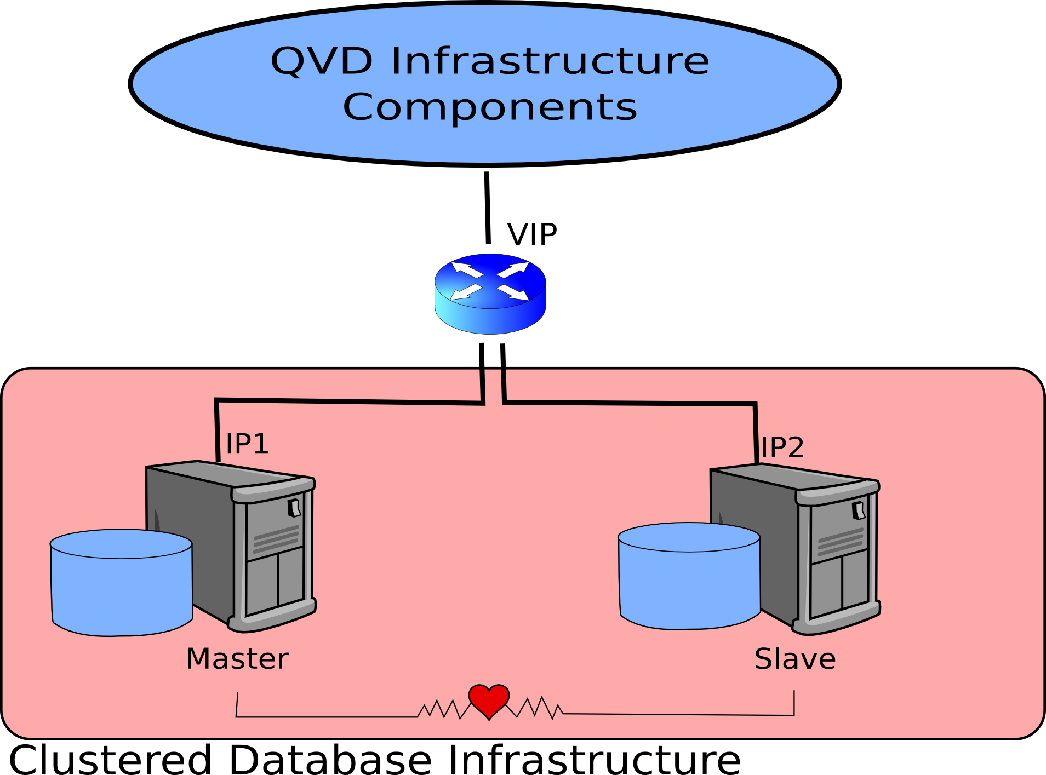
Advanced Topics
HA Clustering
In production environments it is fairly usual to take advantage of HA clustering to ensure that the QVD Database is capable of handling load and is always available
It is fairly easy to set up your own
clustering environment for
PostGreSQL using Pacemaker
and Corosync.
QVD provides instructions to
guideyou through setting up
your own cluster as a separate
optional training module

Slide 11
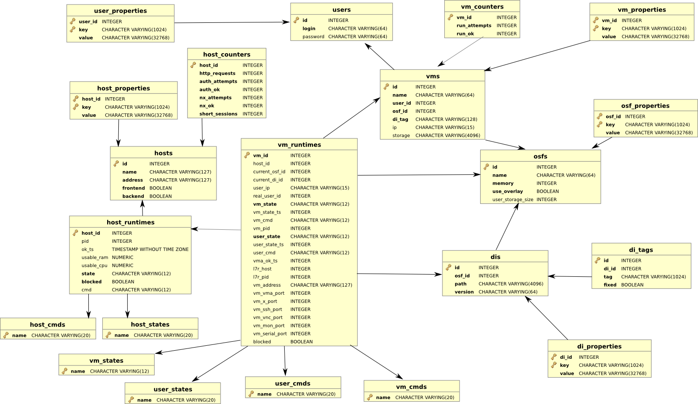
Advanced Topics
QVD Database Schema

Slide 12
Bootstrapping QVD
Bootstrapping
All server-side components require access to the QVD-DB.
Bootstrapping options are stored in '/etc/qvd/node.conf'
Typical Configuration options are:
Other parameters specific to a host can be stored in the bootstrapping configuration file, but matching options within the QVD-DB will have precedence.
# nodename: the name of the machine running this configuration file
# database.host: where the QVD database is found
# database.name: the name of the QVD database
# database.user: the user account needed to connect
# database.password: the password needed to connect

Slide 13
Qindel Group
http://theqvd.com
Tel: 917662421
Julián Camarillo n.29 Ed D2 4I, 28037 Madrid, España

