Slide 1

Nombre del Producto
The QVD Training
Database Clustering
Fulanito de Tal
Cargo

Slide 2
Advanced Topics
HA Clustering
In production environments it is fairly usual to take advantage of HA clustering to ensure that the QVD Database is capable of handling load and is always available
It is important that all UDP traffic is free to flow between servers in the cluster and that any switches or routers between servers allow Multicast traffic
The following instructions will help you to set up an HA cluster for PostGreSQL using the Pacemaker and Corosync tools
To set up your apt sources and to install the required packages, do the following on each node in your cluster:
# sudo apt-add-repository 'deb http://people.debian.org/~madkiss/ha lenny main'
# sudo apt-get update
# sudo apt-get install openais corosync pacemaker

Slide 3
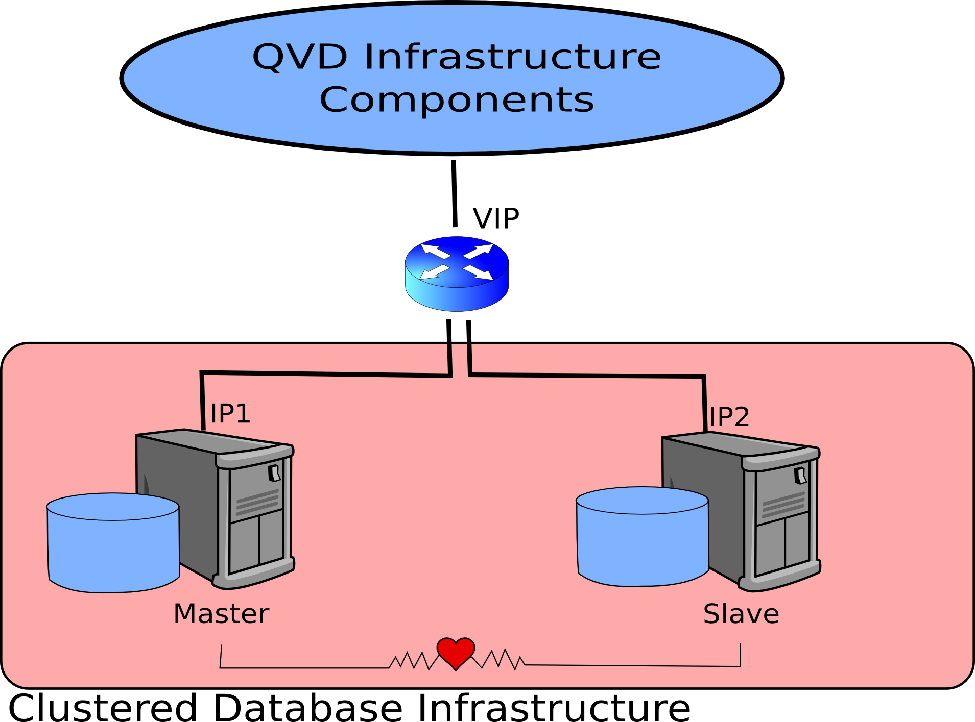
Advanced Topics
HA Clustering

Slide 4
Advanced Topics
HA Clustering ...continued...
Create an 'authkey' and share it across nodes in your cluster. To create an authkey do the following on the first node in your cluster:
Now copy the generated key to the other nodes in your cluster:
On each host, ensure that the authkey is put into the correct folder and assigned the correct permissions:
# sudo corosync-keygen
# scp /etc/corosync/authkey node2:/tmp
# sudo mv /tmp/authkey /etc/corosync/authkey
# sudo chown root:root /etc/corosync/authkey
# sudo chmod 400 /etc/corosync/authkey

Slide 5
Advanced Topics
HA Clustering ...continued...
On each node, configure the file /etc/corosync/corosync.conf to update the network interface information to match your local network addressing:
Note that the direction of bindnetaddr is a logical "and" of the mask ipadress and machines that make up the cluster.
interface {
# The Following values need to be based on your environment...
ringnumber: 0
bindnetaddr: 172.20.64.0
mcastaddr: 226.94.1.1
mcastport: 5405
}
consensus: 3600

Slide 6
Advanced Topics
HA Clustering ...continued...
To increase logging for your cluster (at least while you get to grips with it) you can configure the same file, /etc/corosync/corosync.conf, with the following parameters:
logging {
FileLine: on
to_stderr: yes
to_logfile: yes
to_syslog: yes
syslog_facility: daemon
debug: on
timestamp: on
{logger_subsys
subsys: AMF
debug: on
tags: enter | leave | trace1 | TRACE2 | TRACE3 | trace4 | trace6
}

Slide 7
Advanced Topics
HA Clustering ...continued...
Enable Corosync by editing the /etc/default/corosync file and changing the value of the START parameter to 'yes'
Then start the cluster on each node and check the status:
Time to configure resources and set some basic settings:
At the prompt, disable the 'stonith' resource type, which can cause problems with resources:
Now you will need to configure the resource. In this example, the VIP that will be assigned to the resource is 172.20.64.93
# sudo /etc/init.d/coroync start
# sudo crm_mon - one-shot-V
# sudo crm
crm(live)#
crm(live)# configure
crm(live) configure # property stonith-enabled=false
crm(live) configure # primitive nodedb ocf:heartbeat:IPaddr params ip=172.20.64.93 op monitor interval=10s

Slide 8
Advanced Topics
HA Clustering ...continued...
Configure the iscsi resource which the filesystem is dependent on
First, disable authentication in /etc/iscsi/iscsid.conf
Now set up the resource in corosync:
Note that the portal and target parameters will be specific to your own environment.
Start the resource:
crm(live)configure# primitive iscsi-db ocf:heartbeat:iscsi params portal="nodeiscsi"\
target="iqn.1998-10.com.qindel:qvd.storage.db" op monitor interval="10"\
timeout="120" depth="0" op start interval="0" timeout="120s" op stop interval="0" timeout="120"
crm(live)configure# commit
crm(live)configure# cd ..
crm(live)# resource
crm(live)# start iscsi-db

Slide 9
Advanced Topics
HA Clustering ...continued...
Check that you can access the resource and that you can migrate it across different nodes
Note that you should check if the resource is accessible on node2 before unmigrating it:
# ls -l /dev/disk/by-path/ip-172.20.64.90:3260-iscsi-iqn.1998-10.com.qindel:qvd.storage.db-lun-0
# sudo iscsiadm-m session
tcp: [17] 172.20.64.90:3260,1 iqn.1998-10.com.qindel: qvd.storage.db
# sudo crm resource migrate iscsi-db node2
# sudo crm resource unmigrate iscsi-db

Slide 10
Advanced Topics
HA Clustering ...continued...
Configure the Filesystem resource, which the PostGreSQL service will be dependent on:
# sudo crm
crm(live)# configure
crm(live) configure # primitive fs-db ocf:heartbeat:Filesystem params\
device="/dev/disk/by-path/ip-172.20.64.90:3260-iscsi-iqn.1998-10.com.qindel:qvd.storage.db-lun-0"\
directory="/var/lib/postgresql/db" fstype="ext4" op start interval="0" timeout="60" op stop interval="0"\
timeout="60" op monitor interval="10" timeout="40" depth="0"
crm(live) configure # commit
crm(live) configure # location fs-loc fs-db 100: node1
crm(live) configure # commit
crm(live) configure # cd ..
crm(live) # resource
crm(live) # start fs-db

Slide 11
Advanced Topics
HA Clustering ...continued...
Before continuing with your cluster configuration, you will need to prepare the PostGreSQL server on all of the nodes in the cluster.
First, stop the server from running on the node
Now edit the config in /etc/postgresql/8.4/main/postgresql.conf to include the following lines:
Note that the listen address now includes the VIP for the cluster
Now clean up the filesystem and recreate the database:
data_directory = '/var/lib/postgresql/db'
external_pid_file = '/var/lib/postgresql/db/postmaster.pid'
listen_addresses = 'localhost,172.20.64.93'
# rmdir /var/lib/postgresql/db/lost+found
# su - postgres
$ /usr/lib/postgresql/8.4/bin/initdb -A ident -D /var/lib/postgresql/db
$ exit
# mkdir /var/lib/postgresql/db/lost+found

Slide 12
Advanced Topics
HA Clustering ...continued...
Under Debian based systems, you need to fix a few symlinks and remove some unwanted files:
Finally, lets create a QVD user, role and database:
And set the permissions for the database
# ln -s /etc/ssl/certs/ssl-cert-snakeoil.pem /var/lib/postgresql/db/server.crt
# ln -s /etc/ssl/private/ssl-cert-snakeoil.key /var/lib/postgresql/db/server.key
# rm /var/lib/postgresql/db/pg_hba.conf /var/lib/postgresql/db/pg_ident.conf
# su - postgres
$ createuser -S -D -R -l -P -E qvd
$ createdb -O qvd qvd
$ exit
# echo 'host qvd qvd 172.20.64.93/32 md5' >> /etc/postgresql/8.4/main/pg_hba.conf

Slide 13
Advanced Topics
HA Clustering ...continued...
Now we can configure the PostGreSQL service within the cluster:
# sudo crm
crm(live)# configure
crm(live) configure # primitive postgresql ocf:heartbeat:pgsql params pgctl="/usr/lib/postgresql/8.4/bin/pg_ctl"\
pgdata="/var/lib/postgresql/db" logfile="/var/log/postgresql/postgresql-8.4-main.log"\
pgdb="qvd" start_opt="-c config_file=/etc/postgresql/8.4/main/postgresql.conf"\
op start interval="0" timeout="120" op stop interval="0" timeout="120"\
op monitor interval="30" timeout="30" depth="0" meta target-role="Started"
crm(live) configure # verify
crm(live) configure # commit
crm(live) configure # cd ..
crm(live) # resource
crm(live) # start postgresql

Slide 14
Advanced Topics
HA Clustering ...continued...
If all has gone well, we can set up the order in which resources are started, the colocation, and we can group the resources:
Finally, to make the resource group migrate when a node loses connectivity:
crm(live)# configure
crm(live) configure # order ip-iscsi-order mandatory: ptemdb iscsi-db
crm(live) configure # order iscsi-fs-order mandatory: iscsi-db fs-db
crm(live) configure # order fs-db-order mandatory: fs-db postgresql
crm(live) configure # colocation ip-iscsi-colo inf: ptemdb iscsi-db
crm(live) configure # colocation iscsi-fs-colo inf: iscsi-db fs-db
crm(live) configure # colocation db-fs-colo inf: postgresql fs-db
crm(live) configure # group db_group ptemdb iscsi-db fs-db postgresql
crm(live) configure # commit
crm(live) configure # primitive pingd ocf:pacemaker:pingd params host_list=10.1.0.1\
multiplier=100 op monitor interval=15s timeout=5s
crm(live) configure # clone pingdclone pingd meta globally-unique=false
crm(live) configure # location db_group_on_connected_node db_group\
rule -inf: not_defined pingd or pingd lte 0
crm(live) configure # commit

Slide 15
Advanced Topics
HA Clustering ...continued...
Your cluster should now be functional. You can manage resources within your cluster using the following commands:
If a resource is in trouble and fails, it is necessary to clean it after you have fixed the problem:
More information on clustering with Pacemaker can be found here:
http://www.clusterlabs.org/wiki/Documentation
# sudo crm
crm(live) # resource
crm(live) resource# start db-group
crm(live) resource# stop db-group
crm(live) resource# migrate db-group node2
crm(live) resource# unmigrate db-group
# sudo crm
crm(live)# resource
crm(live) resource# cleanup iscsi-db

Slide 16

Qindel Group
http://theqvd.com
Tel: 917662421
Julián Camarillo n.29 Ed D2 4I, 28037 Madrid, España

