Slide 1

Nombre del Producto
The QVD Training
QVD Nodes
Fulanito de Tal
Cargo

Slide 2

Summary of Training
Server Side Configuration:
HKD (House Keeping Daemon)
How to start/stop the daemon.
How the KVM is started
About overlays, base qcows etc
Changing Log levels
Extra configuration items
L7R (Layer 7 Routing Daemon)
How to start/stop the daemon.
How to check the daemon (see the /qvd/ping URL for healthchecks, in case of loadbalancers)
How to include authentication plugins and to chain them: Default, auto and LDAP at least.

Slide 3
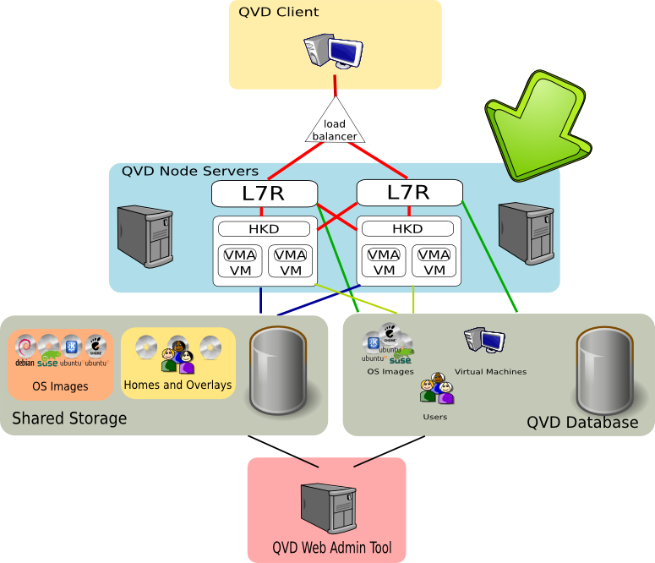
Summary of Training

Slide 4
Basic Info about QVD Nodes
HKD:
  The House Keeping Daemon that runs on each QVD Server Node is responsible for starting and stopping virtual machines for users as required. The HKD must keep track of the status of a VM at all times and is required to update the QVD-DB when the status of a VM changes.
L7R:
  The Layer 7 Routing Daemon will authenticate a user using the appropriate authentication module that it has loaded, and will use the load-balancing algorithm to determine which node server would be best suited to loading a virtual machine for a user (if a virtual machine has not already been started for that user). Once authenticated, the L7R will proxy NX traffic between the VMA within the virtual machine and the workstation client software

Slide 5
QVD Node Configuration
Bootstrapping Parameters:
  Both the HKD and the L7R need to connect to the QVD database in order to access other global configuration parameters and runtime data. The basic bootstrapping parameters are usually stored in `/etc/qvd/node.conf`, and contain the information required to connect to the QVD database.
Configuration Parameters:
  Most configuration parameters for the QVD are stored in the QVD-DB, which is used to define global behaviour within a solution. These parameters are usually set using the 'qvd-admin.pl' command-line interface utility.
Network Configuration:
  IP Forwarding is enabled withing the kernel
  A network bridge is created and managed using brctl
  DHCP service is enable to provision Virtual Machines

Slide 6
Bootstrapping QVD
Bootstrapping
All server-side components require access to the QVD-DB.
Bootstrapping options are stored in /etc/qvd/node.conf
Typical Configuration options are:
Other parameters specific to a host can be stored in the bootstrapping configuration file, but matching options within the QVD-DB will have precedence.
# nodename: the name of the machine running this configuration file
# database.host: where the QVD database is found
# database.name: the name of the QVD database
# database.user: the user account needed to connect
# database.password: the password needed to connect

Slide 7
QVD Node Basic Commands
Starting and Stopping Server Node Components
In general, you can rely on Noded to handle the starting and stopping of the other QVD Server Node components:
The following configuration settings can be used to control how the HKD and L7R are started:
# /etc/init.d/qvd-node start
# /etc/init.d/qvd-node stop
# hkd.as_user: user that the HKD should run as
# hkd.pid_file: path to the PID file for the HKD, used to start, stop and check the status of the HKD
# l7r.as_user: the user that should be used to run the QVD L7R daemon
# l7r.use_ssl: whether or not to make use of SSL to encrypt client connections
# l7r.port: the port that should be listened on for client connections to the L7R
# l7r.address: the IP address that the L7R should bind to
# l7r.pid_file: the path to the PID file that is created when the L7R daemon is running

Slide 8
HKD and VMs
How the HKD starts and stops Virtual Machines
The HKD is designed to perform a variety of checks during the process of starting and stopping a Virtual Machine, to help with health-checking and reporting
Machine States are stored within the QVD DB for each VM, and determine which commands the HKD will perform an action for
Commands are delivered to the HKD via the database and are triggered by various events (e.g. actions within the QVD-WAT, or connections made to an L7R by a client)
In the case of a KVM/QEMU-based VM, the HKD will run a KVM instance according to the parameters set for the OSF within the database. Typically, the virtual machine might be started with the following base parameters:
# kvm -m 1024M -name qvd/20/test-19 -net nic,macaddr=54:52:00:14:7b:eb,model=virtio \
-net tap,fd=3 -serial telnet::2001,server,nowait,nodelay -nographic \
-drive file=/var/lib/qvd/storage/overlays/6-20-overlay.qcow2,index=0,media=disk,if=virtio,boot=on

Slide 9
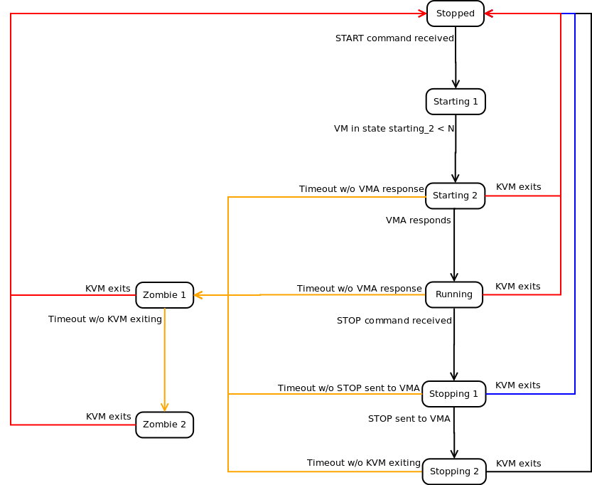
HKD: VM Runtime States
VM Runtime Workflow

Slide 10
HKD: Workflow for a VM
VM Runtime Workflow ...continued...
Machine States reported by the HKD for Virtual Machines:
  Stopped: the VM is not running on any host
  Starting 1: the HKD has received the start command but is waiting until it has the resources available to move to the next machine state
  Starting 2: the VM has been started but the boot process has not yet completed
  Running: the VM is running on a host
  Stopping 1: the HKD received the stop command but is waiting for the VMA within the VM to respond to the request
  Stopping 2: the VMA has responded to the stop request and the VM is in the process of shutting down
  Zombie 1: The VM is running but is not responding, a TERM signal has been sent to the process
  Zombie 2: The VM is running but is not responding, a KILL signal has been sent to the process

Slide 11
QVD Node Basic Commands
Starting and Stopping Server Node Components
Virtual Machine parameters (largely used by HKD):
Note that options that are specific to LXC virtualization will only be available in the 3.1 release of the software, which is still in development
# vm.hypervisor: used to describe which virtual machine hypervisor should be used (LXC/KVM)
# vm.lxc.unionfs.type: if using LXC, this setting will describe which COW filesystem to use (LXC)
# vm.overlay.persistent: whether to keep overlay images from one session to the next
# vm.kvm.virtio: if using KVM, whether to make use of virtio capabilities
# vm.vnc.redirect: whether to provide KVM VNC availability
# vm.vnc.opts: options for KVM VNC support
# vm.serial.redirect: whether to provide KVM serial port facility
# vm.serial.capture: whether to capture serial port traffic to file (KVM and LXC)
# vm.network.bridge: the network bridge interface that all VMs will be attached to
# vm.network.device.prefix: used to set LXC's lxc.network.veth.pair parameter
# vm.network.ip.start: the starting IP of the range of network addresses used by VMs

Slide 12
L7R-Client Interaction
How the L7R interacts with the QVD Client
Common architecture for a deployment would include multiple QVD Server Nodes running behind a Load Balancer within a cluster
The L7R receives connections from a client and performs the following tasks:
  Route Client Connection: the client connection is re-routed to the most appropriate Server Node to handle the request, according to the Load-balancing algorithm.
  Authenticate User: the L7R checks settings within the DB and determines what authentication mechanism should be used. By default, the L7R will authenticate users against user data held in the DB, but may alternatively use another authentication plugin such as the LDAP authentication module.
  Initialize VM in Database: if a VM is not already running for the user, the L7R will update the DB to reflect that one should be started, prompting the HKD to load KVM
  Proxy NX Connection: the L7R connects to the VMA running within the VM on the users behalf and then proxies an NX session on behalf of the client

Slide 13
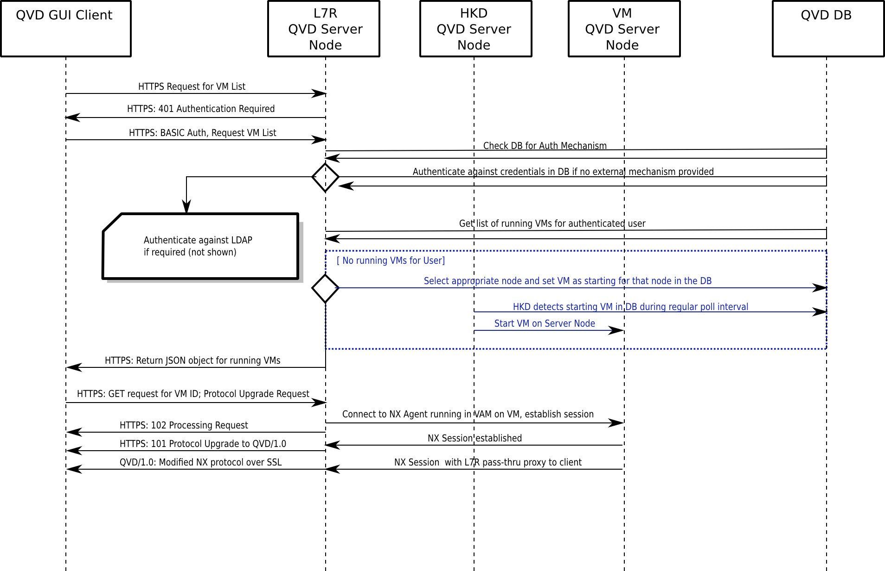
L7R-Client Interaction
Client/Server Node Process Workflow

Slide 14
L7R Load Balancing
L7R Load Balancing Architecture
QVD includes its own Load Balancing algorithm to control where new VMs are started and how to reroute connections
L7R Load Balancing is handled by an independent plugin that can be replaced if an alternative algorithm is required, a simple API is provided to allow for external development
The default algorithm is calculated based on a combination of the following factors:
        the weighted sum of free RAM
        the weighted sum of unused CPU
        and a weighted random value for added entropy
By changing the weighting of these variables, it is possible to control how VMs are started across the cluster based on your resource requirements

Slide 15
L7R Load Balancing
L7R Load Balancing Options
Load Balancing weights are stored as configuration options within QVD-DB and can be modified to change behaviour
Increasing the weight on the RAM variable will add precedence to systems with more available RAM.
Increasing the weight on the CPU variable will add precedence to systems with more available CPU.
Increasing the weight on the random variable will increase the likelihood that a more random server node will be selected.
# qvd-admin.pl config set l7r.loadbalancer.plugin.default.weight.ram=3
# qvd-admin.pl config set l7r.loadbalancer.plugin.default.weight.cpu=3
# qvd-admin.pl config set l7r.loadbalancer.plugin.default.weight.random=3

Slide 16
L7R Authentication
L7R Authentication Modules
By default the L7R authenticates users directly against the data held within the QVD-DB, however this authentication framework is handled as a module and can easily be replaced by an alternative framework
QVD includes pre-built modules to support LDAP authentication and to add functionality to the authentication process
Plugins can be chained together so that they run in sequence, allowing you to fall back to an alternative authentication framework, or initialize some behaviour based on the success or failure of an authentication. For example:
will cause the L7R to load three authentication modules, Auto, NotifyByMail and LDAP
# l7r.auth.plugins: can be used to provision additional authentication plugins
# qvd-admin.pl config set l7r.auth.plugins=auto,notifybymail,ldap

Slide 17
L7R Authentication
LDAP Authentication
If the LDAP Module is loaded, the L7R will first search for the user's DN within the LDAP directory using the configuration information provided in the QVD-DB. Once the DN has been found, the L7R will attempt to perform a BIND on behalf of the user using the password provided in the original authentication request
The following configuration options exist for the LDAP Authentication Module
If using LDAP Auth, you will need to create matching users within your QVD-DB in order to assign virtual machines to them
Note that changing User Passwords in the QVD-WAT will not have any effect on LDAP credentials
# l7r.auth.ldap.host: Hostname/IP Address and optionally the port number to connect to LDAP
# l7r.auth.ldap.base: The Base DN against which searches will be performed
# l7r.auth.ldap.scope: The scope of a search (usually 'sub')
# l7r.auth.ldap.filter: A filter for the search. Usually something like (|(uid=%u)(cn=%u))

Slide 18
Plugins and Modules
Writing your own
As already mentioned, it is possible to write your own plugins to handle different behaviours within a Server Node, such as Authentication or Load Balancing
An API is provided to allow you to interact with the database and the various other QVD components
It is possible to create additional properties for elements within the database, such as users, which will allow you to store additional information for your own plugins. For example, you may want to modify the LDAP Authentication plugin to obtain the BindDN mapping for a user directly from the database. In which case, you would store the BindDN as a property of the user
Parameters from within a plugin can be passed between the L7R and the VMA running on a virtual machine, so that activities taking place outside of the VM can control events within the VM
This topic is covered in more detail in the Advanced Configuration Training Module

Slide 19
Qindel Group
http://theqvd.com
Tel: 917662421
Julián Camarillo n.29 Ed D2 4I, 28037 Madrid, España

