Slide 1

Nombre del Producto
The QVD Training
QVD Disk Images and the VMA
Fulanito de Tal
Cargo

Slide 2

Summary of Training
Disk Image Types:
KVM/QEMU
LXC Images
Disk Image Creation:
Creating a KVM Image for a Linux Distribution
Mandatory packages and configuration
Common Package Requirements
VMA Configuration:
Common configuration options (Audio, Printing etc)
VMA Hooks

Slide 3
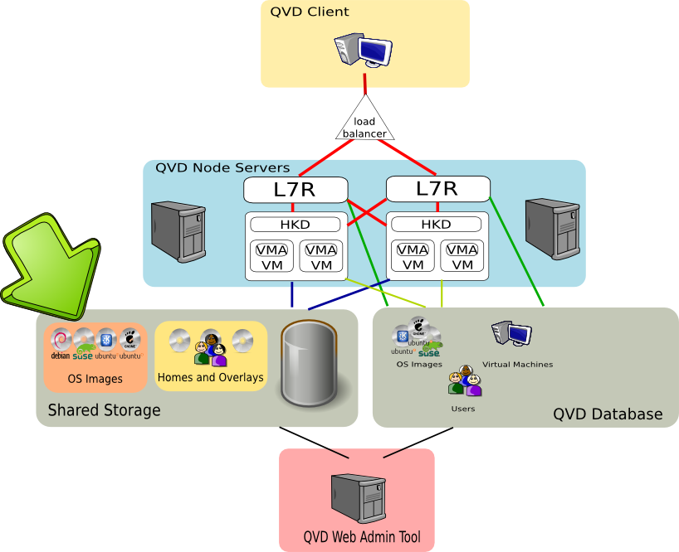
Summary of Training

Slide 4
Disk Image Types
KVM/QEMU
KVM/QEMU style disk images offer full-scale virtualization allowing the virtual machine to run a distinct kernel with dedicated resources made available to it
The disk images make use of the QCOW2 disk image format
LXC (v3.1)
LXC Images will only be implemented in the forthcoming release and will currently not work with existing deployments. They are mentioned here for the purpose of distinguishing the technologies involved.
LXC style disk images require that the virtual machine share the host kernel in an advanced CHROOT type of environment, allowing for better resource management and more flexible control over resource allocation
LXC disk images are TAR files that represent the filesystem for the CHROOT environment that will be created

Slide 5
Disk Image Creation (KVM)
Commands and requirements
KVM Disk Images are qcow2 images, usually created using the qemu-img tool, or the kvm-img tool. This tool is available in the qemu-kvm package under Ubuntu.
QVD Disk Images can be created easily in the following way:
The size of a QVD Disk Image does not include home directories, since these are handled separately by the QVD infrastructure.
The qcow2 image format has a small initial footprint, but will be capable of growing to the maximum size specified
To install a Linux operating system into the qcow2 image, load it into a KVM virtual machine and attach the installation ISO to the cdrom interface:
# kvm-img create -f qcow2 example.img 4G
kvm -hda example.img -cdrom ubuntu-10.10-alternate-i386.iso -m 512

Slide 6
Disk Image Creation (KVM)
Commands and Requirements ...Continued...
Once you have completed installation, you will need to include the QVD repositories within your apt sources inside of the disk image.
Install the required qvd-vma package.
Install any other packages and perform any other required configuration within the image as needed (we will cover VMA configuration soon).
To configure serial port access for Administrator access to a running VM, edit /etc/init/ttyS0.conf to match the following:
# sudo apt-add-repository 'deb http://theqvd.com/debian lucid main'
# sudo apt-get update
# sudo apt-get install qvd-vma'
start on stopped rc RUNLEVEL=[2345]
stop on runlevel [!2345]
respawn
exec /sbin/getty -L 115200 ttyS0 xterm

Slide 7
Disk Image Creation (KVM)
Commands and Requirements ...Continued...
At any point in the future you may want to edit the image to add or remove programs, change configuration options or implement security policies. To do so, run:
When all configuration is complete and you are ready to use the image, Ensure that it is as small as possible to transfer across the network. To do this, remove any unnecessary files and clean up the image. e.g. apt-get clean; etc. Then do the following to shrink the image file:
# kvm -hda example.img -m 512
# kvm-img convert -O qcow2 -c example.img clean_example.img

Slide 8
Disk Image Creation
Common Package Requirements
QVD uses CUPS (Common Unix Printing System) and its ability to share printer resources across a network. Therefore, in order to take advantage of shared printings capabilities, CUPS would need to be installed within the Disk Image and the appropriate drivers for any shared printers would also need to be configured
QVD makes use of the PulseAudio sound system in order to facilitate access to audio resources within the virtual machine. In order for client workstations to be able to access audio, PulseAudio must be installed and set up properly within the Disk Image.

Slide 9
Disk Image Creation
Common Package Requirements
QVD uses CUPS (Common Unix Printing System) and its ability to share printer resources across a network. Therefore, in order to take advantage of shared printings capabilities, CUPS would need to be installed within the Disk Image and the appropriate drivers for any shared printers would also need to be configured
Printer sharing with Windows Workstations may require that Samba (SMB) is installed and configured within the Image.
QVD makes use of the PulseAudio sound system in order to facilitate access to audio resources within the virtual machine. In order for client workstations to be able to access audio, PulseAudio must be installed and set up properly within the Disk Image.

Slide 10
VMA Configuration
Common Configuration Options
The VMA is the QVD Virtual Machine Agent that runs within a Virtual Machine and is installed into the Disk Image that the Virtual Machine is loaded from.
The VMA includes common configuration options that allow you to configure things like audio and printer sharing.
VMA configuration options are specified within /etc/qvd/vma.conf on the disk image.
The following common configuration options are available:
# vma.audio.enable: whether to enable audio sharing using PulseAudio via the nxagent (1=enabled)
# vma.printing.enable: whether to enable printer sharing via the nxagent (1=enabled)
# vma.pid_file: path to the VMA PID file
# vma.user.home.drive: the device that contains home directories (e.g. /dev/vdb)
# vma.user.home.fs: the filesystem that should be used when autoprovisioning homes (e.g. ext4)
# vma.user.home.path: the path where the virtual home device will be mounted to
# vma.user.default.name: the default username for the vma user
# vma.user.default.groups: the groups that the vma user belongs to

Slide 11
VMA Configuration
VMA Hooks
VMA Hooks can be used to trigger actions or scripts based on particular events or activities that take place within the Virtual Machine
These are useful for a wide variety of purposes including Auditing and Notifications, Additional Provisioning and Configuration etc.
VMA Hooks can be configured by adding them to the VMA configuration file /etc/qvd/vma.conf on the disk image
Hooks are categorized in the following ways:
State Hooks – Related to different states that the VM enters
Provisioning Hooks – Related to user provisioning
Event Hooks – Related to events taking place within the VM
The following State Hooks exist:
# vma.on_state.connected: executable to be run just before a client is connected to the VM
# vma.on_state.suspended: executable to be run when a client's connection to the VM is suspended
# vma.on_state.disconnected: executable to be run when a client is disconnected from the VM

Slide 12
VMA Configuration
VMA Hooks ...Continued...
Provisioning Hooks will be called each time a VM is started for a particular user and can be useful to perform additional configuration and provisioning, such as automatically adding network mount points etc.
Event Hooks are useful for troubleshooting and auditing and can be used to control running behaviour:
# vma.on_provisioning.mount_home: executable to be run when the user's home directory is mounted
# vma.on_provisioning.add_user: executable to be run before the user is added to the VM instance
# vma.on_provisioning.after_add_user: executable to be run after the user has been added to the VM
# vma.on_action.pre-connect: when a client has initiated a connection but it has not been established
# vma.on_action.connect: when the client establishes the connection
# vma.on_action.stop: when the VM has been stopped, this executable will be run first
# vma.on_action.disconnect: when a client has disconnected from the VM
# vma.on_action.suspend: when the VM has been told to suspend
# vma.on_action.poweroff: when the VM has been told to shutdown or poweroff

Slide 13
Qindel Group
http://theqvd.com
Tel: 917662421
Julián Camarillo n.29 Ed D2 4I, 28037 Madrid, España

