Slide 1

Nombre del Producto
The QVD Training
QVD Administration
Fulanito de Tal
Cargo

Slide 2

Summary of Training
Common Admin Tasks using the WAT:
Adding and Editing Images
Adding and Editing Server Nodes
Adding a User and Attaching VMs
VM admin (Start, Stop, Block and Unblock)
Serial Port Access to a VM
Common Admin Tasks using the CLI:
Working with general Configuration Variables
Adding and Editing Images
Adding and Editing Server Nodes
Adding a User and Attaching VMs
VM admin (Start, Stop, Block and Unblock)
Access to a VM (Serial, SSH and VNC)

Slide 3
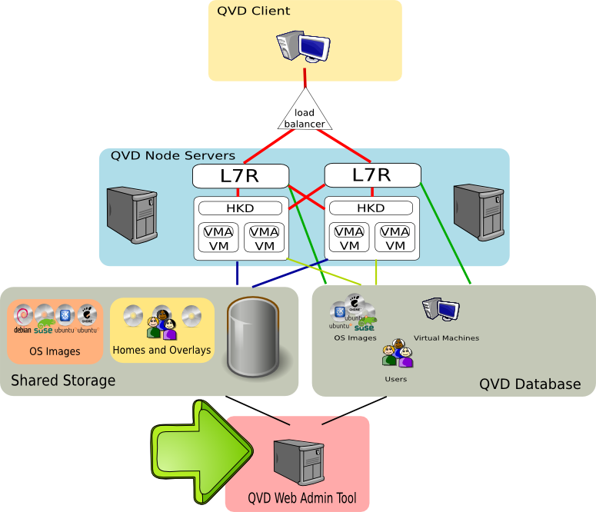
Summary of Training

Slide 4
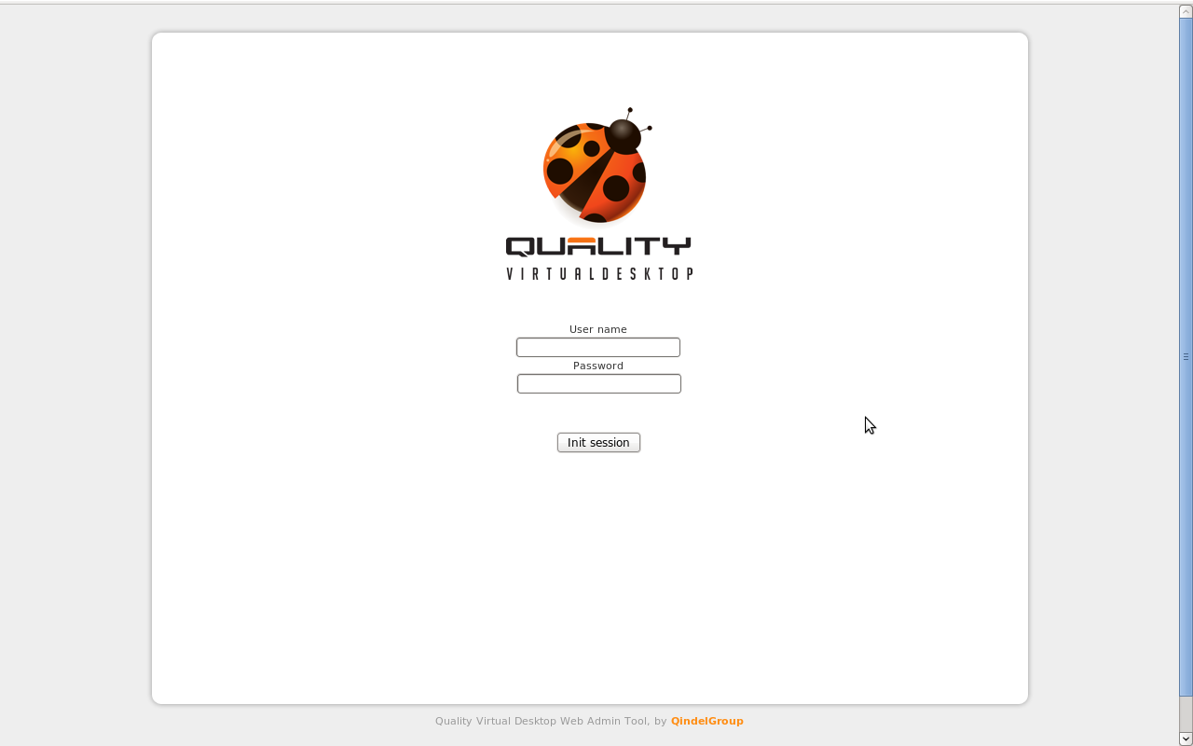
Accessing QVD-WAT
Default URL Port and Login Credentials:
  Open a web browser to: http://qvd-wat.server.ip:3000/
  Where qvd-wat.server.ip is the IP address or hostname of the server that is hosting the QVD-WAT service
  The default login credentials are: admin/admin

Slide 5

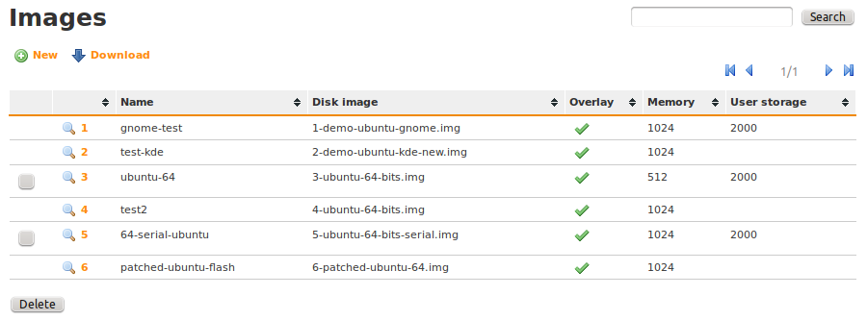
QVD-WAT: Managing Images
Images can be managed by clicking on the Images link
You can add New Images, Edit existing Images and Delete Images
Note that you are unable to Delete an Image if it has been assigned to an active Virtual Machine

Slide 6
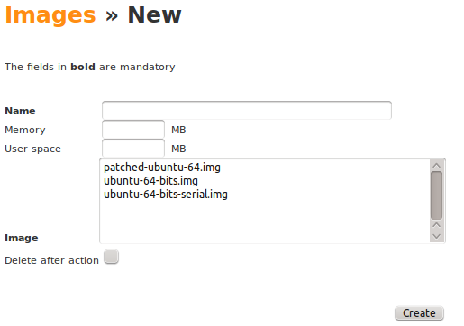
QVD-WAT: Managing Images
When adding a New Image, the image file that you wish to load should be in the Staging folder within the shared storage location
You should specify a Name for the Image, the Memory that will be allocated to the image within each running VM, and the size of a user Home image that will be created for each user that uses this image to access a virtual desktop

Slide 7

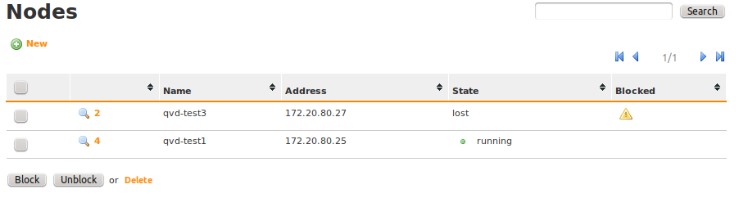
QVD-WAT: Managing Nodes
Nodes can be managed by clicking on the Nodes link
You can add New Nodes, Edit existing Nodes and Delete Nodes
It is also possible to Block or Unblock access to a Node, for the purpose of maintenance work
Nodes can be automatically Blocked if they become inaccessible

Slide 8
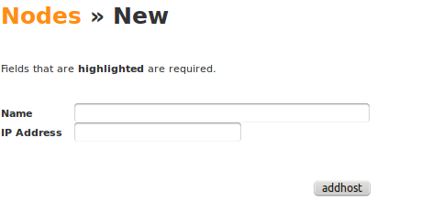
QVD-WAT: Managing Nodes
Adding New Nodes to the cluster is as simple as providing the IP address for the host, and a name to identify the Node

Slide 9

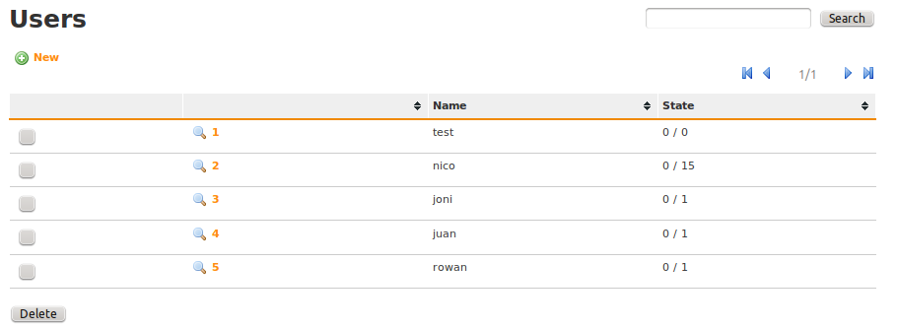
QVD-WAT: Managing Users
Users can be managed by clicking on the Users link
You can add New Users, Edit existing Users and Delete Users

Slide 10
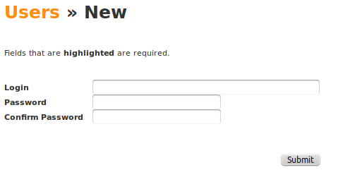
QVD-WAT: Managing Users
Adding a New User is as Simple as specifying a user Login name and Password
If you choose to make use of an external authentication mechanism such as LDAP, users will still need to be added to the database, and accounts will need to be mapped

Slide 11
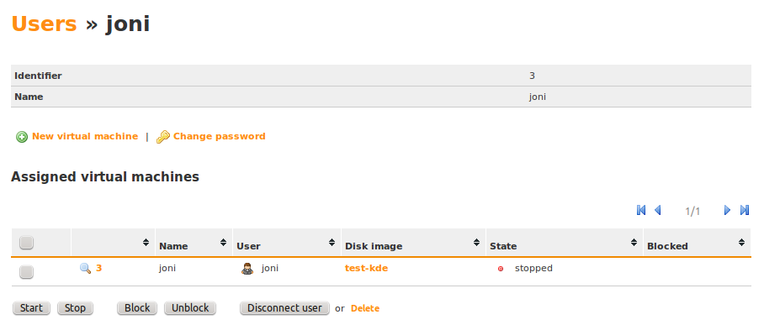
QVD-WAT: Managing Users
Once a User has been added, you can edit the user to Change Password or to manage the Virtual Machines that have been assigned to the user
You are also able to create New Virtual Machines for users

Slide 12
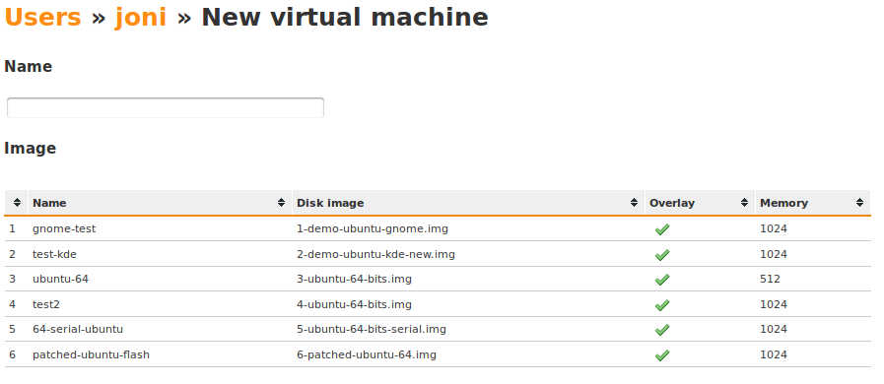
QVD-WAT: Managing VMs
Adding a New VM is usually done directly from inside of the User view within the WAT
It only requires that you specify a name for the VM and attach a specified Disk Image

Slide 13

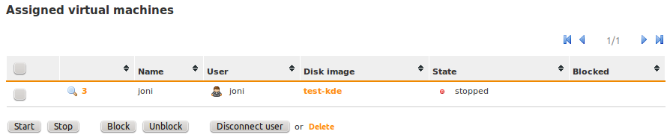
QVD-WAT: Managing VMs
It is possible to Manage VMs either by selecting a specific user under the Users link (to get only the VMs associated with a specific user) or by clicking on the Virtual Machines link
From the list of VMs, it is possible to perform a number of tasks including manually starting or stopping a VM, Blocking or Unblocking access to a VM, Disconnecting the user, or removing the VM permanently
You can also view the running state of any VM in the list
By clicking on the VM ID and magnifying glass icon, you can view the details for a VM

Slide 14
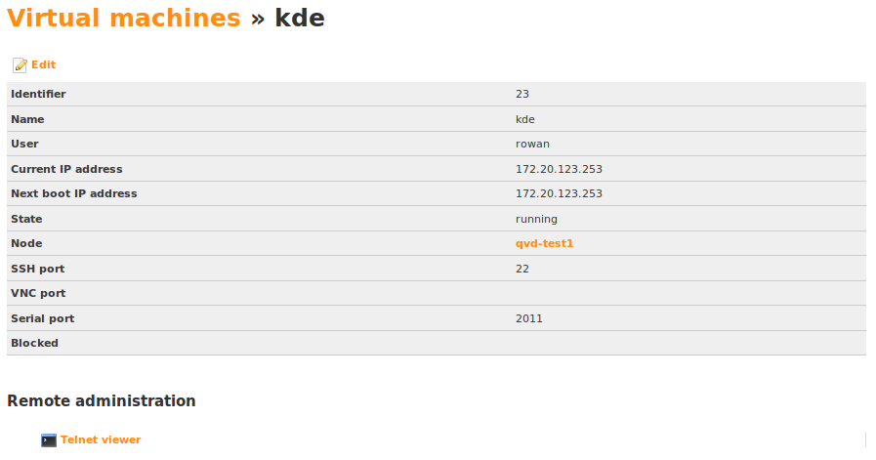
QVD-WAT: Managing VMs
While Viewing a VM, you can see useful administrative information, including the node where the VM is running, the IP address that it is using and the port to which you can telnet in order to access the serial terminal of the VM
A Java applet is accessible via the Telnet Viewer link, which will allow you to directly access the Serial Port for a running VM

Slide 15
QVD Admin CLI
QVD provides a CLI utility that allows you to administer all of the components and configuration options within a running deployment: qvd-admin.pl
All of the actions that can be performed using the QVD-WAT can be performed using the CLI utility, making QVD entirely scriptable
The utility requires that the /etc/qvd/node.conf file exists on the system where it is run, and that this file includes the parameters required to access the database
A complete list of commands and actions available using this utility can be obtained by simply running the script without any arguments:
config del
config get
config set
config ssl
osi add
osi del
osi list
host add
host block
host del
host list
host propdel
host propget
host propset
host unblock
user add
user del
user list
user passwd
user propdel
user propget
user propset
vm add
vm block
vm console
vm del
vm disconnect_user
vm edit
vm list
vm propdel
vm propget
vm propset
vm ssh
vm start
vm stop
vm unblock
vm vnc

Slide 16
QVD Admin CLI
Working with Configuration Variables
The majority of QVD's configuration variables are stored within the QVD database and are managed using the QVD Admin CLI Utility.
Commonly, you will be required to configure networks parameters using commands like:
You may also use the QVD Admin CLI Utility to set the WAT username and password:
To obtain a complete list of currently configured variables do:
# qvd-admin.pl config set vm.network.ip.start=10.1.0.50
# qvd-admin.pl config set vm.network.netmask=16
# qvd-admin.pl config set vm.network.gateway=10.1.0.1
# qvd-admin.pl config set vm.network.bridge=qvdnet0
# qvd-admin.pl config set wat.admin.login = admin
# qvd-admin.pl config set wat.admin.password = c0mplExP455woRD
# qvd-admin.pl config get

Slide 17
QVD Admin CLI
Adding and Editing Images
In general, adding and editing Images using the CLI utility requires root privileges as the disk image file is copied to or deleted from a read-only storage area
In order to Add an Image using the CLI utility, the system that the command is run from must have access to the shared storage resources used by QVD
For instruction on how to use a command, run it without any parameters:
# qvd-admin.pl osi add
usage: osi add name=string disk_image=path [memory=size] [use_overlay=boolean]
[user_storage_size=size]
The disk_image is copied to the read-only storage area.
The default values for the optional parameters are:
memory=256
use_overlay=y
user_storage_size=undef (no user storage)

Slide 18
QVD Admin CLI
Adding and Editing Server Nodes
To obtain a list of all QVD Server Nodes registered within the QVD infrastructure run:
Adding a Node that you have just installed is as simple as running:
Note that you will need to specify a Name for your Node, and its IP address on the network
Most other management commands allow you to use a Filter to determine which Nodes should be affected by the command:
# qvd-admin.pl host list
# qvd-admin.pl host add name=qvdNode1 address=192.168.0.3
# qvd-admin.pl host block -F name=qvd-test3 #blocks access to this host
# qvd-admin.pl host unblock -F address=172.20.80.27 #unblocks access to this host
# qvd-admin.pl host del -F name=*-test* #deletes all hosts with -test in their names

Slide 19
QVD Admin CLI
Adding Users and Setting Properties
Adding Users using the Admin CLI Utility is also fairly easy:
Resetting a password is as simple as:
As with Nodes, other operations are performed using Filters to determine which users will be affected, for example:
Other parameters specific to a user that may be useful for the purpose of scripting particular behaviours can be stored as properties:
Propset commands are commonly used when designing your own L7R plugins, such as authentication and load-balancing
# qvd-admin.pl user add login=username1 password=s3cr3t
# qvd-admin.pl user passwd user=username1 #you will be prompted to enter the new password
# qvd-admin.pl user del -F login=*smith* #deletes all users with smith in their login names
# qvd-admin.pl user propset beverage=beer -F login=rowan
propset in 1 users.
# qvd-admin.pl user propget
rowan beverage=beer
# qvd-admin.pl user propdel beverage
Are you sure you want to delete the prop in all users? [y/N] y

Slide 20
QVD Admin CLI
VM Admin
Adding a VM for a user:
Filters can be used to control many of the actions run against VMs:
Like Users, VMs also support the option of defining properties that are specific to a VM for the purpose of scripting particular solutions
# qvd-admin.pl vm add name=MyVM user=testuser osi=DefaultDesktop
# qvd-admin.pl vm block -F user_id=5 #block access on any VM where the user has an id=5
# qvd-admin.pl vm unblock -F name=test #unblock access on any VM where the name=test
# qvd-admin.pl vm disconnect_user -F id=23 #force disconnect the user on VM with id=23
# qvd-admin.pl vm start -F id=1 #manually start the VM with id=1
# qvd-admin.pl vm stop -F osi_id=2 #manually stop all VMs using the OS Image with id=2
# qvd-admin.pl vm del -F user_id=5 #delete all Vms for the user with id=5
# qvd-admin.pl vm propset desktop_env=KDE -F name=*_kde
propset in 2 virtual machines.
# qvd-admin.pl vm propget
test_kde desktop_env=KDE
generic_kde desktop_env=KDE
# qvd-admin.pl vm propdel desktop_env
Are you sure you want to delete the prop in all virtual machines? [y/N] y

Slide 21
QVD Admin CLI
Accessing a running VM
The CLI Utility makes it easy to to connect to a VMs Serial Console:
If SSH has been configured within the VM, you can also SSH directly into a VM using the CLI Utility
If VNC is enabled and you have a VNC client on the host that you are running the CLI Utility from, you can access VNC doing the following:
# qvd-admin.pl vm console -f id=12
Trying 172.20.80.25...
Connected to 172.20.80.25.
Escape character is '^]'.
Ubuntu 10.10 ubuntu ttyS0
ubuntu login: qvd
Password:
qvd@ubuntu:~$
# qvd-admin.pl vm ssh -f id=12
# qvd-admin.pl vm vnc -f id=12 -- -depth=8

Slide 22
Qindel Group
http://theqvd.com
Tel: 917662421
Julián Camarillo n.29 Ed D2 4I, 28037 Madrid, España

