Slide 1

Nombre del Producto
The QVD Training
QVD Clients
Fulanito de Tal
Cargo

Slide 2

Summary of Training
Client Installation:
Downloading Packages
Installing the Client
Thin-Client
Client Configuration:
Common configuration options
Getting the client to load at boot time
Troubleshooting:
Common pitfalls and configuration problems

Slide 3
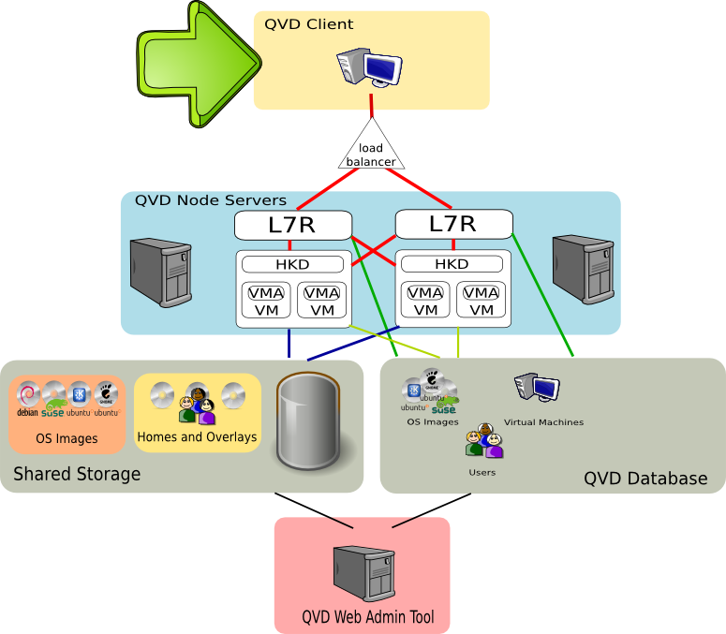
Summary of Training

Slide 4
Client Packages
Linux Packages
  These can be downloaded and installed using your usual package manager, by simply adding the appropriate QVD repository to your package sources:
  Debian/Ubuntu
  SuSE
Microsoft Windows
  The Microsoft Windows installation executable can be downloaded directly from the QVD website at: http://theqvd.com/product/download
  The installer provides a graphical installation wizard to guide through the installation and will run on most moder versions of the Windows operating system.
  Silent installation is supported.
# apt-add-repository 'deb http://theqvd.com/debian lucid main'
# apt-get update
# apt-get install qvd-client
# zypper ar http://download.opensuse.org/repositories/home:/qvd:/qvd-3.0/SLE_11_SP1 QVD
# zypper refresh
# zypper install qvd-client

Slide 5
Client Configuration
Client Configuration Parameters
QVD Client Configuration Parameters are stored on a per-user basis within the client workstation:
  Linux/Unix: ~/.qvd/client.conf
  Windows: %USERPROFILE%\Application Data\.qvd\client.conf
Client Configuration Parameters generally have a counterpart parameter either for the L7R in the QVD Node config, or for the VMA within the disk image.
The following Client Configuration Parameters can be used:
# client.link: can be: modem, isdn, adsl, wan, lan, local or a bandwidth specification (56k, 1m, 100m...)
# client.geometry: used to report the size and the depth of the client display
# client.fullscreen: used to run the client in fullscreen mode
# client.audio.enable: used to enable the Pulse audio server in the client
# client.printing.enable: used to enable Printer sharing with the client
# client.host.port: the L7R port the client should connect to
# client.host.name: the L7R host the client should connect to
# client.user.name: the user name for client authentication
# client.use_ssl: whether or to use SSL in client-server communications

Slide 6
Client Configuration
Loading the Client at Boot (Thinclient)
Ideally, many users would prefer that client workstations boot straight into the QVD authentication dialog, so that the end-user experiences a seamless experience using a virtual desktop.
To get the client to load at boot time, we suggest that you install Ubuntu Linux on the workstation PC, using the Minimal Install disk available at: https://help.ubuntu.com/community/Installation/MinimalCD
Once you have completed the installation, you will need to install the following additional packages:
      xserver-xorg
      xinit
      mingetty
      qvd-client*
      *You will need to add the qvd repositories to your apt sources

Slide 7
Client Configuration
Loading the Client at Boot (Thinclient)
Ideally, many users would prefer that client workstations boot straight into the QVD authentication dialog, so that the end-user experiences a seamless experience using a virtual desktop.
To get the client to load at boot time, we suggest that you install Ubuntu Linux on the workstation PC, using the Minimal Install disk available at: https://help.ubuntu.com/community/Installation/MinimalCD
Once you have completed the installation, you will need to install the following additional packages:
      xserver-xorg
      xinit
      mingetty
      qvd-client*
      *You will need to add the qvd repositories to your apt sources

Slide 8
Client Configuration
Loading the Client at Boot (Thinclient) ...continued...
Once the packages are installed, you will need to configure a few things so that when the workstation boots, autologin is achieved, an Xserver is started and the QVD client is loaded.
To configure autologin, edit /etc/init/tty1.conf to look as follows:
Note that 'qvd' in the file above, should match the username that you used when you created your Ubuntu installation
# tty1 - getty
#
# This service maintains a getty on tty1 from the point the system is
# started until it is shut down again.
start on stopped rc RUNLEVEL=[2345]
stop on runlevel [!2345]
respawn
exec /sbin/mingetty --autologin qvd tty1

Slide 9
Client Configuration
Loading the Client at Boot (Thinclient) ...continued...
Now, edit the user's bash profile to start an Xserver on login, edit ~/.bashrc to include the following lines:
Now, configure xinit to load the QVD Client when the Xserver starts, by editing ~/.xinitrc to look like this:
Finally, you should configure your QVD Client to run in full-screen mode by editing its configuration file in ~/.qvd/client.conf and including the line:
Reboot and you should find that you are confronted with the QVD Client logon dialog.
if [[ -z $DISPLAY && ! -e /tmp/.X11-unix/X0 ]] && (( EUID )); then
exec startx
fi
#!/bin/bash
exec /usr/bin/qvd-gui-client.pl
client.fullscreen=1

Slide 10


Troubleshooting
Audio
If vma.audio.enable is set to 1, audio should stream through to the client.
The client also needs to be configured to receive audio: client.audio.enable = 1
Audio takes advantage of PulseAudio Network Server and nxagent audio forwarding
If you are unable to get audio to stream, check that the following environment variable is set within the VM for nxagent to forward the audio stream:
On the client workstation, if running Linux, you will need to ensure that PulseAudio is configured to Enable Network Access to Local Sound Devices. Preferably, you should disable any requirement for authentication. You can set these parameters using the paprefs utility.
If using Microsoft Windows on the client workstation, you will need to install the PulseAudio binaries for Windows: http://pulseaudio.org/wiki/WindowsSupport
It is essential that the OS Image is properly set up and configured for audio and that the VMA has been configured to enable audio streaming.
Note that since streaming audio does require a fair amount of bandwidth over and above the requirements of the NX connection, audio in low-bandwidth environments may skip.
PULSE_SERVER=tcp:127.0.0.1:8000

Slide 11
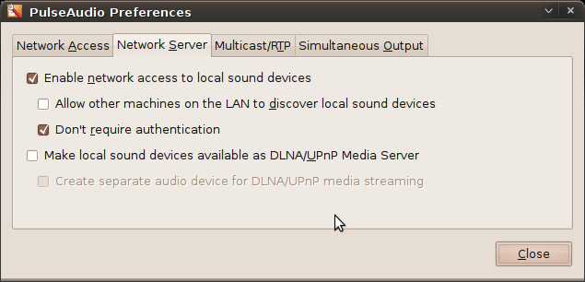
Troubleshooting
Audio

Slide 12
Troubleshooting
Printing
If vma.printing.enable=1 in `vma.conf`, the VMA will run `qvd-printing` when the session starts, listing the printers available on the client and configuring them locally:
  On MS-Windows clients, SMB/CIFS is used to list printers shared on the client
  On Linux clients, CUPS is used to list printers shared on the client
client.printing.enable=1 must be enabled in the client configuration `client.conf`
Under Windows, in order to use a local printer in conjunction with QVD, the printer must be 'shared' on the local network. Under Windows 7, you will also need to turn off password protected sharing in “Advanced sharing settings” as printer listings are shared anonymously
To troubleshoot printing problems with Windows clients you can use the `smbclient` tool from within the VM to test that you can access the printer list from within the VM:
  Called name not present - Reinstall the QVD client and restart Windows.
  NT_STATUS_ACCESS_DENIED - Check that you have turned off "password protected sharing.
NOTE: CUPS and Samba MUST be installed within the OS Image in order for printer sharing to work properly
# smbclient -L 127.0.0.1 -p 2100 -gN

Slide 13
Troubleshooting
General Networking Problems

Slide 14
Qindel Group
http://theqvd.com
Tel: 917662421
Julián Camarillo n.29 Ed D2 4I, 28037 Madrid, España

