Slide 1

Nombre del Producto
The QVD Training
Commercial and Sales Training
Fulanito de Tal
Cargo

Slide 2

Training Overview
General Sales Information
What is QVD?
Targeting Potential Customers and Leads
Product Benefits and Technical Characteristics
Pricelist
Reinforcement
QVD Code Maturity
Qindel customers and representation
Open Source/Partners/Community
3Rd party audits and reports
Comparative Benefits Analysis
QVD vs other commercial VDI software
Key Messages
Summary

Slide 3
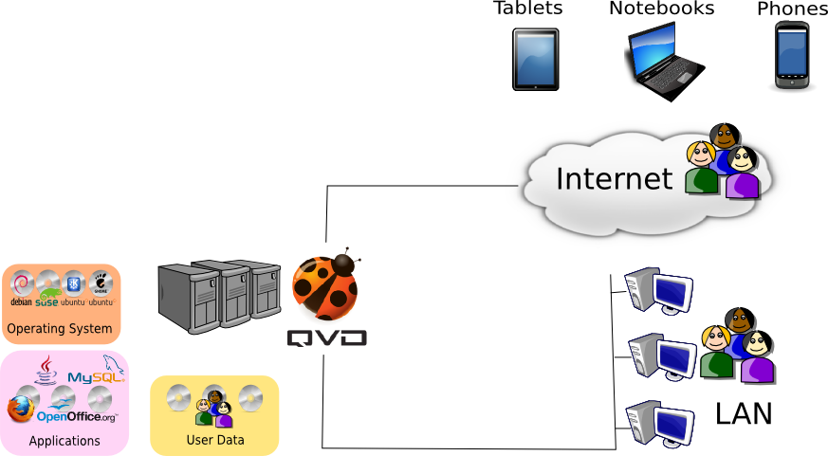
General Sales Information
What is QVD?
QVD is Virtual Desktop Infrastructure (VDI) software that offers a server-centric approach to managing user desktops
This means users can access their own applications, data and desktop environment from any computer or device that has access to the QVD infrastructure

Slide 4



General Sales Information
What is QVD?
QVD provides services similar to VMWare and Citrix and Xen:
    Virtual Machines running on a centralized cluster of servers
    Web-based management console and Administrative CLI
    Multi-platform client software
    Thin provisioning to avoid redundant disk usage
    Load-balancing and connection brokering
    Auto-provisioning to instantly create virtual desktops as users authenticate
Unlike VMWare and Citrix and Xen:
    QVD is designed to exclusively serve Linux and Unix desktops
    QVD makes use of exclusively open-source technologies so that all code is open to review and modification
    No data is stored in proprietary formats and tools usually exist to access all user data outside of QVD itself
    QVD is comparatively inexpensive to run while offering competitive performance and scalability

Slide 5
General Sales Information
Targeting Potential Customers and Leads
Exploring VDI or Remote Desktop Solutions
    Considering using a competing VDI, such as VMWare or Citrix
    Exploring VPNs or alternative technologies for remote access
Searching for Linux Desktops or considering migrating from Windows to Linux in order to reduce costs or avoid vendor lock-in
    Capable of meeting end-user requirements using:
      Native Linux or Java-based software (e.g. LibreOffice, OpenOffice.org etc)
      Web-based applications (e.g. Salesforce.com, SugarCRM, Google Docs etc)
      Software capable of running in an emulator (Wine / CrossOver Office) (e.g. Microsoft Office, Adobe Photoshop etc)
Many homogenous desktops
    A typical scenario includes a 'call center' with 3 or more desktop types: (staff user, supervisor, manager, director)
Deploying a solution that caters to over 200 users
    VDI is only really cost effective for larger user-bases

Slide 6

General Sales Information
Example Customers and Leads
Schools and Training Facilities:
  Many homogenous desktops
  Applications are standardized
Call centers:
  Many homogenous desktops
  Applications are standardized
Public institutions, Governmental Ministries:
  Strong incentive to switch to OpenSource software
  Many examples (Berlin, Paris, Brazil, UK initiative)
Bank branches:
  Dumb-terminal computer environment
  Deployment of single finance terminal application
Retail industry:
  Distributed offices accessing a central application
Software Development:
  Popular integrated development environments (Eclipse, Netbeans etc)
  Mainstream languages (C, C++, Java, JBoss, Python, Ruby, Perl, PHP)

Slide 7


General Sales Information
Product Benefits
Improve Security
  Minimize the number of hosts that can be compromised
  R/O image for desktop OS protects the desktop
  Snapshots for quick rollback and improved DR
  A single security policy across all desktops
Lower infrastructure costs
  Minimize hardware requirements and lower energy footprint
  Memory Overcommitment, Thin Provisioning and shared
  use of CPU resources improve hardware efficiency to cater
  for many users using a single host

Slide 8
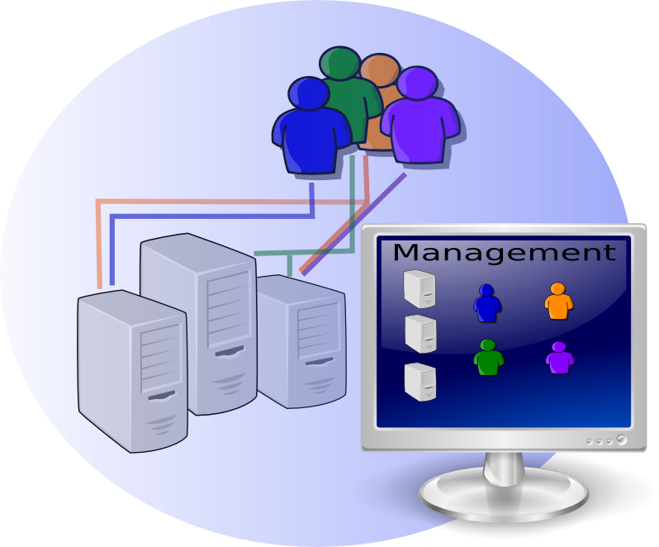
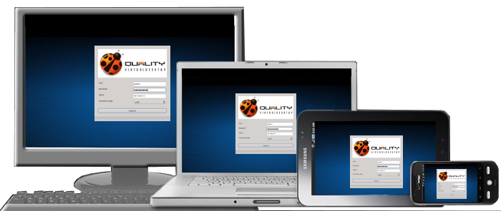
General Sales Information
Product Benefits
Improve manageability
  Deploy new desktops within minutes by simply assigning a user a Virtual Machine and loading a predefined image into the VM
  Use a centralized web administration console to track and administer virtual machines and user activity
Improve Accessibility
  Remote access can be provided securely over the Internet
  Client runs on a variety of devices including Notebooks, Tablets and Phones
  Client supports low-bandwidth environments (down to slow dial-up connections)

Slide 9
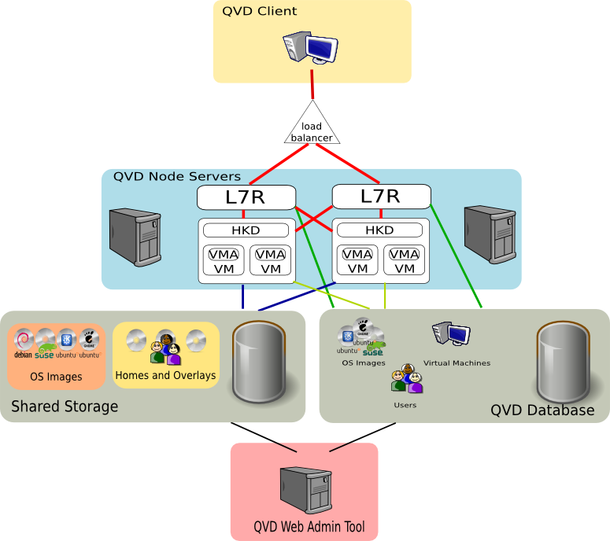
General Sales Information
Technical Characteristics – QVD

Slide 10
General Sales Information
Technical Characteristics – QVD
QVD is a framework that is built in Perl to deliver a complete VDI
  QVD Server Nodes
    Layer-7 Router for brokering client connections
    House Keeping Daemon for managing virtual machines
  QVD WAT and Admin CLI
    Web based administration system
    Scriptable shell utility to perform administration tasks
  QVD Database
    Central storage for configuration and status information
    Open-source SQL server (PostGreSQL)
  QVD Shared Storage
    Location that all components can mount to access images etc
  QVD OSIs and VMA
    Image used to store a base Operating System and the QVD VMA
  QVD Client
    Cross-platform client used to access a Virtual Desktop

Slide 11



General Sales Information
Technological Advantages
NX Protocol
  Mature (over 10 years development)
  Open Source
  Extremely low bandwidth requirements
KVM Hypervisor
  Type 1 Baremetal Virtualizer (hardware level virtualization)
  Very resource efficient
  Second in performance only to VMWare ESX (SPECvirt 2011)
QEMU Disk Images
  Efficient disk usage using qcow2 (avoids redundancy, small footprint)
  Portable images that are easy to migrate, clone and backup
  OS and Application data stored on a read-only image (secure, policy driven)
  'Overlay' images can be used for temporary data
* Further details provided in separate Technical Background slide presentation.

Slide 12
General Sales Information
Pricelist
QVD pricing is based on a subscription model with per-user licensing
MUCH simpler than VMWare or Citrix pricing models
Easier to see overall cost over a long term period
All future releases of the software are costed into the subscription fee
Current price structure is as follows:
User Base | 1st Year per user | Subsequent Annual User Fee | Discount
500 | 120.00 € | 27.00 € | 9.2%
1000 | 109.00 € | 24.53 € | 15.0%
2500 | 102.00 € | 22.95 € | 20.0%
5000 | 96.00 € | 21.60 € | 25.0%
>8500 | 84.00 € | 18.90 € | 30.0%

Slide 13
Reinforcement
QVD Product History and Code Maturity
QVD is an evolution of a much earlier Qindel project, called 'Mind The Box' or MTB, which was started in 2006 to help meet the requirements of Mexican Bank BBVA Bancomer
Qindel continued work on the MTB project for a further 3 years
First work on an official QVD release began in October 2009, using the original code from the MTB project
Since then, QVD has continued to be developed by Qindel alongside a number of sub-contractors, bringing a range of new features and functionality to the project

Slide 14

Reinforcement
QVD Product History and Code Maturity
So far QVD has over 6 years of solid development work and the team who are actively working on the product has grown substantially and now consists of contributors from around the world (España, México, Colombia, Perú, Chile and United Kingdom)
Recently QVD sold a 35,000 subscriber license
agreement
A current deployment of the QVD software is
handling a 20,000 user environment that has
an average of 9,000 concurrent users

Slide 15
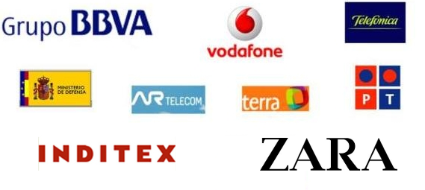
Reinforcement
Qindel Customers and Representation
Qindel was formed in 1998 by a group of IT professionals with over 15 years of experience in the industry.
Qindel is based in Spain, with offices in Madrid, Vigo and Mexico City.
Focus has been on consulting services and value-added solutions for some major customers in the Banking and Telecommunications industry, including BBVA Bancomer, Vodafone UK and Vodafone Spain.

Slide 16
Reinforcement
Qindel Customers and Representation
When describing Qindel's relationship with customers, care should be taken to evaluate whether a potential customer may feel intimidated by Qindel's involvement with larger companies like Vodafone and BBVA
In general, it is better to only mention these deals when dealing with larger potential customers who may feel comforted in the knowledge that other large enterprises have used Qindel's services

Slide 17
Reinforcement
QVD Longevity (Open Source, Partners, Community)
QVD is constantly looking for ways to improve its longevity both technically and in its relationship to its customers
  Avoid vendor lock-in by using open-source software:
    Source code is released under the GPL
    Exclusive use of open-source technology
  Ensure that the product is extensible and customizable:
    APIs to allow developers to hook into the product and include additional or alternative functionality
  Ongoing development of the product:
    Dedicated development resources provided by Qindel Group
    Open source code allows for external modification and development
    Community of developers and implementors
  Non-exclusivity of support or implementation:
    Partnership program includes extensive product training to provide customers with options for support and professional services
    Open-source community can offer additional support and services
    Dedicated support for commercial customers and partners

Slide 18
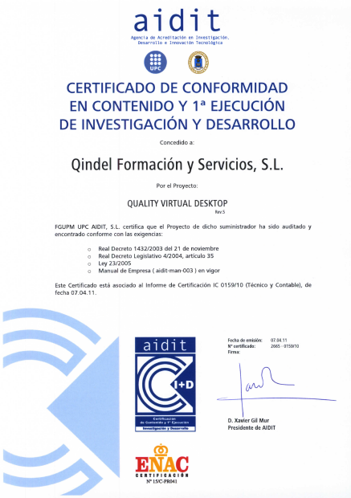

Reinforcement
3rd Party Audits and Certifications
Qindel has been audited for the
QVD Project to ensure that all
development and research into
the product is above board and
follows industry norms
QVD is also certified as a member
of the Open Virtualization Alliance,
dedicated to the promotion and
development of the KVM hyper-
visor

Slide 19
Comparative Analysis
QVD vs VMWare
Scalability
  QVD: scales to 64 virtual CPUs and 2 TB virtual memory per VM
  VSphere5: scales to 32 virtual CPUs and 1 TB virtual memory per VM
Performance
  ESX Server & ESXi: own 7 of the top 17 SPECvirt benchmarks (1st, 3rd,4th,5th,7th,16th and 17th)
  KVM: owns the other ten spots (ahead of Xen and Hyper-V)
Price
  QVD: simple annual support subscription cost per user (low cost)
  VMWare: complex pricing structure (expensive)

Slide 20
Key Messages
Summary
Huge cost savings
Specialized for Linux environments with more than 200 Users
Perfect for homogenous desktop types in enterprise environments
Open-source software avoids vendor lock-in
Improves security and manageability
Simplifies remote access
Reliable and mature technology

Slide 21
Qindel Group
http://theqvd.com
Tel: 917662421
Julián Camarillo n.29 Ed D2 4I, 28037 Madrid, España

