Slide 1

Nombre del Producto
The QVD Training
Commercial and Sales Training
Technical Background
Fulanito de Tal
Cargo

Slide 2

Training Overview
How QVD Works
General architecture
Component description
Incorporated Technology
NX Protocol
Virtual Machines
VM Images and Storage

Slide 3
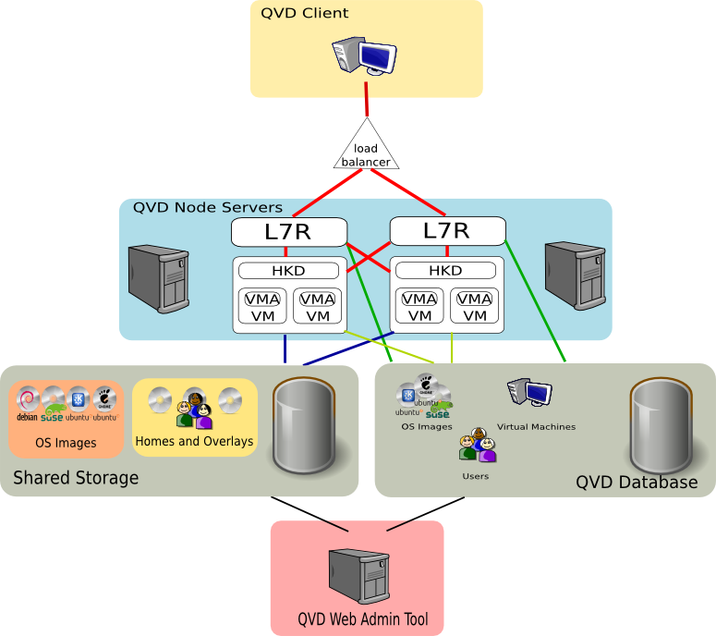
Technical Background
Technical Characteristics – QVD

Slide 4
General Sales Information
Technical Characteristics – NX Protocol
QVD takes advantage of the NX Protocol to deliver the virtual desktop:
  NX protocol provides superior compression to many other remote desktop protocols:
    compression ratios ranging from 10:1 to 100:1 and over
    capable in low-bandwidth environments (slow dial-up connection)
    can provide seamless desktop experience within a LAN environment
  NX communications are secured and authenticated using SSL certificates, providing a simple mechanism to allow secure remote access
  NX can proxy a variety of desktop protocols including X11 and RDP and is generally considered about 2-3 times faster than native RDP and uses significantly less bandwidth
  NX protocol is mature, actively developed for nearly 10 years
  Protocol is open-sourced and released under GPL

Slide 5
General Sales Information
Technical Characteristics – NX Protocol
What does it all mean?
  Low bandwidth requirements – QVD can guarantee functional virtual desktop access even in poor network conditions
  Fast and secure communications protocol no matter what device or where the client is located
  Mature protocol that has been around for nearly 10 years

Slide 6

General Sales Information
Technical Characteristics – Virtual Machines
QVD makes use of KVM:
  type-1 bare-metal hypervisor that runs within the Linux kernel
  same VMM design as used in Xen and VMWare
  designed for security on similar principal to VMWare
  takes advantage of Linux scalability features: lock avoidance, parallelization, RCU etc
http://code.ncultra.org/wp-content/uploads/2011/04/kvm-not-what-you-heard1.pdf
Future releases of QVD will offer LXC virtualization capabilities:
  Lightweight high-density virtualization
  Process and resource isolation between VMs
  Similar to Unix CHROOT, but with more isolation
  Better control over resource allocation etc
  Able to handle more VMs per node
  Shared Kernel space

Slide 7
General Sales Information
Technical Characteristics – Virtual Machines
What does it all mean?
  Commercial-grade Virtualization engine:
    Virtualization happens within Host Kernel at hardware layer
    Resource efficient for processor and memory usage
    As secure as other top commercial products
    As scalable as the Linux operating system itself
  Support for new and future virtualization technologies such as LXC
    Better resource handling
    Greater scalability
    High-granularity of control in image management
  Open Source technology
    Find alternative professional help
    Customize to your own requirements
    Easy to migrate to alternative platforms

Slide 8
General Sales Information
Technical Characteristics – VM Images, Homes etc
What does it all mean?
  Massive reduction in hardware costs (e.g. Thin Provisioning)
  Easily manage and administer base operating systems and application requirements for hundreds of users (OS Images)
  Feel confident about OS and Application Security (actual Images are read-only, so restarting the VM will reset it and remove nasties)
  Easy backups of User Data and OS Images (snapshots of images)
  Disaster Recovery (OSIs and Homes mounted in any VM)
  Armed with images, you can access data without QVD simply using KVM on any Linux system (open source technologies)

Slide 9
General Sales Information
Technical Characteristics – VM Images, Homes etc
For KVM based VMs, a QCow2 image is created using standard tools available for any Linux distribution
The Operating System and applications are installed into the image as if onto another physical machine
The QCow2 image will only grow to the size of the amount of disk space actually used (Thin Provisioning)
The same QCow2 image can be used for all VMs that share the same requirements, massively reducing the requirement for disk space
OS Images are loaded in read-only mode for improved security
User data is stored within an independent writable QCow2 image called a Home image, which is easily backed up and which can be mounted into any appropriate VM
Runtime data and other temporary data that needs to be written is stored within an 'overlay' image which is mounted onto the OS Image when the VM loads

Slide 10
Qindel Group
http://theqvd.com
Tel: 917662421
Julián Camarillo n.29 Ed D2 4I, 28037 Madrid, España

