Slide 1
Project Presentation
On
Artificial Intelligence In Education
By
Raghav Dua(2210990697)
Gourvi Sharma (2210991585)
Gagan Bansal(2210991558)
Lakshey Asija(2210991843)
Supervised By Mr. Ajay
Department of Computer Science and Engineering, Chitkara University, Punjab

Slide 2
INTRODUCTION
Traditional education systems face challenges like lack of personalization, large class sizes, and delayed feedback.These issues reduce learning efficiency and student engagement.Therefore, the shift to digital learning has increased the need for smarter solutions.
AI has emerged as a powerful tool to improve learning and teaching processes.
This study explores how AI can enhance assessment, tutoring, and personalization.
Objective: To analyze effectiveness, challenges, and future scope of AI in education.

Slide 3
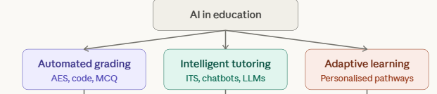
BACKGROUND
Artificial Intelligence in education has evolved from simple rule-based systems to advanced models using machine learning and deep learning. These technologies are now widely used in automated assessment, intelligent tutoring, and personalized learning. However, most existing research focuses on individual areas, creating a gap in comprehensive analysis.
Core technologies: Machine Learning, NLP, Deep Learning
Evolution: Rule-based → AI-driven systems
Research Gap: Lack of integrated analysis

Slide 4
METHODS
Research Approach:
A systematic literature review was conducted.
Research papers from 2015 to 2026 were analyzed.
Sources included IEEE, ACM, Springer, and other academic databases.
Process:
Papers were filtered based on relevance and quality.
Studies were categorized into three domains:
1. Automated Grading Systems
2. Intelligent Tutoring Systems
3. Adaptive Learning Platforms
Comparative analysis was performed.

Slide 5
RESULTS
Automated Grading Systems
AI-based grading systems provide fast and consistent evaluation.
They use NLP and machine learning for tasks like essay scoring and code evaluation.
Achieve high accuracy but may struggle with creativity and fairness.
Scalable for large classrooms
Accuracy: 87–94%
Intelligent Tutoring Systems
ITS provide personalized, real-time guidance to students.
They simulate one-on-one tutoring using AI models.
Significantly improve learning outcomes and engagement.
Continuous feedback loop.
Learning gains: 15–25%

Slide 6
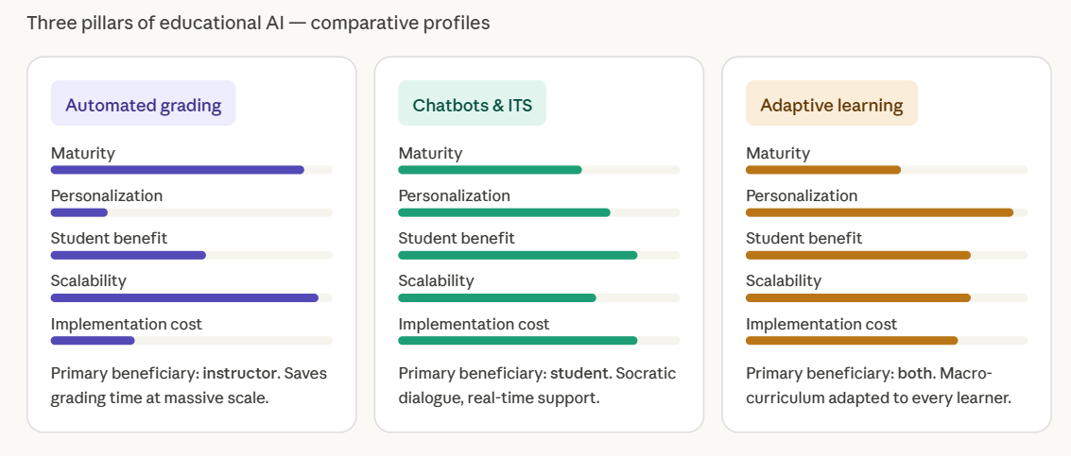
RESULTS
Adaptive Learning Systems
Adaptive systems personalize learning paths and pace.
They adjust content based on student performance.
Most effective when combined with human teaching.

Slide 7
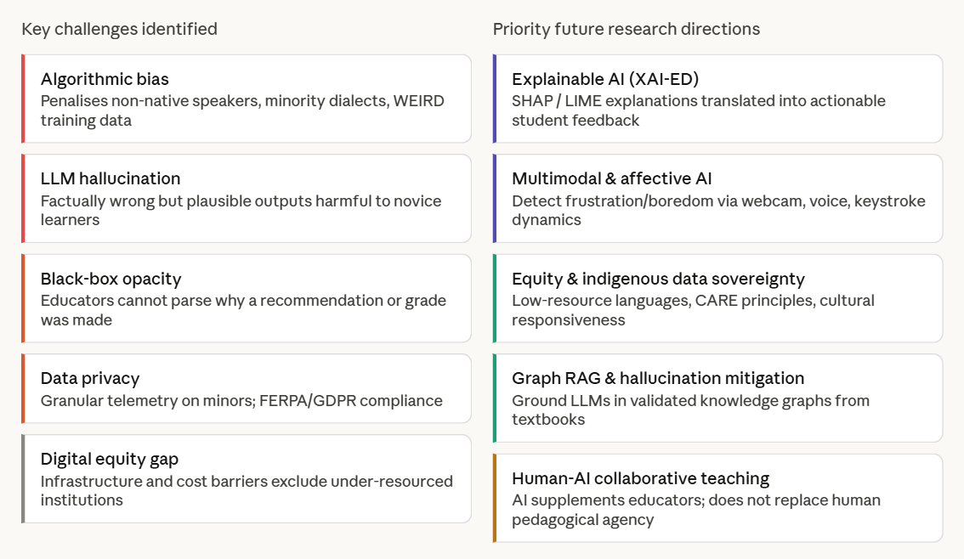
CHALLENGES VS FUTURE DIRECTIONS

Slide 8
DISCUSSION
Our analysis shows that AI significantly improves learning efficiency by making education more personalized and adaptive. It also increases student engagement and overall learning outcomes.”
However, each system comes with its own trade-offs. For example, some are highly accurate but expensive, while others are scalable but less personalized.
Additionally, there are important challenges such as algorithmic bias, lack of transparency, and concerns related to student data privacy.
“Based on our findings, the most effective approach is not replacing teachers, but combining AI with human instruction to create a more balanced learning environment.”

Slide 9
CONCLUSION
AI is transforming education towards personalized learning
Improves efficiency, scalability, and feedback speed
Challenges still exist: bias, privacy, transparency
Future lies in human-centered AI integration

Slide 10
Thank You
11

