Slide 1



JEPPIAAR ENGINEERING COLLEGE
DEPARTMENT OF COMPUTER SCIENCE AND ENGINEERING
FREELANCE APPLICATION USING MERN
TEAM LEADER : SHALVIN SAVIO V.X(310821104086)
TEAM MEMBER 1 : RAHUL T(310821104074)
TEAM MEMBER 2 : SIVAJI G(310821104090)
TEAM MEMBER 3 : RISHIBALAN S(310821104079)

Slide 2
FULLSTACK DEVELOPMENT PROJECT
WITH MERN
1. Introduction:
Project Title: Work Wonders Freelancing Platform
Work Wonders is a dynamic freelancing platform designed to connect freelancers and clients seamlessly.
Clients can post jobs, review applications, and hire freelancers, while freelancers can browse job postings, submit applications, and manage their services efficiently.

Slide 3
2. Project Overview:
Work Wonders provides a seamless platform for freelancers and clients to connect and collaborate.
Clients can post projects, browse freelancer profiles, and hire talent with ease. Freelancers can showcase their skills, apply for projects, and manage their work efficiently.
The platform ensures secure payments, transparent reviews, and an intuitive interface for both freelancers and clients to achieve their goals effectively.
Purpose :
Seamless Freelancer and Client Connectivity
Efficient Project Management
Secure Payment Integration
Transparent Reviews and Ratings
Intuitive Dashboard for Freelancers and Clients
Features :

Slide 4
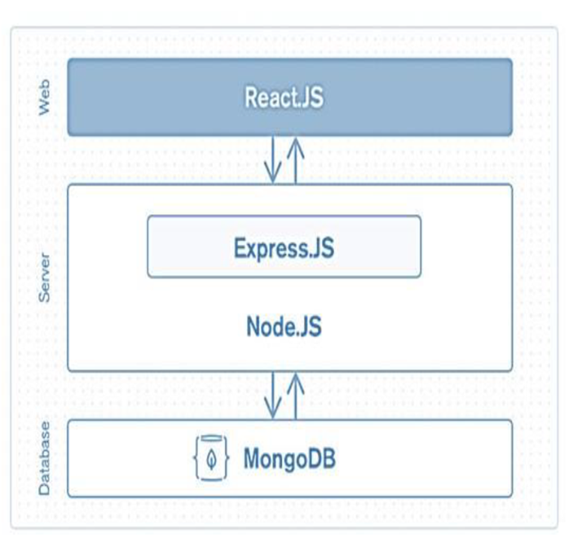
3. Architecture:
Frontend:
Component-Based Design: Modular and reusable components ensure scalability and easier maintenance.
State Management: Manage shared states
like authentication and orders using Context
API or Redux.
Routing: Use React Router for smooth
navigation and protected routes for secure
access.
UI/UX: Responsive, user-friendly design with a focus on clean layouts and accessibility.
Backend Integration: APIs are accessed via
Axios/Fetch for dynamic data updates.

Slide 5
Backend :
Modular Structure: Organized codebase with separate sections for routes,
controllers, and models to ensure maintainability and scalability.
Database Management: MongoDB is used for data storage, with Mongoose
to define schemas for collections like users, jobs, and applications.
API Development: RESTful APIs handle CRUD operations and ensure data flow
between frontend and database.
Middleware: Implements middleware for tasks like authentication, request parsing,
and enabling CORS.
Authentication & Authorization: Secures endpoints with JWT-based token validation
and role-based access control.
Error Handling: Centralized error-handling mechanism to provide meaningful error
responses and ensure system stability.
Real-Time Features: Socket.io or similar libraries can be used for
notifications or live updates if needed.

Slide 6
4. Setup Instruction:
Prerequisites:
To develop a full-stack e-commerce app, there are several prerequisites are required.
The key prerequisites for developing such an application: Node.js and npm ,
MongoDB , Express.js , React.js , HTML, CSS, and JavaScript , Version
Control: GitHub , Development Environment:Visual Studio Code, Sublime Text,
or WebStorm.
Installation:
Navigate into the cloned repository directory:
cd Work-Wonders
Install the required dependencies by running the following command:
npm install

Slide 7
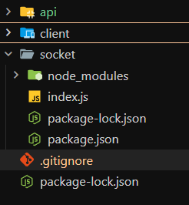
6. Folder Structure:
api/
Contains all backend API route files such as auth.js, jobs.js, and applications.js.
Handles CRUD operations and communication with the database.
client/
Contains the React frontend application, including src/ for components, pages, and utilities.
Manages user interface, routing, and state management for a seamless experience.
socket/
Handles real-time communication using WebSocket or Socket.io.
Manages events for real-time updates like notifications or live messaging.

Slide 8
7. Running the application:
Frontend:
Navigate to the client directory: cd client/
Install dependencies and start the React server:
npm install
npm start
Access the frontend at http://localhost:3000.
Backend:
Navigate to the server directory: cd api/
Install dependencies and start the backend server: npm install & npm start
Verify the backend at http://localhost:5000 (or your configured port).
Socket:
Navigate to the socket directory: cd socket/
Install dependencies and start the socket server: npm install & npm start
Verify the socket server is running at http://localhost:6000 (or your configured port).

Slide 9
8. API Documentation:
User Authentication
Register: POST /api/auth/register
Login: POST /api/auth/login
Job Management
Add Job: POST /api/jobs
Get Jobs: GET /api/jobs
Application Management
Submit Application: POST /api/applications
View Applications: GET /api/applications
Dashboard
Fetch Dashboard Data: GET /api/dashboard
Order Management
Place Order: POST /api/orders
Get Orders: GET /api/orders

Slide 10
9. Authentication:
Method:
JSON Web Tokens (JWT) are utilized for secure authentication.
Tokens are issued upon successful login and stored securely on the client side, either in local storage or session storage.
Authorization:
Protected Routes: Specific features, such as posting jobs or managing applications, are accessible only to authenticated users.
JWT-Based Access: Upon login, users receive a token, which is included in subsequent API requests to verify access.
Secure Password Handling: Passwords are hashed securely using Bcrypt to protect user data.
Token Verification: JWT tokens are validated using a secret key to confirm the user’s identity and permissions.
Session Management:
JWT tokens are stored in the browser's local storage or session storage to maintain user sessions without requiring repeated logins.

Slide 11
10. User Interface:
The user interface is designed to be simple, modern, and easy to navigate. Below are some key UI features:
The following screenshots illustrate the user interface:
Login Page: Allows users to log in securely with their credentials.
Homepage: Displays featured jobs and categories to explore.
User Dashboard: Shows personalized details like profile info, job applications, and notifications.
Job Listing Page: Lists available jobs with filters and sorting options.
Job Details Page: Provides detailed descriptions of a job with options to apply or save.
Chatroom: Facilitates real-time communication between freelancers and clients.
User Profile: Displays user information, skills, reviews, and job history.

Slide 12
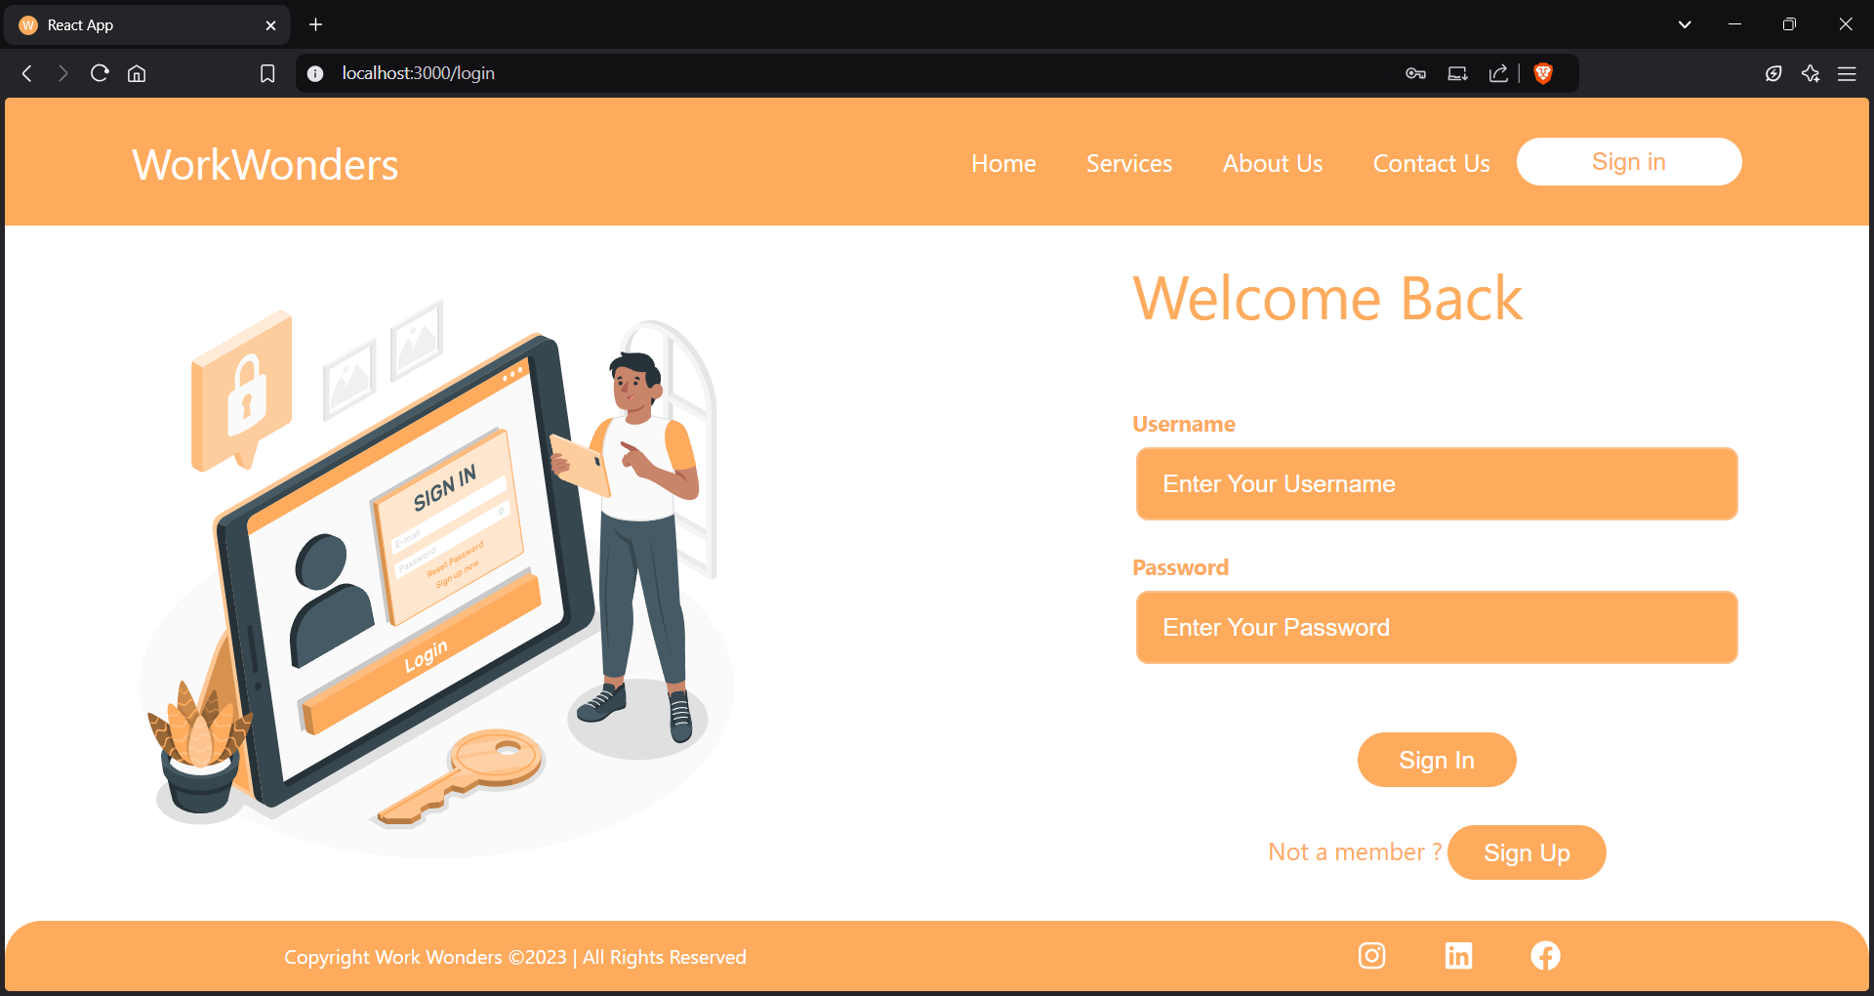
11. Screen Shots:
Login Page :

Slide 13
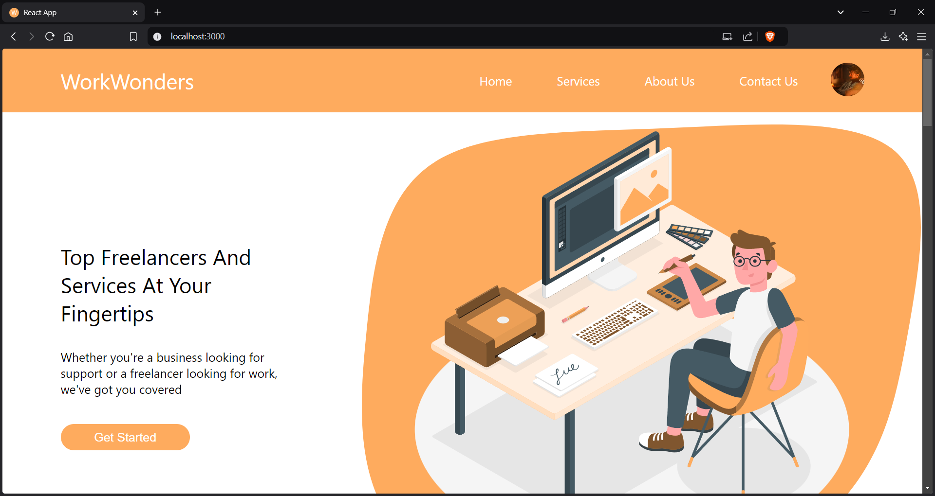
Home Page :

Slide 14
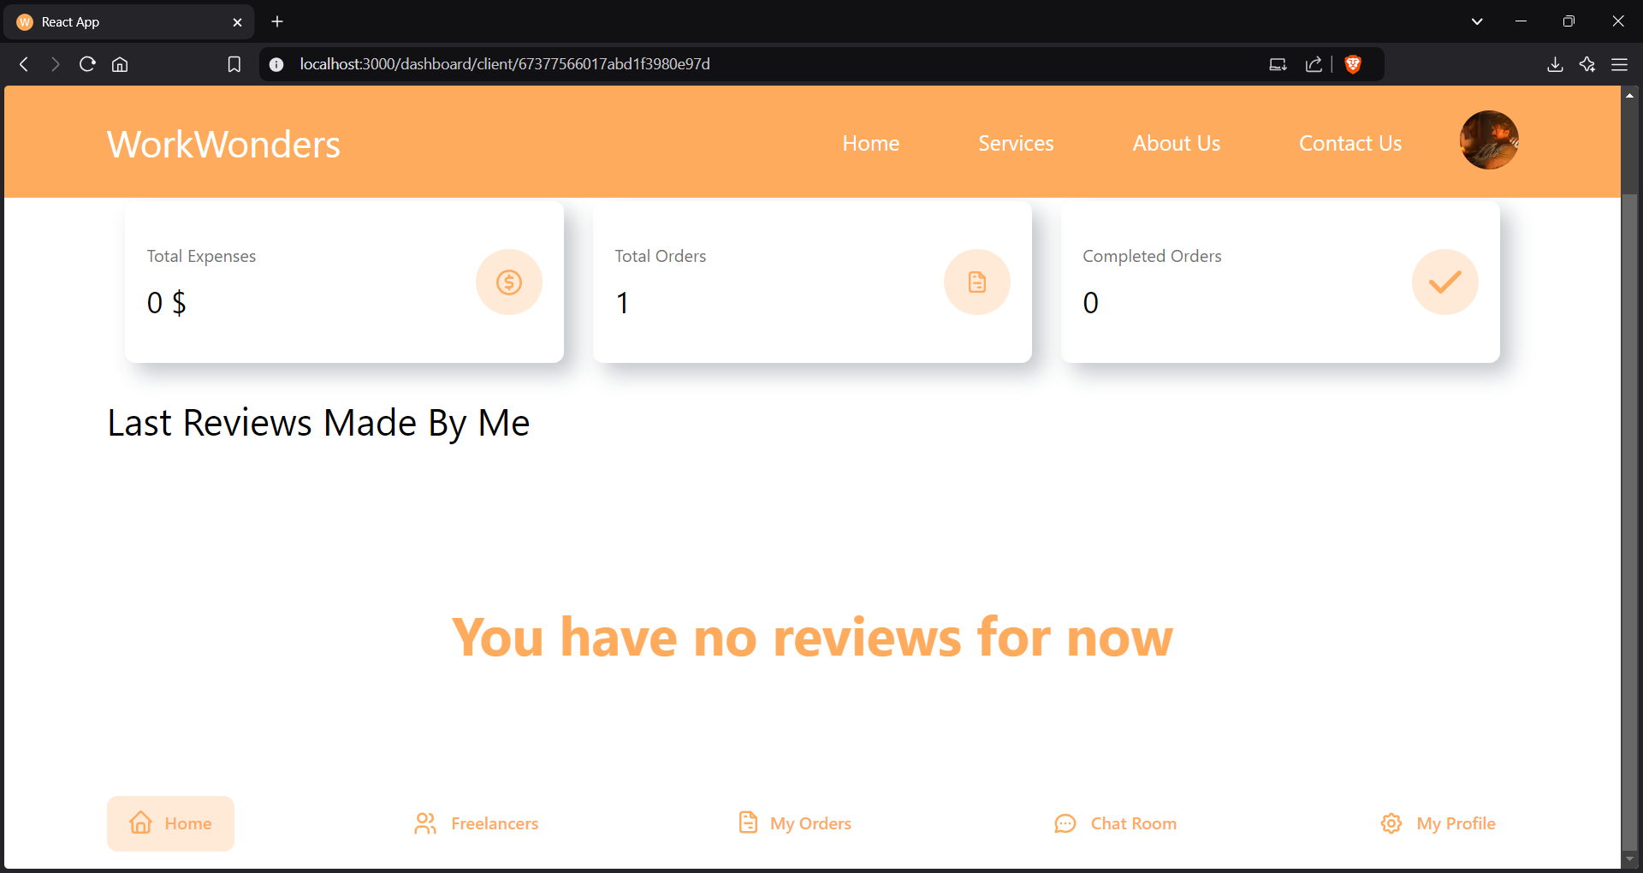
User Dashboard:

Slide 15
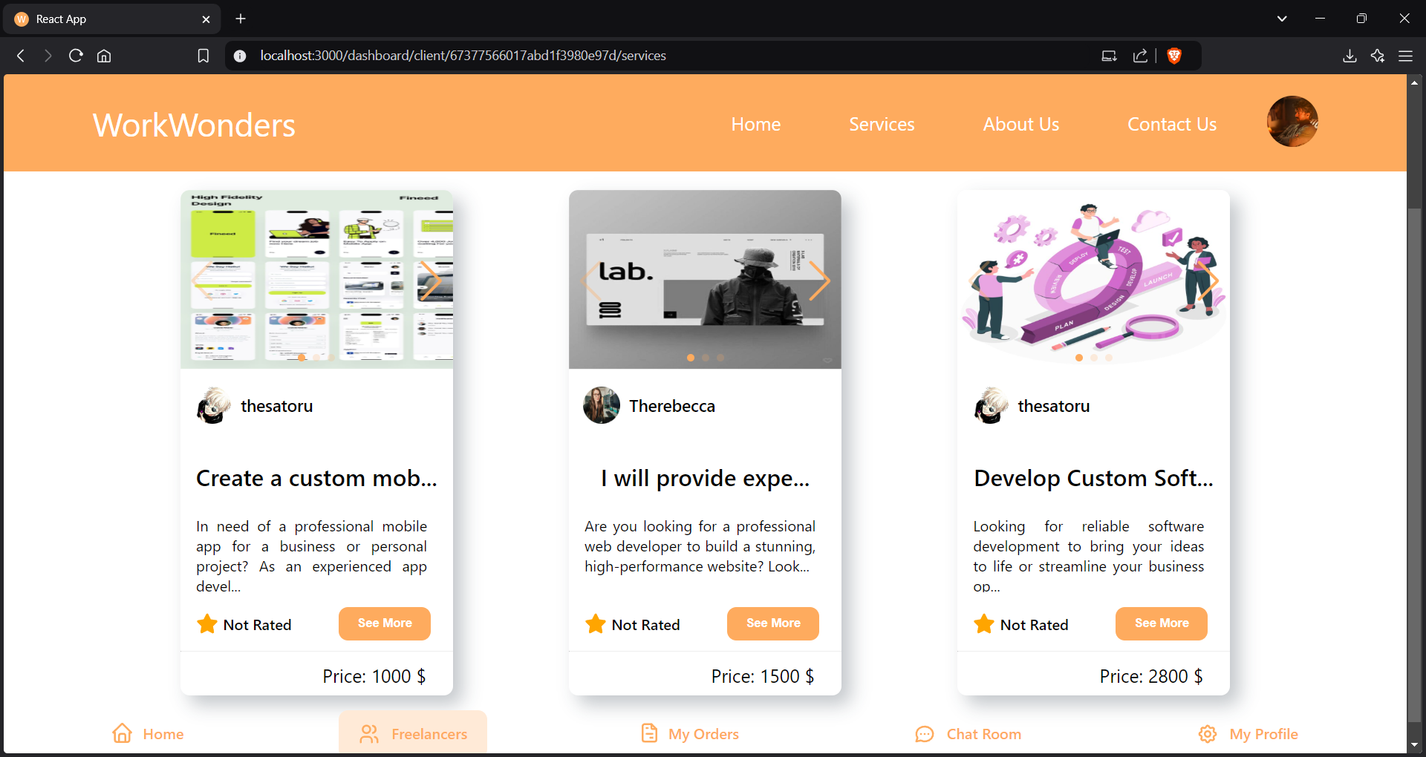
Job Listing Page :

Slide 16
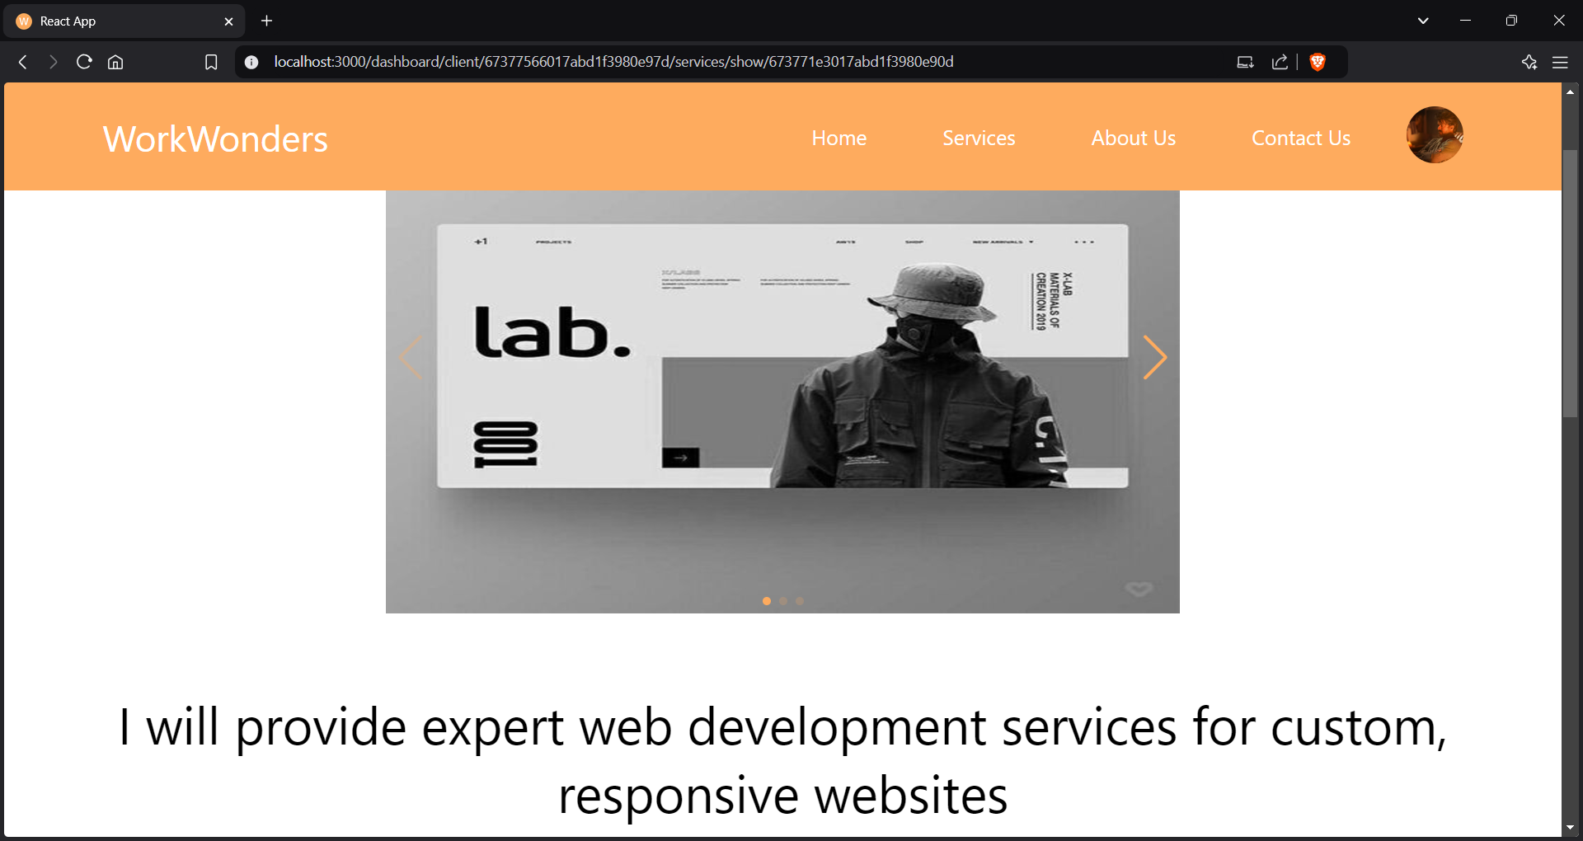
Job Details Page :

Slide 17
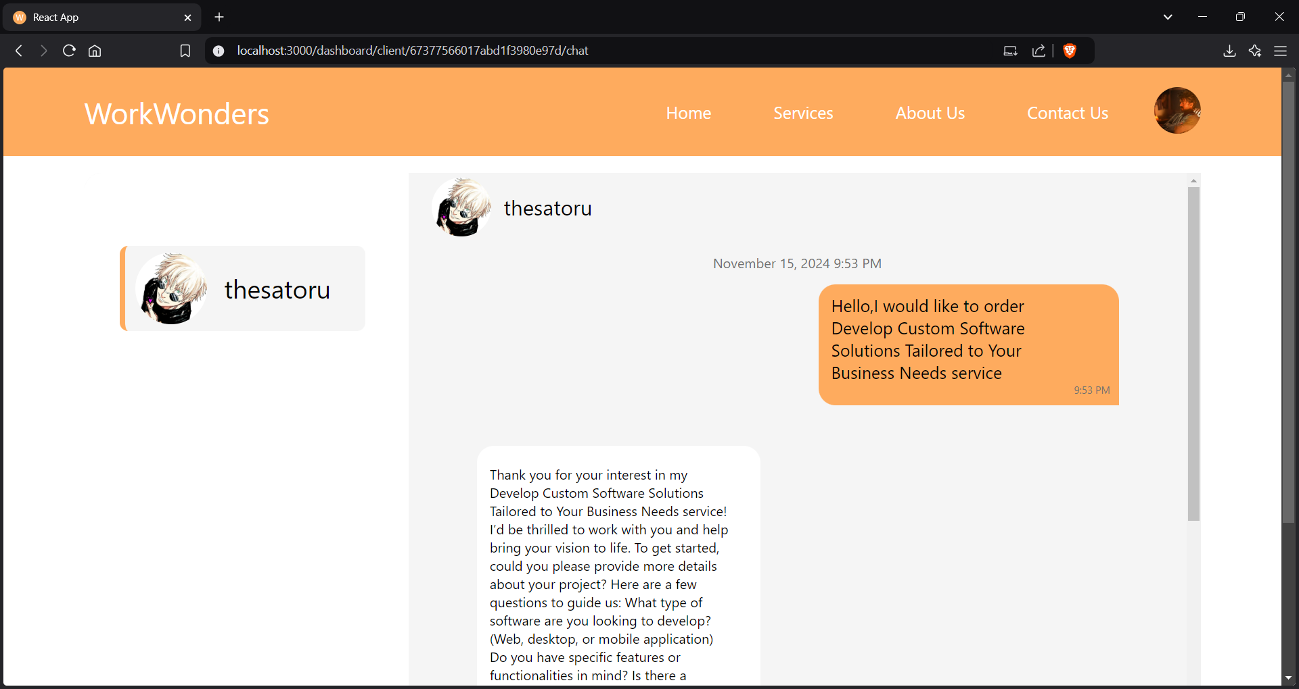
Chatroom Page:

Slide 18
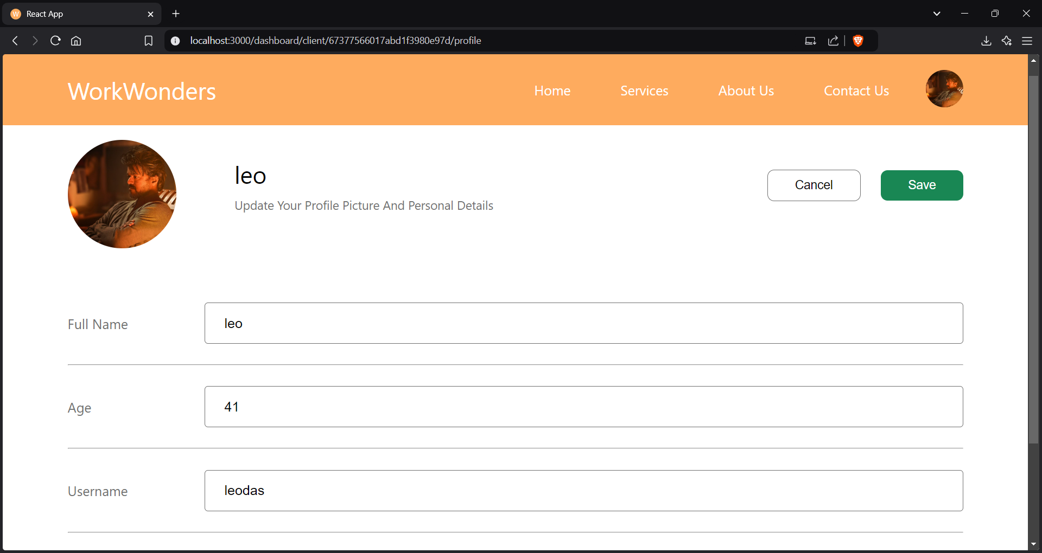
User Profile Page:

Slide 19
12.Testing :
Tools Used:
Postman: For API testing and validation.
Jest: Used for frontend unit testing.
JMeter: To assess API performance under load.
Selenium: For automating end-to-end testing.
Test Cases:
Testing user login with both valid and invalid credentials.
Verifying the job application process from start to finish.
Checking that users can update their profiles successfully.
Ensuring seamless job posting and editing for clients.
Testing Types:
Performance Testing: Ensures the application performs efficiently under high user loads.
Security Testing: Validates protection against vulnerabilities like SQL Injection, XSS, and CSRF.
Regression Testing: Confirms new changes don’t disrupt existing functionalities.

Slide 20
13.Technical Issue:
Known Issues:
Payment gateway integration is incomplete, leading to limited transaction options.
Limited functionality for user notifications, including delays in real-time updates.
UI inconsistencies on certain mobile devices, affecting responsiveness.
Role-based access control needs further refinement to handle edge cases.
Occasional server downtime during high traffic due to insufficient load balancing.
Lack of multi-language support for a more global user base.

Slide 21
14.Future Enhancement:
The enhancement features :
AI-Powered Job Recommendations
Use AI to match freelancers with the most suitable jobs based on their skills, past work, and preferences.
Real-Time Project Tracking
Implement a system for freelancers and clients to track the progress of ongoing projects in real time.
Gamified Freelancer Rewards
Introduce a reward system where freelancers can earn points, badges, or bonuses based on their
performance and completed tasks.
Skill-Based Certification System
Allow freelancers to earn certifications based on their expertise and completed projects, building their
Credibility.
Voice-Based Job Search
Integrate voice search for freelancers and clients to easily find and post jobs using voice commands.

