Slide 1

Tachyon Systems – Task 1 Presentation
Role: Backend Developer
Candidate: Rahul T
October 2025

Slide 2
Introduction:
I am a Computer Science graduate with strong skills in backend and full-stack development, including Java, Python, JavaScript, React, Node.js, SQL, Git, and Docker. I have worked on projects like AI Resume Analyzer, Spam Email Classification (NLP), and a Freelance Website using MERN. I am passionate about building scalable, efficient, and secure server-side applications and am keen to contribute as a Backend Developer.
Agenda:
Deep dive into Primary Backend Topics.
Overview of key Secondary Topics.
Demonstrate a foundational understanding of building robust, scalable, and secure server-side applications.

Slide 3
Primary Topics - Overview
This presentation will cover the core concepts essential for a Backend Developer as per the guidelines.
Primary Topics Covered:
Node.js
RESTful APIs
Authentication & Authorization
Testing APIs

Slide 4
Node.js Deep Dive (Primary Topic)
Key Concepts:
Runtime Environment: Built on Chrome's V8 engine for high-performance JavaScript execution outside browsers.
Event-Driven Architecture: Non-blocking I/O model using an event loop for handling concurrent operations efficiently, ideal for scalable applications.
- Event Loop Phases: Timers, Pending Callbacks, Idle/Prepare, Poll, Check, Close Callbacks.
Asynchronous Programming: Evolution from callbacks to Promises and async/await for cleaner code.
Built-in Modules: fs for file system ops, http for servers, path for file paths, crypto for security.
NPM Ecosystem: Dependency management with semantic versioning; tools like nodemon for development.
Real-World Applications: REST APIs, real-time apps (e.g., chat servers), microservices in cloud environments.

Slide 5
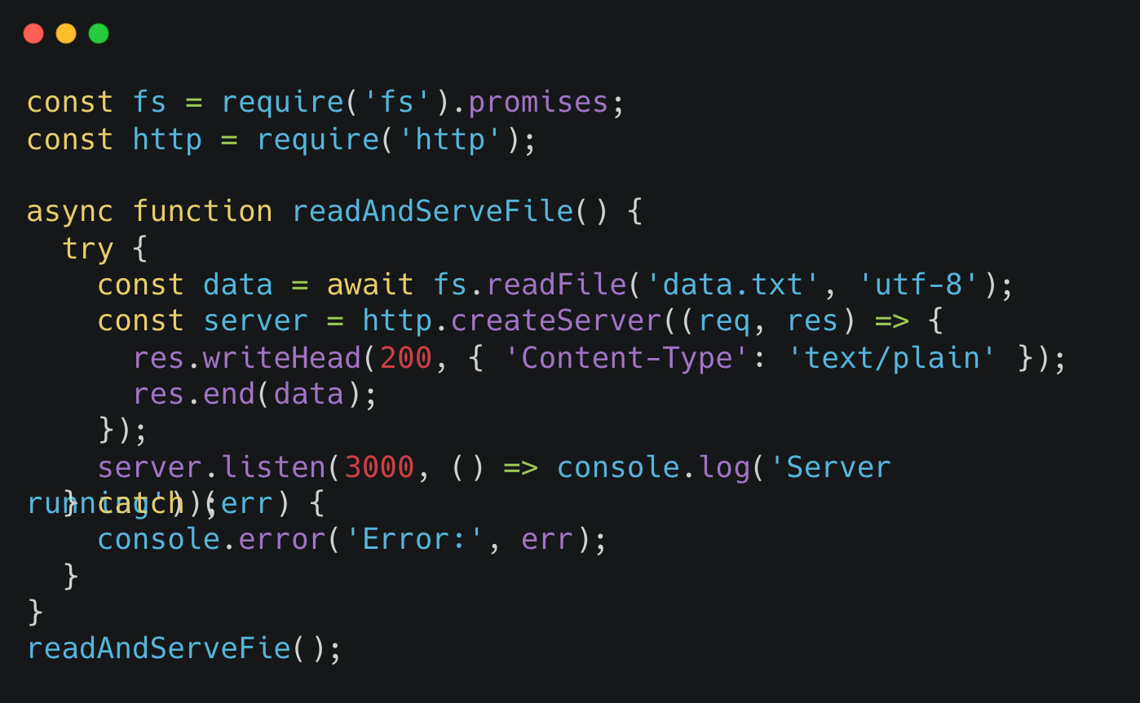
Code Example
This demonstrates async file reading integrated with an HTTP server, handling errors professionally.

Slide 6
Express.js Routing & Middleware (Primary Topic)
Framework Overview: Lightweight web framework for Node.js, simplifying API and web app development with robust routing and middleware support.
Routing: HTTP methods (GET, POST, PUT, DELETE, PATCH) for endpoint definition.
- Example: app.get('/users', handler); for resource retrieval.
Middleware: Functions that process requests/responses; executed in sequence.
- Built-in: express.json() for JSON parsing.
- Third-party: Morgan for logging, Helmet for security headers.
- Custom: Error handling with next(err).
Request Lifecycle: Request → Middleware Chain (e.g., auth, logging) → Route Handler → Response.
Modular Architecture: Use routers for scalable code organization, e.g., const userRouter = express.Router();.
Flow Diagram:
[Request] → [Middleware 1: Logging (Morgan)] → [Middleware 2: Authentication] → [Middleware 3: Rate Limiting] → [Route Handler] → [Error Handler] → [Response]

Slide 7
RESTful API Concepts (Primary Topic)
Core Principles: Stateless, client-server model using HTTP for uniform interface.
CRUD Operations: Mapped to HTTP methods – GET (read), POST (create), PUT/PATCH (update), DELETE (remove).
HTTP Status Codes: 2xx (Success: 200 OK, 201 Created), 4xx (Client Error: 400 Bad Request, 401 Unauthorized, 404 Not Found), 5xx (Server Error: 500 Internal Server Error).
Advanced Features:
- Pagination: Query params like /users?page=2&limit=10 with offset/limit logic.
- Versioning: URL-based (/v1/users) or header-based for backward compatibility.
- Filtering/Sorting: /users?role=admin&sort=asc using query parsing.
Best Practices: Idempotency, HATEOAS (Hypermedia as the Engine of Application State) for self-descriptive APIs.

Slide 8
Authentication & Authorization (Primary Topic)
Authentication: Verifying user identity (who are you?).
Authorization: Enforcing access controls (what can you do?).
JWT (JSON Web Tokens): Stateless, signed tokens (header.payload.signature) for secure sessions; use libraries like jsonwebtoken.
- Implementation: Generate on login, validate in middleware.
OAuth2 Flows: Authorization Code for web apps, Client Credentials for machine-to-machine; integrate with providers like Google/Auth0.
Security Best Practices: Use HTTPS, short token expiration (e.g., 15 mins), refresh tokens, bcrypt for password hashing, protect against CSRF/XSS.
Integration with Secondary Topics: Use in WebSocket for real-time auth; store sessions in databases (SQL/NoSQL).

Slide 9
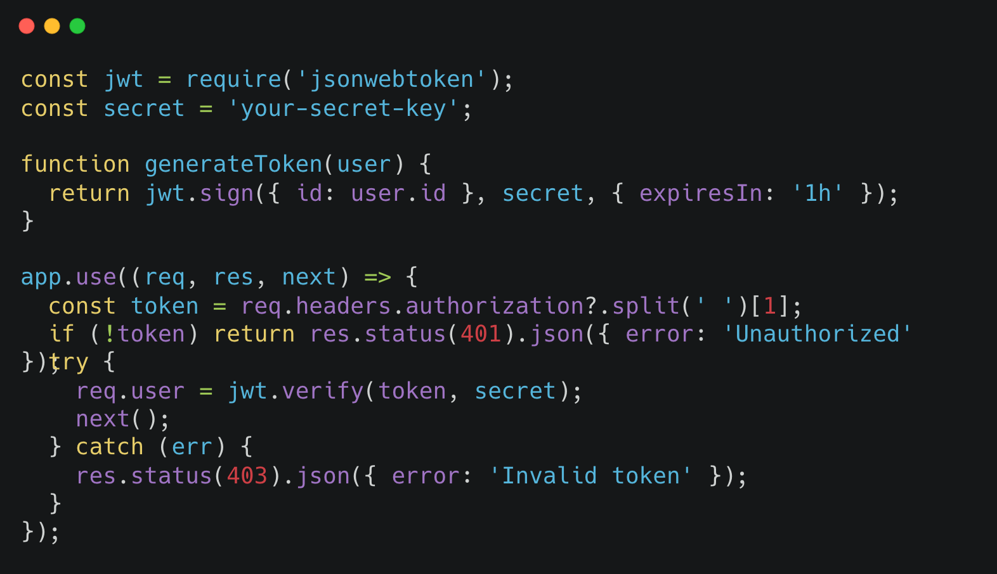
Code Example:
JWT Authentication Middleware: Secures routes by verifying tokens and attaching user info to requests

Slide 10
Testing APIs (Primary Topic)
Tools Overview:
Postman: For manual/exploratory testing; create collections with variables for environments.
Jest: Unit testing framework; mock dependencies for isolated tests.
Supertest: Integration testing for Express apps; simulate HTTP requests.
Test Pyramid: Unit → Integration → E2E.
Best Practices: Cover happy paths, edge cases, errors; use TDD (Test-Driven Development).
Example: Test auth failures (401), successful CRUD (200/201).
Automation: Integrate with CI/CD (secondary topic) for regression testing.

Slide 11
Secondary Topics - Overview
A brief look at complementary technologies and concepts that enhance backend development.
Secondary Topics Covered:
WebSocket
Database Design
Cloud Basics
System Design
LLM API Usage & RAG

Slide 12
Secondary Topic - WebSocket & Database Design
WebSocket:
- A communication protocol providing full-duplex communication channels over a single TCP connection.
- Ideal for real-time applications like chat apps, live notifications, and online gaming.
Database Design:
SQL (Relational): Structured data, predefined schema (e.g., PostgreSQL, MySQL).
NoSQL (Non-relational): Unstructured data, dynamic schema (e.g., MongoDB, DynamoDB).
Indexing: A data structure technique to efficiently retrieve records from a database file.

Slide 13
Secondary Topic - Cloud & System Design
Cloud Basics:
- Deploying applications on cloud platforms.
- Serverless Computing: Services like AWS Lambda or Azure Functions allow you to run code without provisioning or managing servers.
System Design:
- The process of defining the architecture, components, and interfaces for a system.
Key Concepts:
Stateless APIs: Each request from a client contains all the information needed by the server to fulfill it. Crucial for scalability.
Scalability: The ability of a system to handle a growing amount of work.
Caching: Storing copies of files or data in a temporary storage location so they can be accessed more quickly.

Slide 14
Secondary Topic - LLM API Usage & RAG
Integrating AI into Applications:
1.LLM API Usage: Leveraging Large Language Models (like GPT) by making API calls to them for tasks like text generation, summarization, or analysis.
2.RAG (Retrieval-Augmented Generation):
- A powerful technique to enhance LLM responses with external, up-to-date information.
- It retrieves relevant data from a knowledge base and provides it to the LLM as context, leading to more accurate and specific answers.
- Essential for building AI-powered workflows and features.

Slide 15
Conclusion
Summary:
Covered the fundamentals of backend development using Node.js and RESTful APIs.
Discussed the importance of security through authentication/authorization and reliability through testing.
Touched upon modern practices like real-time communication, cloud deployment, and AI integration.

Slide 16
Thank You
Name: Rahul T
Email: rahulnilvan43@gmail.com
Github Link: https://github.com/therahul-yo/tachyon-backend-task1.git

