Slide 1
School of Engineering and Applied Science Ahmedabad University
Machine Learning project Final presentation
Group 14

Slide 2
Group Details
Group Name: Rahul Parmar(AU2044001)
Murli Alva (AU2044006)
Pathik Patel (AU2044010)
Vatsal Suthar (AU2044013)
Team Name : G4 Tech
Project Title : Yellow Taxi Fare Prediction
Date : 15-04-2021
Time : 14:00

Slide 3
Introduction
In NYC, taxicabs come in two varieties: yellow and green; they are widely recognizable symbols of the city. Taxis painted yellow (medallion taxis) are able to pick up passengers anywhere in the five boroughs. in Upper Manhattan, the Bronx, Brooklyn, Queens, Staten island. The yellow taxi cab was first introduced in 1915 by a car salesman named John Hertz. Hertz decided to paint his taxis yellow because of a study by a Chicago university to establish what color would grab the attention of passers-by more easily. The results proved that yellow with a touch of red was most noticeable. As a result, Hertz started to paint all his taxicabs yellow and went on to start the Chicago-based Yellow Cab Company in 1915.

Slide 4
Problem Statement
In this project, we have predicted taxi fare using ML algorithm i.e., regression and to predict that from which area is most cabs are booked with the help of the ML algorithm i.e., clustering on yellow taxi cab of New York City. We have analyzed the dataset which has October 2020 month yellow taxi cab data. During analysis, we used different parameters to check which area has more cab booking, the average number of passengers for each trip, average fare for the trip, and many more…. Etc. to be followed.

Slide 5
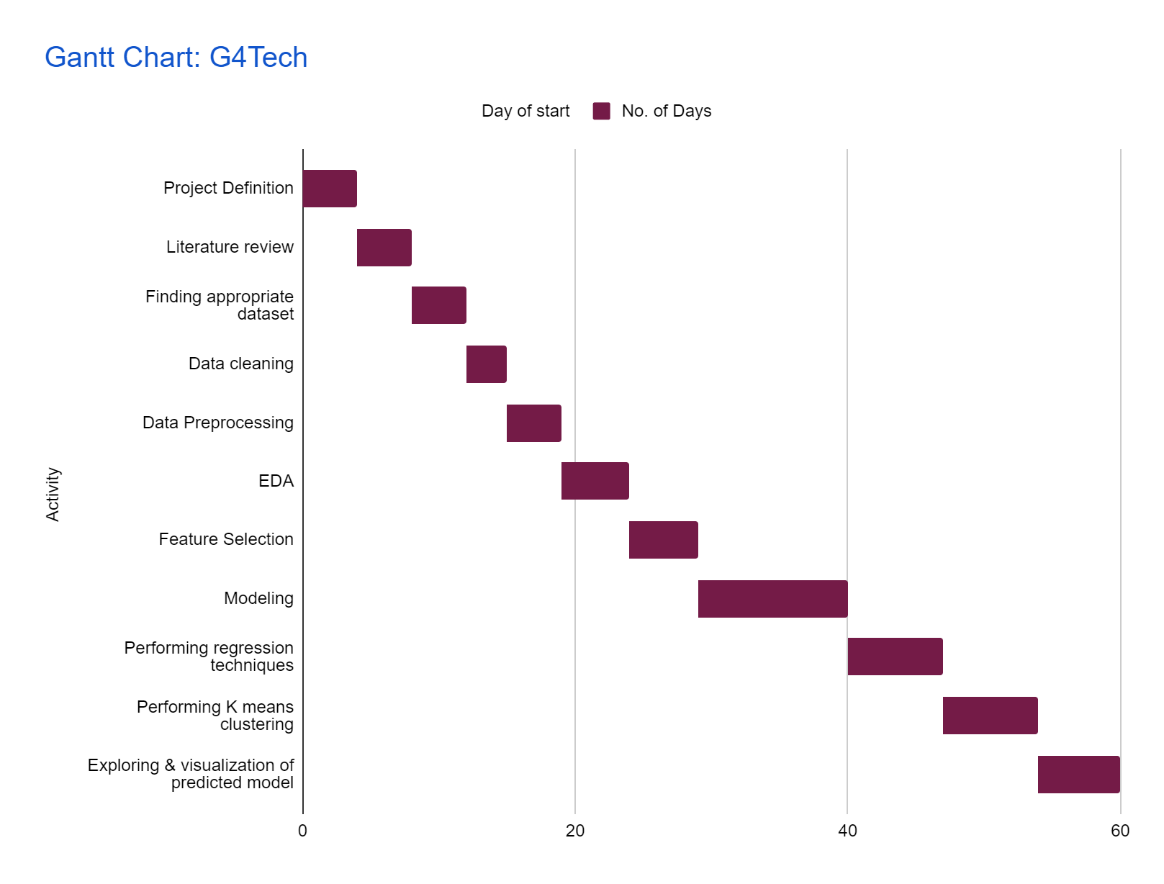
GANTT Chart

Slide 6
Existing body of work
https://www1.nyc.gov/site/tlc/about/data-and-research.page
https://www.researchgate.net/publication/252023141_A_case_study_The_New_York_City_yellow_cab_System_of_Systems
https://www.researchgate.net/publication/313451485_Predicting_taxi_demand_at_high_spatial_resolution_Approaching_the_limit_of_predictability.
https://www1.nyc.gov/site/tlc/about/tlc-trip-record-data.page

Slide 7
Your Approach
We have following techniques for feature selection
PCA
Backward Elimination
Recursive feature elimination
Lasso Model
Using a classification algorithm we will classify the areas where most cabs are booked. We took K=6 clusters.
K-Means algorithm

Slide 8
Your Approach (2)
We want to help customers to know what is the average fare for the trip as per location and time using
Linear regression
Lasso regression
Decision Tree regression
Random Forest regression
XGBoost regressor

Slide 9
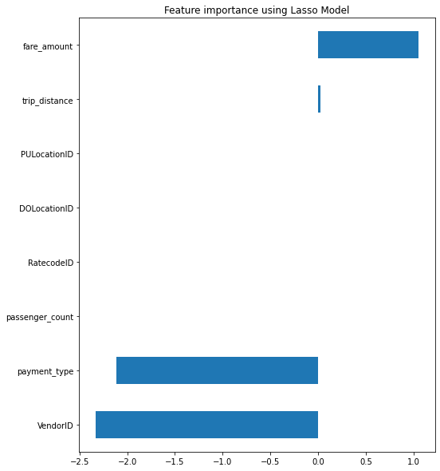
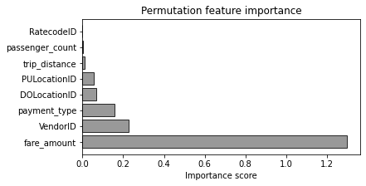
Final Results
In the first graph, we have imported features with the Lasso model and checked correlation.
In the second graph, we performed permutation feature importance with an importance score.

Slide 10
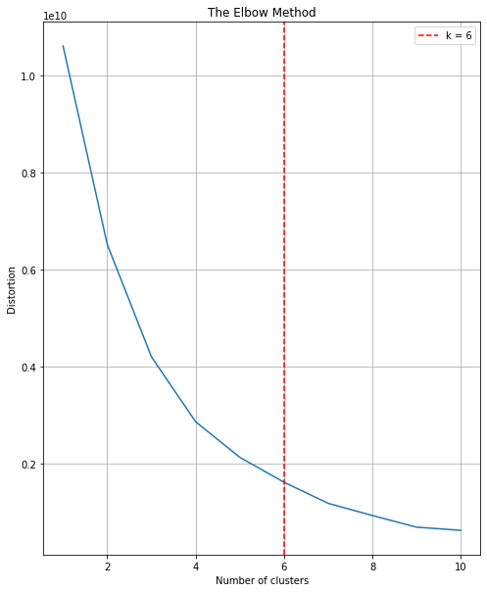
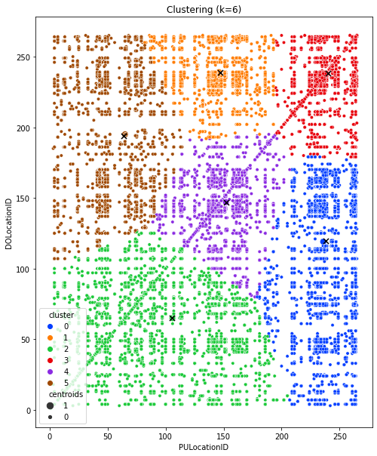
Final Results(2)
In the first graph, we performed clustering based on the elbow method.
In the second graph, we performed clustering based on pickup and drop-off locations.

Slide 11
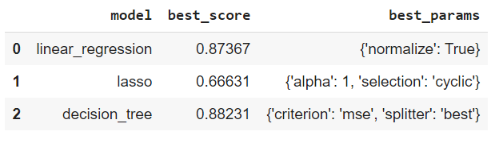
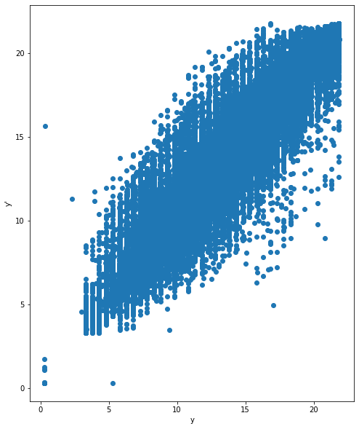


Final Results(3)
Results of different Regression models.
In the second graph, we performed a scatterplot between taxi fare and predicted taxi fare.

Slide 12
Conclusion
Firstly we have done feature selection on data using various techniques. Then we performed regressions like Linear Regression in which we got an accuracy of 87.3%, in lasso regressor we got 66.6%, decision tree regressor we got 88.2%, in the random forest we obtained an accuracy of 92%, and finally, in XGBoost we got an accuracy of 91.4%.
After using K means clustering we found out that there are no clusters which shows that there is no specific location for Pick up and Drop off. So from this, we can conclude that there are discrete points.
From this, we conclude that a random forest regressor is the best regression method for this use case. So that to predict a fare of trip this is an appropriate method. Also, that taxi fare vs predicted taxi fare graph says it is highly correlated.

Slide 13
Role of each group members in the project
Rahul Parmar: Mostly data acquisition and coding, final editing.
Murli Alva : Mostly data acquisition and coding, visualization.
Pathik Patel: Mostly coding and ideas for visualization.
Vatsal Suthar: Documentation, Presentation, Coding.

Slide 14
References
https://www1.nyc.gov/site/tlc/about/tlc-trip-record-data.page
https://www.youtube.com/watch?v=lJitdOke2bs&ab_channel=CodingNest
https://towardsdatascience.com/new-york-taxi-data-set-analysis-7f3a9ad84850
https://www1.nyc.gov/site/tlc/about/tlc-trip-record-data.page

Slide 15
THANK YOU

