Slide 1
School of Engineering and Applied Science, Ahmedabad University
Machine Learning project presentation 1
Group 14

Slide 2
Group Details
Name : Rahul Parmar (AU2044001)
Murli Alva (AU2044006)
Pathik Patel (AU2044010)
Vatsal Suthar (AU2044013)
Team Name : G4 Tech
Project Title : Yellow taxi fare prediction
Date : 18-03-2021
Time : 14:30 to 17:00

Slide 3
Introduction
In NYC, taxicabs come in two varieties: yellow and green; they are widely recognizable symbols of the city. Taxis painted yellow (medallion taxis) are able to pick up passengers anywhere in the five boroughs. in Upper Manhattan, the Bronx, Brooklyn, Queens. The yellow taxi cab was first introduced in 1915 by a car salesman named John Hertz. Hertz decided to paint his taxis yellow because of a study by a Chicago university to establish what colour would grab the attention of passers-by more easily. The results proved that yellow with a touch of red was most noticeable. As a result, Hertz started to paint all his taxi cabs yellow and went on to start the Chicago-based Yellow Cab Company in 1915.

Slide 4
Problem statement
In this project we are planning to predict fare using ML algorithm i.e., regression and to predict that from which area is most cabs are booked with the help of ML algorithm i.e., clustering on yellow taxi cab of New York city. We have analysed the dataset which has October 2020 month yellow taxi cab data. During analysis we used different parameters to check which area has more cab booking, average number of passengers for each trip, average fare for the trip, and many more…. Etc. to be followed.

Slide 5
Existing body of work
https://www1.nyc.gov/site/tlc/about/data-and-research.page
https://www.researchgate.net/publication/252023141_A_case_study_The_New_York_City_yellow_cab_System_of_Systems
https://www.researchgate.net/publication/313451485_Predicting_taxi_demand_at_high_spatial_resolution_Approaching_the_limit_of_predictability

Slide 6
Your Approach
We want to help customers to know what is average fare for the trip as per location and time using
Linear regression
Neural network
Using classification algorithm we will classify the areas where most cabs are booked.
K-nearest neighbours

Slide 7
Initial Results
In the initial phase while analysing the data we have got some useful insight such as most cabs trips are with 1 passengers or 2 passengers, upper east side north of Manhattan has more bookings for the yellow taxi cab.
To sum up in the pandas library there are no duplicate entries in the dataset, performed the correlation of the columns in the dataset ,visualized the passenger’s count.
We merged all extra amount columns into the final amount.
We have split the date & time into different columns.
We have performed EDA on the dataset.

Slide 8
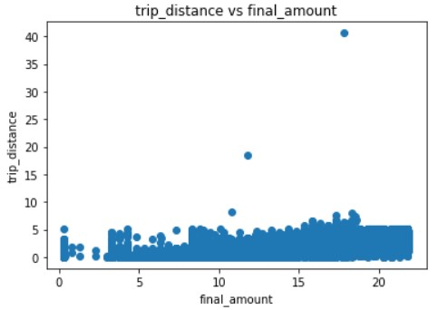
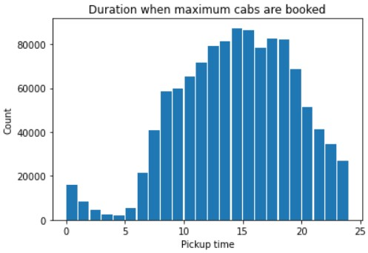
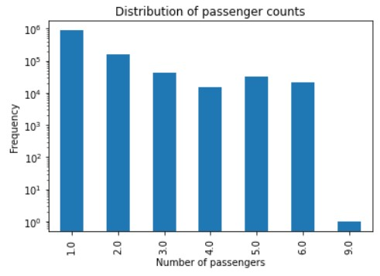
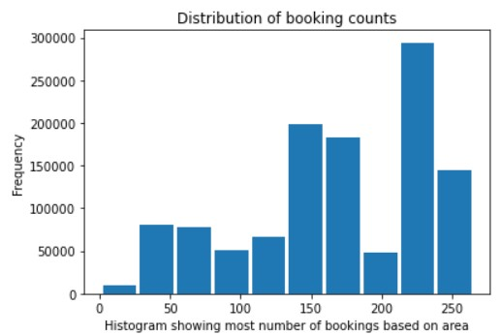
Screenshots of some visualizations

Slide 9
Role of each group members in the project
Rahul Parmar: Mostly data acquisition and coding, final editing
Murli Alva : Mostly data acquisition and coding, visualization
Pathik Patel: Mostly coding and ideas for visualisation
Vatsal Suthar: Documentation, Presentation, Coding

Slide 10
Future work
We will try to analyse the data more and get some useful insight from it.
We are planning to make model to predict the fare for the trip and predict areas where most cabs are booked.
We will be using clustering to see the areas where most taxis are booked.
We are planning to predict actual fare price with most accurate prediction model.

Slide 11
References
https://www1.nyc.gov/site/tlc/about/tlc-trip-record-data.page
https://www.youtube.com/watch?v=lJitdOke2bs&ab_channel=CodingNest
https://towardsdatascience.com/new-york-taxi-data-set-analysis-7f3a9ad84850
https://www1.nyc.gov/site/tlc/about/tlc-trip-record-data.page

Slide 12
THANK YOU

